Slide 1


CHROMOSOMAL DISORDERS
DOWN’S SYNDROME , TURNER’S SYNDROME &
KLINEFELTER’S SYNDROME
SUBJECT : BIOLOGY
CHAPTER NUMBER: 05
CHAPTER NAME : PRINCIPLE OF INHERITANCE AND VARIATION

Slide 2
CHROMOSOMAL DISORDERS :
The chromosomal disorders are caused due to absence or excess or abnormal arrangement of one or
more chromosomes.
The aneuploidy and polyploidy conditions mainly cause chromosomal aberrations.
These disorders may or may not be transmitted and can be known through amniocentesis.
Sometimes though rarely either an additional copy of a chromosome may be included in an individual
or an individual may lack one of any one pair of chromosomes.
These situations are known as trisomy (diploids which have one extra chromosome i.e. 2n+1) or
monosomy (diploids that are missing one chromosomes 2n-1) of a chromosome respectively.
Such a situation leads to very serious consequences in the individual.
Aneuploidy in autosomes and sex chromosomes were well studied and Down’s syndrome,
Turner's syndrome, Klinefelter's syndrome are common examples of it .

Slide 3
DOWN’S SYNDROME:
The cause of this genetic disorder is the presence of an additional copy of the chromosome number 21(autosome)
(trisomy of 21 ). It is caused by an occasional non-disjunction during meiosis when a gamete comes to possess an extra chromosome.
Fusion with normal gamete produces trisomy [n+(n+1)].
This disorder was first described by Langdon Down (1866).
The affected individual is short statured with small round head, partially open mouth, broad forehead, protruding furrowed tongue, short neck, short phalanges, small ears, projecting lower lips and congenital heart diseases .
Palm is broad with characteristic palm crease. Physical, psychomotor and mental development is retarded.
Under developed gonads with short life expectancy is also observed.

Slide 4
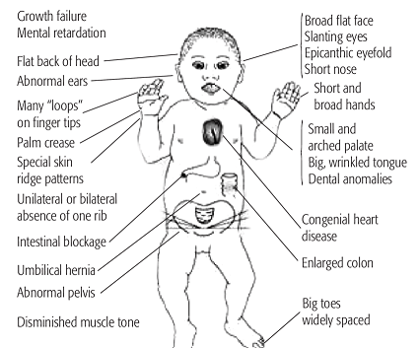
DOWN’S SYNDROME:
.

Slide 5
TURNER’S SYNDROME :
Changes in sex chromosomes lead to abnormalities like Turner’s syndrome.
The individual appears phenotypically female .
The effect app]ears due to fusion of a gamete without sex chromosome (A+0) and a gamete with one X-chromosome (A+X).
The suffering female have short stature, webbed neck , small uterus with subnormal intelligence.
Such females are sterile as ovaries are rudimentary besides other features including lack of other secondary sexual characters.

Slide 6
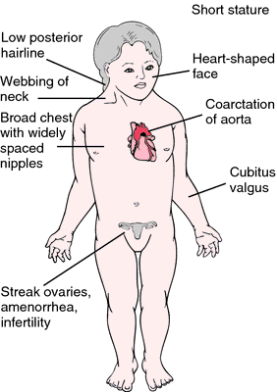
TURNER’S SYNDROME :

Slide 7
KLINEFELTER’S SYNDROME :
This genetic disorder is also caused due to the presence of an additional copy of xchromosome resulting into a karyotype of 47, XXY.
The individuals are phenotypically males.
The defect appears due to fusion of egg having unreduced sex complement (A+XX) with normal sperm (A+Y).
The individuals suffering from this disorder have long stature with long legs, reduced mental ability.
Such in individual has overall masculine development ,however the feminine development (development of breast. i.e. Gynaecomastia) is also expressed.
Such individuals are sterile.
Other examples: In cucumber and melon, day lights length, temperature etc also differentiate sex.

Slide 8
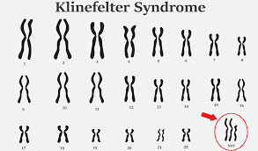
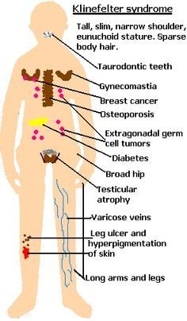
KLINEFELTER’S SYNDROME :

Slide 9
THANKING YOU
ODM EDUCATIONAL GROUP

