Slide 1


MENDELIAN DISORDERS
HAEMOPHILIA, SICKLE-CELL ANAEMIA, PHENYLKETONURIA, COLOUR
BLINDNESS,THALASSEMIA
SUBJECT : BIOLOGY
CHAPTER NUMBER: 05
CHAPTER NAME : PRINCIPLE OF INHERITANCE AND VARIATION

Slide 2
MENDELIAN DISORDERS :
There are many diseases in man due to gene mutations (dominant or recessive) .
They are transmitted to the offspring as per Mendelian principles.
The mutated person may become incapable to produce specified enzyme, so result in inborn errors of metabolism.
The pattern of inheritance of such Mendelian disorders can be traced in a family by pedigree analysis.
Some of the Mendelian disorders are :
Haemophilia.
Sickle-cell anaemia.
Phenylketonuria.
Colour blindness.
Thalassemia.

Slide 3
HAEMOPHILIA :
This hereditary sex linked recessive blood disease. It shows its transmission from unaffected carrier
female to some of the male progeny has been widely studied.
In this disease a single protein that is a part of the cascade of proteins involved in the clotting of blood
is affected.
It is caused due to absence of factor-VIII and plasma thromboplastin.
Due to this in an affected individual a simple cut will result in non-stop bleeding. In normal persons the
blood clots in 2-8 minutes, but in haemophilic patients clotting is delayed for 20 minutes to 24 hours.
The heterozygous female (carrier) for haemophilia may transmit the disease to sons.
The possibility of a female becoming a haemophilic is extremely rare because mother of such a female
has to be at least carrier and the father should be haemophilic (unviable in the later stage of life).
The family pedigree of Queen Victoria shows a number of haemophilic descendents as she was a
carrier of the disease.

Slide 4
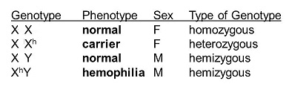
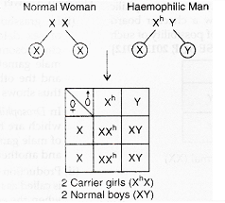
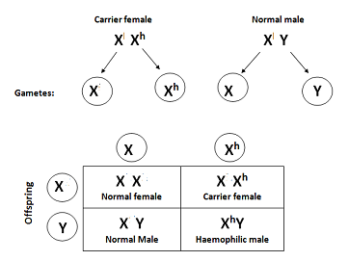
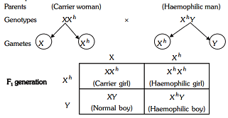
GENOTYPES & CROSSES IN CASE OF HAEMOPHILIA :

Slide 5
SICKLE-CELL ANAEMIA:
This is an autosome linked recessive trait that can be transmitted from parents to the offspring when both the partners are carrier for the gene (or heterozygous).
The disease is controlled by a single pair of allele HbA and HbS which is located upon chromosome- 11.
Out of the three possible genotypes only homozygous individuals for Hb^{S} (Hb^{S}Hb^{S}) show the diseased phenotype.
Heterozygous (Hb^{A}Hb^{S}) appear apparently unaffected but they are carrier of the disease as there is 50 percent probability of transmission of the mutant gene to the progeny. Thus exhibiting sickle -cell trait.
The defect is caused by the substitution of Glutamic acid (Glu) by valine (Val) at the sixth position of the beta-globln chain of the haemoglobln molecule.
The substitution of amino acld in the globin protein results due to the Single base substitution at the sixth codon of the beta-globin gene from GAG to GUG.
The mutant haemoglobin molecule undergoes polymerization under low oxygen tension causing the change in the shape of the RBC from biconcave disc to elongated sickle like structure.
The sickle shaped RBC cannot pass through the capillaries and get clotted and then degenerate leading to anaemia.

Slide 6
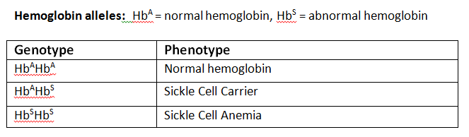
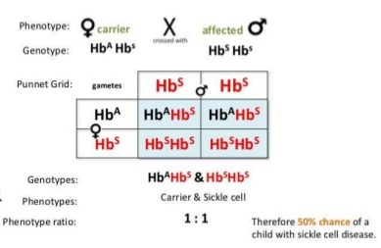
GENOTYPES & CROSS IN CASE OF SICKLE-CELL ANAEMIA :
.

Slide 7
PHENYL KETONURIA:
This inborn error of metabolism is also inherited is the autosomal recessive trait present upon chromosome-12 .
The affected individual lacks an enzyme phenyl alanine hydroxylase that converts the amino acld phenylalanine to tyrosine.
This lack of enzyme is due to mutation of gene upon chromosome-12
As a result of this phenylalanine is accumulated and converted into phenyl pyruvic acid and other derivatives.
Three genotypes of this disorder are AA- normal, Aa-heterozygous/carrier , aa- affected individual
Accumulation of these amino acid derivatives in brain results in mental retardation.
It also interferes in cartilage and muscle development.
Decreased pigmentation of hair and skin is also marked in this disorder
These are also excreted through urine because of its poor absorption by kidney .

Slide 8
COLOURBLINDNESS :
Colour blindness is a sex linked recessive trait in which the eye fails to distinguish red and green colours.
Vision is however not affected and the colourblind person can lead a normal life.
The gene for normal vision is dominant and is located upon X chromosome.
The defect is due to mutation the gene located upon X chromosome.
It occurs near about in 8 percent of males and 0.4 percent of females.
This disorder is also known as Daltonism as famous physicist John Dalton was colourblind.

Slide 9
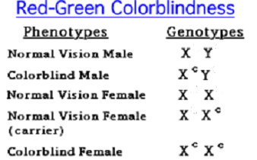
GENOTYPES OF COLOURBLINDNESS :

Slide 10
THALASSEMIA:
This is also an autosomal linked recessive blood disorder transmitted from parents to offsprings when both the partners are unaffected carrier for the gene (or heterozygous).
This defect can occur due to mutation or deletion of genes controlling the formation of globin chains (alpha and beta)of haemoglobin.
This results in reduced synthesis of one of the globin chain (alpha or beta) and abnormal formation of haemoglobin which leads to anaemia.
Thalassemia is a quantitative disorder as it is related to synthesis of globin molecule.
Thalassemia is classified according to which molecule of globin is affected.
Alpha thalasemia : it is caused by the defective formation of alpha globin and is controlled by two genes present on chromosome -16.
It is controlled by two closely linked genes HBA1 and HBA2 with a total four alleles. The more the alleles get affected the less will be the synthesis of alpha globin molecule.
Beta thalassemia : it is caused by decreased synthesis of beta globin.
The defect is due to alleles of HBB gene present on chromosome-11 on each parent due to mutation of one or both alleles.

Slide 11
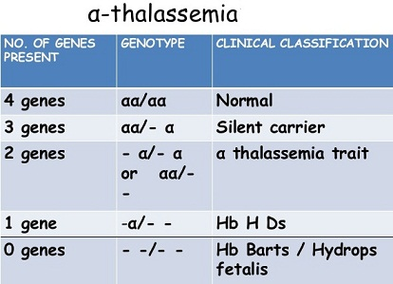
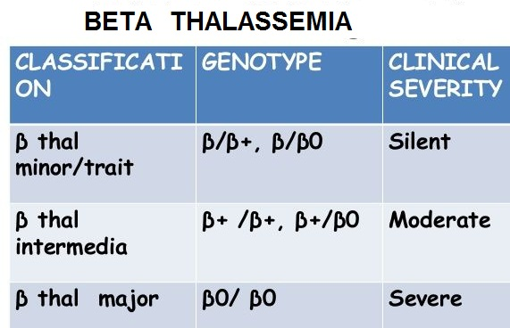
GENOTYPES OF ALPHA AND BETA THALASSEMIA :

Slide 12
THANKING YOU
ODM EDUCATIONAL GROUP

