Slide 1


CHROMOSOMAL THEORY OF INHERITANCE ,LINKAGE AND RECOMBINATION
VERIFICATION OF CHROMOSOMAL THEORY OF INHERITANCE,PARALLELISM BETWEEN GENES & CHROMOSOMES,LINKAGE ,RECOMBINATION
SUBJECT : BIOLOGY
CHAPTER NUMBER: 05
CHAPTER NAME : PRINCIPLE OF INHERITANCE AND VARIATION

Slide 2
REDISCOVERY OF MENDELISM :
In 1900 three Scientists De Vries, Correns and Von Tschermark independently rediscovered Mendel’s result on the inheritance of characters.
Also by this time due to advancements in microscopy that were taking place scientists were able to carefully observe cell division.
This led to the discovery of structures in the nucleus that appeared to double and divide just before each cell division.
These were called chromosomes (coloured bodies as they were visualized by staining).
By 1902 the chromosome movement during meiosis had been worked out.
We have already studied the behaviour of chromosomes during mitosis (equational division) and during meiosis (reduction division).

Slide 3
CHROMOSOMAL THEORY OF INHERITANCE:
Mendel’s mathematical derivations and explanation of biological phenomena was not accepted at that time by scientific world .
But the advancement in technology introduced the structure of nucleus , chromosomal movement during cell division which indicated parallelism between factor and chromosomes.
Walter Sutton and Theodore Boveri noted that the behaviour of chromosomes was parallel to the behaviour of genes and used chromosome movement to explain Mendel's laws .
Walter Sutton and Theodore Boveri proposed independently the chromosomal theory of inheritance in 1902.

Slide 4
FEATURE OF CHROMOSOMAL THEORY OF INHERITANCE :
1. Gametes (sperm & ova) constitute bridge between one generation and next.
2. The two gametes fuse during fertilization and contribute equally in the genetic constitution of offsprings.
3. Both the nucleus of gametes possess all the hereditary information .
4. Nucleus contains chromatin which organises to be known as genes lying upon the chromosomes.
5. Genes are the physical entities present upon chromosome.
6. When chromosomes segregate during cell division the genes (Mendelian factor) moves to gametes.
7. So its the chromosome which became the basis of inheritance seen between parents and offsprings.

Slide 5
VERIFICATION OF CHROMOSOMAL THEORY OF INHERITANCE :
Experimental verification of the chromosomal theory of inheritance was conducted by Thomas Hunt Morgan and his colleagues which led to discovery of the basis for the variation produced in sexual reproduction.
Morgan worked with the tiny fruit files - Drosophila melanogaster.
Drosophila is a better experimental material due to following reasons:
. It is easily available hovering upon ripe fruits.
. The flies can bred throughout year and each mating produced large number of offsprings.
. They could be grown on simple synthetic medium in the laboratory.
. They complete their life cycle in about two weeks.
. Male and females are easily distinguishable.
. They can be easily grown in synthetic culture media.

Slide 6
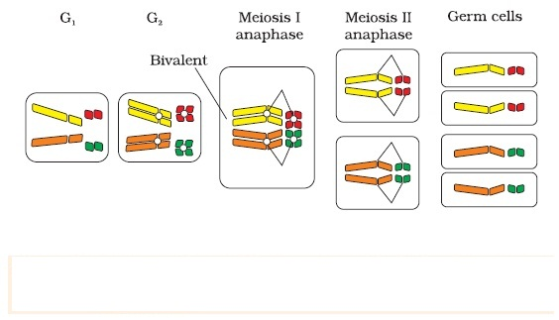
FIGURE SHOWING MOVEMENT OF CHROMOSOMES & GENES
DURING MEIOSIS:

Slide 7
PARALLELISM BETWEEN GENES & CHROMOSOMES :
MENDELIAN FACTORS (GENES) :
Genes are transferred from generation to generation .
Genes occur in allelic pair
Allelic of genes undergo replication and splitting during mitosis.
In meiosis alleles segregate .
Fusion restores allelic pair in offsprings.
Genes follow law of segregation.
CHROMOSOMES :
Chromosomes are also transferred from generation to generation.
Chromosomes occur in homologous pairs.
Homologous chromosomes undergo both replication and splitting like genes during mitosis.
Chromosomes also segregate during meiosis.
Fusion restore homologous chromosomes in offsprings.
Chromosomes follow law of segregation.

Slide 8
LIMITATION OF LAW OF INDEPENDENT ASSORTMENT:
Mendel’s law of independent assortment is correct to the extent that only those alleles can assort independently which are either present on different chromosomes or show regular crossing over.
Morgan carried out several di-hybrid crosses in Drosophila to study genes that were sex-linked like Mendel’s di-hybrid cross.
He observed that the two genes did not segregate independently of each other and the F2 ratio deviated very significantly from the 9:3:3: 1 ratio.
Sutton and Boveri reported presence of number of factors (genes) upon limited number of chromosomes.
Hence further Morgan distinguished linked genes from unlinked one and noted presence of linkage & absence of independent assortment.

Slide 9
LINKAGE:
Linkage is a staying together of genes and they inherit together from generation to generation or separation without any change as present on same chromosome.
Morgan and his group knew that the genes were located on the X chromosome and saw quickly that when the two genes in a di-hybrid cross were situated on the same chromosome and the proportion of parental gene combinations were much higher than the non-parental type.
Strength of linkage between 2 genes is inversely proportional to the distance between them.
Morgan attributed this due to the physical association or linkage of the two genes and coined the term linkage to describe this physical association of genes on a chromosome.
Morgan and his group also found that even when genes were grouped on the same chromosome, some genes were very tightly linked known as linkage group.

Slide 10
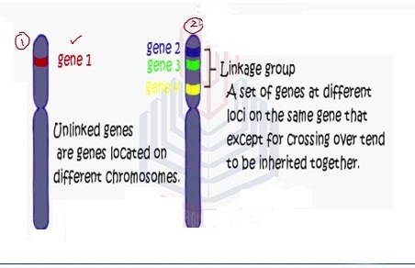
FIGURE SHOWING GENE LINKAGE :

Slide 11
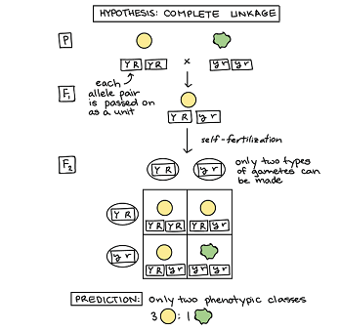
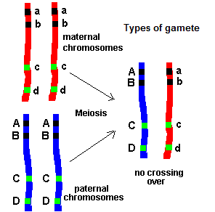
FIGURE SHOWING LINKAGE :

Slide 12
TYPES OF LINKAGE:
Complete linkage: genes located on same chromosome inherit together over generation to generation and allows parental trait to appear in progenies.
Incomplete linkage: it allows appearance of non parental trait to appear in progenies due to crossing over.
Sex linkage : it is the linked group of genes found along with sex controlling genes present on sex chromosome. These genes inherit along with sex determining genes .
SIGNIFICANCE OF LINKAGE :
Linkage reduces chances of formation of new combination.
It helps in maintaining the traits.
It helps in giving information about the location of genes in the chromosomes.

Slide 13
RECOMBINATION :
Recombination is a new arrangement of genes present in offsprings that is different from those of parents due to independent assortment, crossing over and random combination during fertilization.
Morgan found the occasional shuffling between homologous chromosome and coined the term crossing over.
CROSSING OVER:
It is the reciprocal exchange of segments between non sister chromatids of homologous chromosomes that gives rise to new combination of alleles .
Increase in distance between 2 genes increases the frequency of recombination & closeness reduces C.O
It occurs in pachytene stage of pro-phase I of meiosis-I.

Slide 14
MECHANISM 0F CROSSING - OVER:
In zygotene phase of meiosis-I the homologous chromosome lie side by side with similar gene loci exactly opposite.
This is called synapsis and the chromosomes are known as bivalents.
The bivalents split to form tetrad with four chromatids .
Out of four the two non sister chromatids remain in contact at one or more points called chaismata.
Chromtide segments break and rejoin with exchange of segments at chaismata . This is known as recombination.
SIGNIFICANCE OF CROSSING - OVER:
Introduces new combination of genes.
It increases variability which is useful for natural selection.
It helps in preparing linkage chromosomal maps.

Slide 15
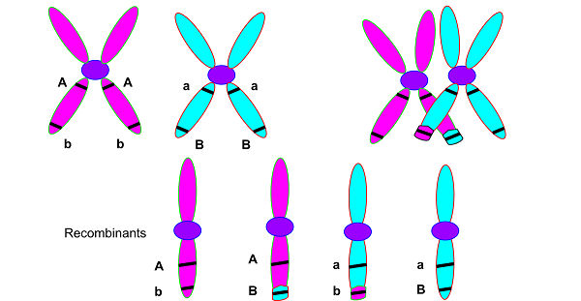
MECHANISM OF CROSSING OVER :

Slide 16
CHROMOSOME MAPS:
Chromosome map is a linear graphic representation of the sequence and relative distance of the various genes present in a chromosome.
This maps were prepared by Sturtevant (student of Morgan) in 1911 in Drosophila.
Both Morgan and Sturtevant found that the genes white and yellow were very tightly linked and showed only 1.3 per cent recombination while white and miniature wing showed 32 per cent recombination.
Sturtevant used the frequency of recombination between gene pairs on the same chromosome as a measure of the distance between genes and 'mapped their position on the chromosome.
FREQUENCY OF RECOMBINATION:
it is measured by : Frequency =total no of recombinants/total no of progenies.
1% frequency =1 map unit or centiMorgan
10% C.O = 1 deciMorgan
100% C.O = 1Morgan
Today genetic maps are extensively used as a starting point in the sequencing of whole genomes as was done in the case of the Human Genome Sequencing Project .

Slide 17
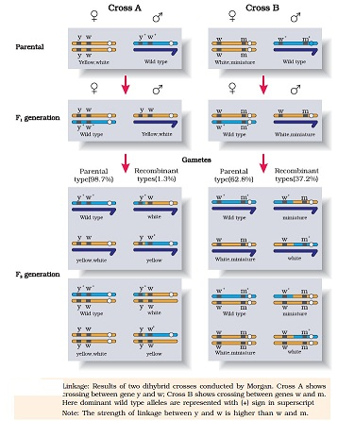
FIGURE SHOWING LINKAGE & RECOMBINATION :

Slide 18
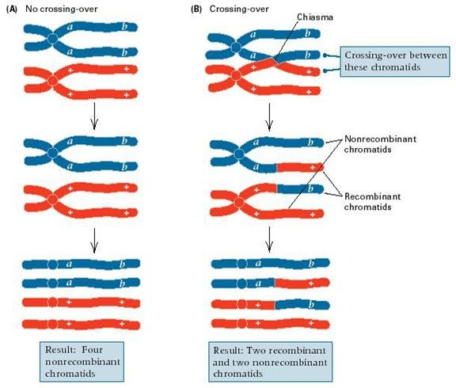
LINKAGE VRS RECOMBINATION:

Slide 19
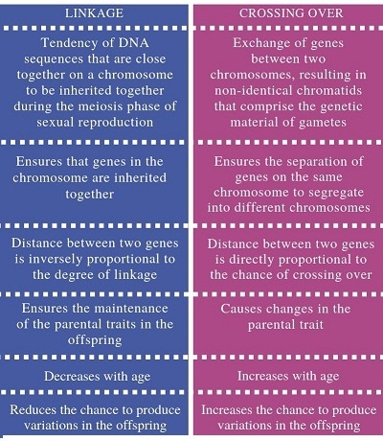
LINKAGE VRS RECOMBINATION :

Slide 20
THANKING YOU
ODM EDUCATIONAL GROUP

