Slide 1


PLANT BREEDING FOR DISEASE RESISTANCE,INSECT RESISTANCE
MUTATIONAL BREEDING
SUBJECT : BIOLOGY
CHAPTER NUMBER: 09
CHAPTER NAME : STRATEGIES FOR ENHANCEMENT FOR FOOD PRODUCTION

Slide 2
PLANT BREEDING FOR DISEASE RESISTANCE :
Several fungal, bacterial and viral pathogens affect the yield and quality of plant products.
To minimise this loss disease resistant varieties were developed.
Breeding is carried out by conventional method or by mutation breeding.
Steps for breeding disease resistant plants:
Selection of genome with disease resistant traits.
Mating of the selected parents.
Selection of superior hybrids.
Testing of the hybrid for superior variety.
Release of the new variety.

Slide 3
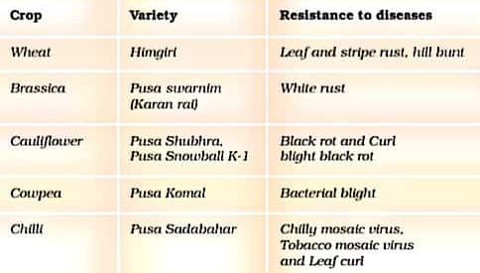
PLANT BREEDING FOR DISEASE RESISTANCE :
The resistant gene may be present in the wild relatives, which are low yielding; hence the gene for resistance has to be incorporated into the better-yielding variety by hybridization.
e.g., the gene for resistance to yellow mosaic virus found in a wild species of bhindi (Abelmoschus maniholtand) has been transferred to raise a new variety of Abelmoschus esculentus,
called Parbhani Kranti.
Some of the crop variety that is resistant to diseases that have been raised .

Slide 4
PLANT BREEDING FOR DISEASE RESISTANCE :
MUTATIONAL BREEDING :
Mutation is the process by which genetic variations are created through changes in the base sequence within genes resulting in the creation of a new character or trait not found in the parental types.
It is done by using mutants like chemicals or radiations.
Mutation is induced artificially through use of chemicals or radiations (like gamma rays, X-rays etc), and selecting and using the plants with desirable characters as a source of breeding.
This process is called mutation breeding.
e.g. Mung bean resistance to yellow mosaic virus and powdery mildew were induced by mutation.

Slide 5
PLANT BREEDING FOR INSECT RESISTANCE :
Resistance to insect pests is also genetically controlled and manifest in the form of morphological, physiological or biochemical characteristics.
Hairy leaves in several plants are associated with resistance to insect pests, e.g. resistance to jassids in cotton and cereal leaf beetle in wheat.
In wheat solid stem leads to non-preference by the stem sawfly and smooth leaved and nectar-less cotton varieties do not attract bollworms.
High aspartic acid, low nitrogen and sugar content in maize leads to resistance to maize stem borers.
Breeding methods for insect pest resistance involve the same steps as those for any other agronomic trait.

Slide 6
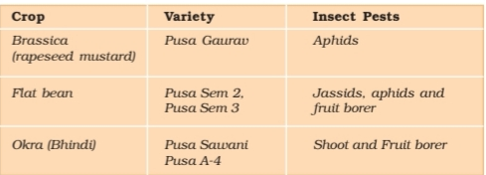
PLANT BREEDING FOR INSECT RESISTANCE :
Some released crop varieties bred by hybridization and selection for insect pest resistance are given below:

Slide 7
THANKING YOU
ODM EDUCATIONAL GROUP

