Slide 1


ROLE OF GOVT IN THE DEVELOPMENT OF THE COUNTRY.
TRANSPORT-AVIATION
SUBJECT : CIVICS CHAPTER NUMBER-8
CHAPTER NAME :ROLE OF GOVT IN THE DEVELOPMENT OF THE THE COUNTRY.

Slide 2
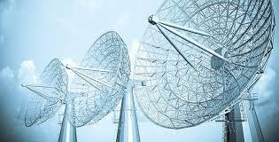
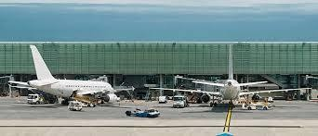
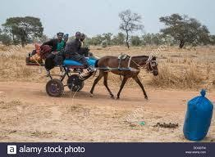

ROLE OF THE GOVT IN THE DEVT OF THE COUNTRY
TRANSPORT
AVIATION.
SESSION-4
Besides ports, modernization and expansion of our airports are other major priorities of Indian Govt.
The govt has decided to have at least 500 operational airports by the year 2020. Modernization of our four main airports at Delhi, Mumbai, Kolkata, and Chennai. RURAL TRANSPORTATION.
In rural India, the bullock cart is still used extensively as a means of transport. Bullock cart are used along with other systems of transport like tractors, buses and trains. Pneumatic tiers and brake systems may be fitted to the traditional carts to make them easier to ply.
TELECOMMUNICATIONS.
Of all sectors telecommunication sector has witnessed the most rapid technological advancement over the past few years Both private like Jio, Idea , Airtel and public like BSNL are in a healthy and competitive spirit, offering the best possible service to the customer.

Slide 3
QUESTION-ANSWER
Q1.What do you mean by Five Year Plans?
Q2.Five Year Plans designed and monitored by whom?
Q3.Five Year Plans were set up under whose guidance and when?
Q4.Give an account of the efforts taken by the government to develop agriculture. What was the result
achieved?
Q5.Name the means of transport which is the fourth largest in the world?
Q6 Name the longest NH in India?
Q7.What do you mean by Golden Quadrilateral project?
Q8.Name the programme of government of India for the Rural Development?
Q9. What do you mean by sustainable development?
Q10.Name the means of transport which works under single management?

Slide 4
THANKING YOU
ODM EDUCATIONAL GROUP

