Slide 1


ROLE OF GOVT IN THE DEVT OF COUNTRY
TRANSPORTATION
SUBJECT - CIVICS CHAPTER NUMBER-8
CHAPTER NAME:ROLE OF GOVT IN THE DEVT OF THE COUNTRY

Slide 2
ROLE OF GOVT IN THE DEVT OF THE COUNTRY
Transportation SESSION-3
.
TRANSPORTATION
The Globalization of market, international economic integration and the economic competition have
enhanced the importance of Transport.
For any region to develop, it needs to be well– liked by an effective transport net work. The British had laid the frame work of the railways and roadways in India. Since independence India has made rapid progress in the transportation system. The Indian transport system is an amalgam of both the ultra- modern and traditional transport – both supersonic jets and the slow moving bullock carts.
ROADWAYS
India has one of the largest net works of roads in the world. Steps taken by govt to develop roadways are , the roads are classified into three
National Highways 2.State High ways 3.Major District roads and other roads, other roads means urban,
village and panchayat roads
The govt set up National Highway Authority of India with the express desire to link every corner of India. The longest National highway of India is NH 7 runs between Varanasi and Kanyakumari.
Another massive project is the Golden Quadrilateral which consists of building 5, 846 kms of four lane or
six lane express highways connecting the 4 metros of Delhi, -Mumbai –Kolkata –Chennai.

Slide 3
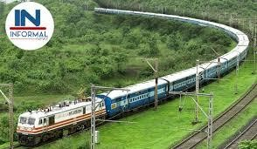
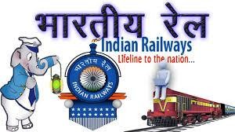
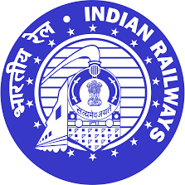
ROLE OF GOVT IN THE DEVT OF THE COUNTRY:
TRANSPORTATION
RAILWAYS
India’s rail network is the fourth largest in the world. Indian railway is the largest railway net work under a single management.
It is the world’s largest commercial employer.
It plays a major role in the development of agriculture and industry.
It is a great source of connectivity, linking people from the remotest corners of India.
The 11th Five Year Plan, decision was there to convert the metre gauge lines to broad gauge.

Slide 4
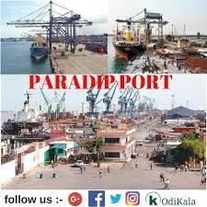
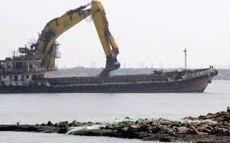
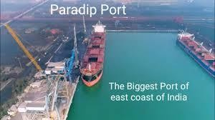
ROLE OF GOVT IN THE DEVT OF THE COUNTRY:
TRANSPORTATION
PORTS
Because of the geographical features of India, the top priority area of the govt i to expand and
modernize the Ports for the development of exports and Imports of India .
There are 12 major and 181 minor ports in India
Madras port is the oldest port in India.
Paradip port is the busiest cargo port in India. It is also a deep – water port.

Slide 5
THANKING YOU
ODM EDUCATIONAL GROUP

