Slide 1


ROLE OF GOVT IN THE DEVT OF THE COUNTRY
RURAL DEVELOPMENT
SUBJECT : CIVICS CHAPTER NUMBER: 8
CHAPTER NAME :ROLE OF GOVT IN DEVELOPMENT OFTHECOUNTRY.

Slide 2

ROLE OF GOVT IN THE DEVELOPMENT OF THE COUNTRY.
Rural Development
session-2
The different schemes introduced by the Govt which aimed at providing employment and development in rural areas during the Five Year Plans are
Integrated Rural Development Programme—The IRDP was launched by the govt of India during 1978 and implanted during 1980. The aim of the programme is to provide employment opportunities to the poor as well as opportunities to develop their skill sets so as to improve their living conditions
Drought Prone Areas Programme -DPAP is earliest area development programme launched by the central Govt in 1973-74 to tackle the special problems faced by those fragile areas which are constantly affected by severe drought conditions
Minimum Needs Programme—MNP was introduced in the first year of the 5th Five Year Plan (1974-
78) _ to provide certain basic minimum needs and improve the living standards of people. It aims at social and economic development of the community, particularly the underprivileged and under reserved population.

Slide 3
ROLE OF GOVT IN THE DEVELOPMENT OF THE COUNTRY:
Rural Development.
Jawahar Rozgar Yojna—JRY was launched in the 7th Five Year Plan. It aims the implementation of additional employment to under employed persons .and unemployed persons in the rural areas. It was launched on April 1 1989 by merging National Rural Employment Programme and Rural Landless Employment Guarantee Programme by then prime – Minister Rajiv Gandhi
Pradhan Mantri Gram Sadak Yojna –It is a nationwide plan in India to provide good all weather road connectivity to unconnected villages. It was launched in 2000 by the then prime minister Atal Bihari Vajpayee for the Rural Development

Slide 4
Role of Govt in the Development of the Country
Rural Development
Indira Awaas Yojana—It is a social welfare programme created by the Indian Govt to provide housing for the rural poor in India.
Rajiv Gandhi National Water Mission-National Drinking Water Mission was introduced as one of the five missions in social sector in 1986. It was renamed as RGNDWM to provide drinking water supply schemes in villages after it also focused on the promotion of positive sanitation and hygiene behavior for households and communities.
Sampoorna Grameen Rozgar Yojana— It was a scheme launched by the govt of India to gain the objective of providing gainful employment for the rural people. The programme was implemented through the Panchayathi Raj Institutions, launched in 2001.

Slide 5
Role of Govt in the Development of the Country Industry
INDUSTRY
Modern nation needed to have a well developed Industrial Sector to become truly independent. So it set up several public sector and joint sector undertakings like NTPC, BHEL, and SAIL. GAIL etc. These corporations were made responsible for putting up thermal power stations, steel plants, oil rigs etc.
NTPC- National Thermal Power Corporation, BHEL. Bharat Heavy Electricals Limited. SAIL- Steel Authority of India, GAIL- Gas and Oil Corporation of India
The Govt encouraged Indian entrepreneurs to manufacture the goods indigenously by
restricting the import of goods.

Slide 6
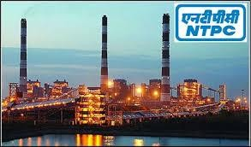
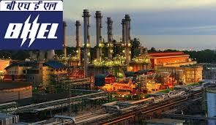
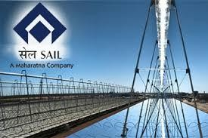
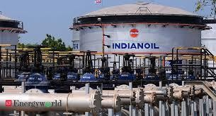
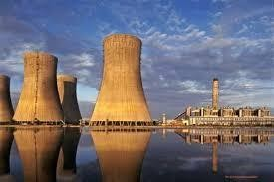
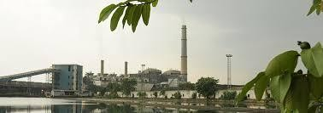
ROLE OF GOVT IN THE DEVT OF COUNTRY INDUSTRY
Talcher Power Thermal Plant- Talcher Thermal PowerStation

Slide 7
Role of Govt in the Development of the Country Transportation
TRANSPORTATION.
The Globalization of market, international economic integration and the economic competition
have enhanced the importance of Transport.
For any region to develop, it needs to be well– liked by an effective transport net work. The British had laid the frame work of the railways and roadways in India. Since independence India
has made rapid progress in the transportation system. The Indian transport system is an amalgam of both the ultra- modern and traditional transport – both supersonic jets and the slow moving bullock carts

Slide 8
THANKING YOU
ODM EDUCATIONAL GROUP

