Slide 1
ROLE OF GOVERNMENT IN THE DEVELOPMENT OF THE COUNTRY
THE FIVE YEAR PLANS
CHAPTER NUMBER:8
CHAPTER NAME :ROLE OF GOVERNMENT IN THE DEVELOPMENT OF THE
COUNTRY

Slide 2
ROLE OF THE GOVT IN THE DEVT OF THE COUNTRY
Five year plans- Agriculture. session-1
Role of the State in Development.
The Government has a vital role to play in development of a nation. The most important of
these include maintaining law and order, controlling natural resources, providing civic
amenities, attending basic infrastructure, working towards poverty alleviation and welfare of
the poor, and sustaining economic growth.
Economic prosperity and social welfare are intrinsically linked. Welfare of the people requires the provision of basic amenities like water, electricity, good roads, adequate housing, health care, sanitation, education, telecommunication, financial institutions and means of
transportation.

Slide 3
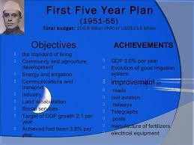
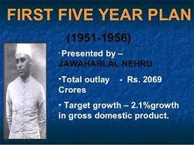
ROLE OF THE GOVT IN THE DEVT OF THE COUNTRY.
Five year plans- Agriculture
Five year plans were designed and monitored by the Planning Commission of India which was set up in 1950, under the guidance of the then Prime – Minister Jawaharlal Nehru to ensure balanced distribution of resources and to ensure that all groups of people are benefited by the process of development

Slide 4

ROLE OF GOVT IN THE DEVT OF THE COUNTRY
Agriculture
Agriculture
The measures launched by the government for the development of agriculture during the Five Year Plans were
1. Land reforms were launched
2. Cooperative banks were started to give the farmers credit at reasonable rate
3. Massive irrigation projects were launched
4. High –yielding seeds, fertilizers, and pesticides were also made available to the farmers
at highly subsidized rates
5 The Government also made arrangement to market the product of the farmers that they got the best price for their product

Slide 5
ROLE OF GOVT IN THE DEVT OF THE COUNTRY
Agriculture
6. From Zilla Parishad, the Govt sent officials to the village to guide the farmers and tell them the best techniques to adopt for maximizing output.
7. Farmers were encouraged to mechanize the process of Farming
As a result of these measures India witnessed a great development in Agriculture came to known as Green Revolution., and agricultural production shot up. India's grain production touched 108 millions tonnes in 1970-71 as compared to 50.8 million tonnes of grain production in 1950-51.
India is today self-sufficient in food, and has a buffer stock to fall back on in case of droughts.

Slide 6
THANKING YOU
ODM EDUCATIONAL GROUP

