Slide 1


ACCOUNT OF EVOLUTION,
ORIGIN & EVOLUTION OF MAN
SUBJECT : BIOLOGY
CHAPTER NUMBER: 07
CHAPTER NAME : EVOLUTION

Slide 2
ACCOUNT OF EVOLUTION:
EVOLUTION OF PLANTS :
Cellular life forms occurred on earth about 2000 million years ago.
Some of these cells had the ability to produce oxygen through reactions similar to photosynthesis
.
Slowly, single-celled organisms became multicellular.
Seaweeds and some plants probably existed around 320 million years ago.

Slide 3
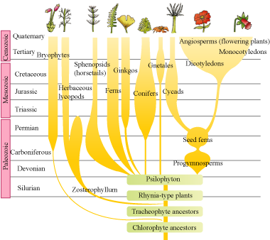
ACCOUNT OF EVOLUTION:

Slide 4
ACCOUNT OF EVOLUTION :
EVOLUTION OF ANIMALS :
Animals evolved about 500 million years ago. The first of them to evolve were invertebrates.
Jawless fishes evolved around 350 million years ago.
Some of the fishes could go on land, and then come back to water.
These were the first amphibians. In 1938, a fish Coelacanth, which was thought to be extinct, was caught in South Africa. This variety of fish, called lobefins, is believed to have evolved into the first amphibians.
Amphibians evolved into reptiles. In the next 200 million years, reptiles of different sizes dominated the earth. The land reptiles were, of course, the dinosaurs .
The biggest of them, i.e., Tyrannosaurus rex was about 20 feet in height and had huge fearsome dagger like teeth.
However, about 65 million years ago, some of them such as dinosaurs disappeared.

Slide 5
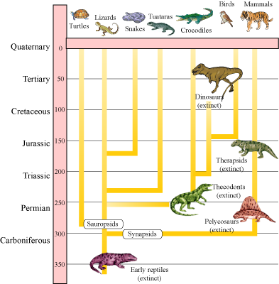
ACCOUNT OF EVOLUTION :

Slide 6
ACCOUNT OF EVOLUTION :
EVOLUTIONARY HISTORY OF MAMMALS :
First mammals were like shrews. Their fossils are small sized. Mammals were viviparous and protected their unborn young inside the mother’s body.
Mammals were more intelligent in sensing and avoiding danger in comparison. When reptiles came down mammals took over this earth.
There were in South America mammals resembling horse, hippopotamus , bear, rabbit, etc. Due to continental drift, when South America joined North America, these animals were overridden by North American fauna.
Due to continental drift pouched mammals of Australia survived because of lack of competition from any other mammal.
Some mammals live wholly in water. Whales, dolphins , seals and sea cows are some examples.

Slide 7
ORIGIN & EVOLUTION OF MAN :
The most successful story is the evolution of man with language skills and self-consciousness.
About 15 mya, primates called Dryopithecus and Ramapithecus were existing. They were hairy and walked like gorillas and chimpanzees.
Ramapithecus was more man-like while Dryopithecus was more ape-like. Few fossils of man-like bones have been discovered in Ethiopia and Tanzania.
These revealed hominid features leading to the belief that about 3-4 mya , man-like primates walked in eastern Africa.
They were probably not taller than 4 feet but walked up right.
Two mya , Australopithecines probably lived in East African grasslands. Evidence shows they hunted with stone weapons but essentially ate fruit.

Slide 8
ORIGIN & EVOLUTION OF MAN :
This creature was called the first human-like being the hominid and was called Homo habilis. The brain capacities were between 650-800cc. They probably did not eat meat.
Fossils discovered in Java in 1891 revealed the next stage, i.e., Homo erectus about 1.5 mya . Homo erectus had a large brain around 900cc.Homo erectus probably ate meat.
The Neanderthal man with a brain size of 1400cc lived in near east and central Asia between 1,00,000-40,000years back. They used hides to protect their body and buried their dead.
Homo sapiens arose in Africa and moved across continents and developed into distinct races. During ice age between 75,000-10,000 years ago modern Homo sapiens arose.
Pre-historic cave art developed about18,000 years ago..
Agriculture came around 10,000 years back and human settlements started.

Slide 9
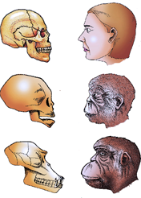
ORIGIN & EVOLUTION OF MAN :
When the skulls of an adult human being, baby chimpanzee, and adult chimpanzee, is compared it is observed that skull of baby chimpanzee resembles human being more as compared to adult chimpanzee.

Slide 10
THANKING YOU
ODM EDUCATIONAL GROUP

