Slide 1


BIOLOGICAL EVOLUTION & LAMARCKISM,
DARWINISM & MUTATIONAL THEORY
HARDY-WEINBERG PRINCIPLE
SUBJECT : BIOLOGY
CHAPTER NUMBER: 07
CHAPTER NAME : EVOLUTION

Slide 2
BIOLOGICAL EVOLUTION :
Microbes that divide fast have the ability to multiply and become millions of individuals within hours.
A colony of bacteria (say A) growing on a given medium has built-in variation in terms of ability to utilise a feed component.
A change in the medium composition would bring out only that part of the population (say B) that can survive under the new conditions.
In due course of time this variant population outgrows the others and appears as new species.
Natural selection is the survival of the fittest, where nature selects the individuals, which are most fit, to adapt to their environment.
Fitness of B is better than that of A under the new conditions. Nature selects for fitness. One must remember that the so-called fitness is based on characteristics which are inherited.
Branching descent and natural selection are the two important concepts of Darwin’s theory of evolution.

Slide 3
LAMARCKISM :
The French naturalist Lamarck observed that evolution occurs due to the use or disuse of particular organs or body parts.
For example, giraffe have developed long necks as a result of attempts to eat leaves high up on trees.
Initially giraffe was habituated with surface vegetation. But due to drought and absence of surface vegetation it opted for foraging leaves on tall trees and had to adapt by elongation of their necks.
Darwin also observed that variations are inheritable and the species fit to survive the most, leaves more offsprings. Hence, the population’s characteristics change, giving rise to the evolution of new life forms.

Slide 4
DARWINISM & MUTATIONAL THEORY:
MECHANISM OF EVOLUTION :
Darwin did not quite explain how evolution gave rise to different species of the same organism.
Mendel mentioned about inheritable factors, which influenced the phenotype of an organism.
Hugo de Vries based on his work on evening primrose suggested that variations occurred due to mutations.
Mutations are random and directionless while the variations that Darwin talked about were small and directional.
Hugo de Vries gave the name saltation (single step large mutation) to the mutations which brought about speciation.

Slide 5
HARDY-WEINBERG PRINCIPLE :
The frequency of occurrence of alleles of a gene in a population remains constant through generations unless disturbances such as mutations, non-random mating, etc. are introduced.
Genetic equilibrium (gene pool remains constant) is a state which provides a baseline to measure genetic change.
Sum total of all allelic frequencies is 1.
Individual frequencies are represented as p and q such as in a diploid, where p and q represent the frequency of allele A and a.
The frequency of AA is p², that of aa is q², and that of Aa is 2pq.
Hence, p² + 2pq + q² = 1, which is the expansion of (p + q)².
When the frequency measured is different from that expected, it is indicative of evolutionary change.

Slide 6
HARDY-WEINBERG PRINCIPLE :
Hardy-Weinberg equilibrium is affected by :
gene flow or gene migration
genetic drift (changes occurring by chance)
Mutation
genetic recombination
natural selection
Sometimes, the change in allele frequency is so prominent in the new sample of population that they become a different species and the original drifted population becomes the founder. This effect is called founder effect.
The advantageous mutations that help in natural selection over the generations give rise to new phenotypes and result in speciation

Slide 7
OPERATION OF NATURAL SELECTION :
Natural selection is a process in which heritable variations enabling better survival are enabled to reproduce and leave greater number of progeny.
coupled to enhance reproductive success natural selection makes it look like different population.
Natural selection can lead to :
Stabilization - in which more individuals acquire mean character value.
Directional change - more individuals acquire value other than the mean character value.
Disruption - more individuals acquire peripheral character value at both ends of the distribution curve.

Slide 8
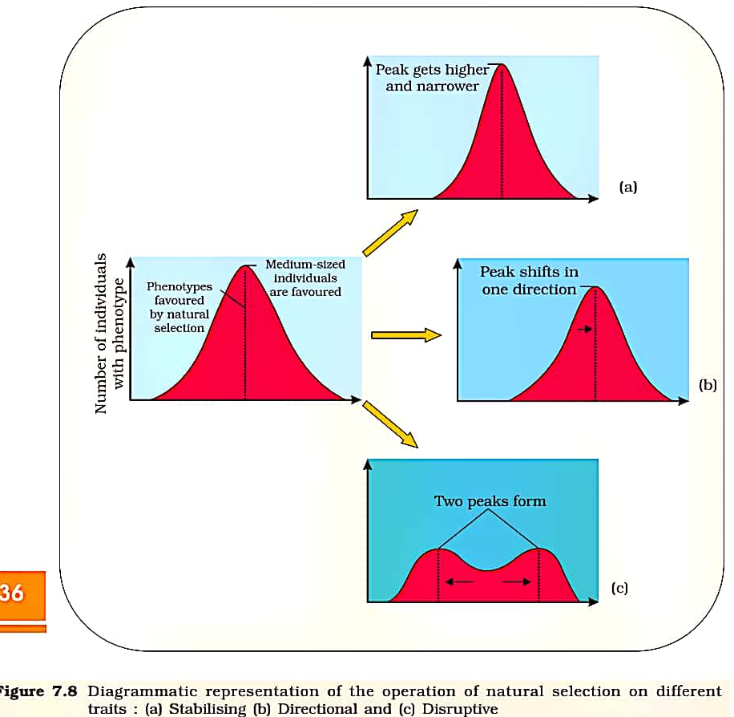
OPERATION OF NATURAL SELECTION :

Slide 9
THANKING YOU
ODM EDUCATIONAL GROUP

