Slide 1


EVIDENCES OF EVOLUTION, ADAPTIVE RADIATION,
INDUSTRIAL MELANISM,
ANTHROPOGENIC ACTION ON EVOLUTION
SUBJECT : BIOLOGY
CHAPTER NUMBER: 07
CHAPTER NAME : EVOLUTION

Slide 2
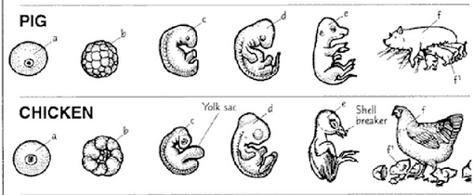
EVIDENCES OF EVOLUTION :
EMBRYOLOGICAL EVIDENCE :
These evidences are based on the comparative study of embryos of various animals.
In all multicellular animals the developmental pattern establishes a close relationship among them.
Development of many vertebral organs like heart, brain, kidney indicate the possible path of evolution as well as
the common ancestry of vertebrates

Slide 3
ADAPTIVE RADIATION :
During his exploration of the Galapagos Islands, Darwin noticed that there were many varieties of finches in the same island.
They varied from normal seed eating varieties to those that ate insects.
This process of evolution starting from a single point and radiating in different directions is called adaptive radiation.
The other example for this is the evolution of the Australian marsupials from a single ancestor.
Placental mammals also exhibit similarities to their corresponding marsupial. Example: placental wolf and the Tasmanian wolf.
When more than one adaptive radiation occurs in an isolated geographical area, the phenomenon is called convergent evolution.

Slide 4
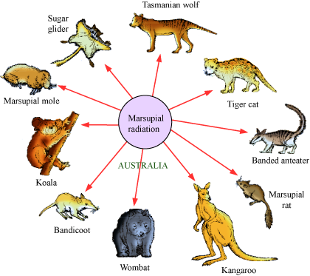
ADAPTIVE RADIATION :

Slide 5
INDUSTRIAL MELANISM :
A case of natural selection was seen in England in 1850s, i.e. before industrialisation in a peppered moth (Biston betularia).
This moth had two forms: grey colour and black colour. In the early part of the nineteenth century , before industrialization only the grey coloured forms of moths were present; the dark forms were rare.
The grey coloured moths were seen on the tree trunks covered with lichens and so they were able to escape from their enemies.
Later on in 1920, due to the development of industries, post industrialization, the lichens were killed and the tree trunks looked dark due to the deposition of industrial soot. Birds, now were able to spot these moths and feed upon them.
So the grey coloured moths were eaten by the birds and the dark coloured moths escaped from the birds.
This showed that in a mixed population, those that can better-adapt, survive and increase in population size. This example clearly brings out the action of natural selection.

Slide 6
ANTHROPOGENIC ACTION ON EVOLUTION :
Resistance of mosquitoes to pesticides:
When DDT was introduced to control mosquitoes it was tremendously successful. Most of the mosquitoes were sensitive to DDT and were therefore killed.
In that population of mosquitoes, few mosquitoes became resistant to DDT and survived. They multiplied and now almost total population of mosquitoes became resistant to DDT.
Same pattern has been observed in bacteria which are multidrug resistant due to excess use of drugs and medicines.

Slide 7
THANKING YOU
ODM EDUCATIONAL GROUP

