Slide 1


GENETIC CODE AND MUTATION
TRIPLET CODON, SALIENT FEATURES OF GENETIC CODON FRAMESHIFT MUTATION
SUBJECT : BIOLOGY
CHAPTER NUMBER: 06
CHAPTER NAME : MOLECULAR BASIS OF INHERITANCE

Slide 2
GENETIC CODON :
It is the genetic information present in the nucleotidic sequences of DNA with three consecutive nucleotides functioning as a codon in a non-overlapping fashion.
There is an intimate connection between genes and synthesis of polypeptides or enzymes.
As modern term for gene is cistron , the cistron contains large number of nucleotides.
The relationship between the sequence of amino-acids in a polypeptide chain and nucleotidic sequence of DNA and mRNA is called genetic codon .
There is one problem, DNA contains only four bases while the number of amino acids is 20.
To establish the relationship between amino acids and nucleotides many scientists like G.Gamow and M.Nirenberg’s contribution was remarkable .

Slide 3
GENETIC CODON :
GAMOW’S HYPOTHESIS AND TRIPLET CODON:
A physicist George Gamow (1955) hypothesized three adjacent bases many code for one amino acid and those three adjacent bases were named as triplet codon. Hence this triplet codon is operative .
lt was George Gamow who argued that since there are only 4 bases and if they have to code for 20 amino acids, the code should constitute a combination of bases.
If one nucleotide (4¹) corresponds to one amino acid then only 4 amino acids can be specified.
If two nucleotides (4²) correspond to one amino acid then only 16 amino acids can be specified, but the number of amino acids is 20 .
So he suggested that in order to code for all the 20 amino acids, the code should be made up of three nucleotides.
This was a bold proposition, because a permutation combination of 4³ (4 x 4 x 4) would generate 64 codons ; generating many more codons than required.
These 64 amino acids are sufficient for all 20 amino acids and their incorporation or termination in polypeptides.

Slide 4
GENETIC CODON :
KHORANA & NIRENBERG’S EXPT. AND TRIPLET CODON:
Providing proof that the codon was a triplet was a more daunting task .
The chemical method developed by Har Gobind Khorana (1964) was instrumental in synthesizing RNA molecules with defined combinations of bases (homopolymers and copolymers).
Marshall Nirenberg's (1961) cell-free system for protein synthesis finally helped the code to be deciphered.
Severo Ochoa enzyme (polynucleotide phosphorylase) was also helpful in polymersing RNA with refined sequences in a template independent manner (enzymatic synthesis of RNA) .
They prepared polymers like poly U (UUUUUU…) , poly A (AAAAAA….) and observed formation of amino acids.
This was compared with the amino acids formed by copolymers like UGUGUGUGUGUG…..and triplet codon hypothesis was confirmed.

Slide 5
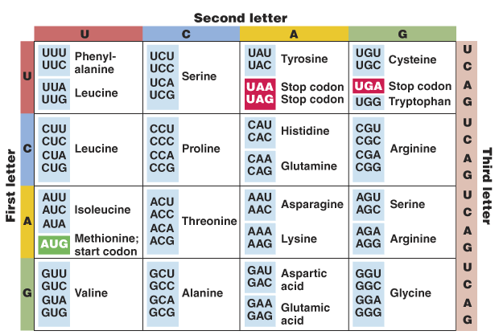
FIGURE SHOWING THE CODONS FOR VARIOUS AMINO ACIDS:

Slide 6
SALIENT FEATURES OF GENETIC CODE :
The codon is triplet. 61 codons code for amino acids and 3 codons do not core for any amino acids. hence they function as stop codons. Stop codons are UAA, UAG & UGA.
2. One codon codes for only one amino acid. hence. it is unambiguous and specific.
3. Since there are 64 codons and only 20 amino acids ,the incorporation of some amino acids must be influenced by more than one codon, so some amino acids are coded by more than one codon. Hence the code is degenerate.
4. The codon is read in mRNA in a contiguous fashion. There are no punctuations.
5. The code is nearly universal; for example from bacteria to human UUU would code for Phenylalanine (phe).
Some exceptions to this rule have been found in mitochondrial codons and in some protozoans.
AUG has dual functions. It codes for Methionine (met) and it also act as initiator codon.

Slide 7
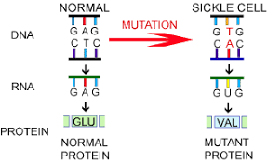
MUTATION & GENETIC CODE :
The relationships between genes and DNA are best understood by mutation studies.
Effects of large deletions and rearrangements in the segment of DNA are easy to comprehend . It may result in loss or gain of a gene and so a function.
A classical example of point mutation is a change of single base pair in the gene for beta globin chain that results in the change of amino acid residue glutamate to valine.
It results into a diseased condition called as sickle cell anemia.

Slide 8
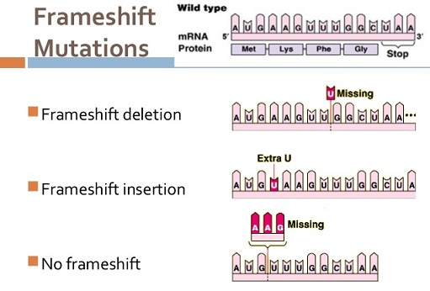
MUTATION & GENETIC CODE :
FRAMESHIFT MUTATION :
Insertion or deletion of one or two bases changes the reading frame from the point of insertion or deletion.
Insertion or deletion of three or its multiple bases insert or delete one or multiple codon.
Hence one or multiple amino acids and reading frame remains unaltered from that point onwards.
Such mutations are referred to as frame-shift insertion or deletion mutations.
This forms the genetic basis of proof that codon is triplet and it is read in a contiguous manner.

Slide 9
THANKING YOU
ODM EDUCATIONAL GROUP

