Slide 1


PROCESS OF TRANSCRIPTION & TYPES OF RNA
MECHANISM OF TRANSCRIPTION IN PROKARYOTES & EUKARYOTES , POST TRANSCRIPTIONAL CHANGE
SUBJECT : BIOLOGY
CHAPTER NUMBER: 06
CHAPTER NAME : MOLECULAR BASIS OF INHERITANCE

Slide 2
PROCESS OF TRANSCRIPTION :
TRANSCRIPTION IN PROKARYOTES:
STEP 3 : TERMINATION:
In case of prokaryotes two types termination process is found.
(A) RHO DEPENDENT TERMINATION :
When the RNA polymerase reaches the terminator site, a specific protein termination-factor-Rho (p) terminates the transcription. Rho disrupts the complex of newly formed RNA from template DNA by acting as helicase in an energy dependent manner.
Association with these factors alter the specificity of the RNA polymerase to terminate the process.
(B) RHO INDEPENDENT TERMINATION :
In this mechanism the mRNA contains a sequence that can base-pair with itself forming stem loop structure ,which ultimately weakens the RNA-DNA duplex and allow the newly formed RNA to dissociate from the complex
In bacteria, since the mRNA does not require any processing to become active and also since transcription and translation take place in the same compartment, many times the translation can begin much before the mRNA is fully transcribed. Consequently, the transcription and translation can be coupled in bacteria.

Slide 3
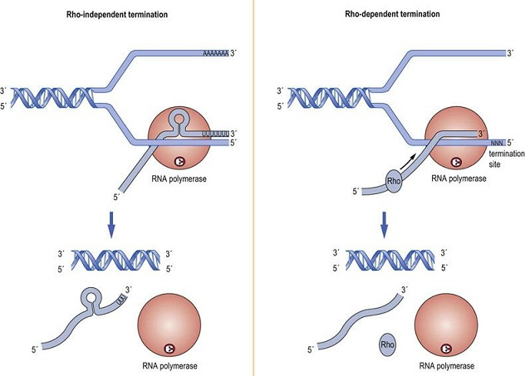
FIGURE SHOWING TERMINATION OF TRANSCRIPTION:

Slide 4
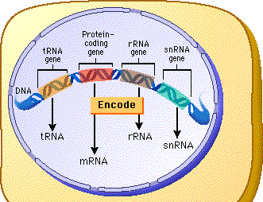
TYPES OF RNA:
There are many different types of RNAs . Out of which 3 RNAs play a great role inside cell.
These are mRNAs, tRNAs and rRNAs.
mRNA – Messenger RNA which possess the information for synthesis of protein.
tRNA – It’s otherwise known as adapter RNA which helps in translation.
rRNA – It forms ribosome which acts as protein synthesis machine .
Apart from all this inside cell small nuclear RNAs (snRNA) are present which possess catalytic activity during splicing.

Slide 5
PROCESS OF TRANSCRIPTION :
TRANSCRIPTION IN EUKARYOTES :
Eukaryotic transcription is much more complex than that of prokaryotes. it occurs inside nucleus and two semi autonomous organelles (mitochondria and chloroplast).
Eukaryotes have three types of RNA polymerases .
RNA POLYMERASE I - It transcribes r RNAs (28S,18S,5.8S) .
RNA POLYMERASE-II- It transcribes precursor of mRNA , the heterogenous nuclear RNA (hnRNA).
RNA POLYMERASE-III – it transcribes tRNA,5SrRNAs and snRNAs (small nuclear RNAs).
As eukaryotes have monocistronic genes so the transcription unit has only one gene . Transcription factors are required for initiation of the process and sigma factor is absent.
Coupled transcription and translation is not possible in case of eukaryotes. The nascent mRNA is called hnRNa or primary transcript which contains both coding (exons) and non coding (introns) sequences.

Slide 6
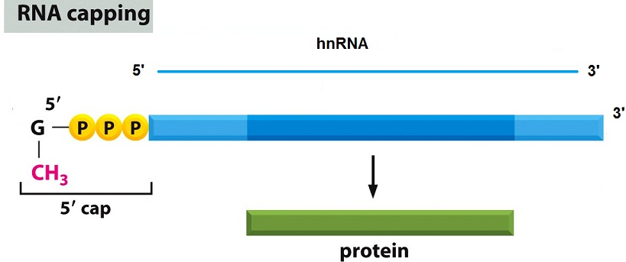
POST TRANSCRIPTIONAL CHANGE :
In eukaryotic transcription the primary transcript is converted into mature mRNA after post transcriptional change
Processing which involves 3 steps.
STEP I – CAPPING AT 5’ END : Addition of a cap to 5’end of hnRNA is called capping. This cap contains unusual nucleotide that is 7- methyl guanosine triphosphate .this residue protects the mRNA from different enzymes like nucleases.

Slide 7
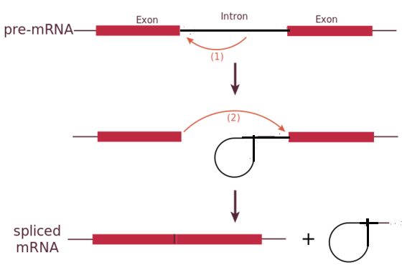
POST TRANSCRIPTIONAL CHANGE :
STEP – II – SPLICING : It is the process of removal of introns through cutting and joining of exons in a particular order . Introns are removed by enzymes and exons are ligated by ligase .

Slide 8
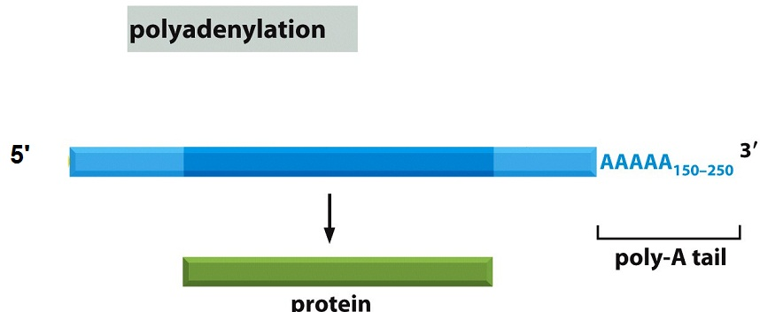
POST TRANSCRIPTIONAL CHANGE :
STEP – III – TAILING AT 3’END : It is the otherwise known as polyadenylation. At 3’end of hnRNA 150 -200 adenine residues are added. This residues are known as poly A tail.

Slide 9
THANKING YOU
ODM EDUCATIONAL GROUP

