Slide 1


TRANSCRIPTION UNIT & PROCESS OF TRANSCRIPTION
GENES AND ENZYMES, TRANSCRIPTION UNIT & GENE , MECHANISM OF TRANSCRIPTION IN PROKARYOTES
SUBJECT : BIOLOGY
CHAPTER NUMBER: 06
CHAPTER NAME : MOLECULAR BASIS OF INHERITANCE

Slide 2
TRANSCRIPTION :
The process a copying genetic information from one strand of the DNA into RNA is termed as transcription.
The principle of complementarity governs the process a transcription except the adenosine now forms base pair with uracil instead of thymine.
However unlike in the process of replication which once set in the total DNA an organism gets duplicated.
In transcription only a segment of DNA and only one of the strands is copied into RNA.
GENES AND ENZYMES :
The term gene was coined by Johannsen and defined as a sequence of DNA located upon chromosome.
These genes are responsible for synthesis of polypeptide chain which in turn forms protein . These proteins after modification act like enzymes and catalyse various metabolic processes .
According to early hypothesis a gene specifies the synthesis of a single enzyme, which later changed and the hypothesis states that a gene specifies the synthesis of a single polypeptide.

Slide 3
TRANSCRIPTION :
Why both the strands are not copied during transcription ?
First. if both strands act as template, they would code for RNA molecule with different and In turn, if they code for proteins the sequence of amino acids in the proteins would be different.
Hence one segment of the DNA would be coding for two different proteins and this would complicate the genetic information transfer machinery.
Second the two RNA molecules if produced simultaneously would be complimentary to each other hence would form a double stranded RNA .
This would prevent RNA from being translated into protein and the exercise of transcription would become a futile one.

Slide 4
TRANSCRIPTION UNIT :
Transcription unit in DNA molecule comprises of three regions.
Promoter.
Structural gene.
Terminator.
A transcription unit is defined as the segment of DNA between the sites of initiation and termination of transcription by enzyme.
The unit may have more than one gene.
PROMOTER REGION – It is the region on DNA molecule to which an RNA polymerase binds and initiates transcription.
STRUCTURAL GENE – It is the area of template strand that is involved in transcription or formation of RNA.
TERMINATOR – This region on DNA molecule which is present downstream of the structural gene , which usually ends the process of transcription.

Slide 5
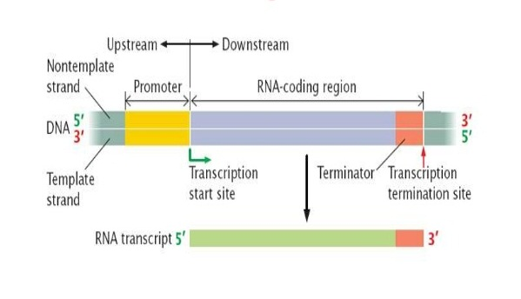
FIGURE SHOWING TRANSCRIPTION UNIT:

Slide 6
TRANSCRIPTION UNIT :
TEMPLATE STRAND – The strand of DNA with polarity 3’ to 5’ which synthesizes RNA is called template strand . It is otherwise known as antisense strand.
CODING STRAND – The other strand of DNA with polarity 5’ to 3’ which is complementary to template DNA strand. It is otherwise known as sense strand.
UPSTREAM REGION – The region that is present left to the structural gene i.e, towards the 5’end of coding strand and 3’ end of template strand.
DOWNSTREAM REGION – The region that is present right to the structural gene i.e. towards 3’ end of coding strand and 5’ end of the template strand.
TRANSCRIPTION START SITE – It is the site present near the promoter from where transcription starts.

Slide 7
TRANSCRIPTION UNIT AND GENE :
Gene is a functional unit of inheritance which is located upon chromosome. the DNA coding for t RNA, r RNA molecule is also defined as gene .
But cistron is defined as a functional unit of gene coding for a polypeptide.
MONOCISTRONIC GENE – In case of eukaryotes monocistronic genes are present which synthesizes one type of polypeptide.
POLYCISTRONIC GENE - In case of prokaryotes monocistronic genes are present which synthesizes different types of polypeptides.
The monocistronic structural genes have interrupted coding sequences , hence the genes are known as split genes.
The coding or expressed sequences are known as exons which synthesizes processed RNA .
The intervening sequences are called introns which never codes for protein.

Slide 8
PROCESS OF TRANSCRIPTION :
TRANSCRIPTION IN PROKARYOTES:
Transcription occurs in prokaryotes in cytoplasm with the help of DNA dependent RNA polymerase enzyme which catalyses synthesis of all 3 types of RNAs.
the process completes in 3 steps :
STEP 1 : INITIATION:
RNA polymerase reaches the promoter region and binds to it. the enzyme has a sigma factor also known as initiation factor. The factor helps in recognizing promoter site.
The factor also helps in binding of the RNA polymerase over the start site .This binding initiates formation of transcription eye and transcription starts.
The enzyme then adds the complementary nucleotide to start site by establishing phospho-diester bond to form a small RNA chain (8-10 nucleotide long).
Then the sigma factor separates from RNA polymerase and the core factor moves over the template DNA strand.

Slide 9
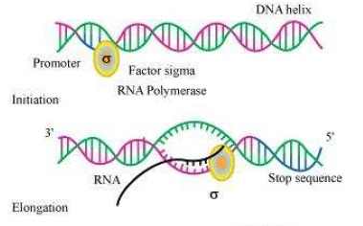
FIGURE SHOWING INITIATION AND ELONGATION OF TRANSCRIPTION:

Slide 10
PROCESS OF TRANSCRIPTION :
TRANSCRIPTION IN PROKARYOTES:
STEP 2 : ELONGATION:
Transcription proceeds in 5’ to 3’ direction .
After separation of sigma factor from RNA polymerase the polymerase alone reads the entire template and in presence of Mg⁺⁺ ion synthesizes RNA.
Only few nucleotides are added at one time to RNA chain due to small size of transcription bubble.
RNA chain becomes longer and the process continues till the enzyme reaches terminator.
After complete synthesis of RNA rewinding of DNA occurs behind.

Slide 11
THANKING YOU
ODM EDUCATIONAL GROUP

