Slide 1


ENZYMES REQUIRED FOR DNA REPLICATION & PROCESS OF DNA REPLICATION
ROLE OF ENZYMES IN DNA REPLICATION &
MECHANISM OF DNA REPLICATION
SUBJECT : BIOLOGY
CHAPTER NUMBER: 06
CHAPTER NAME : MOLECULAR BASIS OF INHERITANCE

Slide 2
ENZYMES REQUIRED FOR DNA REPLICATION :
A large number of enzymes are required for DNA replication.
The main enzyme required for the process is DNA dependent DNA polymerase which takes part in combining deoxyribose nucleotides to form new DNA strands.
DNA polymerase was first discovered by Kornberg in 1957 .
Prokaryotes have three main type of DNA polymerases like DNA polymerase I,II,III .
Eukaryotes have five types of DNA polymerases like α, β, ϒ, δ & ϵ .
The other enzymes required for DNA replication are DNA ligase, helicase, primase, topoisomerase, etc .

Slide 3
ROLE OF ENZYMES IN DNA REPLICATION:
DNA polymerase – This enzyme takes part in combing the nucleotidic residues to form a new strand of DNA.
Other DNA polymerases help in initiation of replication, DNA repair, mitochondrial DNA synthesis .
Helicase – Otherwise known as unwindase, which unwinds the two strands of DNA by destroying hydrogen bonds .
Primase - It synthesizes RNA which acts as primer during DNA replication .
DNA ligase – This enzyme joins newly synthesized fragments of DNA .
Topoisomerase – It makes a swivel cut and releases tension above replication fork during super coiling.

Slide 4
MECHANISM OF DNA REPLICATION:
RATE OF REPLICATION :
The main enzyme is referred to as DNA-dependent DNA polymerase which uses a DNA template to catalyze the polymerization of deoxynucleotides.
These enzymes are highly efficient enzymes as they have to catalyze polymerization of a large number of nucleotides in a very short time.
E. coli that has only 4.6 x 10⁶bp completes the process of replication within 38 minutes: that means the average rate of polymerization has to be approximately 2000 bp per second.
ORIGIN OF REPLICATION :
The replication does not initiate randomly at anyplace in DNA. There is a definite region in E. coli DNA where the replication originates. Such regions are termed as origin of replication (ori).

Slide 5
MECHANISM OF DNA REPLICATION:
ROLE OF DEOXYRIBONUCLEOTIDES :
Energetically replication is a very expensive process . Deoxyribonucleoside triphosphates serve dual purposes.
In addition to acting as substrates, they provide energy for polymerization reaction .
The two terminal phosphates in a deoxyribonucleoside triphosphates are high-energy phosphates, same as in case of ATP.
PROCESS OF DNA REPLICATION :
Helicase unwinds the two strands by destroying the H-bonds in DNA duplex which results in formation of a y-shaped structure known as replication fork.
Due to unwinding of a super coiling develops on the end of DNA opposite to the replication fork. This tension is released by topoisomerase.
At the free 3’ end of one template strand and the fork end of another template strand a primer RNA is synthesized by enzyme primase . This primer provides 3-OH group for joining of nucleotides.

Slide 6
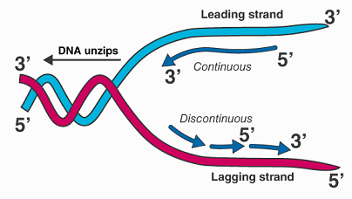
FIGURE SHOWING REPLICATION FORK:

Slide 7
MECHANISM OF DNA REPLICATION:
PROCESS OF DNA REPLICATION :
The two separated DNA strands in the area of replication fork now function as template and their nitrogenous bases attract complementary phosphorylated nucleotides i.e. dATP opposite T , dTTP opposite A, dGTP opposite C and dCTP opposite G by forming H-bond .
The DNA polymerase helps in establishing phospho-diester linkages between successive nucleotides which produces polynucleotide chain .
As the strands of DNA are antiparallel to each other, so the strand running with polarity 3’ to 5’ is known as leading strand or continuous strand. This strand is known as continuous strand as the 3’ end is always open for elongation.
Replication is discontinuous for other template with polarity 5’ to 3’ as it is running opposite to the replication fork. So the daughter strand is synthesized in small fragments known as okazaki fragments.
Okazaki fragments are joined together by means of DNA ligase .

Slide 8
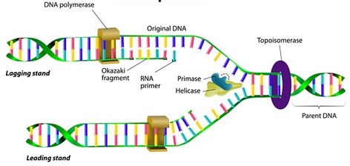
FIGURE SHOWING MECHANISM OF DNA REPLICATION:

Slide 9
MECHANISM OF DNA REPLICATION:
PROOF READING:
A wrong base is sometimes introduced during replication .
The frequency is one in ten thousand. DNA polymerase is able to sense the same . It removes the wrong base allows addition of proper base .
After removal of wrong base the newly formed segment is sealed by DNA ligase .
This proof reading activity of DNA makes the process of DNA replication accurate and error free.

Slide 10
THANKING YOU
ODM EDUCATIONAL GROUP

