Slide 1


REPLICATION OF DNA & IT’S EXPERIMENTAL VERIFICATION
SEMICONSERVATIVE MODE OF DNA REPLICATION , MESELSON & STAHL’S EXPERIMENT , TAYLOR’S EXPERIMENT
SUBJECT : BIOLOGY
CHAPTER NUMBER: 06
CHAPTER NAME : MOLECULAR BASIS OF INHERITANCE

Slide 2
REPLICATION OF DNA :
SEMICONSERVATIVE DNA REPLICATION:
Watson and Crick had immediately proposed scheme for DNA replication while proposing the double helical structure of DNA.
Replication is the formation of exact copies of a substance. DNA replication is a auto catalytic process which takes place during S-phase of cell cycle.
In order the hereditary phenomenon to be explained these strands should be accurately copied and transmitted from parental cell to the daughter ones
The scheme suggested that the two strands would separate and act as a template for synthesis of new complementary strands.
After the completion of replication of each DNA molecule would have one parental and one newly synthesized strand.
This scheme was termed as semi-conservative DNA replication.

Slide 3
SEMICONSERVATIVE DNA REPLICATION:
There are three possible modes that describe the accurate creation of the daughter chains.
SEMICONERVATIVE MODEL.
CONSERVATIVE MODEL.
DISPERSIVE MODEL.
SEMICONSERVATIVE MODEL : According to this model, DNA replication would create two molecules . Each of them would be a complex of an old (parental) and a new (daughter strand).
CONSERVATIVE MODEL : According to this model the DNA replication process would create a brand new DNA double helix made of daughter strands while the parental chains would be conserved.
DISPERSIVE MODEL : According to this model the replication process would create two DNA double chains each of them with parts of both old (parent) and new (daughter) molecules.
But the correct model out of three is the semi-conservative DNA replication, which was proved that experiment.

Slide 4
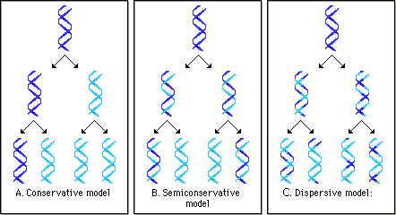
FIGURE SHOWING MODELS OF DNA REPLICATION:

Slide 5
EXPERIMENTAL VERFICATION OF SEMI-CONSERVATIVE DNA REPLICATION:
MESELSON AND STAHL’S EXPERIMENT :
Matthew Meselson and Franklin Stahl in year 1958 performed an experiment in E.coli to prove the DNA replication is semi conservative .
They performed this experiment using heavy isotope of nitrogen (¹⁵N) in E.coli .
They grew E.coli in a medium containing ¹⁵NH₄Cl as the only nitrogen source for many generations . ¹⁵N was incorporated into newly synthesized DNA .
The heavy DNA molecule could be distinguished from the normal DNA by centrifugation in Cesium Chloride density gradient method.
On centrifugation with CsCl solution , forms density gradient bands of a solution of lower density at the top , that increases gradually towards bottom with highest density.

Slide 6
MESELSON AND STAHL’S EXPERIMENT :
Then they transferred the cells into a medium with normal ¹⁵NH₄Cl and took samples at various definite time intervals as the cells multiplied and extracted the DNA that remained as double stranded helix .
The samples were separated independently on CsCl gradients to measure the densities of DNA.
Thus the DNA that was extracted from the culture after 1st generation (after 20mins) had a hybrid (N¹⁴N¹⁵) or intermediate density .
DNA extracted from the culture after another generation (after 40mins) was composed of equal amount of hybrid DNA (N¹⁴N¹⁵) and light DNA (N¹⁴N¹⁴) .
Increase in the amount of light DNA and decrease in hybrid DNA amount can be possible due to semi conservative mode of replication .

Slide 7
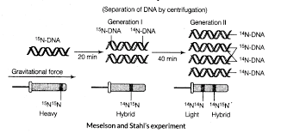
FIGURE SHOWING MESELSON & STAHL’S EXPERIMENT:

Slide 8
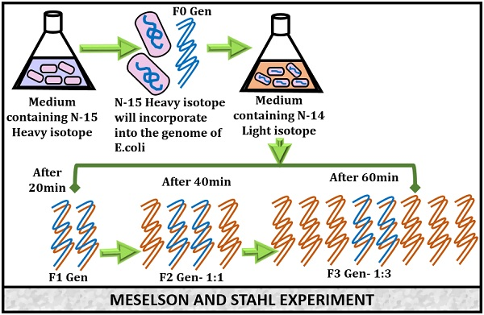
FIGURE SHOWING MESELSON & STAHL’S EXPERIMENT:

Slide 9
TAYLOR’S EXPERIMENT:
Taylor et al conducted experiment in faba beans in 1958 with radioactive tritiated thymidine .
When radioactive thymidine supplied to the roots of broad beans for a few days till all the chromosomes of dividing cells became radioactive.
Thereafter the radioactive chemical was withdrawn and replaced with non radioactive chemical and every cell cycle was studied.
It was found that in first generation after removing tritiated thymidine , one or two chromatids of each chromosome remained radioactive while the second chromatid was non-radioactive.
In second generation 50% of the chromosomes were unlabelled where the remaining were labeled (only one or two strands) .
It proves that one strand of chromosome persists in daughter while the second one is formed newly at time of each replication . This is semi-conservative replication .

Slide 10
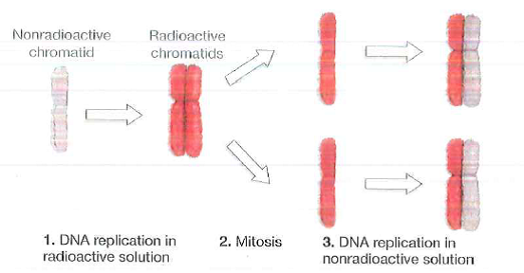
FIGURE SHOWING TAYLOR’S EXPERIMENT:

Slide 11
THANKING YOU
ODM EDUCATIONAL GROUP

