Slide 1


PACKAGING OF DNA HELIX, RNA WORLD
PACKAGING OF PROKARYOTIC & EUKARYOTIC DNA, EUCHROMATIN & HETEROCHROMATIN , NHC PROTEINS
SUBJECT : BIOLOGY
CHAPTER NUMBER: 06
CHAPTER NAME : MOLECULAR BASIS OF INHERITANCE

Slide 2
PACKAGING OF DNA HELIX :
The average distance between two consecutive base pairs as 0.34nm (0.34xl0⁻⁹m).
if the length of DNA double helix in a typical mammalian cell is calculated (simply by multiplying the total number of bp with distance between two consecutive bp, that is, 6.6 x 10⁹bp x 0.34 x I0⁻⁹m/bp), it comes out to be approximately 2.2 metres.
A length that is far greater than the dimension of a typical nucleus (approximately l0⁻⁶ m).
How is such a long polymer packaged in a cell?
Such long sized DNA accommodated in small areas only through packing or compaction.
Compaction of DNA occurs by folding and attachment of DNA with different important components like histone and non-histone proteins.

Slide 3
PACKAGING OF PROKARYOTIC DNA:
In prokaryotes, such as, E. coli, though they do not have a defined nucleus, the DNA is not scattered throughout the cell.
DNA (being negatively charged) is held with some proteins (that have positive charges) in a region termed as 'nucleoid‘ or ‘prochromosome’ .
The DNA in nucleoid is organized in large loops held by proteins.
The proteins are known as nucleoid-associated proteins (NAP), that have positive charges present in the region termed as nucleoid.

Slide 4
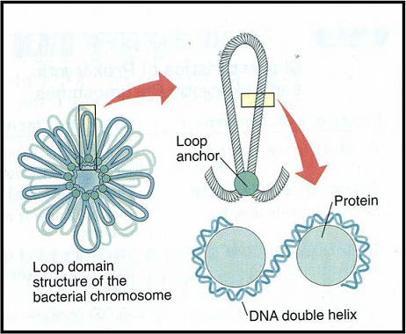
FIGURE SHOWING PACKAGING OF PROKARYOTIC DNA :

Slide 5
PACKAGING OF EUKARYOTIC DNA:
NUCLEOSOME :
In eukaryotes, this organization is much more complex. There is a set of positively charged, basic proteins called histones.
A protein acquires charge depending upon the abundance of amino acids residues with charged side chains. Histones are rich in the basic amino acid residues lysines and arginines. Both the amino acid residues carry positive charges in their side chains.
The negatively charged DNA is wrapped around the positively charged histone octamer to form a structure called nucleosome .
A typical nucleosome contains 200 bp of DNA helix. Nucleosomes constitute the repeating unit of a structure in nucleus called chromatin, thread-like stained (coloured) bodies seen in nucleus.
Small segment of DNA connecting two adjacent nucleosome is called linker DNA which along with nucleosome constitute chromatosome.
The nucleosomes in chromatin are seen as 'beads -on-string' structure when viewed under electron microscope.

Slide 6
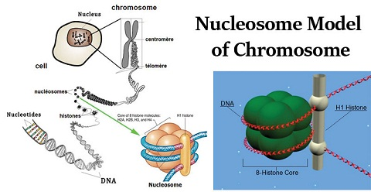
FIGURE SHOWING NUCLEOSOME MODEL:

Slide 7
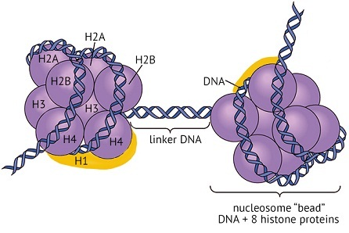
PACKAGING OF EUKARYOTIC DNA:
HISTONE :
Histones are organized to form a unit of eight molecules called as
histone octamer.
There are five types of histone proteins : H₁, H₂A, H₂B, H₃ and H₄ .
Four of them H₂A,H₂B, H₃ and H₄ , oocur in pairs to produce
histone octamer called core of nucleosome.
The fifth type of histone called H₁ is attached over the linker DNA.

Slide 8
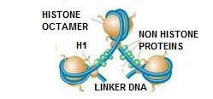
NON HISTONE CHROMOSOMAL PROTEINS:
The beads-on-string structure in chromatin is packaged to form chromatin fibers that are further coiled and condensed at metaphase stage of cell division to form chromosomes.
The packaging of chromatin at higher level requires additional set of proteins that collectively are referred to as Non-histone Chromosomal (NHC) proteins .

Slide 9
EUCHROMATIN & HETEROCHROMATIN :
On the basis of staining behaviour in a typical nucleus, chromatin is of two types :
EUCHROMATIN :
It stains lightly.
This type of chromatin is loosely packed.
It is transcriptionally active.
HETEROCHROMATIN:
It stains darkly.
This type of chromatin is tightly packed.
It is transcriptionally inactive.

Slide 10
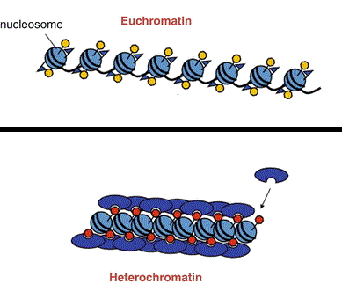
FIGURE SHOWING EUCHROMATIN & HETEROCHROMATIN :

Slide 11
RNA WORLD:
There is a little doubt that early life was RNA centric with every important function being controlled by it .
The first genetic material was RNA . Metabolism, splicing and translation evolved around RNA.
RNA used to act as a genetic material as well as a catalyst (there are some important biochemical reactions in living systems that are catalysed by RNA catalysts and not by protein enzymes).
But RNA being biocatalyst was reactive and hence unstable. Even now some enzymes are made of RNAs, e.g., ribozyme.
Therefore DNA has evolved from RNA with chemical modifications that make it more stable and for biocatalysis RNA was replaced by protein enzymes.
DNA being double stranded and having complementary strand further resists changes by evolving a process of repair.
Therefore it can be that early life evolved around RNA.

Slide 12
THANKING YOU
ODM EDUCATIONAL GROUP

