Slide 1


STRUCTURE OF POLYNUCLEOTIDE CHAIN(DNA),CENTRAL DOGMA
CHEMICAL STRUCTURE OF DNA, DISCOVERIES RELATED TO DNA
SUBJECT : BIOLOGY
CHAPTER NUMBER: 06
CHAPTER NAME : MOLECULAR BASIS OF INHERITANCE

Slide 2
CHEMICAL STRUCTURE OF DNA :
DNA is a long polymer of deoxyribonucleotides.
A nucleotide has three components - a nitrogenous base, a pentose sugar (ribose in case of RNA and deoxy ribose for DNA) and a phosphate group.
NITROGENOUS BASE: A heterocyclic nitrogen containing compound is called nitrogenous base.
There are two types of nitrogenous bases - Purines (Adenine and Guanine) and Pyrimidines (cytosine, Uracil and Thymine).
Cytosine is common for both DNA and RNA and thymine is present in DNA whereas Uracil is present in RNA at the place of thymine.
PURINES: It is a double ring (9 membered) structure with N at position 1,3,7 & 9. E.g., A &G .
PYRIMIDINE: It is a 6-membered single ring structure with N at 1 and 3 position. E.g., C,T/U .

Slide 3
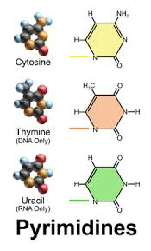
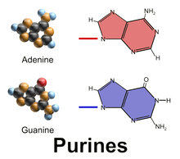
FIGURE SHOWING STRUCTURE OF PURINE & PYRIMIDINE :

Slide 4
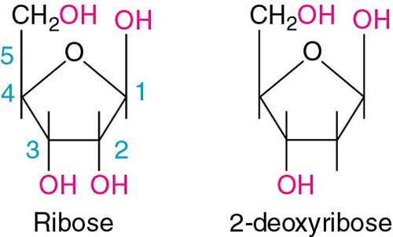
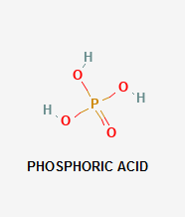
CHEMICAL STRUCTURE OF DNA:
PENTOSE SUGAR : In DNA the sugar is 2-deoxyribose . It is a five carbon sugar. In RNA the sugar is ribose.
PHOSPHATE GROUP: Phosphate radicals are the important components of DNA which joins the back bone of DNA to the base.

Slide 5
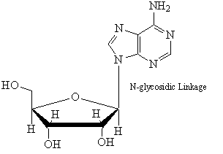
CHEMICAL STRUCTURE OF DNA:
BONDS INVOLVED IN DNA CHAIN :
Glycosidic linkage:
A nitrogenous base is linked to the pentose sugar through a N-glycosidic linkage to form a nucleoside, such as adenosine or deoxyadenosine, Guanosine or deoxyguanosine, cytidine or deoxycytidine and uridine or deoxythymidine.

Slide 6
CHEMICAL STRUCTURE OF DNA:
BONDS INVOLVED IN DNA CHAIN :
PHOSPHODIESTER LINKAGE :
When a phosphate is linked to 5' -OH of a nucleoside through phosphoester linkage a corresponding nucleotide (or deoxyucleotide depending upon the type of sugar present) is formed.
Two nucleotides are linked through 3 '-5' Phosphodiester linkage to form a di-nucleotide.
More nucleotides can be joined in such a manner to form a polynucleotide chain.
A polymer thus formed has at one end a free phosphate moiety at 5’ end of ribose sugar which is referred to as 5’-end of polynucleotide chain.
Similarly at the other end of the polymer the ribose has a free 3’OH group which is referred to as 3’end of the polynucleotide chain.

Slide 7
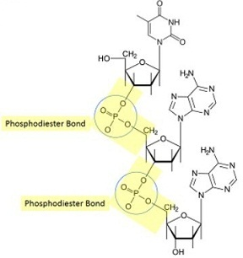
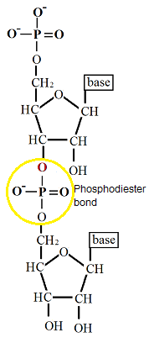
FIGURE SHOWING STRUCTURE PHOSPHODIESTER BOND &
DI-NUCLEOTIDE:
PHOSPHODIESTER BOND
DI NUCLEOTIDE

Slide 8
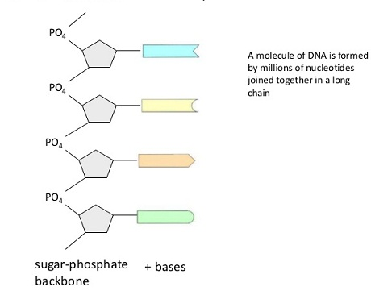
CHEMICAL STRUCTURE OF DNA :
SUGAR- PHOSPHATE BACKBONE :
The backbone in a polynucleotide chain is formed due to sugar and phosphates. The nitrogenous bases linked to sugar moiety project from the backbone. In RNA. every nucleotide residue has an additional-OH group present at 2’position in the ribose. Also, in RNA the Uracil is found at the place of thymine (5-methyluracil another chemical name for thymine).

Slide 9
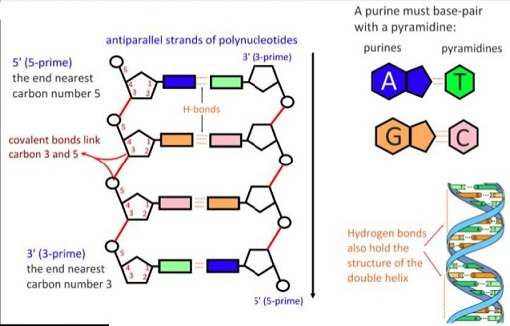
CHEMICAL STRUCTURE OF DNA :
HYDROGEN BOND:
The two strand of DNA are held together by hydrogen bonds between their bases. Two hydrogen bonds occur between Adenine and Thymine . There are three hydrogen bonds occur between Cytosine and Guanine.

Slide 10
DISCOVERIES RELATED TO DNA:
CONTRIBUTION OF WILKINS & FRANKLIN AND CHARGAFF :
DNA as an acidic substance present in nucleus was first identified by Friedrich Meischer in 1869. He named it as 'Nuclein'.
However due to technical limitation in isolating such a long polymer intact the elucidation of structure of DNA remain elusive for a very long period of time.
It was only in 1953 that James Watson and Francis Crick who first worked out the correct structure of DNA and it is the double helix model of DNA.
But their double helix model was based on two major investigation:
(i)The X-ray diffraction data produced by Maurice Wilkins and Rosalind Franklin on pattern of DNA:
Both Wilkins and Franklin took X-ray diffraction pictures of crystalline DNA and concluded that DNA is long molecule consisting of two similar strands running in parallel and helical manner where successive nucleotides occur.
(ii) Chargaff’s rule: Erwin Chargaff formulated the generalization that the Purines and Pyrimidine are always present in equal amount in DNA chain ; A+G = C+T.
The amount of adenine is always equal to that of thymine and amount of guanine is always equal to that of cytosine,
; A =T & C = G

Slide 11
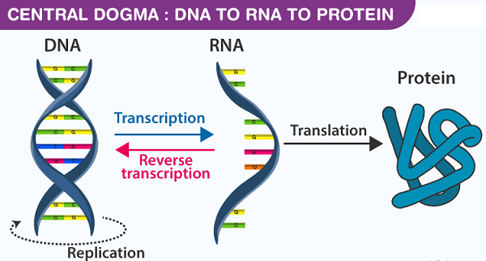
CENTRAL DOGMA :
Francis Crick proposed the Central dogma in molecular biology, which states that the genetic information flows from DNA RNA Protein .
In some viruses the flow of information is in reverse direction, that is, from RNA DNA.

Slide 12
THANKING YOU
ODM EDUCATIONAL GROUP

