Slide 1


SEARCH FOR GENETIC MATERIAL, INTRODUCTION TO STRUCTURE OF POLYNUCLEOTIDE CHAIN
HERSHEY & CHASE’S EXPERIMENT, SALIENT FEATURE OF DNA,PROPERTIES OF GENETIC MATERIAL
SUBJECT : BIOLOGY
CHAPTER NUMBER: 06
CHAPTER NAME : MOLECULAR BASIS OF INHERITANCE

Slide 2
EXPERIMENTAL EVIDENCE – 3:
HERSHEY AND CHASE’S EXPERIMENT :
The unequivocal proof that DNA is the genetic material came from the experiments of Alfred Hershey and Martha Chase (1952). They worked With Viruses that infect bacteria called bacteriophages.
Alfred Hershey and Martha Chase took an effort to find the genetic material in organisms.
Bacteriophages (viruses that affect bacteria) were the key element for Hershey and Chase experiment.
PRINCIPLE : The bacteriophages are made up of DNA and protein coat (capsid).Thus it is a suitable material to determine whether DNA or protein contains genetic material.
The experiment began with the culturing of viruses in two types of medium.
One set of viruses (A) was cultured in a medium of radioactive phosphorus whereas another set (B) was cultured in a medium of radioactive sulphur.
They observed that the first set of viruses (A) consisted of radioactive DNA but not radioactive proteins.
This is because DNA is a phosphorus-based compound while protein is not. The latter set of viruses (B) consisted of radioactive protein but not radioactive DNA. Hence the bacteriophages got labelled.

Slide 3
PROCEDURE:
The following three steps were followed after labeling : Infection, Blending, Centrifugation.
INFECTION : Both types (A &B) of labeled phages were allowed to infect normally cultured bacteria (E.coli) in separate experiments. DNA was introduced and protein coat was left out.
BLENDING : As the infection proceeded the bacterial cells were agitated in a blender to break the contact between virus and bacteria.
CENTRIFUGATION : The virus particles were separated from the bacteria by spinning them in a centrifuge . The heavier mass settled down in form of pellet and the lighter at the upper part known as supernatant.

Slide 4
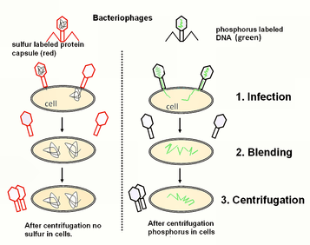
HERSHEY & CHASE’S EXPERIMENT :

Slide 5
OBSERVATION AND CONCLUSION :
Both the pellet and supernatant were analysed. It was found that phage with labelled protein did not make the bacteria labelled, instead radioactivity was restricted to the supernatant which was found to contain only empty phages.
In the second culture labelled phage with radioactive DNA did not produce any radioactivity in supernatant, instead the bacteria become labelled
E.coli bacteria which were infected by radioactive DNA viruses (A) were radioactive but the ones that were infected by radioactive protein viruses (B) were non-radioactive.
Resultant radioactive and non-radioactive bacteria infer that the viruses that had radioactive DNA transferred their DNA to the bacteria but viruses that had radioactive protein didn’t get transferred to the bacteria.
Hence, DNA is the genetic material and not the protein.

Slide 6
THE SALIENT FEATURES OF THE DOUBLE-HELIX STRUCTURE OF DNA
It is made of two polynucleotide chains where the backbone is constituted by sugar-phosphate and the bases project inside.
(ii) The two chains have anti-parallel polarity. It means, if one chain has the polarity 5’ 3’ the other has polarity from 3’ 5’.
(iii) The bases in two strands are paired through hydrogen bond (H -bonds) forming base pairs (bp).
Adenine forms two hydrogen bonds With Thymine from opposite strand and vice-versa.
Similarly, Guanine is bonded with cytosine with three H-bonds. As a result. Always a Purine comes opposite to a Pyrimidine. This generates approximately uniform distance between the two strands of the helix.
(iv) The two chains are coiled in a right-handed fashion.
The pitch of the helix is 3.4 nm (a nanometre is one billionth of a metre that is 10⁻⁹ m and there are roughly 10 bp in each turn. consequently the distance between a bp in a helix is approximately equal to 0.34 nm.
(v) The plane of one base pair stacks over the other in double helix. This in addition to H-bonds, confers stability of the helical structure.
.

Slide 7
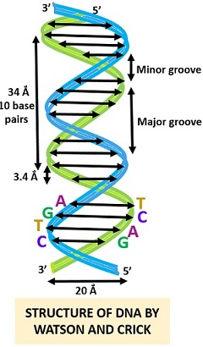
STRUCTURE OF DNA:
A DNA molecule has 2 spirally coiled chain collectively called as DNA duplex.
DNA duplex has a diameter of 20 A^{0 .}
The whole duplex is coiled upon itself around common axis in a right handed manner in such a way that 2 strands cannot be separated without completely unwinding them.
Due to spiral twisting the duplex comes to have two types of alternate grooves, major groove (22A⁰) and minor groove (12A⁰)
One turn of the spiral has a distance of 34A⁰.
This length contains 10bp in each chain and the average distance between adjacent base is 3.4A⁰.
.

Slide 8
LENGTH OF DNA:
DNA is a long polymer of deoxyribonucleotides.
The length of DNA is usually defined as number of nucleotides (or a pair of nucleotide referred to as base pairs) present in it. This also is the characteristic of an organism.
For example, a bacteriophage known as Ø * 174 has 5386 nucleotides.
Bacteriophage lambda has 48502 base pairs (bp).
Escherichia coli has 4.6 x 10⁶bp, and haploid content of human DNA is 3.3 x 10⁹bp.
PROPERTIES OF GENETIC MATERIAL :
It is clear that the debate between proteins versus DNA as a genetic material was resolved from Hershey-Chase experiment.
It became an established fact that it is DNA that act as genetic material.
However. it subsequently become clear that in some viruses RNA is the genetic material (for example-Tobacco Mosaic virus, QB bacteriophage, etc)
A molecule that can act as a genetic material must fulfill the following criteria:
(i) It should be able to generate its replica (Replication).
(ii) It should chemically and structurally be stable.
(iii) It should provide the scope for slow changes (mutation) that are required for evolution.
(iv) It should be able to express itself in the form of 'Mendelian Characters'.

Slide 9
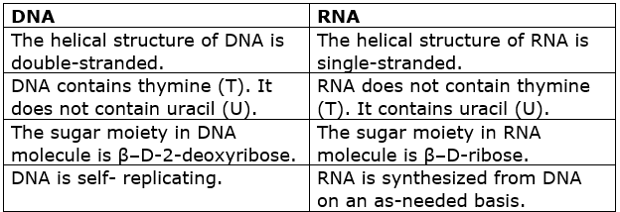
DNA VERSUS RNA:
Further, 2' -OH group present at every nucleotide in RNA is a reactive group and makes RNA labile and easily degradable. RNA is also now known to be catalytic, hence reactive. Therefore, DNA chemically is less reactive and structurally more stable when compared to RNA.
Therefore among the two nucleic acids the DNA is a better genetic material. In fact. the presence of thymine at the place of uracil also confers additional stability to DNA . Both DNA and RNA are able to mutate.
In fact RNA being unstable mutate at a faster rate. Consequently viruses having RNA genome and having shorter life span mutate and evolve faster.
.

Slide 10
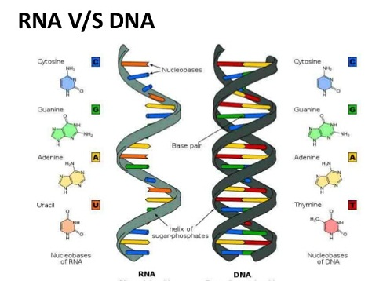
DNA VERSUS RNA:
.

Slide 11
THANKING YOU
ODM EDUCATIONAL GROUP

