Slide 1


RICE GENOME PROJECT
SUBJECT : BIOLOGY
CHAPTER NUMBER: 06
CHAPTER NAME : MOLECULAR BASIS OF INHERITANCE

Slide 2
RICE GENOME PROJECT :
INTRODUCTION :
Rice (Oryza sativa) is one of the most important crops in the world.
Rice, wheat, and maize together account for about half of the world's food production, and rice itself is the principal food of half of the world's population .
Rice is the obvious choice for the first whole genome sequencing of a cereal crop.

Slide 3
RICE GENOME PROJECT :
INTRODUCTION :
An International Rice Genome sequencing project (IRGSP) was conceived in September 1997.
Some 32 institutions of ten countries participated in it .
The Indian participants were IARI and university of Delhi.
The tools used in sequencing were BAC (bacterial artificial chromosomes) and PAC (P1- phage derived artificial chromosome).
The map based draft sequence was released in December , 2002.

Slide 4
RICE GENOME PROJECT :
Rice has the smallest genome amongst the major cereals with only 389 million base pairs.
The number of genes is, however high ,some 37544.
Many of them occur in clustered gene families.
Nearly 0.4% of nuclear genes contain organelle DNA segments.
Number of transposons is quite high, some 35%.
18.9 million SNPs and 80,127 polymorphic sites occur in the genome.
There are five varietal groups in rice :
(1) Basmati (2) Indica (3) Aus (4) Tropical and Japonica (5) Temporate japonica

Slide 5
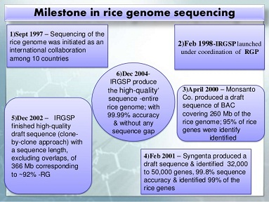
RICE GENOME SEQUENCING:

Slide 6
THANKING YOU
ODM EDUCATIONAL GROUP

