Slide 1


SEARCH FOR GENETIC MATERIAL
GRIFFITH’S EXPERIMENT AND AVERY, Mac LEOD AND Mc CARTY’S EXPERIMENT
SUBJECT : BIOLOGY
CHAPTER NUMBER: 06
CHAPTER NAME : MOLECULAR BASIS OF INHERITANCE

Slide 2
EXPERIMENTAL EVIDENCE – 1: GRIFFITH’S EXPERIMENT [1920]
(TRANSFORMATION)
The genetic recombination in which naked DNA from one cell can enter and integrate in another cell is referred to as genetic transformation.
In 1928, Frederick Griffith, an English bacteriologist conducted transformation experiments on two strains of bacterium, Streptococcus pneumoniae (Diplococcus).
Organism Used:
Mice and two strains of pneumonia causing bacteria Diplococcus pneumoniae.
a. Smooth (S) or Capsulated Type:
The smooth strain has a capsule composed of polysaccharide (a polymer of glucose and glucuronic acid). This type of strain is virulent and causes pneumonia. The capsule is believed to protect the bacterium from attack by the immune system of the host.
b. Rough (R) or Non-Capsulated Type:
In this strain the capsule is absent. These bacteria are non-virulent and do not produce pneumonia.

Slide 3
PRINCIPLE AND PROCEDURE
Principle Involved:
The virulent strain causes pneumonia and death of mice, whereas a virulent strain does not cause pneumonia. The experiment is based on the principle of genetic transformation.
Procedure Adopted:
There are two types of strains in above bacteria, viz. virulent with smooth surface [having coating of polysaccharide] designated as SIII; and a virulent with rough surface [without coating] designated as RII.
The virulent strain causes pneumonia and death of mice, whereas a virulent strain does not cause pneumonia.
Griffith injected strains of Streptococcus pneumoniae bacteria into mice in following four combinations and recorded the results.
i. Virulent strain SIII which causes pneumonia.
ii. A virulent strain RII which does not cause pneumonia.
iii. Heat killed virulent strain SIII.
iv. Mixture of heat killed virulent strain SIII + a virulent strain RII

Slide 4
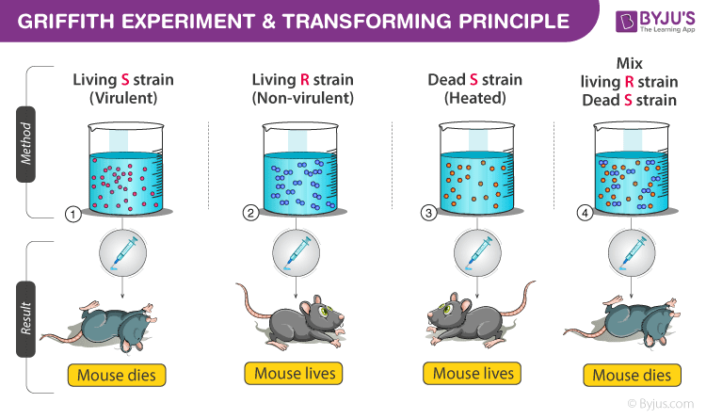
PROCEDURE AND RESULT
The S and the R type occur in several subtypes and are represented as SI, SII, SIII, etc. and RI, RII, RIII, etc. respectively. These subtypes differ from each other in the type of antigens they produce. Griffith injected mice with both forms of the bacteria and obtained the result

Slide 5
CONCLUSION:
The results suggest that the chemical from the heat killed bacteria transformed the a virulent bacteria into virulent which caused death of the mice.
Griffith concluded that the live R-strain bacteria, were transformed by the heat-killed S-strain bacteria.
He proved that there was some ‘transforming principle’ that was transferred from the heat-killed S-strain, which helped the R-strain bacteria to synthesise a smooth polysaccharide coat and thus, become virulent. That was due to the transfer of the genetic material.
However, he was not able to define the biochemical nature of genetic material from his experiments.

Slide 6
EXPERIMENTAL EVIDENCE -2: AVERY, MACLEOD AND MCCARTY EXPERIMENT [1944](BIOCHEMICAL CHARACTERISATION OF TRANSFORMING PRINCIPLE)
Oswald Avery, Colin MacLeod and Maclyn McCarty (1933-44) worked to determine the biochemical nature of ‘transforming principle’ in Griffith’s experiment in an in vitro system.
Organism Used:
They used pneumonia causing bacteria Diplococcus pneumonia. These experiments provided the first evidence that the chemical nature of the genetic material was DNA.
The two strains R - strain & heat killed S-strain of Diplococcus pneumonia were used in their experiment.

Slide 7
PRINCIPLE AND PROCEDURE :
Principle Involved:
The extract from virulent strain when mixed with the hydrolysing enzyme DNA - ase will not to transformation the R- strain to S- strain .
Procedure Adopted:
Avery, Macleod and McCarty isolated DNA from virulent strain (SIII) and applied the same in culture medium of a virulent strain [RII] in following four combinations and recorded the results.
The extract from heat killed virulent strain SIII was taken which contains all the components i.e. DNA, RNA and proteins.
The extract from heat killed virulent strain SIII treated with DNAase enzyme which digests DNA, so there are RNA and proteins but no DNA.
The extract from heat killed virulent strain SIII treated with RNAase enzyme which digests RNA, so there are DNA and Proteins but no RNA.
The extract from heat killed virulent strain SIII treated with protease enzyme which digests proteins, so there are DNA and RNA but no protein.
All the components after treated with enzyme was added to a medium supported by R strain bacteria and the transformation was observed.

Slide 8
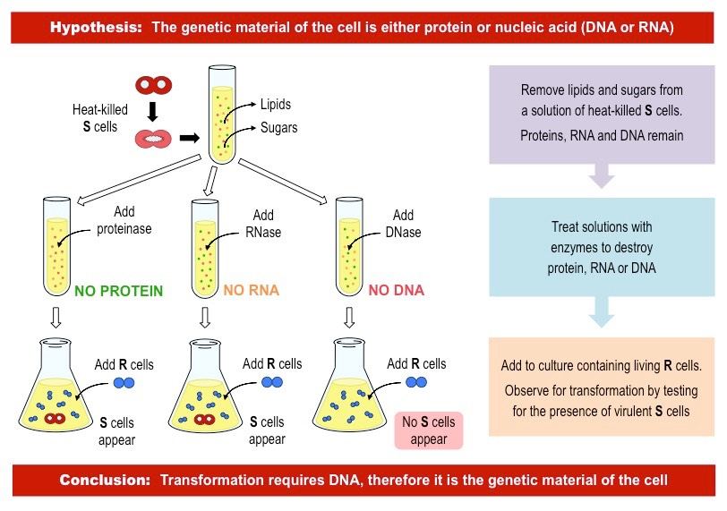

Slide 9
CONCLUSION:
There was a change in two culture medium having Protease and RNAase where R- strain transformed to S-strain.
Because the transformation occurred when DNA was present in the extract and there was no transformation of R- strain into S- strain when DNA was digested with DNAase enzyme.
They concluded that DNA was the genetic material and not the proteins.

Slide 10
THANKING YOU
ODM EDUCATIONAL GROUP

