Slide 1


GLOBAL WARMING & ITS CAUSE, OZONE LAYER DEPLETION
SUBJECT : BIOLOGY
CHAPTER NUMBER: 16
CHAPTER NAME : ENVIRONMENTAL ISSUES

Slide 2
GLOBAL WARMING :
GREENHOUSE EFFECT :
The greenhouse effect is a naturally occurring phenomenon that is responsible for heating of Earth’s surface and atmosphere due to increase in concentration of carbon dioxide and methane gas.
Clouds and gases reflect about one-fourth of the incoming solar radiation and absorb some of it but almost half of incoming solar radiation falls on Earth’s surface heating it, while a small proportion is reflected back.
The surface of earth re- emits heat in the form of infrared radiation but part of this does not reflected back due to greenhouse gases that leads to heating of earth atmosphere.
Global warming is caused due to greenhouse effect. Without greenhouse effect the average temperature at surface of earth would have been a chilly -18⁰C rather than the present average of 15⁰C .

Slide 3
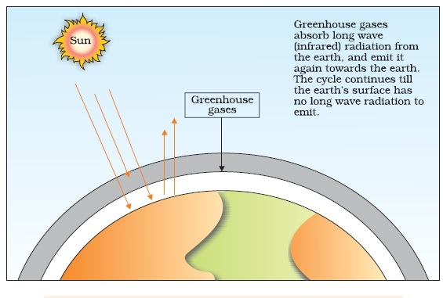
FIGURE SHOWING SUNLIGHT ENERGY AT OUTMOST ATMOSPHERE :

Slide 4
GLOBAL WARMING :
CONTRIBUTION OF VARIOUS GREENHOUSE-GASES :
Earth's surface re-emits heat in the form of infrared radiation. but part of this does not escape into space as atmospheric gases like carbon dioxide and methane absorb a major fraction of it.
The molecules of these gases radiate heat energy and a major part of which again comes to Earth’s thus heating it up once again.
This cycle is repeated many a times.
The above mentioned gases-carbon dioxide and methane- are commonly known as greenhouse gases.
Scientists believe that this rise in temperature is leading to harmful changes in the environment and resulting in odd climatic changes (e.g. El Nino effect) , thus leading to increased melting of polar ice caps.

Slide 5
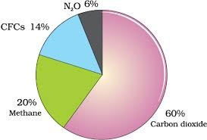
CONTRIBUTION OF VARIOUS GASES TO GLOBAL WARMING :

Slide 6
OZONE LAYER DEPLETION & CAUSE :
Ozone found in the upper part of the atmosphere called stratosphere acts as a shield absorbing ultraviolet radiation form the sun. UV rays are highly injurious to living organisms.
‘Bad' ozone, formed in the lower atmosphere (troposphere) that harms plants and animals.
There is 'good' ozone also; this ozone is found in the upper part of the atmosphere called the stratosphere.
The thickness of the ozone-layer in a column of air from the ground to the top of the atmosphere is measured in terms of Dobson units (DU).
Chlorofluoro Carbons deplete the ozone layer. The part of atmosphere with lesser concentration of ozone is called ozone hole.
Steps leading to ozone depletion :
UV-rays split CFCs and release atomic chlorine (Cl) .
UV-rays also split ozone into oxygen.
Chlorine atoms trap oxygen atoms and ozone is not formed again from oxygen. Cl atoms are not consumed in the reaction. Hence, whatever CFCs are added to the stratosphere, they have permanent and continuing affects on Ozone level.
This leads to depletion of ozone in the stratosphere.

Slide 7
OZONE LAYER DEPLETION & EFFECTS :
Ozone layer absorbs the harmful UV-rays. It causes aging of skin, damage to skin cells and various types of skin
cancers. In human eye, cornea absorbs UV-B radiation, and a high dose of UV-B causes inflammation of cornea,
called snow-blindness cataract, etc. Such exposure may permanently damage the cornea.
Although ozone depletion is occuring widely in the stratosphere , the depletion is particularly marked over the
Antarctic region.
This has resulted in formation of a large area of thinned ozone layer, commonly called as the Ozone hole .
Recognizing the deleterious affects of ozone depletion an international treaty known as the Montreal protocol
was signed at Montreal(Canada) in 1987 to control the emission of ozone depleting substances.
Subsequently many more efforts have been made and protocols have laid down definite roadmaps, separately
for developed and developing countries for reducing the emission of CFC and other ozone depleting chemicals.

Slide 8
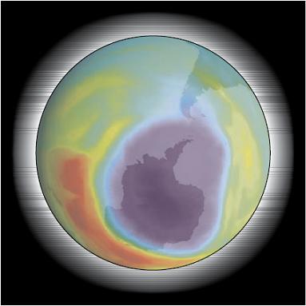
FIGURE SHOWING OZONE HOLE IN ANTARCTICA :

Slide 9
THANKING YOU
ODM EDUCATIONAL GROUP

