Slide 1


PATTERNS OF BIODIVERSITY
SUBJECT : BIOLOGY
CHAPTER NUMBER: 15
CHAPTER NAME : BIODIVERSITY AND CONSERVATION

Slide 2
PATTERNS OF BIODIVERSITY :
Latitudinal gradients :
The diversity of plants and animals is not uniform throughout the world and shows uneven distribution.
This distribution pattern is along the latitudinal gradient in diversity. With very few exceptions, tropics latitudinal range of ( 23.5° N to 23.5° S) harbour more species than temperate or polar areas.
Species diversity decreases as we move away from the equator towards the poles. Tropics harbor more species than temperate or polar areas.
Colombia located near the equator has nearly 1400 species of birds while New York at 41° N has 105 species and Greenland at 71° N only 56 species.
Amazonian Rainforest has the greatest biodiversity on earth. It has more than 40000 species of plants, 1,25,000 species of insects, 300 species of fish, 427 of amphibian and 378 of reptiles, 1300 species of birds and 427 of mammals. Various hypothesis has been proposed regarding this such as-

Slide 3
PATTERNS OF BIODIVERSITY
Tropics that might account for their greater biological diversity, reasons are
Speciation is a function of time unlike temperate regions subjected to frequent glaciation in past, tropical latitudes have remained relatively undisturbed for millions of years and thus had long evolutionary time for species diversification.
Tropical environments unlike temperate ones are less seasonal and more constant and predictable which promote niche specialization and lead to a greater species diversity.
There is more solar energy available in the tropics which contribute to higher productivity this in turn contribute indirectly to greater diversity.

Slide 4
PATTERNS OF BIODIVERSITY :
Species-Area relationships:
• Alexander Von Humboldt has observed that within a region, species richness gets increased when explored area is increased, but only up to a limit.
• The relationship between species richness and area for a number of taxa like angiospermic plants, fresh water fishes and birds is found to be a rectangular hyperbola.
On logarithmic scale, the relationship is a straight line described by the equation-
log S = log C + Z log A.
Where, S= species, A= Area, Z= slope of the line, C =Y- intercept.

Slide 5
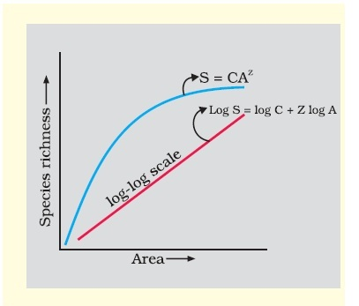
SPECIES – AREA RELATIONSHIP ON LOG SCALE :

Slide 6
PATTERNS OF BIODIVERSITY :
Ecologists have discovered that the value of Z lies in the range of 0.1 to 0.2. regardless of the taxonomic group or the region whether it is the plants in Britain, birds in California, molluscs in New York state, the slopes of the regression line are amazingly similar.
But the species area relationships among very large areas like the entire continents the slope of the line to be much steeper (Z values in the range of 0.6 to I. 2) .
For example for frugivorous (fruit-eating) birds and mammals in the tropical forests of different continents the slope is found to be 1.15.

Slide 7
THANKING YOU
ODM EDUCATIONAL GROUP

