Slide 1


BIODIVERSITY, GENETIC,SPECIES AND ECOLOGICAL DIVERSITY
SUBJECT : BIOLOGY
CHAPTER NUMBER: 15
CHAPTER NAME : BIODIVERSITY AND CONSERVATION

Slide 2
BIODIVERSITY :
Biodiversity or biological diversity is the occurrence of different types of ecosystems, different species of organisms and their variant like biotypes, ecotypes and gene adapted to different climates and environments of different regions including their interactions and processes.
There are more than 20,000 species of ants. 3,00,000 species of beetles, 28,000 species of fishes and nearly 20,000 species of orchids.
Scientists and evolutionary biologists have been trying to understand the significance of such diversity
This term was coined by Edward Wilson.
The vast array of species of micro-organisms, algae, fungi, plants and animals occurring on the earth either in the terrestrial or aquatic habitats and the ecological complexes of which they are a part comprises biodiversity .
Diversity ranges from macromolecules to biomes.

Slide 3
BIODIVERSITY:
The most important forms of biodiversity are:
  Genetic diversity (diversity at the genetic level)
  Species diversity (diversity at the species level)
  Ecological diversity (diversity at the ecosystem level)
  Genetic Diversity :
  A single species might show high diversity at the genetic level over its distributional range.
  Rauwolfia vomitoria shows genetic variation in terms of concentration and potency of chemical reserpine.
  India has more than 50,000 genetically different strains of rice and 1000 varieties of mango.

Slide 4
BIODIVERSITY:
Species Diversity :
Diversity at species level for example, the Western Ghats have more amphibian species diversity than the Eastern Ghats.
Ecological Diversity :
At the ecosystem level, India for a instance with its deserts, rain forests, mangroves, coral reefs, wetlands, estuaries and alpine meadows, has a greater ecosystem diversity than a Scandinavian country like Norway.
are types of ecological diversity.
It has taken millions of years of evolution to accumulate this rich diversity in nature. but we could lose all that wealth in less than two centuries if the present rates or species losses continue.

Slide 5
SPECIES ON EARTH & SPECIES ON INDIA:
According to the IUCN (2004) there are close to 1.5 million plants and animals that have to be discovered and described.
More species have been discovered in temperate regions as compared to tropics.
According to an estimate made by Robert May, global species biodiversity is about 7 million.
Of the total species discovered so far, 70% are animals and 22% are plants. Of the animals, 70% are insects.
India has 2.4% of the world’s land and 8.1% of the total species diversity.
According to May’s estimate, 78% of the biodiversity is still to be discovered.

Slide 6
SPECIES ON EARTH & SPECIES ON INDIA:
BIODIVERSITY IN INDIA :
• India is one of the twelve mega biodiversity countries of the world.
• India has only 2.4% of the land area of the world, it has 8.1% of the global species biodiversity.
• There are about 45,000 species of plants and about 90,000-1,00,000 species of animals.
• New species are yet to be discovered and named.
• Applying Robert May’s global estimate, only 22% of the total species have been recorded, India has probably more than 1,00,000 species of plants and 3,00,000 species of animals to be discovered and described.

Slide 7
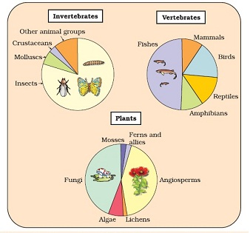
GLOBAL DIVERSITIES OF MAJOR TAXA:
It should be noted that these estimates do not give any figures for prokaryotes.
Biologists are not sure about how many prokaryotic species there might be.
The problem is that unconventional taxonomic methods are not suitable for identifying microbial species and many species are simply not culturable under laboratory condition.

Slide 8
THANKING YOU
ODM EDUCATIONAL GROUP

