Slide 1


ECOLOGICAL SUCCESSION,NUTRIENT CYCLING
ECOSYSTEM SERVICES
SUBJECT : BIOLOGY
CHAPTER NUMBER: 14
CHAPTER NAME : ECOSYSTEM

Slide 2
ECOLOGICAL SUCCESSION & IT’S TYPES :
The composition of all ecosystems keeps on changing with change in their environment.
These changes finally lead to the climax community.
During succession some species colonize an area and their population becomes more numerous whereas population of other species decline and even disappear.
Pioneer species - The species that invade a bare area are called pioneer species
Climax community − It is the community which is in equilibrium with its environment. Gradual and fairly predictable change in the species’ composition of a given area is called ecological succession.
Sere(s) − It is the sequence of communities that successively change in a given environment. The transitional communities are called seral stages or seral communities.

Slide 3
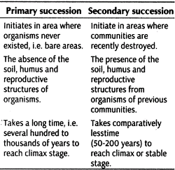
ECOLOGICAL SUCCESSION & IT’S TYPES :
TYPES :
Primary succession - Succession happens in areas where no life forms ever existed as in bare rocks, cool lava, etc.
Secondary succession – Succession happens in areas which have lost all life forms due to destructions and floods .
Primary succession takes hundreds to thousands of years as developing soil on bare rocks is a slow process.
Secondary succession is faster than primary succession since the nature does not have to start from scratch.

Slide 4
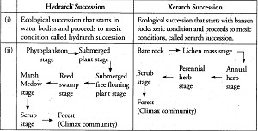
ECOLOGICAL SUCCESSION & IT’S TYPES :
Hydrarch succession − It takes place in wet areas and converts hydric conditions to mesic.
In primary succession in water, the pioneer species are the small phytoplanktons that are replaced by free floating angiosperms
Xerarch succession − It takes place in dry areas and converts xeric conditions to mesic.
In primary succession on rocks lichens are pioneer species that secrete acids to dissolve the rock for weathering to form soil.
The ultimate result of all successions is a climax community, a mesic.

Slide 5
NUTRIENT CYCLING :
The amount of nutrients present in the soil at a given time is known as the standing state.
Nutrients are never lost from the ecosystem.
They are only recycled from one state to another.
The movement of nutrients through the various components of the ecosystem is called nutrient cycling or biogeochemical cycles.
They are of two types:
Gaseous − Reservoir for these types of cycles exist in the atmosphere, e.g. - carbon cycle
Sedimentary − Reservoir for these types of cycles exist in the earth’s crust, e.g. – phosphorous cycle

Slide 6
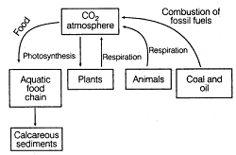
NUTRIENT CYCLING :
CARBON CYCLE
About 49% of the dry weight of living organisms is made up of carbon.
The ocean reserves and fossil fuels regulate the amount of CO₂ in the atmosphere.
Plants absorb CO₂ from the atmosphere for photosynthesis, of which a certain amount is released back through respiratory activities.
A major amount of CO₂ is contributed by the decomposers who contribute to the CO₂ pool by processing dead and decaying matter.
The amount of CO₂ in the atmosphere has been increased considerably by human activities such as burning of fossil fuels, deforestation.

Slide 7
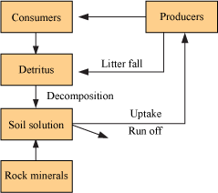
NUTRIENT CYCLING :
PHOSPHORUS CYCLE
Phosphorus is an important constituent of cell membranes, nucleic acids, and cellular energy transfer systems.
Rocks contain phosphorus in the form of phosphate.
When rocks are weathered, some of the phosphate gets dissolved in the soil solution and is absorbed by plants.
The consumers get their phosphorus from the plants.
Phosphorus returns back to the soil by the action of phosphate-solubilizing bacteria on dead organisms.

Slide 8
ECOSYSTEM SERVICES :
The products of ecosystem processes are called ecosystem services. It includes-
The healthy forest ecosystem purify air and water
Mitigates floods and droughts
Cycle nutrients
Generate fertile soil
Provide wildlife habitat
Maintain biodiversity etc.
Robert Constanza and his colleagues have very recently tried to put price tags on nature's life support services.
Researchers have put an average price tag of US $33 trillion a year on these fundamental ecosystems services which are taken granted because they are free although its value is twice the total global gross national product (GNP).

Slide 9
THANKING YOU
ODM EDUCATIONAL GROUP

