Slide 1


ENERGY FLOW & ECOLOGICAL PYRAMID
SUBJECT : BIOLOGY
CHAPTER NUMBER: 14
CHAPTER NAME : ECOSYSTEM

Slide 2
ENERGY FLOW :
Sun is the sole source of energy for all ecosystems on the earth.
Plants and other photosynthetic organisms utilize less than 50% of the solar radiation known as the photosynthetically active radiation (PAR).
In an ecosystem, plants are called producers and all animals depend upon the plants directly or indirectly for their food. Hence, they are known as consumers or heterotrophs.
The consumers can be further divided into primary consumers (herbivores), secondary consumers (primary carnivores), and tertiary consumers (secondary carnivores).
Trophic level − Every organism occupies a specific level in their food chain known as the trophic level.
Standing crop − Each trophic level contains a certain amount of living material at a certain time known as the standing crop.
The number of trophic levels in a food chain is restricted since the energy transfer follows the 10 percent law i.e., only 10% of the energy is transferred from a lower trophic level to a higher one .

Slide 3
ENERGY FLOW :
Food chain − The energy flow among the various constituent animals is known as the food chain.
The process of eating and being eaten is called food chain in which energy flow from producers to consumers.
In Grazing food chain (GFC) following trophic levels are possible- producer (plants), herbivore, primary carnivore, secondary carnivore.
The detritus food chain begins (DFC) begins with dead organic matter. It is made up of decomposers which are heterotrophic organisms (fungi and bacteria).
These are also known as saprotrophs (sapro: to decompose). Decomposers secrete digestive enzymes that breakdown dead and waste materials into simple, inorganic materials, which are subsequently absorbed by them.
Food web − The interconnection of the various food chains is called the food web.
Natural interconnection of food chain forms the food web.

Slide 4
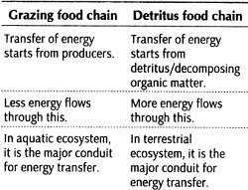
DIFFERENCE BETWEEN GFC & DFC :

Slide 5
ENERGY PYRAMID :
Ecological pyramid is the graphical representation of an ecological parameter (number, biomass, energy) sequence wise in various trophic levels of a food chain with producers at the base and herbivores in the middle and carnivores at the top tiers.
It can be upright, inverted, or spindle shaped.
Ecological pyramids are of 3 types:
  Pyramid of number.
  Pyramid of biomass.
  Pyramid of energy.

Slide 6
ENERGY PYRAMID :
(A)PYRAMIDS OF NUMBER- This employs the number of individuals per unit area at various trophic levels with
producer at base and various consumers at successively higher levels. It is generally upright.
A pyramid of number in case of a big tree is generally inverted because number of insects feeding on that tree generally exceeds in number.
(B)PYRAMIDS OF BIOMASS- This represent the biomass in various trophic levels. A pyramid of mass is upright except in aquatic food chain involving short lived plankton.
A pyramid of biomass in sea is generally inverted because biomass of fishes generally exceeds that of phytoplankton.
(C)PYRAMIDS OF ENERGY- that give s graphic representation of amount of energy trapped by different trophic levels per unit area.
Pyramid of energy is always upright, can never be inverted, because when energy flows from a particular trophic level to the next trophic level, some energy is always lost as heat at each step e.g in feeding, digestion, assimilation and respiration.

Slide 7
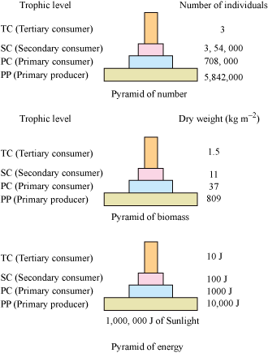
ENERGY PYRAMID :

Slide 8
THANKING YOU
ODM EDUCATIONAL GROUP

