Slide 1


POPULATION INTERACTION , PREDATION
SUBJECT : BIOLOGY
CHAPTER NUMBER: 13
CHAPTER NAME : ORGANISMS AND POPULATION

Slide 2
POPULATION INTERACTION :
LIFE HISTORY VARIATION :
Populations have evolved to maximise their reproductive fitness, also called Darwinian fitness (high r-value), in the habitat in which they live.
Some organisms breed only once in their lifetime (Pacific salmon fish, bamboo).
Some others breed many times during their lifetime (most birds and mammals).
Some produce a large number of small-sized offspring (Oysters, pelagic fishes).
Some others produce a small number of large-sized offspring (birds, mammals).
Ecologists suggest that life history traits of organisms have evolved in relation to the constraints imposed by the abiotic and biotic components of the habitat in which they live.

Slide 3
POPULATION INTERACTION :
In nature, animals, plants, and microbes do not and cannot live in isolation but interact in various ways to form a biological community.
These interactions may be:
Beneficial (represented by + sign).
Detrimental (represented by – sign).
Neutral (represented by 0 sign).
Inter-specific interactions are the interaction of populations of two different species.
The different types of interactions are predation, competition, parasitism, commensalism, mutalism.

Slide 4
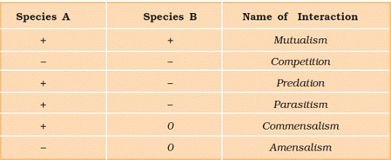
POPULATION INTERACTION :

Slide 5
PREDATION:
Predation:
It is an inter-specific interaction where species A (predator), kill and consumes another species B (Prey).
Roles of predators:
Transfer energy from plants to higher trophic levels (position of organism in food chain) so acts as ‘conduits’ for energy transfer across trophic levels.
Control Prey population – Prickly pear cactus- moth.
Biological control of Agricultural pest .
Maintain species diversity by reducing intensity of competition among competing prey species.
Over exploitation of prey by the predators results in extinction of prey and predator. Predators in nature are ‘prudent’.

Slide 6
PREDATION:
Examples:
Prickly pear cactus introduced into Australia in the early 1920’s caused havoc by spreading rapidly into millions of hectares of rangeland (Grassland, shrublands, woodlands, wetlands, and deserts that are grazed by domestic livestock or wild animals).
The invasive cactus was brought under control only after a cactus-feeding predator (a moth) from its natural habitat was introduced into the country.
Experiment to show predator-prey inter-relationship:
In the rocky intertidal communities of the American Pacific Coast, the starfish Pisaster is an important predator.
In an experiment, when all the starfish were removed, more than 10 species of invertebrates became extinct within a year, because of inter-specific competition.
If a predator is too efficient and overexploits its prey, then the prey might become extinct following it, the predator will also become extinct for lack of food.

Slide 7
PREDATION:
Adaptations developed by the prey:
Some species of insects and frogs are cryptically-coloured (camouflaged) to avoid being detected easily by the predator.
The Monarch butterfly is highly distasteful to its predator (bird) because of a special chemical present in its body.
Nearly 25 percent of all insects are known to phyto-phagous feeding on plant sap and other parts of plants.
Presence of thorns in certain plant species (Acacia, Cactus).
Production and storage of toxic chemicals by plants.
Calotropis produces highly poisonous cardiac glycoside.
Nicotine, caffeine, quinine, strychnine, opium, etc., are produced by various plants.

Slide 8
THANKING YOU
ODM EDUCATIONAL GROUP

