Slide 1


COMMENSALISM,MUTUALISM
SUBJECT : BIOLOGY
CHAPTER NUMBER: 13
CHAPTER NAME : ORGANISMA AND POPULATION

Slide 2
COMMENSALISM:
In this kind of interaction one species benefits and the other is neither harmed nor benefited.
Example:
An orchid growing as an epiphyte on a mango branch.
Barnacles growing on the back of a whale.
The cattle egret and grazing cattle.
The cattle egrets are benefitted by the cattle to detect insects because cattle stir up the bushes and insects gets flushed out from the vegetation, to be detected by the cattle egrets.
The Clownfish and Sea Anemone :
The fish gets protection from predators which stay away from the stinging tentacles of the Sea Anemone.
In the above examples, the mango tree, whale, cattle and Sea anemone – neither of them derives any benefit by hosting other organisms, nor do they get any harm.

Slide 3
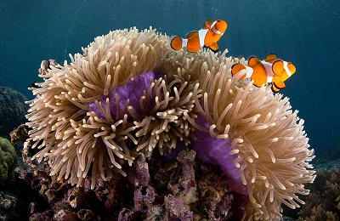
FIGURE SHOWING COMMENSALISM BETWEEN CLOWN FISH & SEA ANEMONE:

Slide 4
MUTUALISM:
In this kind of interaction both the interacting species derive benefits from each other.
Mediterranean orchid- sexual deceit for pollination- appears as female bee
Examples:
  Lichens: An Intimate mutualistic relationship between a fungus and photosynthesizing algae or cyanobacteria.
  Mycorrhizae: Associations between fungi and the roots of higher plants.
  Fungi help the plant in the absorption of essential nutrients from the soil.
  The plant provides the fungi with energy-yielding carbohydrates.

Slide 5
MUTUALISM:
  Pollination:
  Plants need the help of animals for pollinating their flowers and dispersing their seeds.
  Animals obviously have to be paid ‘fees’ for the services that plants expect from them.
  Plants offer rewards in the form of pollen and nectar for pollinators and juicy and nutritious fruits for seed dispersers.
  But the mutually beneficial system should also be safeguard against ‘cheaters’, for example, animals that try to steal nectar without aiding in pollination.

Slide 6
MUTUALISM:
Co-Evolution of Mutualism :
  In many species of Fig trees, there is a tight one-to-one relationship with the pollinator species of wasp.
  Fig species can be pollinated only by its ‘partner’ wasp species and no other species.
  The female wasp uses the fruit not only as an ovipositor (egg-laying) site but uses the developing seeds within the fruit for nourishing its larvae.
  The wasp pollinates the fig inflorescence while searching for suitable egg-laying sites.

Slide 7
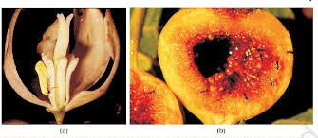
FIGURE SHOWING MUTUALISM BETWEEN FIG & WASP :

Slide 8
MUTUALISM:
  Pseudo-copulation: (Co-evolution):
  The Mediterranean orchid Ophrys employs ‘sexual deceit’ to get pollination done by a species of bee.
  One petal of its flower bears an uncanny resemblance to the female of the bee in size, colour, and markings.
  The male bee is attracted to what it perceives as a female, ‘pseudo-copulates’ with the flower, and during that process is dusted with pollen from the flower.
  When this same bee pseudo-copulate with another flower, it transfers the pollen to it and thus pollinates the flower.
  If the female bee’s colour patterns change even slightly for any reason during evolution, pollination success will be reduced unless the orchid flower co-evolves to maintain the resemblance of its petal to the female bee.

Slide 9
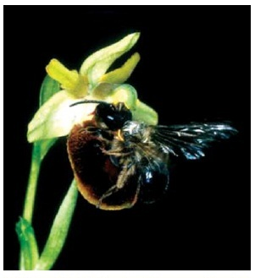
FIGURE SHOWING MUTUALISM BETWEEN ORCHID & BEE :

Slide 10
THANKING YOU
ODM EDUCATIONAL GROUP

