Slide 1
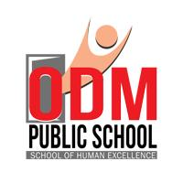

GENETICALLY MODIFIED INSULIN
SUBJECT : BIOLOGY
CHAPTER NUMBER: 12
CHAPTER NAME : BIOTECHNOLOGY AND ITS APPLICATIONS

Slide 2
BIOTECHNOLOGICAL APPLICATIONS IN MEDICINE :
The rDNA technological processes have made immense impact in the area of healthcare by enabling mass production of safe and more effective therapeutic drugs.
At present, about 30 recombinant therapeutics have been approved for human use the world over.
Further, the recombinant therapeutics do not induce unwanted immunological responses as is common in case of similar products isolated from non-human sources.
In India, 12 of these are presently being marketed.

Slide 3
GENETICALLY ENGINEERED INSULIN :
Adult –onset diabetes can be controlled by taking insulin at regular intervals.
Insulin is in great demand due to increase in number of patients with adult onset diabetes.
Insulin extracted from animal source (example, slaughtered cattle and pigs) induce allergy in humans.
Now a day’s insulin can be obtained from bacterium using techniques of biotechnology .
From human source the insulin gene is isolated , hence no more it is treated as a foreign protein, in humans,.
An American company, Eli Lilly in 1983 prepared human insulin called as humulin.

Slide 4
GENETICALLY ENGINEERED INSULIN :
Insulin is synthesized as a pro-hormone, which contains an extra stretch called C peptide, which is absent in mature insulin.
The main challenge for production of insulin using rDNA technique was getting insulin assembled into a mature form
Insulin as a pro-hormone consists of 3 peptide chains − A, B, and C.
removal of C -peptide
Pro-hormone insulin Mature insulin.
Mature insulin consists of only two peptide chains − A and B. Both these chains were separately isolated and introduced in plasmids of E. coli to produce insulin chains.
Separately produced chains A and B were extracted and combined by creating a disulphide bond to form mature human insulin.

Slide 5
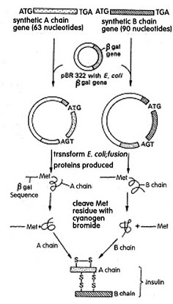
SCHEME SHOWING PREPARATION OF HUMULIN:

Slide 6
THANKING YOU
ODM EDUCATIONAL GROUP

