Slide 1


PEST RESISTANCE PLANTS
RNAi
SUBJECT : BIOLOGY
CHAPTER NUMBER: 12
CHAPTER NAME : BIOTECHNOLOGY AND ITS APPLICATIONS

Slide 2
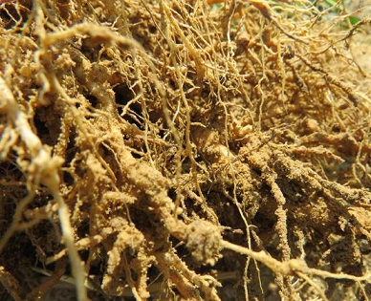
PEST RESISTANCE PLANTS:
Several nematodes parasitize a wide variety of plants and animals including human beings.
A nematode Meloidegyne incognitia infects the roots of tobacco plants and causes a great reduction in yield.
RNAi is a method adopted to prevent infestation of roots of tobacco plants by a nematode Meloidegyne incognitia.

Slide 3
RNA INTERFERENCE :
RNA i
In RNAi, a complementary RNA binds to mRNA to form a dsRNA, which cannot translate and hence, its expression is blocked (Silencing).
The source of complementary dsRNA may be from an infection by viruses having RNA genomes or mobile genetic elements that replicate through RNA intermediate.
Nematode specific genes were introduced into host plant using Agrobacterium vectors.
The parasite could not survive in a transgenic host expressing specific interfering RNA.
RNAi exists naturally in eukaryotes as a method of cellular defence.

Slide 4
RNA i :
Nematode specific genes (DNA) were introduced in the host plant.
Using Agrobacterium vectors, nematode -specific genes were introduced into the host plant .
The introduced DNA forms both sense and anti-sense RNA.
Two strands being complementary to each other bend and form dsRNA, leading to RNAi.
Nematode specific mRNA due to complementary dsRNA molecules that bind to and prevents translation of
them RNA.
mRNA of nematode is silenced and the parasite cannot survive in the transgenic host.
The consequence was that the parasite could not survive in a transgenic host expressing specific interfering RNA The transgenic plant therefore got itself protected from the parasite

Slide 5
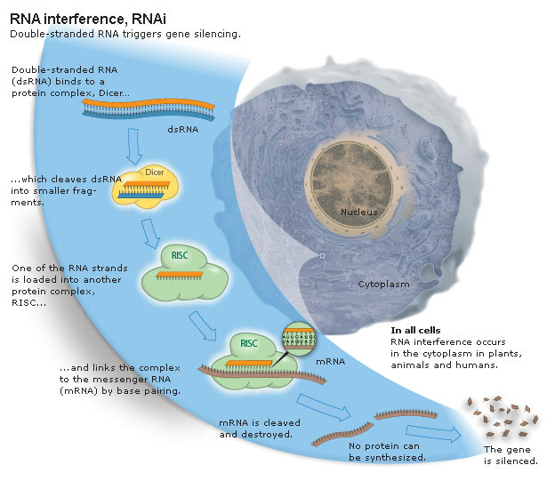
SCHEME SHOWING RNA INTERFERENCE :

Slide 6
THANKING YOU
ODM EDUCATIONAL GROUP

