Slide 1


ISOLATION OF GENETIC MATERIAL & PCR
SUBJECT : BIOLOGY
CHAPTER NUMBER: 11
CHAPTER NAME : BIOTECHNOLOGY : PRINCIPLE AND PROCESSES

Slide 2
ISOLATION OF DNA :
Recombinant DNA technology involves several steps in specific sequence-
Isolation of DNA.
Fragmentation of DNA by restriction endonucleases .
Isolation of a desired DNA fragment.
Ligation of the DNA fragment into vector.
Transforming the recombinant DNA into the host.
Culturing the host cells in a medium at large scale.
Extraction of the desired product.

Slide 3
ISOLATION OF DNA :
For the processes of RDT, DNA must be available in its pure form.
First of all, cells are treated with specific chemicals to break open the cell to release cellular components such as DNA, RNA, proteins, etc.
Genetic material is isolated from other macromolecules by using enzymes such as lysozyme (bacteria), cellulase (plant cells), chitinase (fungus).
Contaminants such as RNA and proteins are digested with the help of ribonucleases and proteases respectively.
Addition of chilled ethanol ultimately precipitates out the purified DNA, which can be seen as collection of fine threads in the suspension.
DNA that separate out can be removed by spooling.

Slide 4
POLYMERASE CHAIN REACTION:
Amplification of Gene of Interest using PCR( Polymerase Chain Reaction) to get multiple copies of the DNA or gene of interest in vitro by using set of primers and enzyme DNA polymerase.
Two sets of primers (chemically synthesised oligonucleotide stretches that are complementary to a region of DNA), enzyme DNA polymerase,and deoxynucleotides are added.
Each PCR cycle has three steps:
Denaturation
Primer annealing
Extension of primers

Slide 5
POLYMERASE CHAIN REACTION:
Denaturation − Double helical DNA is denatured by providing high temperature. Near about in 94⁰ c temperature the target DNA was heated. It separates the two strands and each act like template.
Annealing – the oligonucleotide primers anneal or hybridize to each single stranded DNA at 3’OH end. This step is performed at lower temperature.
Extension – DNA polymerase does not get degraded in such high temperatures (72⁰c) since the DNA polymerase used in this reaction is thermostable as it is isolated from thermophilic bacteria, Thermus aquaticus (Taq). The enzyme is Taq polymerase along with deoxyribonucleotides synthesizes new DNA strand complementary to template .
Replication of DNA occurs in vitro.
This cycle is repeated several times to generate up to 1 billion identical copies of the DNA.

Slide 6
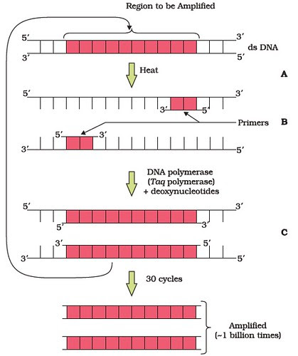
PCR :

Slide 7
THANKING YOU
ODM EDUCATIONAL GROUP

