Slide 1


STAGES OF r-DNA TECHNOLOGY
STEPS IN r-DNA TECHNOLOGY,ACTION OF RESTRICTION ENZYME
SUBJECT : BIOLOGY
CHAPTER NUMBER: 11
CHAPTER NAME : BIOTECHNOLOGY : PRINCIPLE AND PROCESSES

Slide 2
STEPS INVOLVED ON r-DNA TECHNOLOGY :
Recombinant DNA technology” or also called “Genetic Engineering” deals about, the production of new combinations of genetic material (artificially) in the laboratory.
These “recombinant DNA” (rDNA) molecules are then introduced into host cells, where they can be propagated and multiplied.
Steps of Recombinant DNA Technology -
I. Identification of DNA with desirable genes.
II. Introduction of the identified DNA into the host.
III. Maintenance of introduced DNA in the host and transfer of the DNA to its progeny.

Slide 3



STEPS INVOLVED ON r-DNA TECHNOLOGY :
ACTION OF ECORI :
Recognition sequences are pallindromic- Pallindromes are the sequence of base pairs that read same both backwards and forwards (i.e., same and direction).
Example:
Restriction enzymes cut a little away from the centre of pallindrome site, but between the same two bases on the opposite strands.
As a result, overhangs (called sticky ends) are generated on each strand.
Sticky ends form hydrogen bonds with their complementary counterparts
with help of DNA ligases.

Slide 4
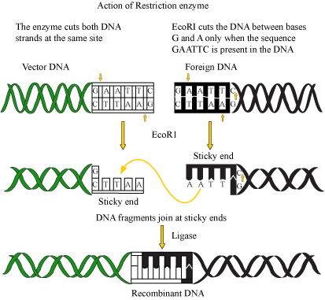
ACTION OF ECORI :

Slide 5
STEPS INVOLVED IN r-DNA TECHNOLOGY :
The foreign or desired DNA is identified as per the requirement upon the genome .
Restriction enzyme cuts the desired DNA at specific site .
The same enzyme cuts the vector DNA .
The sticky ends of both vector and foreign DNA join by ligase enzymes .
The constructed DNA is known as recombinant DNA .
The construct then is transferred into host cell by transformation which allows multiplication of r-DNA .
This allows formation of multiple copies of foreign gene.

Slide 6
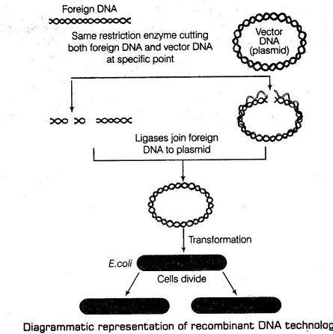
DIAGRAM OF r-DNA TECHNOLOGY :

Slide 7
THANKING YOU
ODM EDUCATIONAL GROUP

