Slide 1


GEL ELECTROPHORESIS, CLONING VECTORS
SUBJECT : BIOLOGY
CHAPTER NUMBER: 11
CHAPTER NAME : BIOTECHNOLOGY : PRINCIPLE AND PROCESSES

Slide 2
GEL ELECTROPHORESIS :
The fragments obtained after cutting with restriction enzymes are separated by using gel electrophoresis.
Electric field is applied to the electrophoresis matrix (commonly agarose gel) and negatively charged DNA fragments move towards the anode.
Fragments separate according to their size by the sieving properties of agarose gel. Smaller the fragment, farther it moves.
Staining dyes such as ethidium bromide followed by exposure to UV radiations are used to visualize the DNA fragments. DNA fragments are visible as bright orange coloured bands in the agarose matrix.
Separated bands of DNA are separated from agarose gel and extracted from gel, called elution .
The DNA fragment purified this way is used in r – DNA technology.

Slide 3
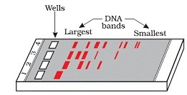
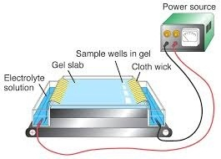
FIGURE SHOWING GEL ELECTROPHORESIS :

Slide 4
CLONING VECTORS:
Plasmids and bacteriophages have the ability to replicate within bacterial cells independent of the control of chromosomal DNA.
Plasmids and bacteriophages are commonly used as cloning vectors.
Bacteriophages − Have high copy number (of genome) within the bacterial cell .
Plasmids − May have 1 − 2 copy number to 15 − 100 copy number per cell .
If foreign DNA is linked to these vectors, then it is multiplied to the number equal to the copy number of vector.
Features present in the vector itself help in the easy isolation of recombinants from the non-recombinants.

Slide 5
CLONING VECTORS:
FEATURES :
Following features are required to facilitate cloning into a vector-
Origin of replication (ori) – The sequence from where replication starts and any piece of DNA when linked to this sequence can be made to replicate within the host cells.
This sequence is responsible for controlling the copy number of the linked DNA.
Selectable marker- Help in the identifying and eliminating non transformants and selectively permitting the growth of the transformants.
Transformation is a procedure through which a piece of DNA is introduced in a host bacterium.
Generally, the genes encoding resistance to antibiotics such as ampicillin, chloramphenicol, tetracycline or kanamycin, etc., are considered useful selectable markers for E. coli.
E. coli cloning vector pBR322 antibiotic resistance genes (amp^{R} and tet^{R} )

Slide 6
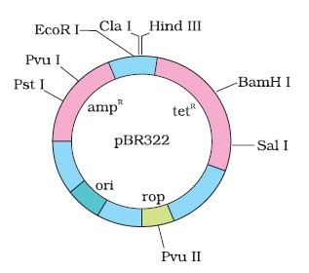
FIGURE SHOWING PLASMID AS A CLONING VECTORS :
pBR322 :

Slide 7
CLONING VECTORS:
Cloning sites- To link the foreign DNA, the vector need to have single recognition sites for the commonly used restriction enzymes as presence of more than one recognition sites within the vector will generate several fragments, which will complicate the gene cloning.
E.g.- E. coli cloning vector pBR322 showing restriction sites Hind III, EcoR I, BamH I, Sal I, Pvu II, Pst I, Cla I
  These are the sites where restriction enzymes cut the DNA.
  Cloning process becomes completed when more than one recognition sites (MCS – Multiple cloning site ) are present.
  Therefore, ligation is carried out only at the restriction sites present on the antibiotic resistance genes.
Rop - rop codes for the proteins involved in the replication of the plasmid.

Slide 8
THANKING YOU
ODM EDUCATIONAL GROUP

