Slide 1


ENTREPRENEURIAL OPPORTUNITIES
BUSINESS OPPORTUNITIES
SUBJECT : (ENTREPRENEURSHIP)
CHAPTER NUMBER:1
CHAPTER NAME : ENTREPRENEURIAL OPPORTUNITIES

Slide 2
LEARNING OUTCOMES
Understand the concepts and elements of business opportunity
Understand the process involved in sensing opportunity.
They will be able to analyse various factors responsible for sensing the opportunities.

Slide 3
ENTREPRENEUR, ENTREPRENEURSHIP, ENTERPRISE
ENTREPRENEUR ENTREPRENEURSHIP ENTERPRISE
PERSON PROCESS OR ACTION OUTCOME

Slide 4
BUSINESS OPPORTUNITY
It is an economic idea which can be implemented to create an enterprise and earn profits.
ELEMENTS OF BUSINESS OPPORTUNITY
Assured market scope
Attractive rate of return
Practicability of the idea
Competency to encash it
Future growth

Slide 5
STAGES OF ENTERPRISE BUILDING PROCESS
Spotting an opportunity by analyzing the needs and problems of the society.
Evaluating the ideas received from different sources to find a creative solution.
Identifying a product or service through innovation.
Setting up a project and nurturing it to success.

Slide 6
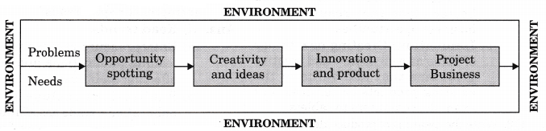

Slide 7
PERCEIVING AND SENSING OPPORTUNITIES
Synthesizing the available information.
Analyze emerging patterns that escapes from the attention of other people.

Slide 8
FACTORS INVOLVED IN SENSING OPPORTUNITIES
Ability to perceive and preserve basic ideas
Factors involved
Ability to harness different sources of information
Vision and creativity

Slide 9
Ability to perceive and preserve (basic idea)
Problem
Change
Invention
Competition
Innovation

Slide 10
ASSIGNMENT
What is a business opportunity?
What are the factors involved in the process of sensing entrepreneurial opportunity?
State the different stages of an ‘enterprise process’ with diagram.
Discuss the elements of business opportunity?

Slide 11
THANKING YOU
ODM EDUCATIONAL GROUP

Slide 12
ENTREPRENEURIAL OPPORTUNITIES
ENVIRONMENT SCANNING
SUBJECT : (ENTREPRENEURSHIP)
CHAPTER NUMBER:1
CHAPTER NAME : ENTREPRENEURIAL OPPORTUNITIES

Slide 13
LEARNING OUTCOMES
Give the meaning of environment scanning.
To understand the need to scan the environment.

Slide 14
ENVIRONMENT SCANNING
Environment scanning means careful monitoring of an organization’s internal and external environment for detecting early signs of opportunities and threats that may influence its current and future plan.
‘If you don’t adapt, you don’t endure.
IMPORTANCE :
Identification of opportunities to get first movers advantage.
Formulation of strategies and policies.
Tapping useful resources.
Better performance.
Sensitization of entrepreneurs to cope up with rapid changes.
Image building

Slide 15
ENVIRONMENT ANALYSIS
The process of monitoring the economic and non- economic environment ,to determine the opportunities and threats to an organization.
This analysis involves:
Data collection
Information processing
Forecasting to provide developing goals
Strategies for business survival.

Slide 16
SOURCES OF INFORMATION
Verbal information from customers, wholesalers, retailers, distributors, etc.
Records of companies.
Government publications.
Publications by financial institution
Formal studies conducted by strategic planners.

Slide 17
ASSIGNMENT
What is the purpose to scan the environment?
‘Sensitivity to environmental factors is essential for an entrepreneur’. In the light of this statement explain the importance of environment scanning.
State the different sources of information?

Slide 18
THANKING YOU
ODM EDUCATIONAL GROUP

Slide 19
ENTREPRENEURIAL OPPORTUNITIES
SWOT ANALYSIS, ENVIRONMENTAL FACTOR
SUBJECT : (ENTREPRENEURSHIP)
CHAPTER NUMBER:1
CHAPTER NAME : ENTREPRENEURIAL OPPORTUNITIES

Slide 20
LEARNING OUTCOMES
Enlist the various factors affecting the business environment.
Understand the need for SWOT analysis.

Slide 21
SWOT ANALYSIS
S _ Strength
W _ Weakness
O _ Opportunities
T _ Threat
SWOT analysis helps an entrepreneur to decide on a particular opportunity keeping in view his strengths and weaknesses (internal analysis) and the opportunities and threats (external analysis) in the market.

Slide 22
ENVIRONMENTAL FACTORS
These factors refers to the various forces within which various small, medium and large enterprises operate.
Business environment is classified into two parts:
Internal environment:
External environment

Slide 23
MICRO ENVIRONMENT
It includes the specific elements:
Suppliers
Customers
Intermediaries
Competitors
General public

Slide 24
ASSIGNMENT
What is environmental factor? State the classification of business environment.
What is micro environment?
Explain the elements of micro environment factors.

Slide 25
THANKING YOU
ODM EDUCATIONAL GROUP

Slide 26
ENTREPRENEURIAL OPPORTUNITIES
PROBLEM IDENTIFICATION, IDEA GENERATION
SUBJECT : (ENTREPRENEURSHIP)
CHAPTER NUMBER:1
CHAPTER NAME : ENTREPRENEURIAL OPPORTUNITIES

Slide 27
LEARNING OUTCOMES
Enlist the various macro-environmental factors affecting the business environment.
Understand problem identification
Meaning of idea generation.

Slide 28
MACRO ENVIRONMENT
These are the factors which affect the industry as a whole.
The following are some PESTEL factors:
Political
Economic
Social/ cultural
Technological
Ecological
Legal

Slide 29
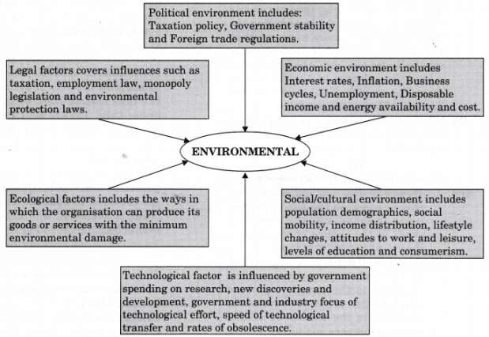

Slide 30
PROBLEM IDENTIFICATION
Road block - that needs a solution.
OBJECTIVES
Clearly state the problem
Identify the target group
Acceptability of the solution.

Slide 31
USES OF PROBLEM IDENTIFICATION
New product
Understanding the market needs and problem.
Creative.
Employment generation
National income.

Slide 32
IDEA GENERATION
Process of creating, developing and communicating ideas which are abstract, concrete or visual.
Business ideas are an outcome of:
Careful analysis of market trends.
Careful analysis of consumer needs.
Discovery through accident
Exploring the ways of getting ideas.

Slide 33
ASSIGNMENT
What is PESTEL model? Explain it.
State the objectives of problem identification.
What is idea generation?

Slide 34
THANKING YOU
ODM EDUCATIONAL GROUP

Slide 35
ENTREPRENEURIAL OPPORTUNITIES
IDEA FIELDS
SUBJECT : (ENTREPRENEURSHIP)
CHAPTER NUMBER:1
CHAPTER NAME : ENTREPRENEURIAL OPPORTUNITIES

Slide 36
LEARNING OUTCOMES
Understand the different fields of ideas.
Enlist the various sources of idea fields.

Slide 37
IDEA FIELDS
Convenient frames of reference for streamlining the process of generation of ideas.
The process of generation of ideas can be streamlined by developing an awareness for different idea fields.
Helps in enlarging the scope of thinking and also gives the entrepreneur with the benefit of structuring ideas based on convenient frames of reference.

Slide 38
SOURCES OF IDEA FIELDS
Natural resources – agriculture, horticulture, forest, animal husbandry etc.
Existing product or service.
Market or Demand driven ideas.
Trading related ideas.
Service sector related ideas.
Creative efforts.

Slide 39
ASSIGNMENT
What is idea fields?
State the different sources of idea fields with examples.

Slide 40
THANKING YOU
ODM EDUCATIONAL GROUP

Slide 41
ENTREPRENEURIAL OPPORTUNITIES
PRODUCT IDENTIFICATION, MARKET ASSESSMENT
SUBJECT : (ENTREPRENEURSHIP)
CHAPTER NUMBER:1
CHAPTER NAME : ENTREPRENEURIAL OPPORTUNITIES

Slide 42
LEARNING OUTCOMES
To understand the idea and opportunity assessment.
To understand the concept of market assessment.

Slide 43
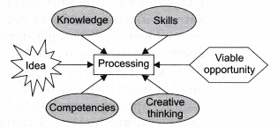
PRODUCT IDENTIFICATION
An idea should lead to An idea should lead to a definite product.

Slide 44
IDEA AND OPPORTUNITY ASSESSMENT
Product identification
Application and use
Level of operation
Cost
Competition
Technical complexity
Annual turnover and profit margin.

Slide 45
MARKET ASSESSMENT
Demand
Supply and nature of competition
Cost and price of product
Project innovation and change

Slide 46
ASSIGNMENT
What are the factors an entrepreneur has to keep in mind while assessing the market?
Outline the process of investigation of ideas for its opportunity assessment.

Slide 47
THANKING YOU
ODM EDUCATIONAL GROUP

Slide 48
ENTREPRENEURIAL OPPORTUNITIES
TREND SPOTTING, CREATIVITY
SUBJECT : (ENTREPRENEURSHIP)
CHAPTER NUMBER:1
CHAPTER NAME : ENTREPRENEURIAL OPPORTUNITIES

Slide 49
LEARNING OUTCOMES
Identify the different ways of spotting trends.
To understand the process of creativity.

Slide 50
TREND SPOTTING
Means identification of new trends.
This is of great help for the entrepreneur as it will help to come out with the products which are according to the trends of the market.
Ways of trend spotting
Read trends
Talk trends
Watch trends
Think trends

Slide 51

CREATIVITY
It is the first stage in the process of innovation which leads to discovery of opportunity and new venture creation.
CREATIVITY PROCESS

Slide 52
ASSIGNMENT
What is the meaning of trend spotting?
What are the different ways in which trends can be spotted by an entrepreneur?
Explain creative process.

Slide 53
THANKING YOU
ODM EDUCATIONAL GROUP

Slide 54
ENTREPRENEURIAL OPPORTUNITIES
INNOVATION
SUBJECT : (ENTREPRENEURSHIP)
CHAPTER NUMBER:1
CHAPTER NAME : ENTREPRENEURIAL OPPORTUNITIES

Slide 55
LEARNING OUTCOMES
Understand the concept of innovation.
Differentiate between the process of creativity and innovation.

Slide 56
INNOVATION
It is a process of entrepreneurship which involves the translation of a useful idea into an application which has a commercial value.
Innovation is required to work out analytically the details of the enterprise, to develop marketing strategies, to organize finance and strategies operations.
ELEMENTS OF INNOVATION PROCESS.
Analytical planning involves:
Identifying the product or service features.
Design
Resources.

Slide 57
ELEMENTS OF INNOVATION PROCESS
Resource organization involves:
Human resources
Material resources
Technology
Capital resources
Implementation involves:
Applying resources
Delivering results
Commercial application involves:
Provision of value to customers
Reward employees
Satisfy stakeholders

Slide 58
SELECTING THE RIGHT OPPORTUNITY
The entrepreneur should look into various factors deciding upon the opportunity.
Even if the opportunity looks promising, an entrepreneur should look into the environmental factors before choosing the best opportunity.

Slide 59
ASSIGNMENT
what is innovation?
State the elements of innovation process.

Slide 60
THANKING YOU
ODM EDUCATIONAL GROUP

