Slide 1


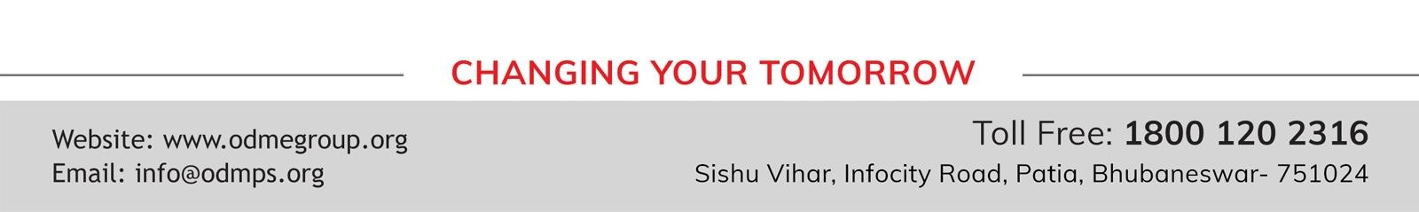
STD-IX
SUBJECT- LITERATURE CHAPTER - 4
TOPIC- A TRULY BEAUTIFUL MIND PERIOD-1

Slide 2











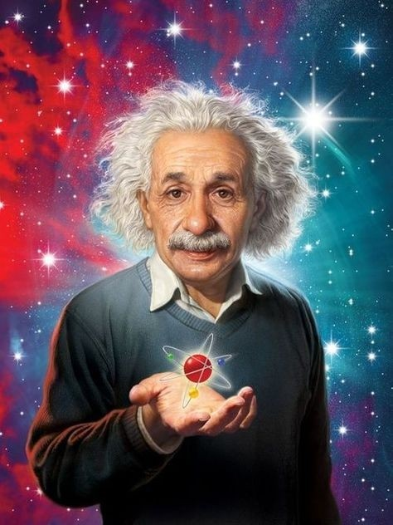





Slide 3
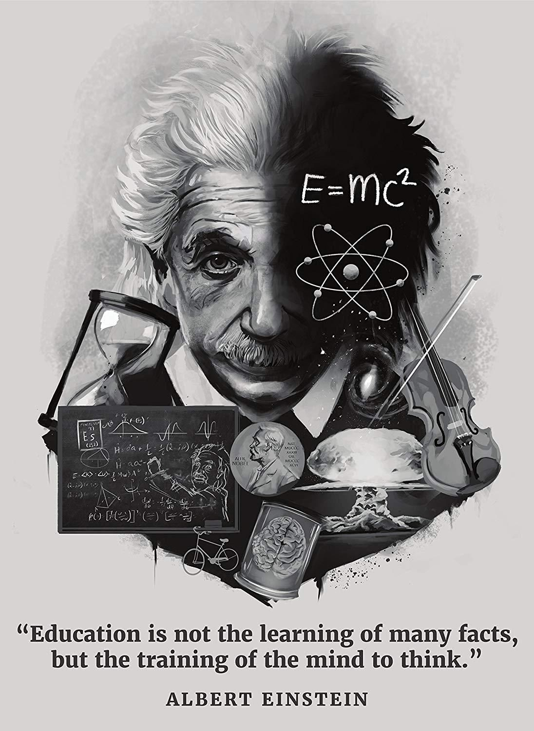
EXPECTED LEARNING OUTCOMES:
GENERAL OBJECTIVES
Understanding the concept
Being acquainted with prose and author’s biography
Understanding the idea
Appreciate the language of the prose
Developing LSRW Skills
SPECIFIC OBJECTIVES/ EXTENDED OBJECTIVES
Understanding the concept
Being acquainted with prose and author’s biography
Understanding the idea
Appreciate the language of the prose
Developing LSRW Skills

Slide 4
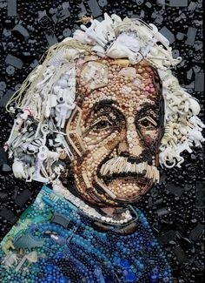
THEME OF THE STORY:
A Truly Beautiful Mind is a summary of the biography of famous scientist Albert Einstein.
The story portrays the other side of his life that he concerns and promote human welfare.
That is the reason why the title of the story is ‘A Truly Beautiful Mind’.

Slide 5
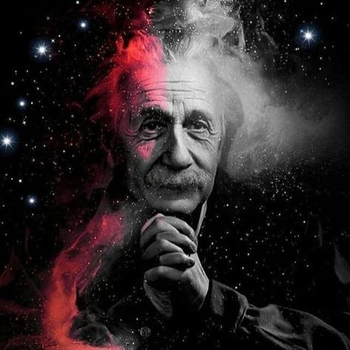
THE TITLE
‘A Truly Beautiful Mind’ makes one wonder how can a scientist’s mind be beautiful.
It is so because in this lesson we come across another aspect of Einstein. He was a humanitarian.
He advocated world peace, non - violence and that is why the title refers to him as a truly beautiful mind.

Slide 6

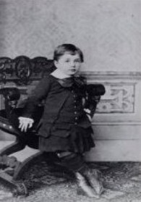
Albert Einstein was born on 14th March 1879. He was born in a city named Ulm in Germany.
Albert’s mother thought that Albert was a freak because he did not behave, talk or look like normal people did.
He was different from other children of his age. He behaved abnormally.
It seemed as if he had lesser intelligence in comparison to other children.

Slide 7
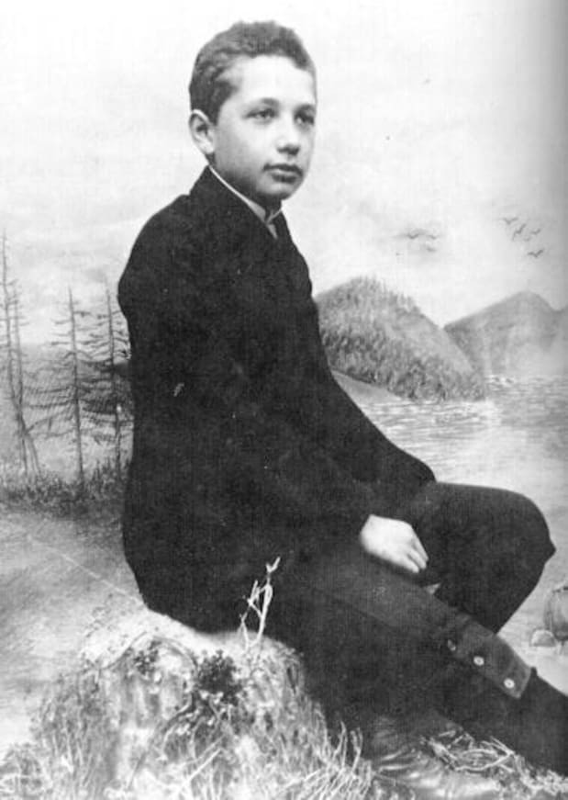
BROTHER BORING
Finally, when Einstein started speaking, he used to repeat the words.
His playmates used to call him ‘brother boring’ because he remained to himself, he did not play or talk to them.
Einstein remained to himself all the time. He used to play with himself only with mechanial toys

Slide 8
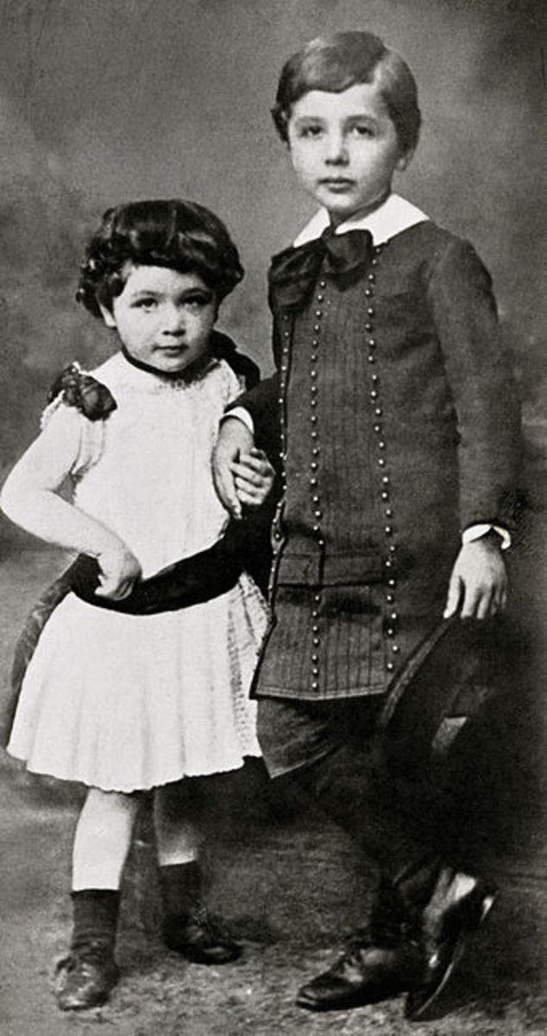
WHERE ARE HER WHEELS?
When his sister was born, and he looked at her, he could not see her feet.
He was wondering where the baby’s wheels were, that means the feet of the baby.
As Albert Einstein used to play with toys and all the toys had a set of wheels, to him Maja seemed to be a toy too and so, he might have thought that where were her wheels.

Slide 9
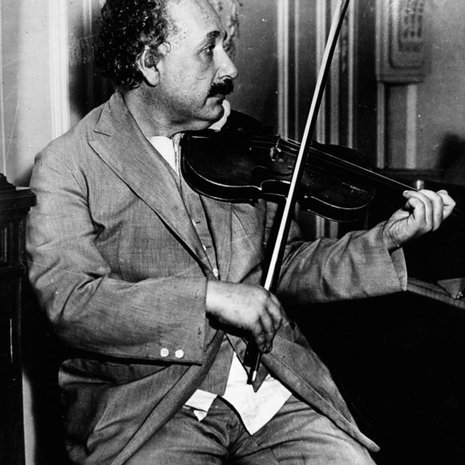
AN AMATEUR VIOLINIST
The headmaster of Einstein’s school told Einstein’s father that Einstein would never be successful in whatever profession he chose.
Einstein was a very good violinist, he learned playing the violin at the age of six because his mother wanted him to learn to play it.
All his life, he was an amateur violinist, he played the violin as a hobby not as a profession.

Slide 10
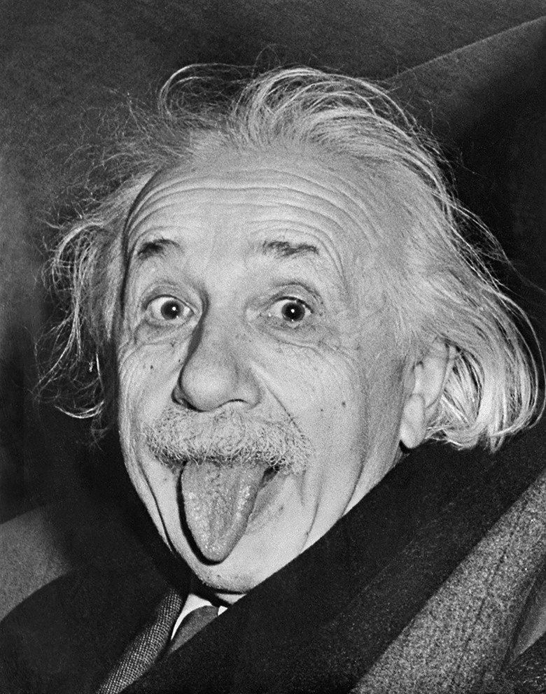
LEFT SCHOOL
Albert Einstein was a very good student. He went to a school in Munich because his family had moved from Ulm to Munich when he was 15 months old and scored good marks in almost every subject.
Einstein hated the school’s regimentation, and often clashed with his teachers.
Einstein was so suffocated in that school, he could not follow the strict discipline and so he left the school for ever.

Slide 11
VOCABULARY
Stifled: unable to breathe; suffocated
Left the school for good: left school forever.
regimentation: order or discipline taken to an extreme
pupil: student
amateur: doing something for personal enjoyment rather than as a profession, something which is your hobby and you do it as a pastime.
Uttered: spoke
destined: fate, a predetermined set of events that has to happen in the future.
HOMEWORK
Find out 5 synonyms and antonyms from the chapter and practice vocabulary

Slide 12
THANKING YOU
ODM EDUCATIONAL GROUP

