Slide 1

READING AND BLENDING
PHONICS
SUBJECT : (ENGLISH)
UNIT-5
CHAPTER NAME : ‘ar’ SOUND WORDS

Slide 2
LISTEN & REPEAT THE WORDS
CAR
JAR
PARK
FARM
CART
CARD
BARK
‘AR’ SOUND
WORDS

Slide 3

C A R

Slide 4
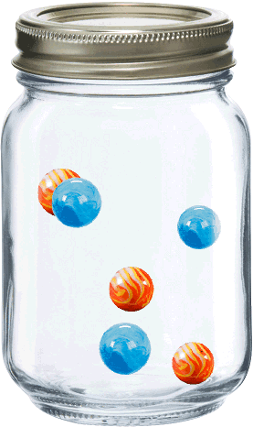
J A R

Slide 5

P A R K

Slide 6
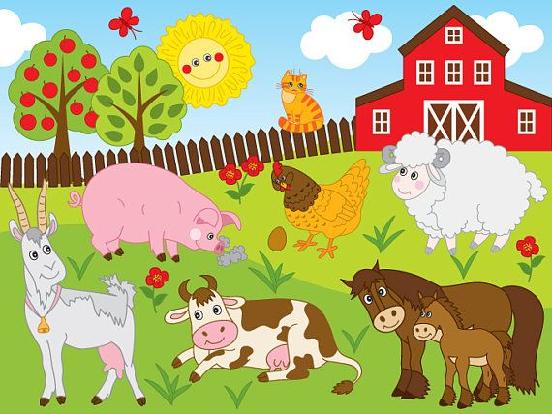
F A R M

Slide 7
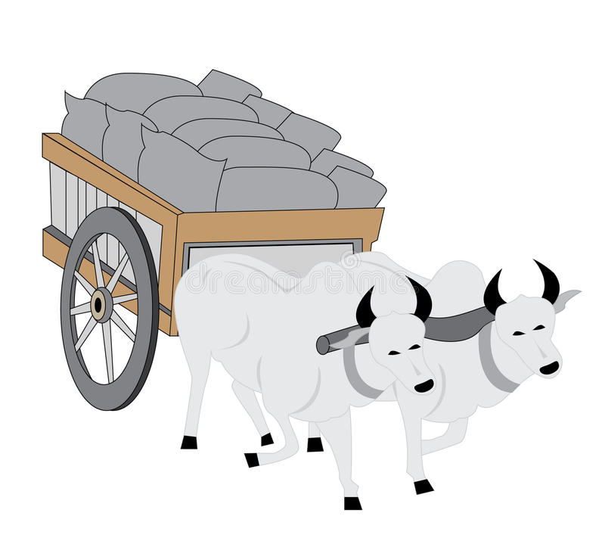
C A R T

Slide 8

C A R D

Slide 9

B A R K

Slide 10
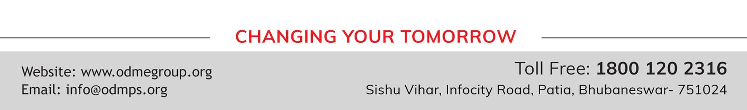
THANKING YOU
ODM EDUCATIONAL GROUP

