Slide 1

WELCOME YOU ALL TO THE ONLINE CLASS
SUBJECT :- MATHS
CHAPTER : COMPARISION

Slide 2
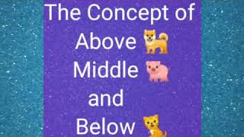


Slide 3


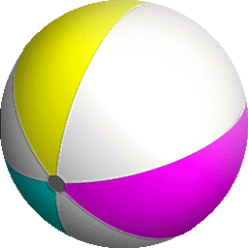


Slide 4




Slide 5


Slide 6



Slide 7

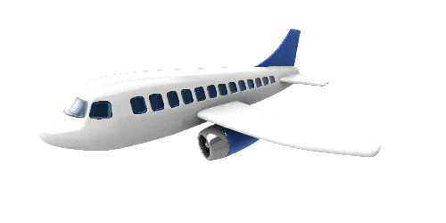


Slide 8
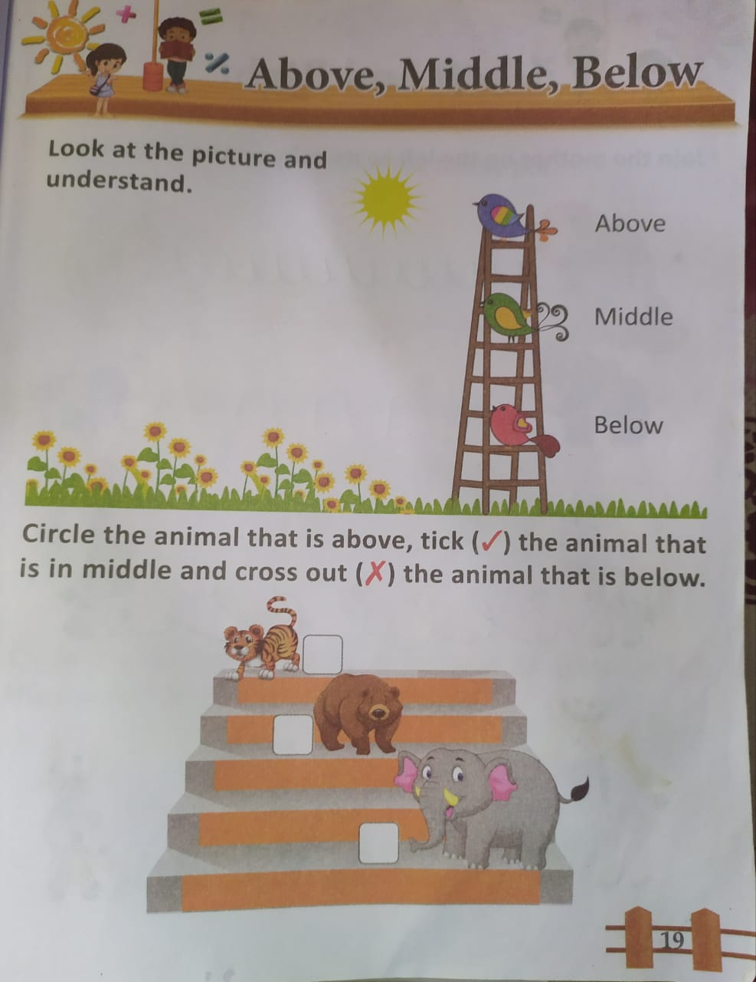


Slide 9
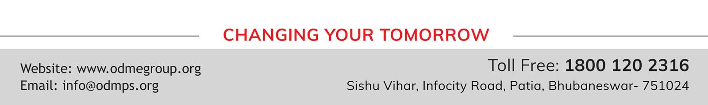
THANKING YOU
ODM EDUCATIONAL GROUP

