Slide 1


TEST AND MEASUREMENT IN SPORTS
SUBJECT : (PHYSICAL EDUCATION)
CHAPTER NUMBER: 6
CHAPTER NAME : TEST AND MEASUREMENT IN SPORTS

Slide 2
LEARNING OBJECTIVES
Motor Fitness Test-
50 M Standing Start
600 M Run/Walk
Sit & Reach
Partial Curl Up
Push Ups (boys)
Modified Push Ups(girls)
Standing Broad Jump
Agility- 4 X 10 M Shuttle Run
General Motor Fitness Test - [ Standing Board Jump, Zig Zag Running, Medicine Ball Throw]
Measurement of Cardiovascular Fitness Test -[Harvard Step Test, Rockford One Mile Test]
Rikli & Jones : Senior Citizen Fitness Test –
Chair Stand Test: To Measure Lower Body Strength
Arm Curl test: To Measure Upper Body Strength
Chair Sit & Reach Test: To Measure Lower Body Flexibility
Back Scratch Test: To Measure Upper Body Flexibility
Eight Foot Up & Go Test: To Measure Coordination and Agility
Six Minute Walk Test: To Measure Functional Fitness

Slide 3
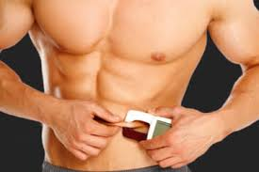
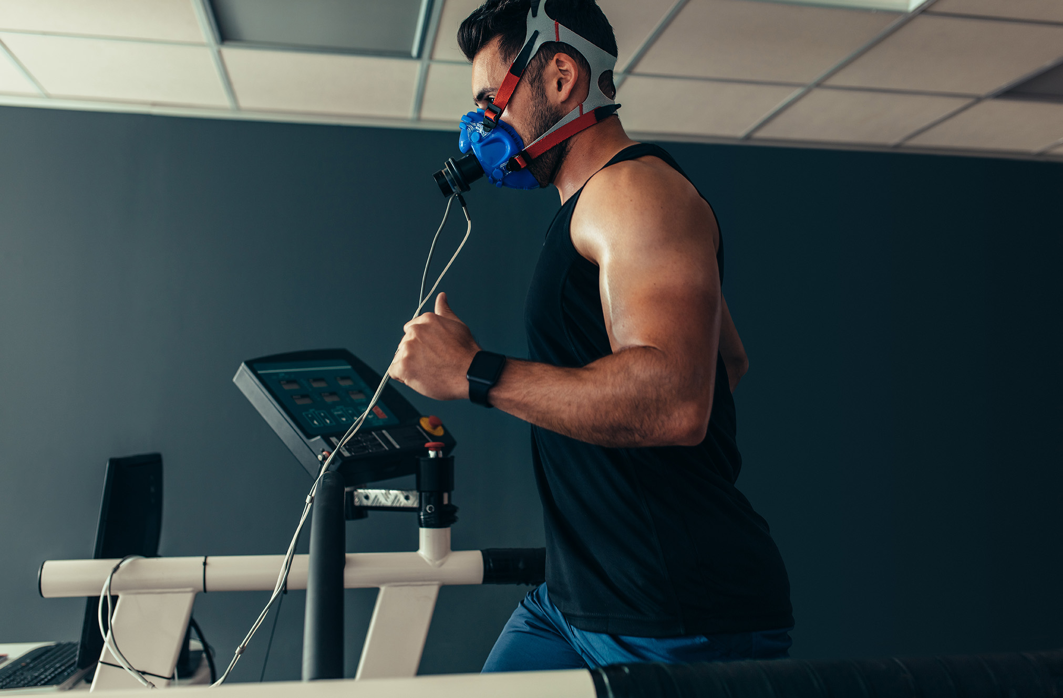
Meaning Of TEST & MEASUREMENT In The Field Of Sports And Games
Test :- are used to collect information/data about a specific skill, strength, endurance, knowledge, behavior, attitude, etc..
Measurement :- refers to the process of administrating a test to obtain a quantitative data/ Measurement aids the evaluation process in which various tools and techniques are used in the collection of data.
Meaning of Motor Fitness :-
Motor fitness refers to the capability of an athlete to take part effectively in his/her particular sports; motor fitness is a person’s ability to do physical activities.
50 Meter Run
600 Meter Run/Walk
Sit & Reach Test
Partial Curl Up
Push up[Boys]
Modified Push up[Girls]
Standing Board Jump
4 x10 Meter Shuttle Run

Slide 4
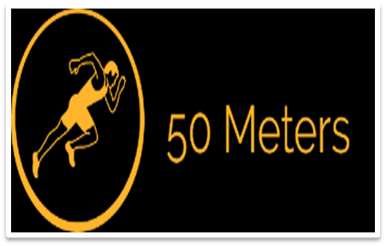
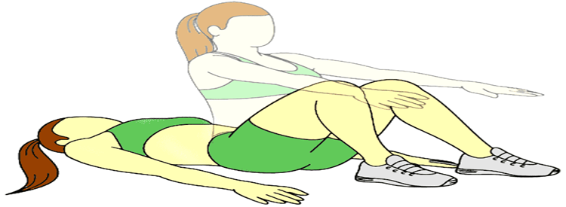
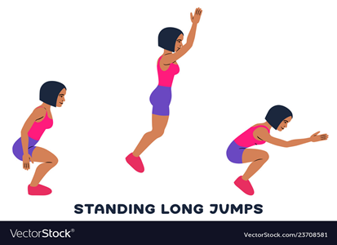
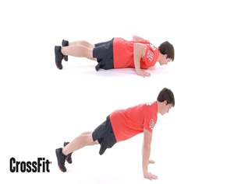
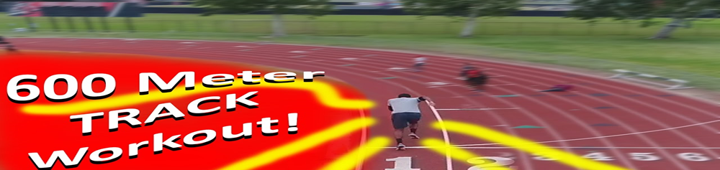
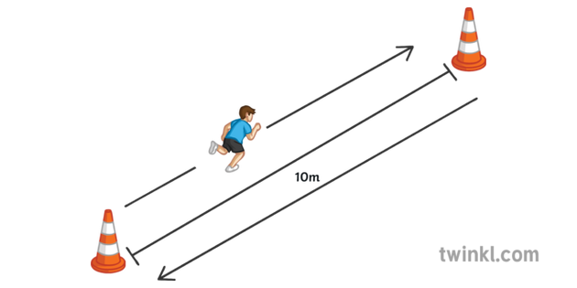
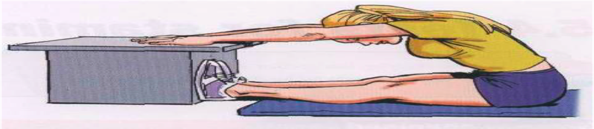
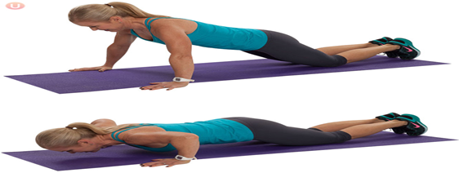
MOTOR FITNESS TEST

Slide 5

50 M STANDING START
Purpose :- Determine or measure speed.
Equipment's :- Measuring taps, stopwatches, whistle.
Procedure :- The subject takes the starting position behind the starting line. The starter commands “Are you ready” and “Go”, the score is recorded in seconds.

Slide 6
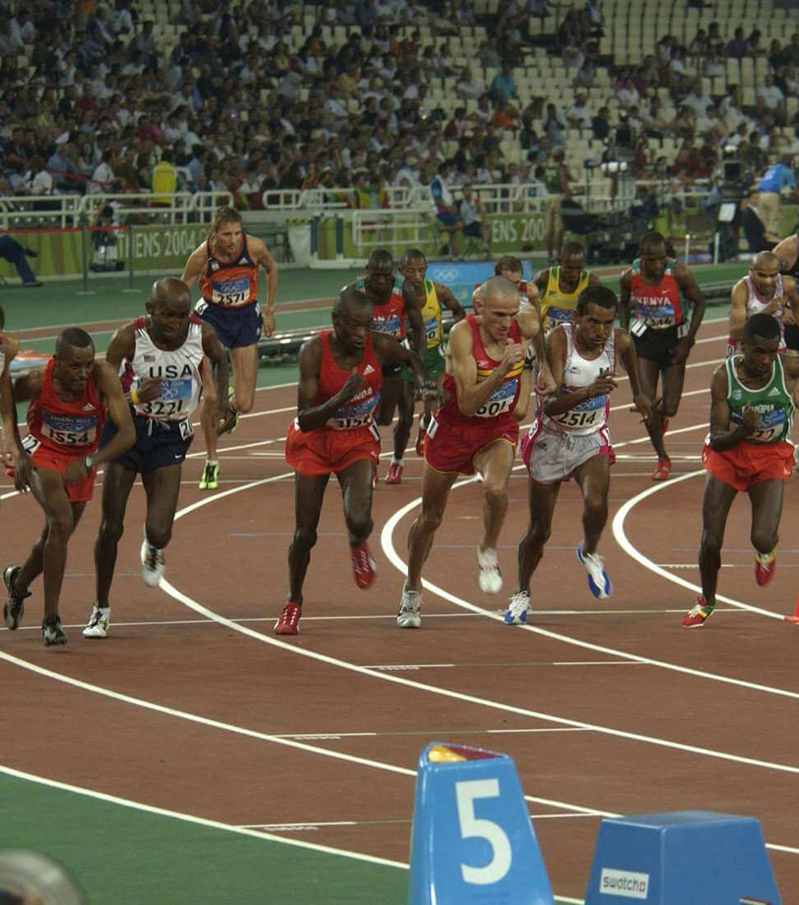
600 M RUN/WALK
Purpose :- To measure endurance.
Equipment's :- 600 m track and stopwatch.
Procedure :- The subject takes the starting position behind the starting line. The starter commands “Are you ready” and “Go”, the score is recorded in seconds.

Slide 7
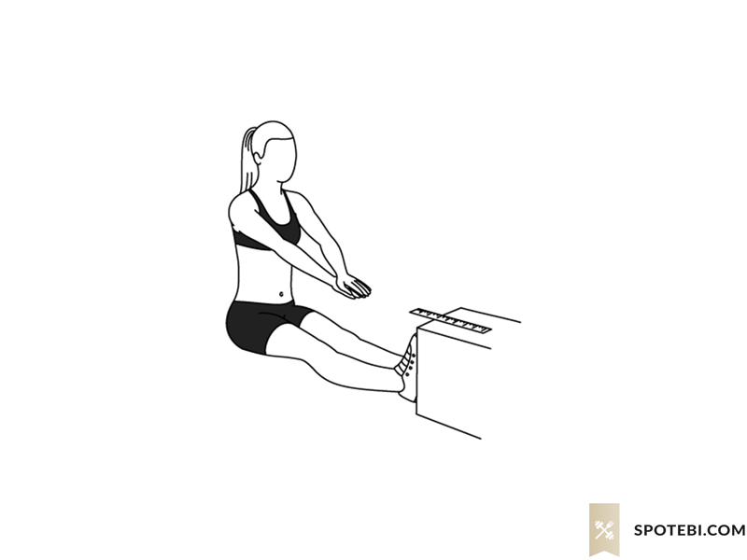
SIT AND REACH TEST
Purpose :- measure the flexibility of your hamstrings and lower back.
Equipment's :- ruler, step (optional, you could make your own sit and reach box if keen too)
Procedure :- If you have completed the home tests in order, you will be well warmed up by the time you are up to the sit and reach test. Otherwise, go for a jog and do some stretching. Remove your shoes and sit on a flat surface, legs extended in front of the body, toes pointing up and feet slightly apart, with the soles of the feet against the base of the step (if there is no step, just any flat surface will do). Place the ruler on the ground between your legs or on the top of the step. Place one hand on top of the other, then reach slowly forward. At the point of your greatest reach, hold for a couple of seconds, and measure how far you have reached. If you have trouble straightening you legs, get a friend to help by holding the knees down flush with the ground. See also video demonstrations of the Sit and Reach.

Slide 8
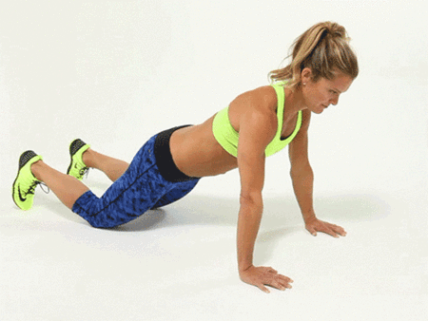
MODIFIED PUSH UP[GIRLS]
Purpose :- to measure the upper body strength & endurance for girl
Procedure:- after warm up, person take position for push up, hands, knees should touch the mat/floor. Both the hands should be shoulder-width apart and elbows fully extended. The body from the knees, to the hips and to the shoulders should be in straight line. While in this position, the person should lower her upper body, so that elbows may be bend to 90 degrees. Then the person back to the starting position. This is one repetition. The same process/action is repeated as per her capacities.

Slide 9
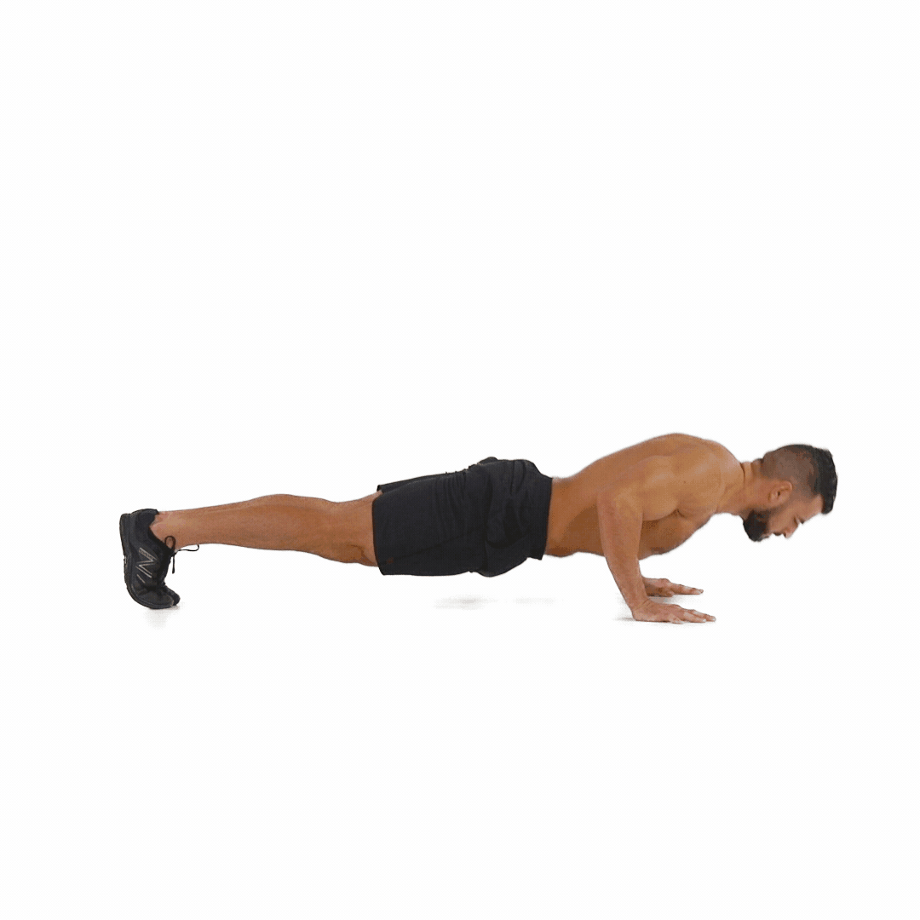
PUSH UP[BOYS]
Purpose:- to measure the upper body strength and endurance to a boy
Procedure:- after warm up, person take position for push up, hands, knees should not touch the mat/floor. Both the hands should be shoulder-width apart and elbows fully extended. The body from the knees, to the hips and to the shoulders should be in straight line. While in this position, the person should lower her upper body, so that elbows may be bend to 90 degrees. Then the person back to the starting position. This is one repetition. The same process/action is repeated as per her capacities

Slide 10
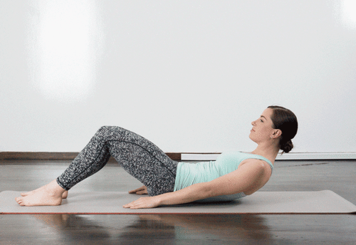
PARTIAL CURL UP
Purpose:- to test the strength & endurance of abdominal muscles.
Equipment:- A flat clean mat, paper, pen.
Procedure:- After warming up ,subject lies in supine position on cushioned surface. feet should be 12 inches from the buttocks. Both the feet be slightly apart. The head should be in neutral position. In this starting position, the object curl up with a slow controlled movement, until the shoulders come off the cushioned surface/mat two inches, then back down again. One complete curl up, every three seconds. It should be a continuous process in a rhythm way as per capacities.
Advantages:-
1- This test is simple and quick to perform.
2- It requires minimum equipment.
3- A numbers of subject/students be tasted at a time.

Slide 11
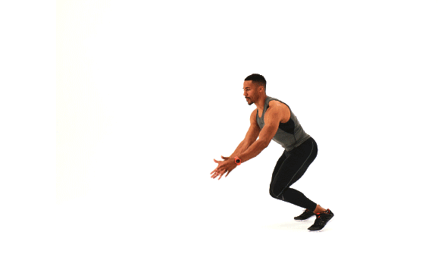
STANDING BOARD JUMP
Purpose:-
(for measuring leg strength) – This test measures the explosive leg power.
Equipment:-
a sandy long jump pit and measuring steel tape.
Procedure:-
If the athlete is fit and has explosive strength then he can use leg poser to jump forward. By this test, the fitness of lower limbs is measured.

Slide 12
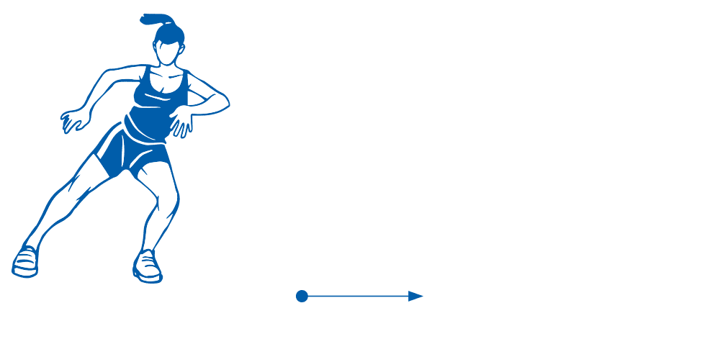
4 X10 METER SHUTTLE RUN
Purpose :-
To measure agility
Equipment’s :-
Field/Arena/Markers/cones
Procedure :-
Mark two parallel lines 3 meters in length, 10 meters apart using marking tape/cones. The subjects stands at starting line/points. On the signal go the subjects run to the lines , touch the end line , return to the stating point.
Scoring :-
Time be recorded in this process.

Slide 13
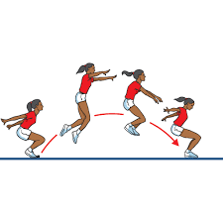
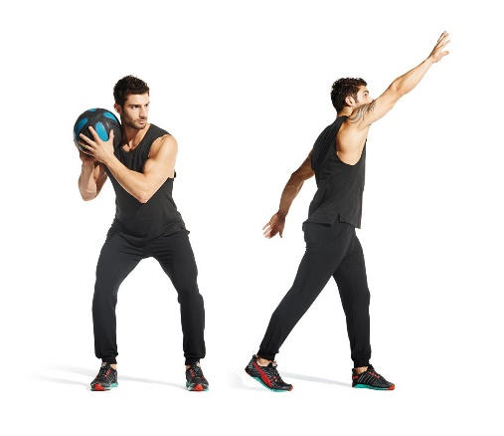
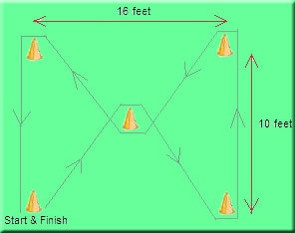
GENERAL MOTOR FITNESS TEST: BARROW THREE- ITEM GENERAL MOTOR ABILITY
Standing Board Jump Medicine Ball Put Zigzag Run

Slide 14
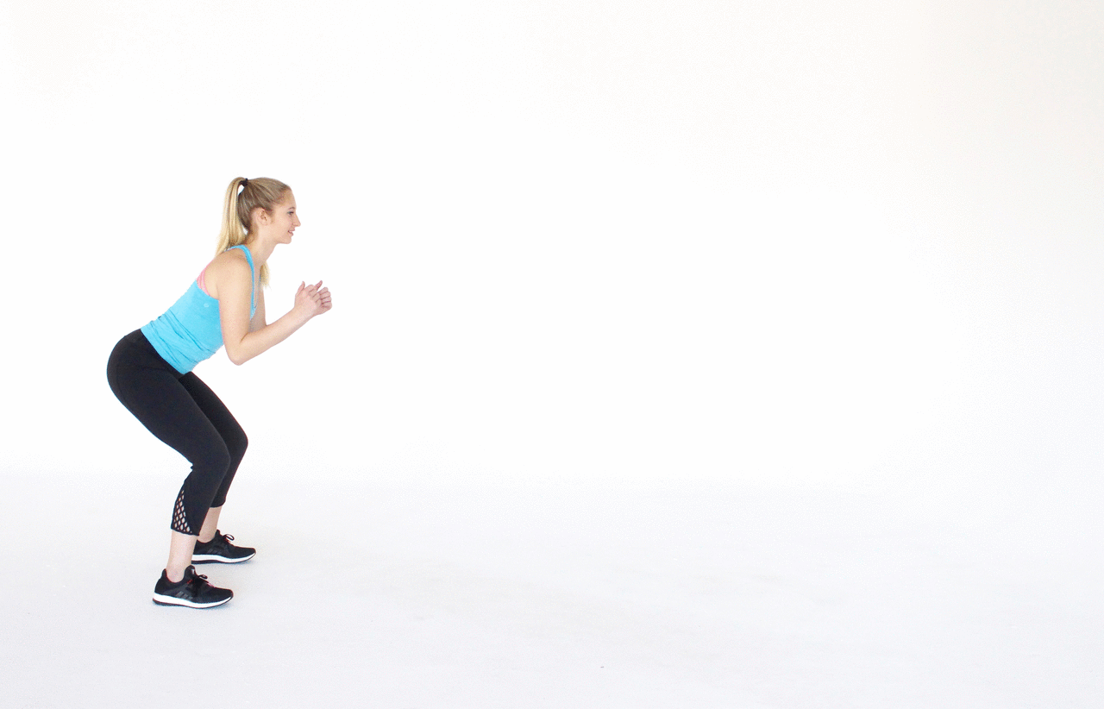
STANDING BOARD JUMP
Purpose:-
for measuring leg strength– This test measures the explosive leg power.
Equipment:-
a sandy long jump pit and measuring steel tape.
Procedure:-
If the athlete is fit and has explosive strength then he can use leg poser to jump forward. By this test, the fitness of lower limbs is measured.

Slide 15
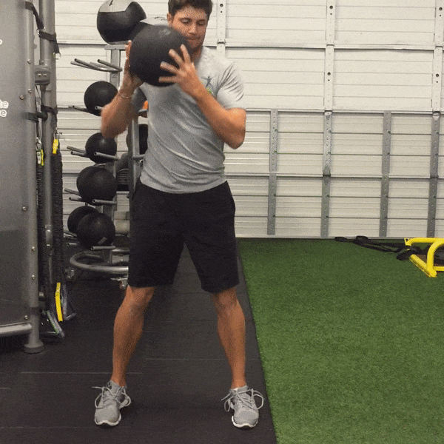
MEDICINE BALL PUT
Purpose:-
For measuring arm and shoulder strength) - This test measures the arm and shoulder girdle explosive strength.
Equipment:-
The athletes are required to throw the medicine ball with specific weight age as far as possible. For boys it is 3kg, for girls it is 1 kg.

Slide 16
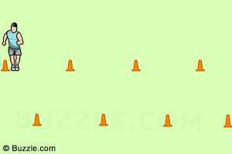
ZIG-ZAG RUN
Purpose:-
for measuring agility and speed
Equipment:-
Five Cones, stopwatch.
Procedure:-
This test measures the agility of the athlete as they are required to run through the zigzag path created by placing cones. Athletes are not to touch or knock the cones while running.

Slide 17
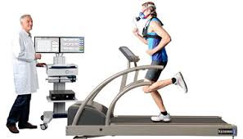
CARDIOVASCULAR FITNESS TEST
Cardiovascular fitness is the ability of the heart and lungs to supply oxygen rich blood to the working muscle tissues and the ability of the muscles to use oxygen to produce energy for movement.
HARVARD STEP TEST
ROCKPORT ONE MILE TEST

Slide 18
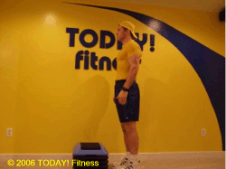
HARVARD STEP TEST
Harvard Step Test is a cardiovascular fitness test. It is also called Aerobic Fitness Test. It was developed by "Brouha in 1943.
Purpose:-
It is used to measure the cardiovascular fitness/Aerobic fitness by checking the recovery rate.
Equipment Requirement:-
A gym bench /box of 20 inches high for men & 16 inches for women, stopwatch and a tape
Procedure:-
Calculation of the Score: (100 x test duration in second)divided by (2 x sum of heart beats in recovery periods) Example: , if the total test duration was 300 seconds and the number of heart beats between 1 to 1.5 minutes was 70 then the fitness index score will be 100 x300/2 x 240 =62.5
Advantages:-
( minimum equipment required, it required minimal cost, it is simple to set up and conduct)

Slide 19

HARVARD STEP TEST
FITNESS INDEX SCORE =
$\frac{(100 X test duration in sec.)}{(2 X sum of heartbeats in recovert periods)}$
I.e. Test duration was 300 sec. and the number of heartbeats between:-
1 to 1.5m. =60
2 to 2.5 m. =50
3 to 3.5 m. = 40
So, fitness Index Score is =
$\frac{(100 X 300)}{(2 X 150)}$ = 100 (Excellent)

Slide 20
HARVARD STEP TEST SCORE
Fitness Scoring |  | Rating
Male | Female
> 90.0 | >86.0 | Excellent
80.0-90.0 | 76.0-85.9 | Good[Above Average]
65.0-79.9 | 61.0-75.9 | Average
55.0-64.9 | 50.0-60.9 | Below Average
<55 | <50 | Poor

Slide 21
ROCKPORT ONEMILE TEST
This test is very good to measure Cardio-Respiratory fitness of the individual. Thus the objective of this test is to monitor the development of the athlete’s maximum Cardio-Respiratory ability (VO2).
Requirements of Test:
Running track (200 m or 400 m),
Stopwatch,
An Assistant/Helper.
Administration of Test:
Choose a windless day to conduct the test.
Record your weight in pounds (lbs)
Walk one mile (1609 mt) as fast as possible
Record the time to complete the one miles walk.
Immediately on finishing the walk record your heart rate (beats per minute).
Determine your Maximum Cardio-Respiratory ability (VO2) from the calculation given below.

Slide 22
Calculation Procedure :-
Analysis of the result is done by comparing it with the result of previous test. It is expected that, appropriate training between each test should be done to show improvement.
The formula used to calculate VO2 Max is: 132·853 – (0·0769 × weight) – (0·3877 × Age) + (6·315 × Gender) – (3·2649 × Time) – (0·1565 × Heart rate) Where:-
Weight is in pounds (lbs), (b) Gender: Male = 1 and Female = 0
Time is expressed in minutes and seconds,
Heart rate is in beats/minute. (e) Age in years.
Evaluation of Test :-
Students who are fit will have better scoring in test as compared to unfit individual.
Advantages :-
minimum equipment required, it required minimal cost, it is simple to set up and conduct, It can be conducted by the athlete, this test can be conducted on more than one individual at a time
Disadvantages :-
Specific facilities are required for the test.

Slide 23
ROCKPORT ONEMILE TEST FITNESS SCORING
Fitness Scoring |  | Rating
Male | Female
> 90.0 | >86.0 | Excellent
80.0-90.0 | 76.0-85.9 | Good[Above Average]
65.0-79.9 | 61.0-75.9 | Average
55.0-64.9 | 50.0-60.9 | Below Average
<55 | <50 | Poor

Slide 24
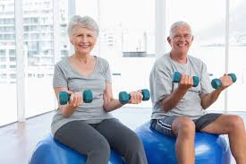
RIKLI & JONES: SENIOR FITNESS TEST
This test is known as 'Fullerton Functional Test of senior Citizens. Rikli and Jones developed the senior Citizen Fitness test in 2001.
Chair Stand Test: To Measure Lower Body Strength
Arm Curl test: To Measure Upper Body Strength
Chair Sit & Reach Test: To Measure Lower Body Flexibility
Back Scratch Test: To Measure Upper Body Flexibility
Eight Foot Up & Go Test: To Measure Coordination and Agility
Six Minute Walk Test: To Measure Functional Fitness

Slide 25
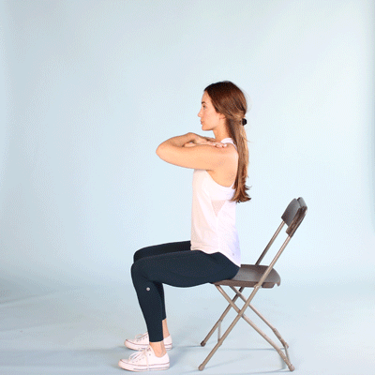
CHAIR STAND TEST: TO MEASURE LOWER BODY STRENGTH
Equipment: A chair with straight back and a seat of at least 44 cm and stopwatch
Instructions :
Participant should sit in the middle of the chair
hands on the opposite shoulder crossed at the wrist.
repeat standing up and sitting down for 30 seconds
Scoring: note total number of completed chair stand during the 3o seconds
Norms for Men |  |  |  |  | Norms for Women
Age | Below Average | Average | Above Average |  | Age | Below Average | Average | Above Average
60-64 | <14 | 14 to 19 | >19 |  | 60-64 | <12 | 12 to 17 | >17
65-69 | <12 | 12 to 18 | >18 |  | 65-69 | <11 | 11 to 16 | >16
70-74 | <12 | 12 to 17 | >17 |  | 70-74 | <10 | 10 to 15 | >15
75-79 | <11 | 11 to 17 | >17 |  | 75-79 | <10 | 10 to 15 | >15
80-84 | <10 | 10 to 15 | >15 |  | 80-84 | <9 | 9 to 14 | >14
85-89 | <8 | 8 to 14 | >14 |  | 85-89 | <8 | 8 to 13 | >13
90-94 | <7 | 7 to 12 | >12 |  | 90-94 | <4 | 4 to 11 | >11

Slide 26
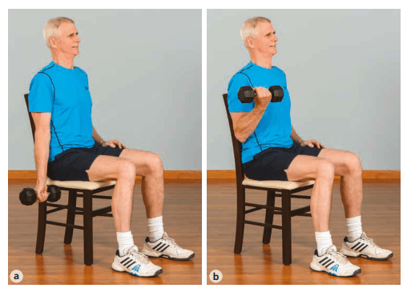
ARM CURL TEST
Purpose :-
To Measure Upper Body Strength.
Equipment :-
8 pound for men & 5 pound for women. A chair with out arm and stopwatch
Procedure :-
person lift the weight towards shoulder side , repeatedly both the hand for 30 second
Scoring :-
Note down in a paper , during 30 second how many times ,the person lift the weights in the both side hands.
Norms for Men |  |  |  |  | Norms for Women
Age | Below Average | Average | Above Average |  | Age | Below Average | Average | Above Average
60-64 | <16 | 16 to 22 | >22 |  | 60-64 | <13 | 13 to 19 | >19
65-69 | <15 | 125to 21 | >21 |  | 65-69 | <12 | 12 to 18 | >18
70-74 | <14 | 14 to 21 | >21 |  | 70-74 | <12 | 12 to 17 | >17
75-79 | <13 | 13 to 19 | >19 |  | 75-79 | <11 | 11to 17 | >17
80-84 | <13 | 13 to 19 | >19 |  | 80-84 | <10 | 10 to 16 | >16
85-89 | <11 | 11 to 17 | >17 |  | 85-89 | <10 | 10 to 15 | >15
90-94 | <10 | 10 to 14 | >14 |  | 90-94 | <8 | 8 to 13 | >13

Slide 27
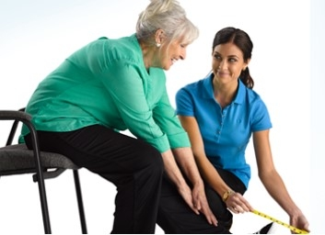
CHAIR SIT & REACH TEST
Purpose: -
To Measure Lower Body Flexibility
Equipment:-
Ruler, a chair with straight back approximately 44 cm high.
Procedure:-
participant sits on the edge of the chair[keep against a wall for safety purpose] one foot should be remains flat on the floor while other leg should be extended forward with the knee in straight position. Heel should be on the floor and ankle should be bent at 90 degree. Place one hand on the top of the other with tips of the middle fingers at the same level, participating to inhale and exhales currently. Avoid jerk/bounce and never stretch too much. Keep the knee straight and hold the reach for 2 seconds. The distance is measured between the tips of the fingertips and the toes.
Scoring: the score is noted down to the nearest ½ inch /1 cm as the distance reached either a negative/position score

Slide 28
CHAIR SIT & REACH TEST INDEX SCORING/RANGE DATA
 |  |  |  |  | Norms for Women[in inches]
Age | Below Average | Average | Above Average |  | Age | Below Average | Average | Above Average
60-64 | <2.5 | - 2.5 to 4.0 | >4.0 |  | 60-64 | <- 0.5 | - 0.5 to 5.0 | >5.0
65-69 | <3.0 | - 3.0 to 3.0 | >3.0 |  | 65-69 | < - 0.5 | - 0.5 to 4.5 | >4.5
70-74 | <3.5 | - 3.5 to 2.5 | >2.5 |  | 70-74 | < - 1.0 | - 1.0 to 4.0 | >4.0
75-79 | <4.0 | - 4.0 to 2.0 | >2.0 |  | 75-79 | < - 1.5 | - 1.5 to 3.5 | >3.5
80-84 | <5.5 | - 5.5 to 1.5 | >1.5 |  | 80-84 | < - 2.0 | - 2.0 to 3.0 | >3.0
85-89 | <5.5 | - 5.5 to 0.5 | >0.5 |  | 85-89 | < - 2.5 | - 2.5 to 2.5 | > 2.5
90-94 | <6.5 | - 6.5 to 0.5 | >- 0.5 |  | 90-94 | < - 4.5 | - 4.5 to 1.0 | > 1.0

Slide 29
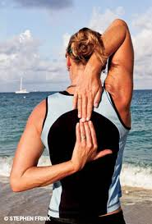
BACK SCRATCH TEST
Purpose:-
To Measure Upper Body (Shoulder) Flexibility
Equipment:-
A ruler
Procedure: -
this test is taken in standing position. Keep one hand behind the hand and lower it down gradually over the shoulder and reach as far as possible at the middle of your back. Palm should be touching your body and the fingers should be downwards. Then carry both your other arm behind your back with palm facing outwards and fingers facing upwards, try to reach up as far as possible in order to touch /overlap the middle fingers of the other hand . Measure the distance between the tips of the fingers. Person allow to practice twice and then two trials be conducted

Slide 30
BACK SCRATCH TEST INDEX SCORING/RANGE DATA
Norms for Men[in inches] |  |  |  |  | Norms for Women[in inches]
Age | Below Average | Average | Above Average |  | Age | Below Average | Average | Above Average
60-64 | >6.5 | 6.5 to 00 | <00 |  | 60-64 | >3.0 | 3.0 to 1.5 | <1.5
65-69 | >7.5 | 7.5 to 1.0 | < - 1.0 |  | 65-69 | >3.5 | 3.5 to 1.5 | <1.5
70-74 | > 8.0 | 8.0 to 1.0 | < -1.0 |  | 70-74 | >4.0 | 4.0 to 1.0 | <1.0
75-79 | > 9.0 | 9.0 to 2.0 | < -2.0 |  | 75-79 | >5.0 | 5.0 to 0.5 | <0.5
80-84 | > 9.5 | 9.5 to 2.0 | < -2.0 |  | 80-84 | >5.5 | 5.5 to 00 | <00
85-89 | > 10.0 | 10.0 to 3.0 | < -3.0 |  | 85-89 | >7.0 | 7.0 to -1.0 | <-0.1
90-94 | >10.5 | 10.5 to 4.0 | <- 4.0 |  | 90-94 | >8.0 | 8.0 to -1.0 | <-1.0

Slide 31
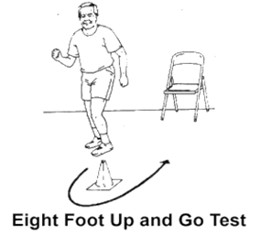
EIGHT FOOT UP & GO TEST
Purpose:-
To Measure Coordination and Agility
Equipment: -
A chair with straight back [about 44 cm height] stopwatch, marker, Measuring tape
Procedure:
Keep a chair nest to wall and place a marker 8 feet away in front of the chair.
Person sit straight , hand resting, knees & feet flat to the ground. On the command of go participate stands and walks[no running] as possible towards to the marker/cone, turn around and returns to the chair to sit down. Two trials are given for this. Time is noted down.
Norms for Men[in seconds] |  |  |  |  | Norms for Women[in seconds]
Age | Below Average | Average | Above Average |  | Age | Below Average | Average | Above Average
60-64 | >5.6 | 5.6 to 3.8 | <3.8 |  | 60-64 | >6.0 | 6.0 to 4.4 | <4.4
65-69 | >5.7 | 5.7 to 4.3 | <4.3 |  | 65-69 | >6.4 | 6.4 to 4.8 | <4.8
70-74 | >6.0 | 6.0 to 4.2 | <4.2 |  | 70-74 | >7.1 | 7.1 to 4.9 | <4.9
75-79 | >7.2 | 7.2 to 4.6 | <4.6 |  | 75-79 | >7.4 | 7.4 to 5.2 | <5.2
80-84 | >7.6 | 7.6 to 5.2 | <5.2 |  | 80-84 | >8.7 | 8.7 to 5.7 | <5.7
85-89 | >8.9 | 8.9 to 5.3 | <5.3 |  | 85-89 | >9.6 | 9.6 to 6.2 | <6.2
90-94 | >10.0 | 10.0 to 6.2 | <6.2 |  | 90-94 | >11.5 | 11.5 to 7.3 | <7.3

Slide 32
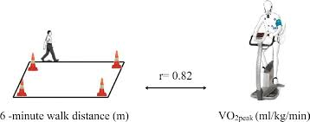
SIX MINUTE WALK TEST
Purpose:- To Measure Functional Fitness
Equipment:-
Area/Field/Treadmill
Procedure:-
A walking distance is marked 45.72 m or 50 yards in a rectangular shape/area. Person start a point and finished it in 6 minutes in between participant can stop any time if desire so
Scoring:- total distance covered in time [minutes] recorded
Norms for Men[in yards] |  |  |  |  | Norms for Women[in Yards]
Age | Below Average | Average | Above Average |  | Age | Below Average | Average | Above Average
60-64 | <610 | 610-735 | >735 |  | 60-64 | <545 | 545 to 660 | >660
65-69 | <560 | 560 to 700 | >700 |  | 65-69 | <500 | 500 to 635 | >635
70-74 | <545 | 545 to 680 | >680 |  | 70-74 | <480 | 480 to 615 | >615
75-79 | <470 | 470 to 640 | >640 |  | 75-79 | <430 | 430 to 585 | >585
80-84 | <445 | 445 to 605 | >605 |  | 80-84 | <385 | 385 to 540 | >540
85-89 | <380 | 380 to 570 | >570 |  | 85-89 | <340 | 340 to 510 | >510
90-94 | <305 | 305 to 500 | >500 |  | 90-94 | <275 | 275 to 440 | >440

Slide 33

1 | What the weight of the bumble for women use for Arm Curl Test. A- 3 Pound. B- 5 Pound. C- 8 Pound, D- 9 Pound
2 | In Arm Curl Test time duration is ________ seconds A-40Sec. B- 20Sec. C- 30Sec. D-10Sec.
3 | What the use of Back Scratch Test to a Senior Citizen. A-To Check Upper Body Strength. B- To Check Lower Body Flexibility. B- To Check Upper Body Flexibility. D- To Check Coordinative Ability.
4 | How many obstacles are use in Zigzag running test for speed and agility. A-4. B-10. C-5. D-8.
5 | In total how many items is use in motor fitness test? A- 10. B- 8. C- 7. D- 9

Slide 34
6 | In which test to measure the upper body strength & Endurance. Arm Curl Test. B- Rockport Test. C- Partial Curl Up. D- Push Up
7 | In which test to measure the strength and endurance of Abdominal Muscles Arm Curl Test. B- Rockport Test. C- Partial Curl Up. D- Push Up
8 | In which test to measure the upper body strength and endurance to a girl Arm Curl Test. B- Modified Push Up. C- Partial Curl Up. D- Push Up
9 | In total how many trials are given in “standing Board Jump Test” 3. B- 5. C- 7. D- 4
10 | In partial curl up test, the knees should be flexed and feet should be how many inches from the buttocks. 13 inches. B- 15 inches. C- 17 inches. D- 12inches.

Slide 35
11 | In partial curl up test, the Curl up should not be counted if the shoulders are not raised up to ______inches. 3 inches. B- 1 inches. C- 4 inches. D- 2 inches
12 | What is the weight of the medicine ball use for girls test in Barrow General Motor fitness test? 3kg. B- 2kg. C- 1 kg. D- 5kg.
13 | What is the weight of the medicine ball use for boys test in Barrow General Motor fitness test? 3kg. B- 2kg. C- 1 kg. D- 5kg.
14 | “Harvard Step Test” developed by Brouha in which year. 1940. B- 1943. C- 1934. D- 1942
15 | What is the bench height use in “Harvard Step test” for bosy? 23 inches. B- 21 inches. C- 24 inches. D- 20 inches

Slide 36
16 | What is the bench height use in “Harvard Step test” for girls? 13 inches. B- 11 inches. C- 14 inches. D- 16 inches
17 | What is the time limits for “Harvard Step test”? 3 minutes. B- 4 minutes. C- 5 minutes. D- 6 minutes
18 | “Fullerton Functional Test” developed in which years? 2000. B- 2001. C- 2002. D- 2003
19 | In which test we check the ‘Upper Body Strength’ to a senior citizenship/Old age person. ‘Chair Stand up Test’. B- ‘Arm Curl Test’. C- ‘Back Scratch Test’ D- ‘Eight Foot Up & Go Test’
20 | In which test we check the ‘Lower Body Strength’ to a senior citizenship/Old age person. ‘Chair Stand up Test’. B- ‘Arm Curl Test’. C- ‘Back Scratch Test’ D- ‘Eight Foot Up & Go Test’

Slide 37
21 | In which test we check the ‘Lower Body Flexibility’ to a senior citizenship/Old age person. ‘Chair Stand up Test’. B- ‘Arm Curl Test’. C- ‘Back Scratch Test’ D- ‘Chair Sit & Reach Test’
22 | In which test we check the ‘Upper Body Flexibility’ to a senior citizenship/Old age person. ‘Chair Stand up Test’. B- ‘Arm Curl Test’. C- ‘Back Scratch Test’ D- ‘Eight Foot Up & Go Test’
23 | In which test we check the ‘Coordination & Agility’ to a senior citizenship/Old age person. ‘Chair Stand up Test’. B- ‘Arm Curl Test’. C- ‘Back Scratch Test’ D- ‘Eight Foot Up & Go Test’
24 | Which motor quality does a senior citizen lack who finds difficulty in tying the shoes laces while sitting on the chair? ‘Upper Body Flexibility’. B- ‘Upper body strength. C- ‘Lower Body Flexibility D- ‘Endurance’
25 | Mr.Well & Mr.Dillion develop the ‘Sit & Reach Test’ in which year? 1950. B- 1952. C- 1953. D- 1954

Slide 38
Sl No | Questions | Marks
26 | Explain the procedure for Eight Foot Up and Go Test? | 3
27 | Calculate the physical Fitness Index for a 12 year old boy having completed Harvard Step Test for duration of 3 minute and pulse rate of 54 beats for 1 to 1.5 minute. 50 beats for 2 to 205 min and 46 beats for 3 to 3.5 min | 3
28 | What is measurement in sports? | 3
29 | Calculate the Physical Fitness Index using short formula for a 12 year old by having completed Harvard step test for a duration of 3 minute and a pulse rate of 54 beats for 1 to 1.5 minute. | 3
30 | List down the fitness index score of Harvard step test? | 3
31 | What is General Motor Fitness? How can it be measured? | 5

Slide 39
THANKING YOU
ODM EDUCATIONAL GROUP

