Slide 1


MANAGEMENT OF SPORTING EVENTS
SUBJECT : (PHYSICAL EDUCATION)
CHAPTER NUMBER: 1
CHAPTER NAME : PLANNING IN SPORTS

Slide 2
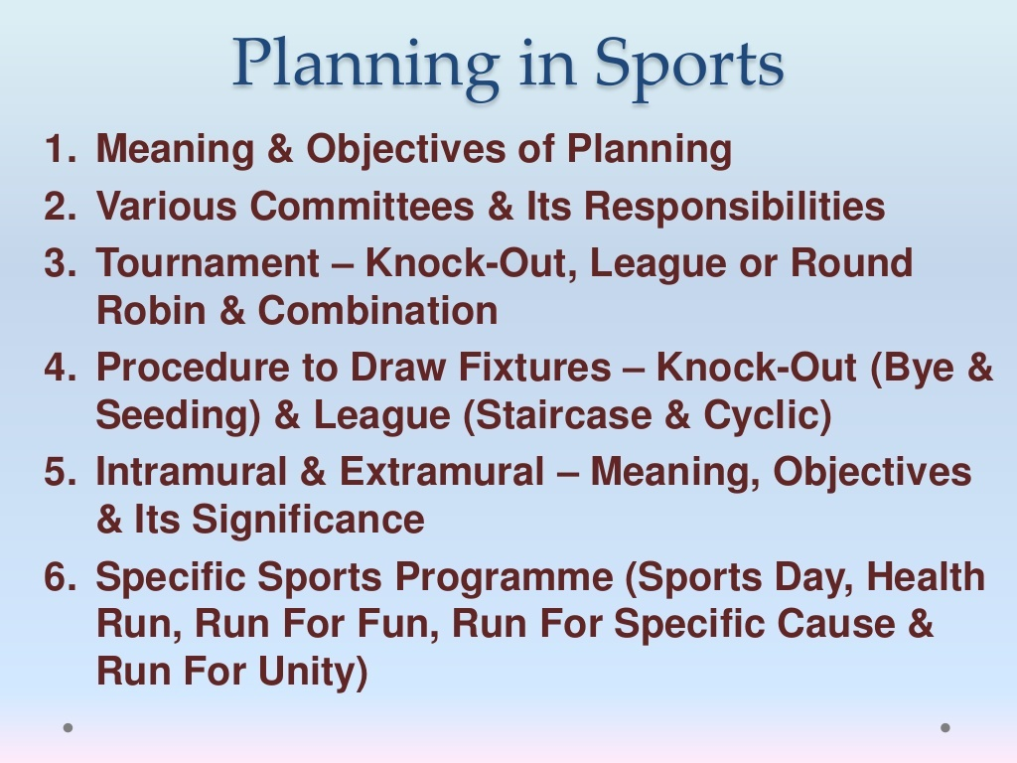

Slide 3
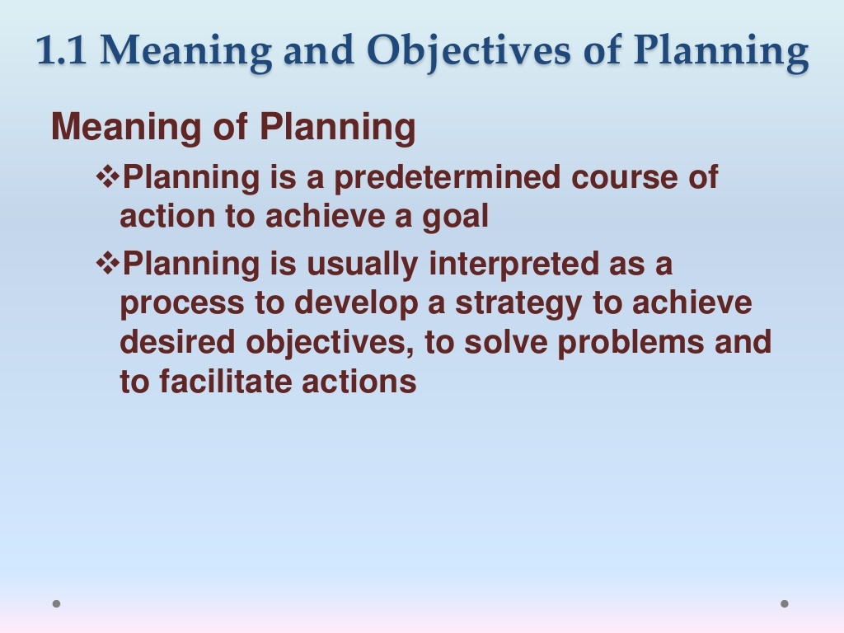

Slide 4
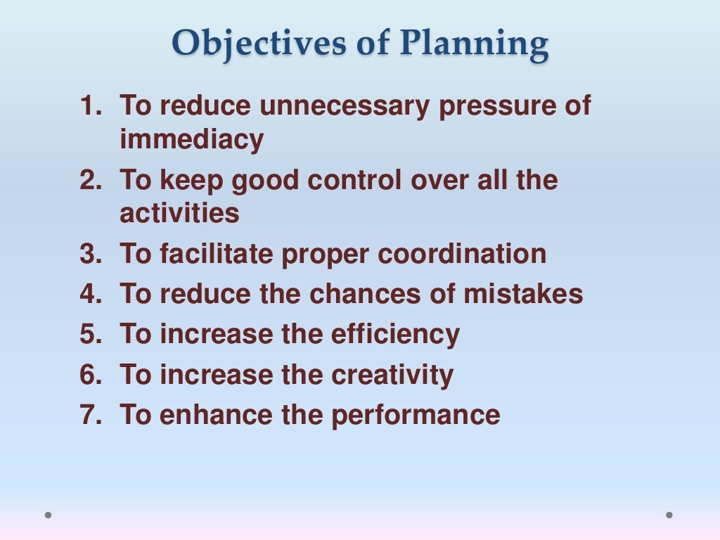

Slide 5


Slide 6
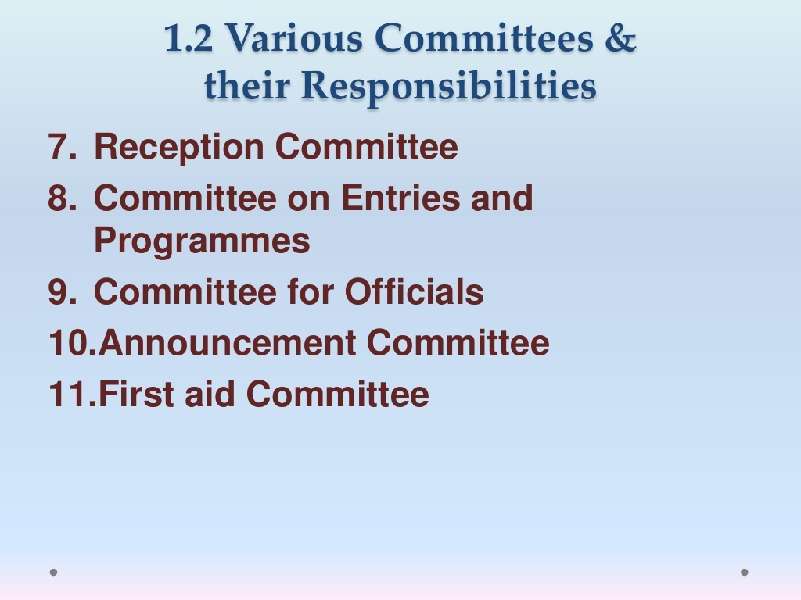

Slide 7
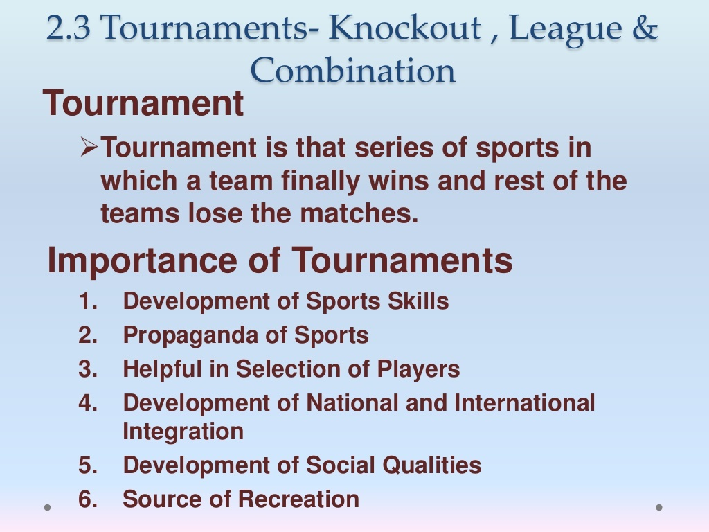

Slide 8
TYPES OF TOURNAMENT
KNOCK-OUT
LEAGUE OR ROUND ROBIN
COMBINATION
CHALLENGE
KNOCK-OUT CUM KNOCK-OUT
LEAGUE CUM LEAGUE
KNOCK-OUT CUM LEAGUE
LEAGUE CUM KNOCK-OUT
SINGLE LEAGUE
DOUBLE LEAGUE

Slide 9
KNOCK-OUT TOURNAMENT
The teams which gets eliminated gets automatically eliminated from the tournament.
If a team is defeated once, it gets eliminated. Only the winners continue in the competition.
OUTFROM TOURNAMENT
TOURNAMENT
TEAM A
TEAM B
TEAM C
TEAM D
TEAM A
WINNER
TEAM C
TEAM C

Slide 10
ADVANTAGES & DISADVANTAGES OF KNOCK-OUT TOURNAMENT
ADVANTAGES
These are less expensive.
Helpful in enhancing standard of sports.
It requires less time to complete the tournament.
Minimum no. of officials are required.
There are many chances of elimination of good teams in preliminary rounds.
There are many chances of weak teams to enter in the final round.
Spectators may not have enough interest in the final round.
DISADVANTAGES

Slide 11
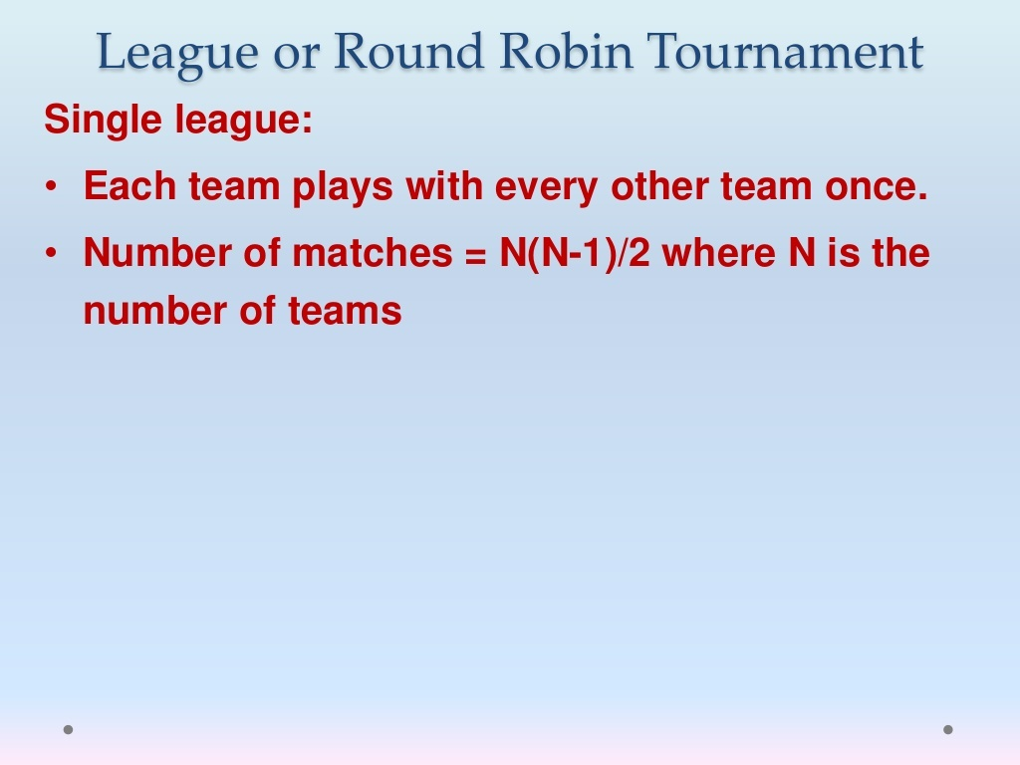

Slide 12
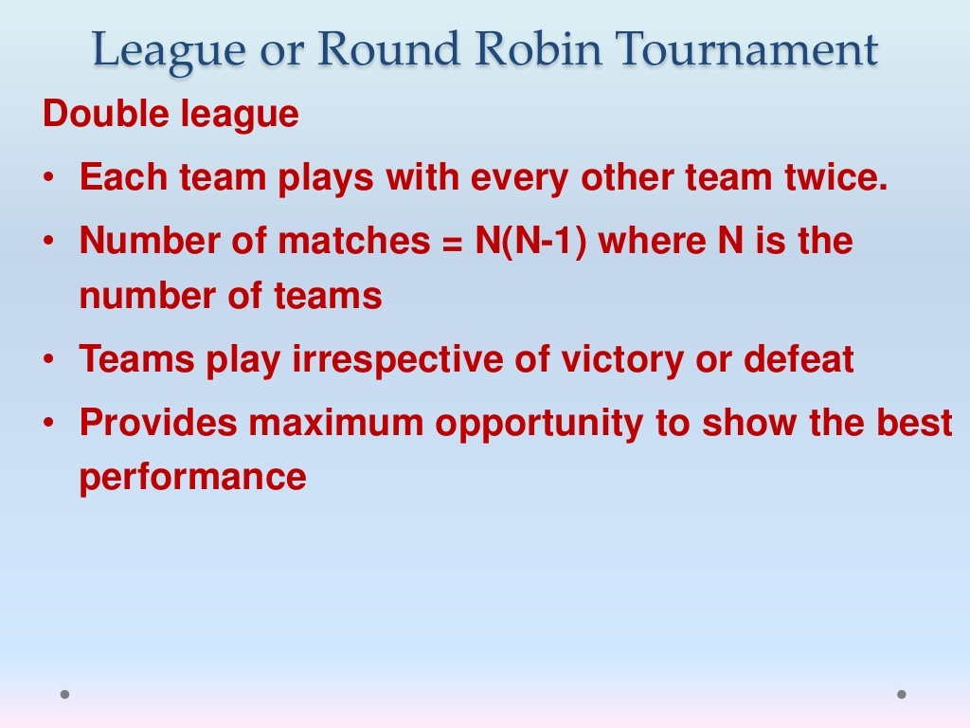

Slide 13
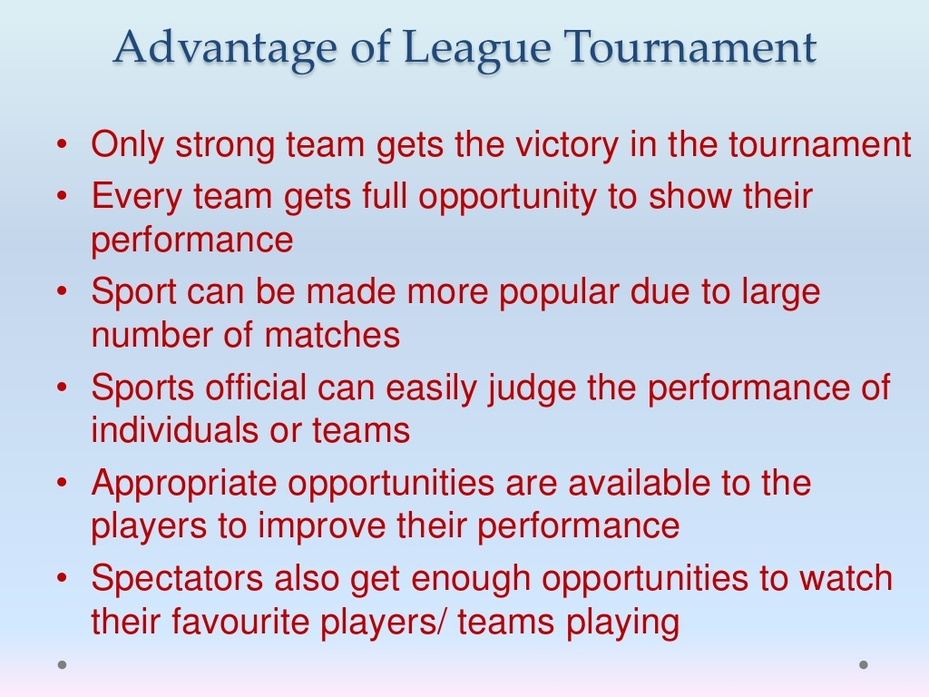

Slide 14
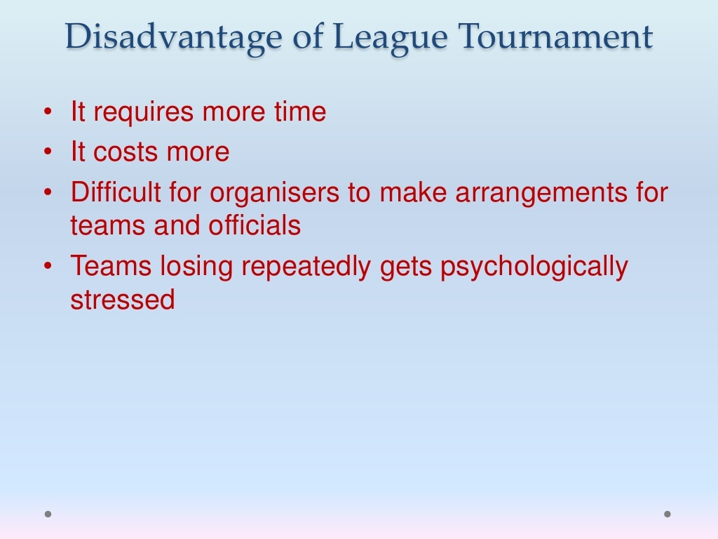

Slide 15
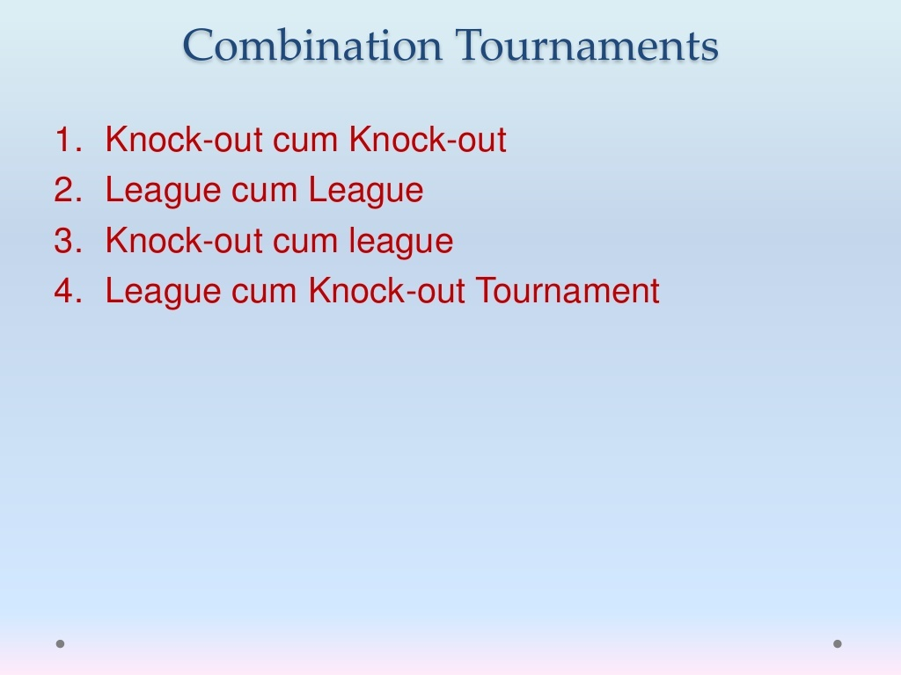

Slide 16
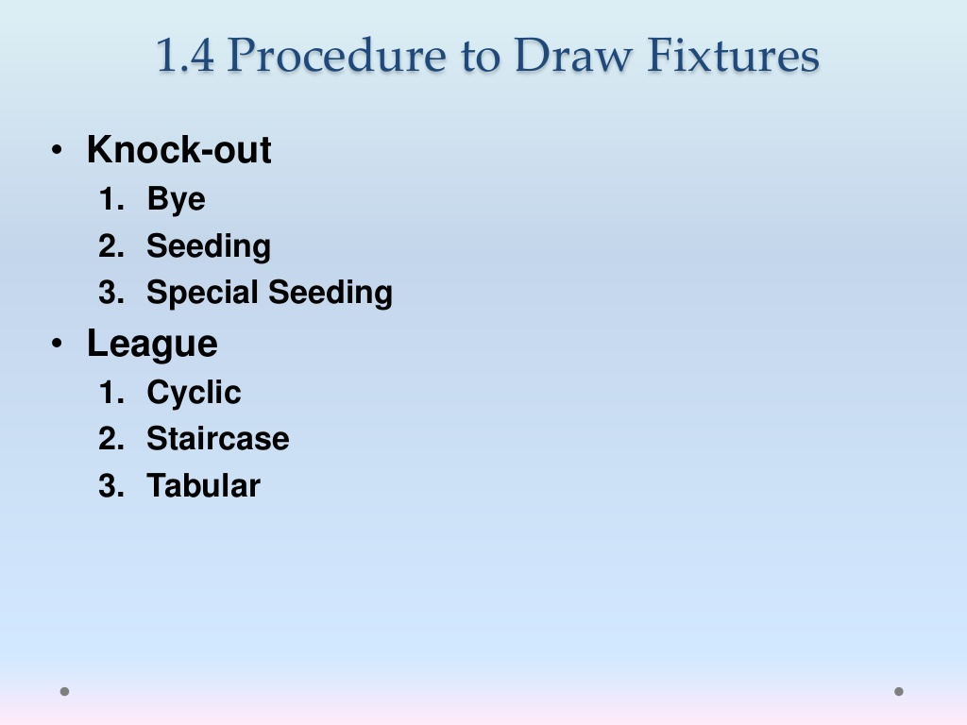

Slide 17
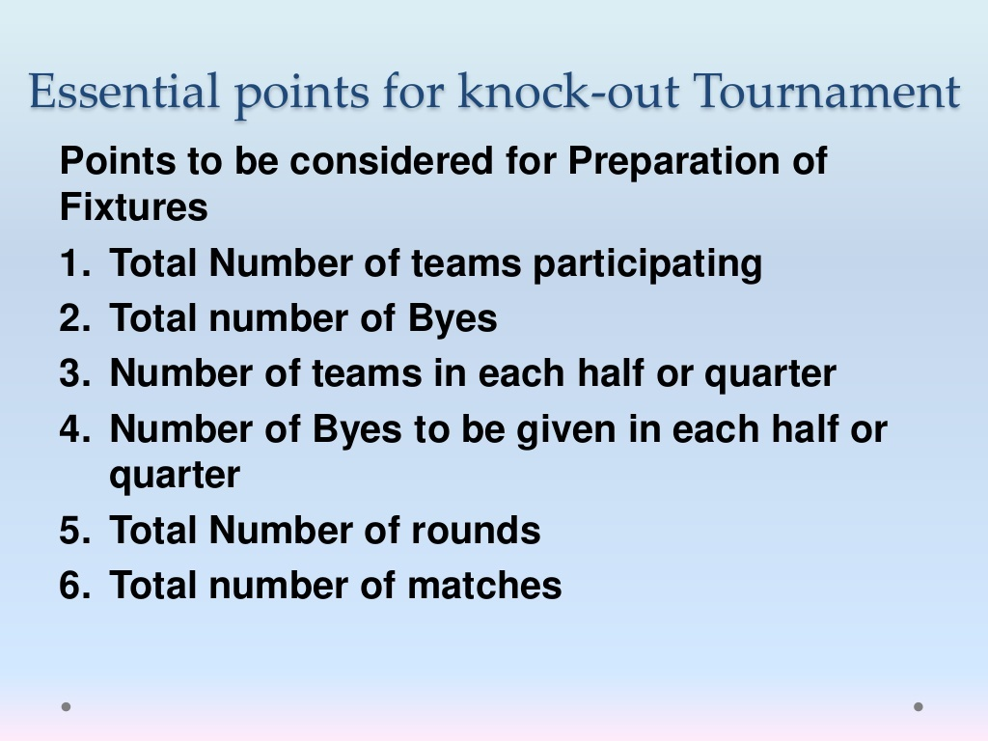

Slide 18
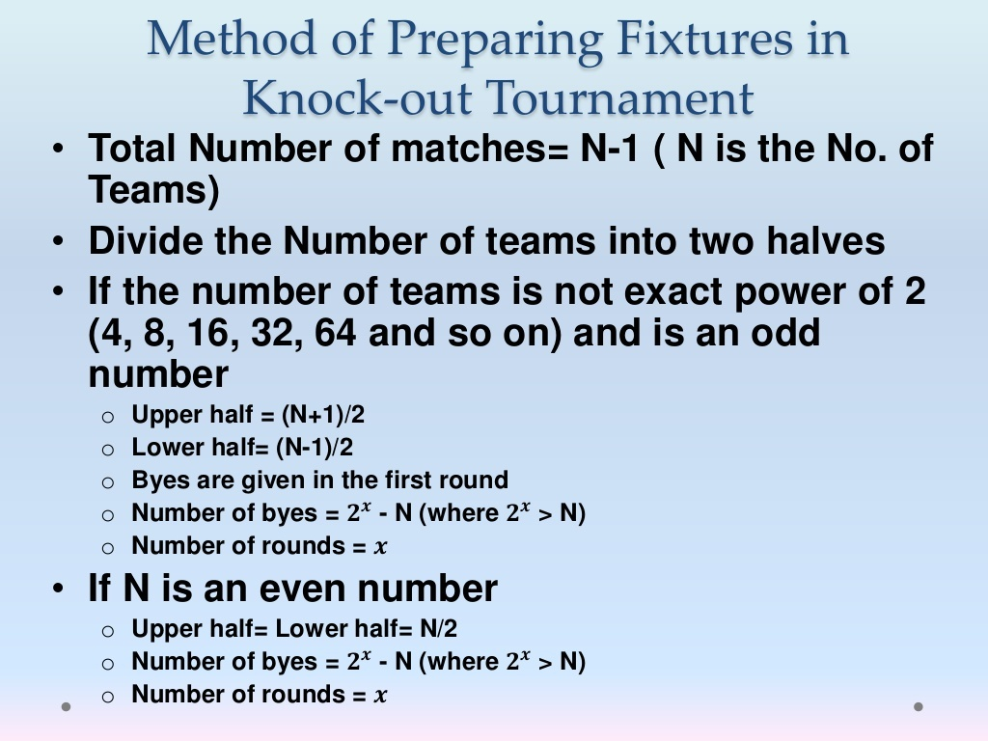

Slide 19
METHOD OF PREPARING FIXTURE IN A KNOCK-OUT TOURNAMENT
BYES :- Bye is a privilege given to the team, which do not play first round.
METHOD OF FIXING BYES :-
1st Bye is given to the BOTTOM of LH
2nd Bye is given to the TOP of UH
3rd Bye is given to the TOP of LH
4th Bye is given to the BOTTOM of UH
NOTE :- The next bye or byes will be given in
the same order.
[LH= Lower Half, UH = Upper Half]
UPPERHALF LOWER HALF
1 2 3 4 5 6 7 8
2nd BYE
4th BYE
3rd BYE
1st BYE

Slide 20
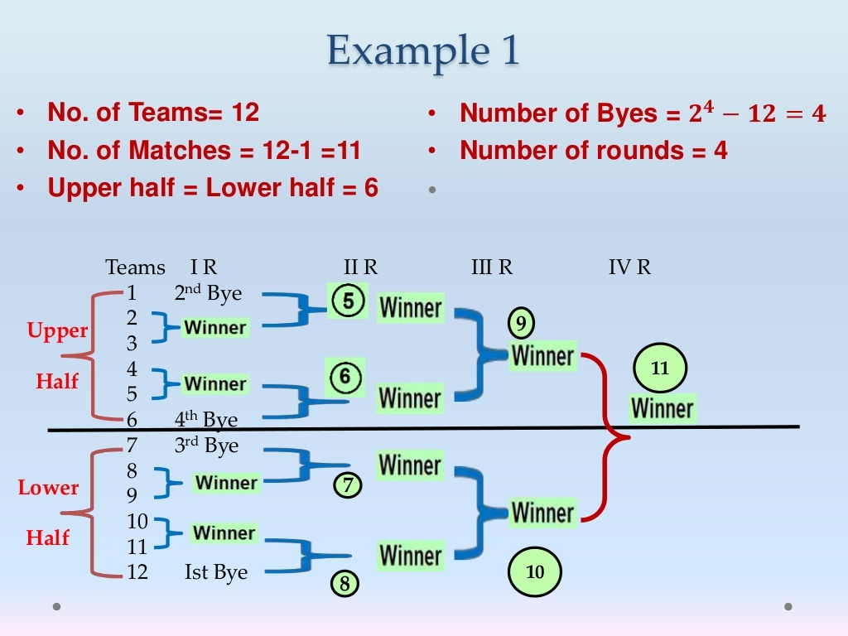

Slide 21
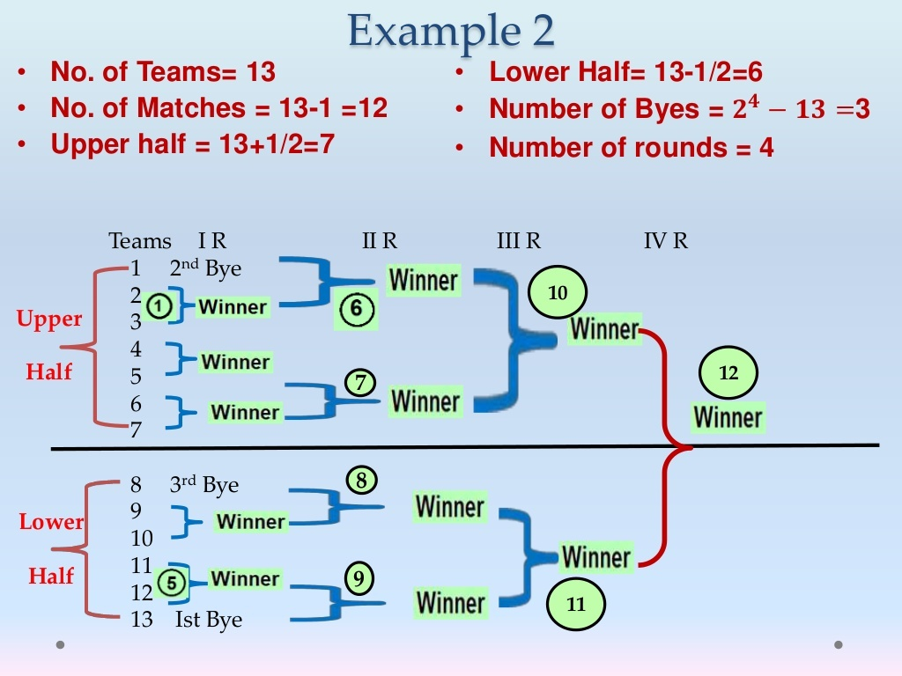

Slide 22
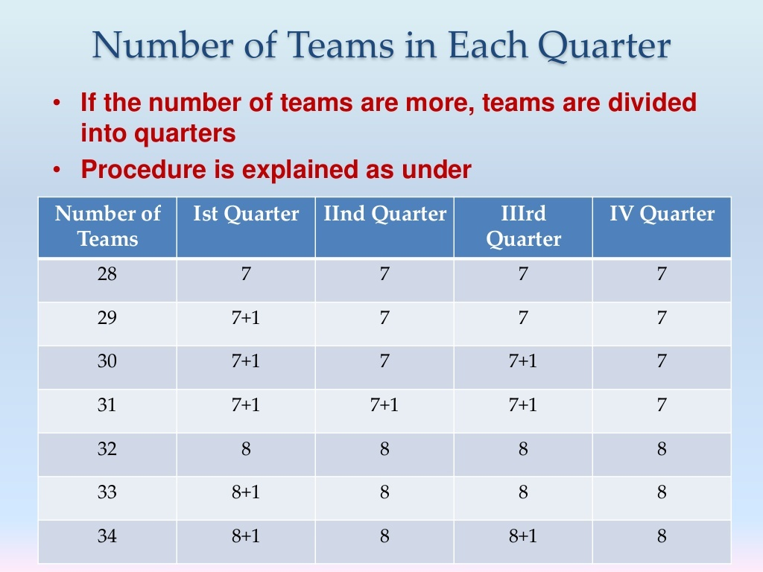

Slide 23
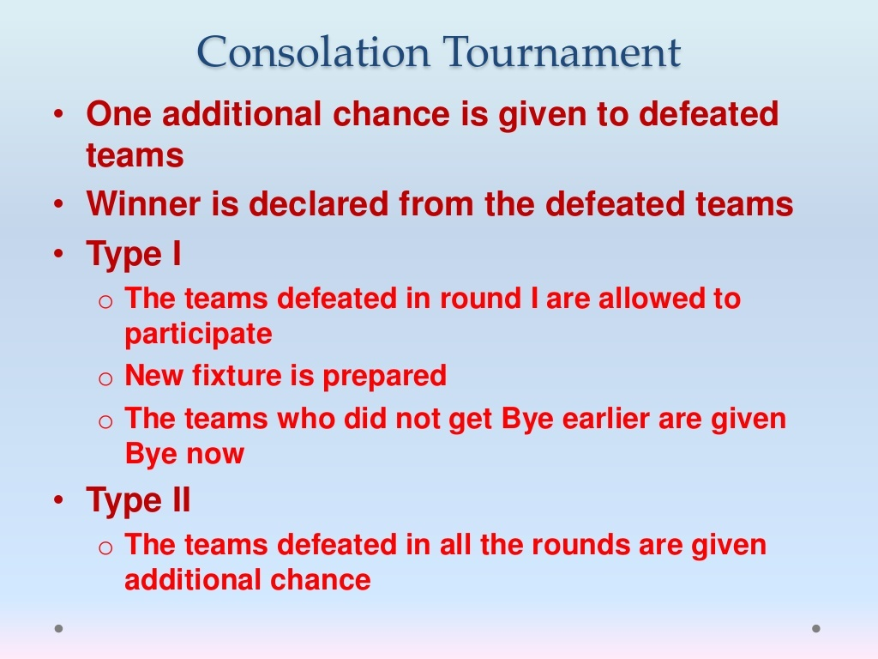

Slide 24
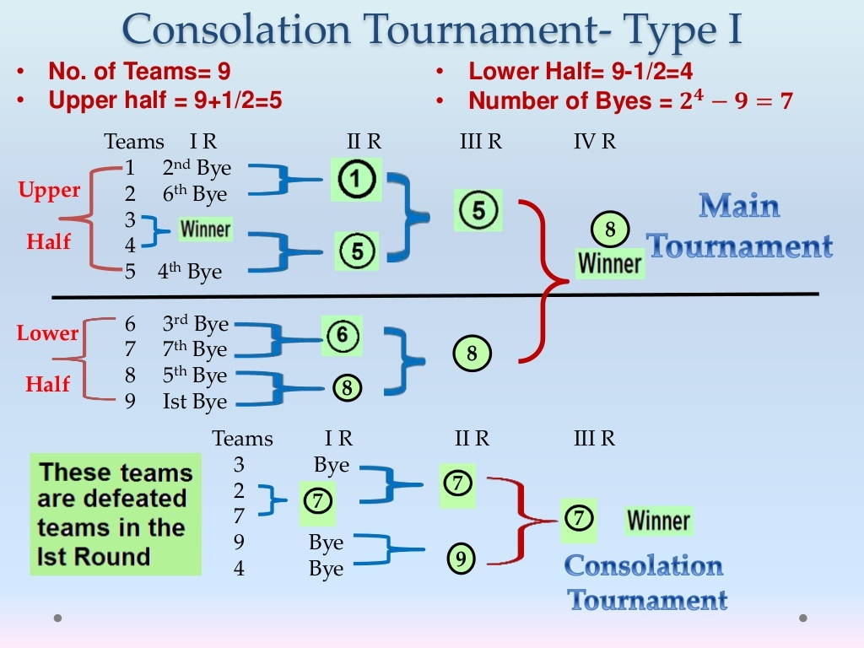

Slide 25
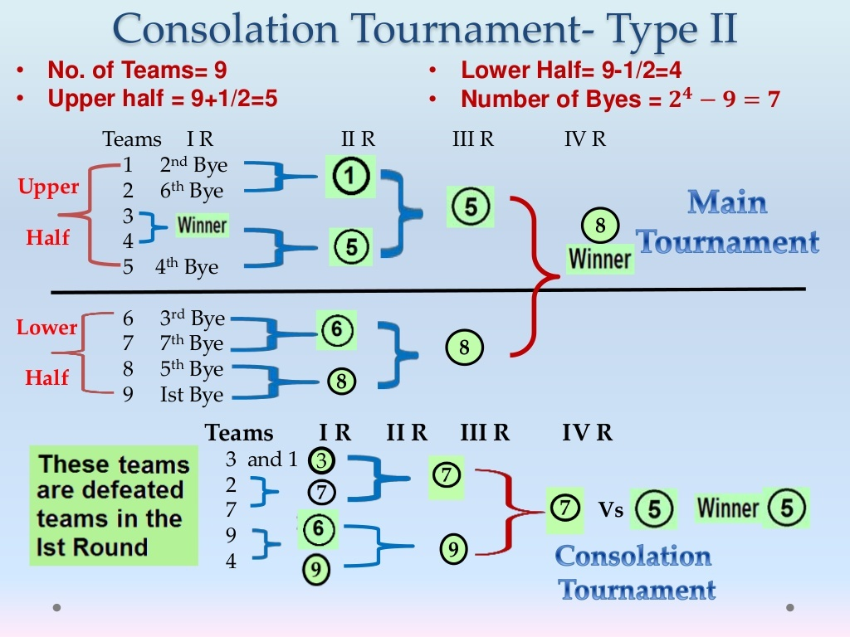

Slide 26
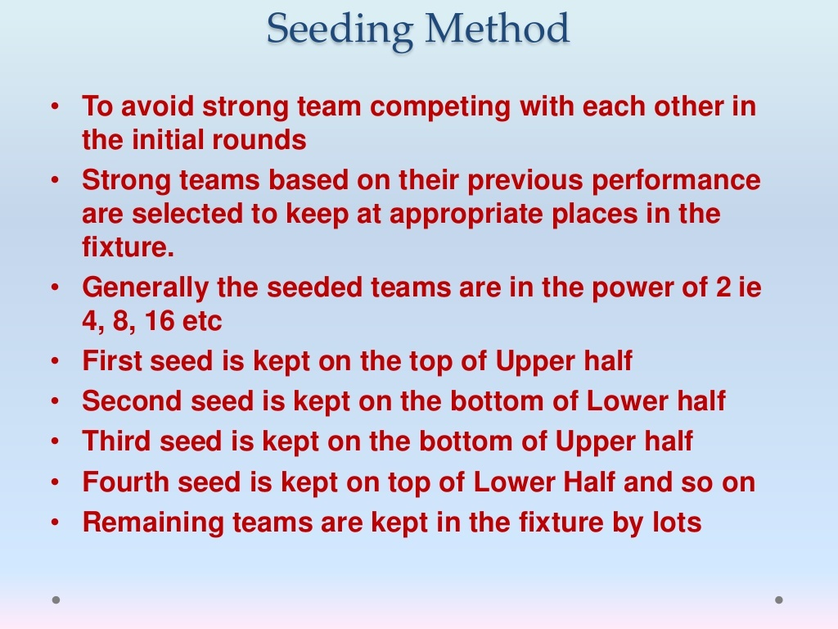

Slide 27
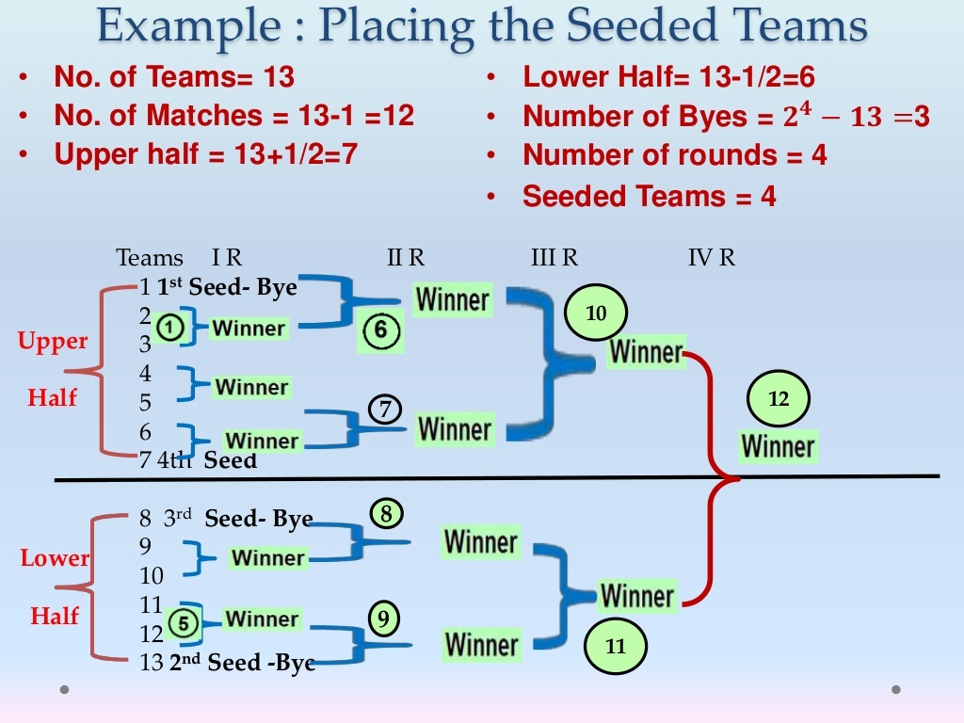

Slide 28
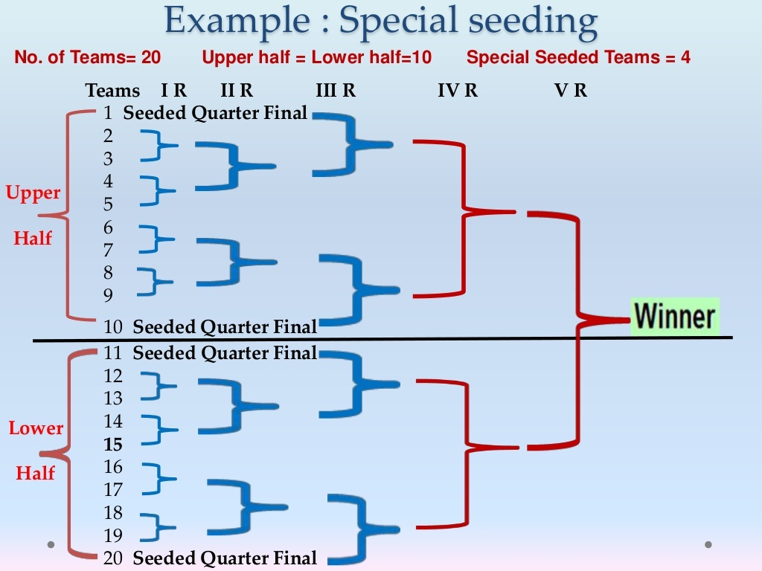

Slide 29
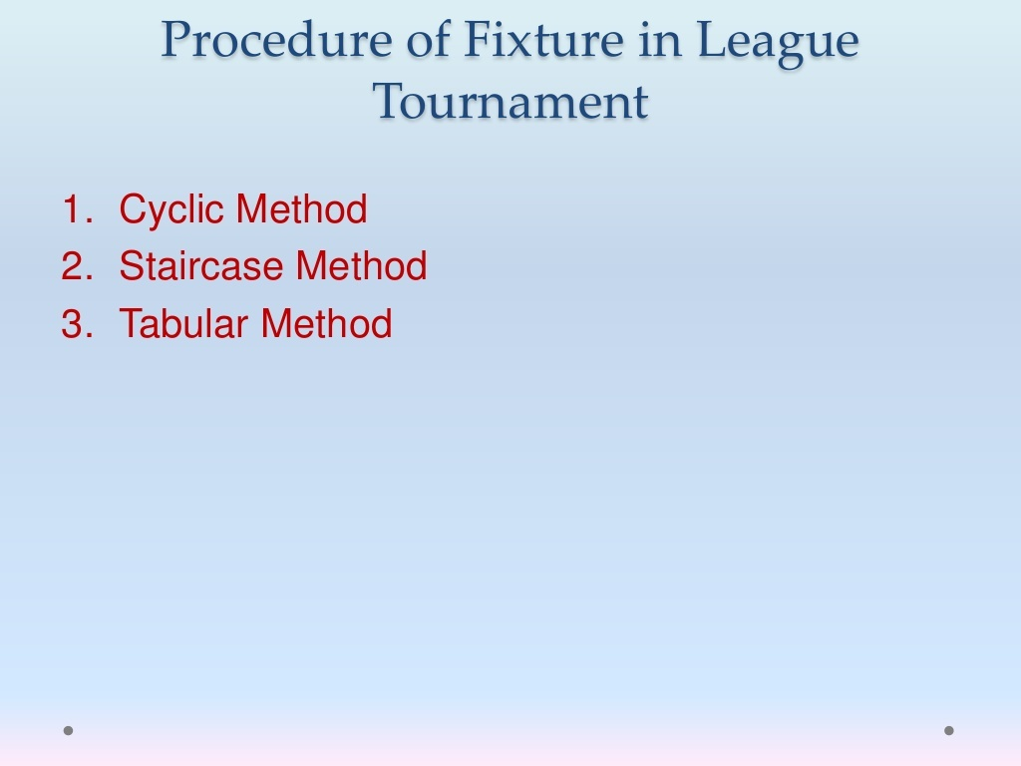

Slide 30
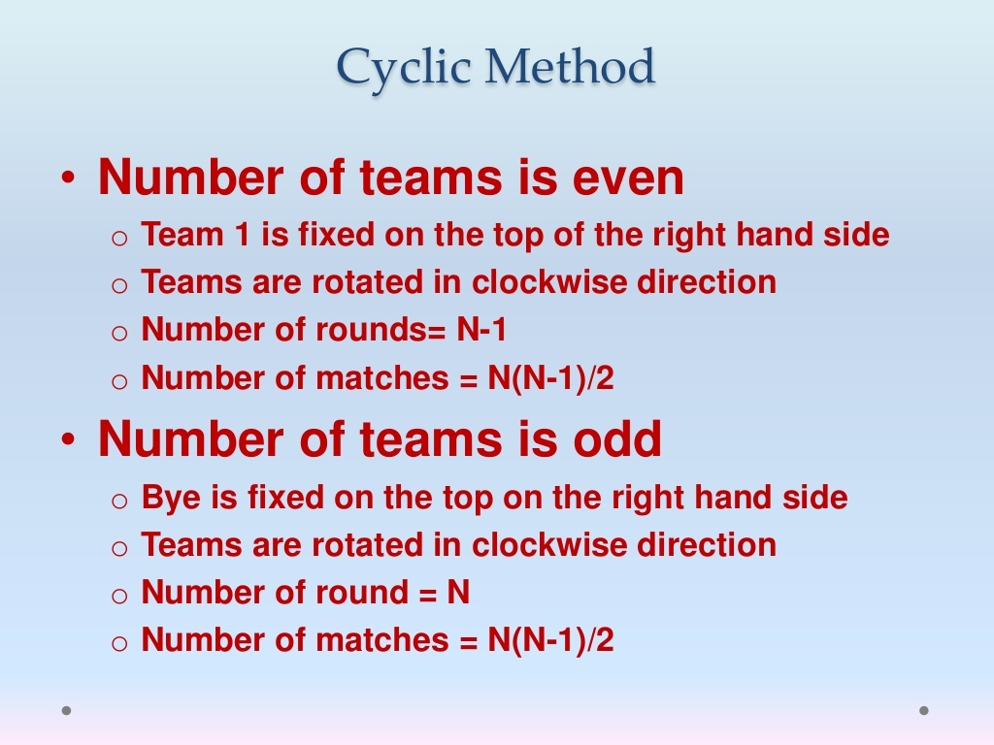

Slide 31
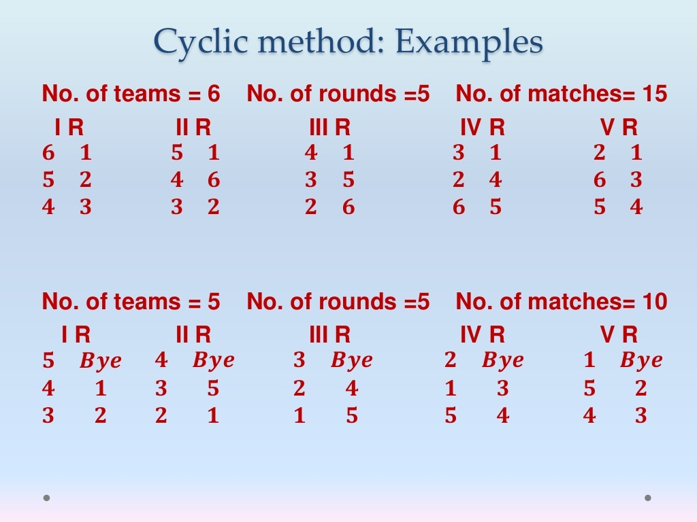

Slide 32
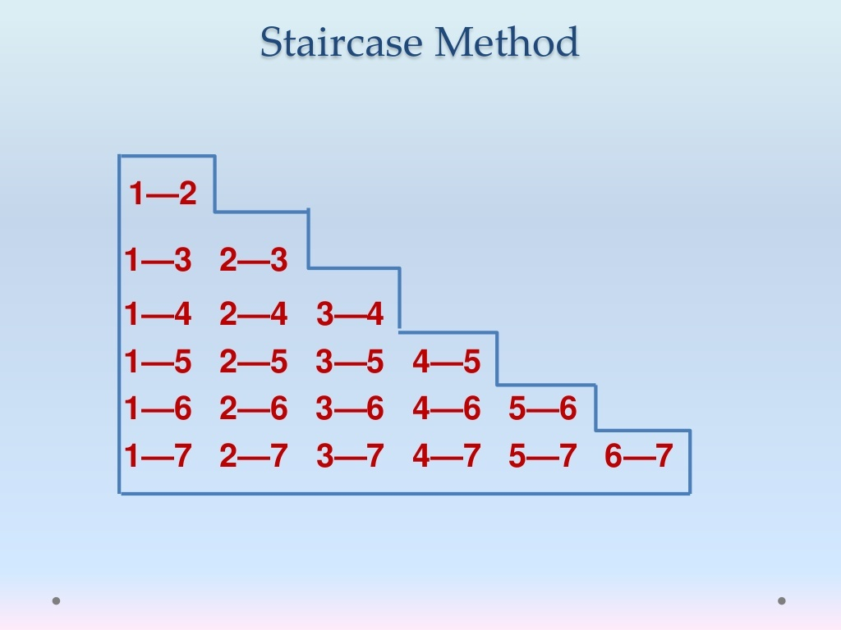

Slide 33
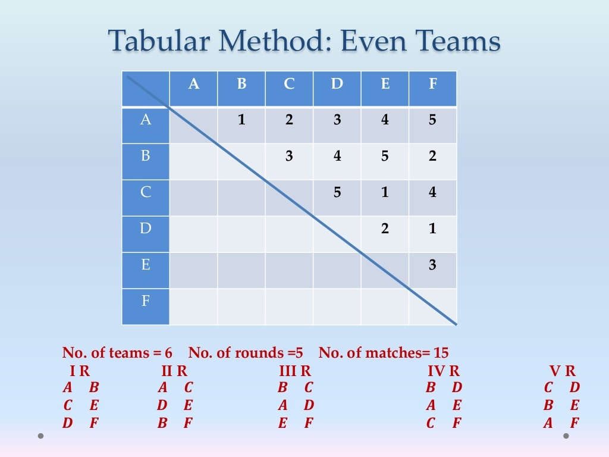

Slide 34


Slide 35
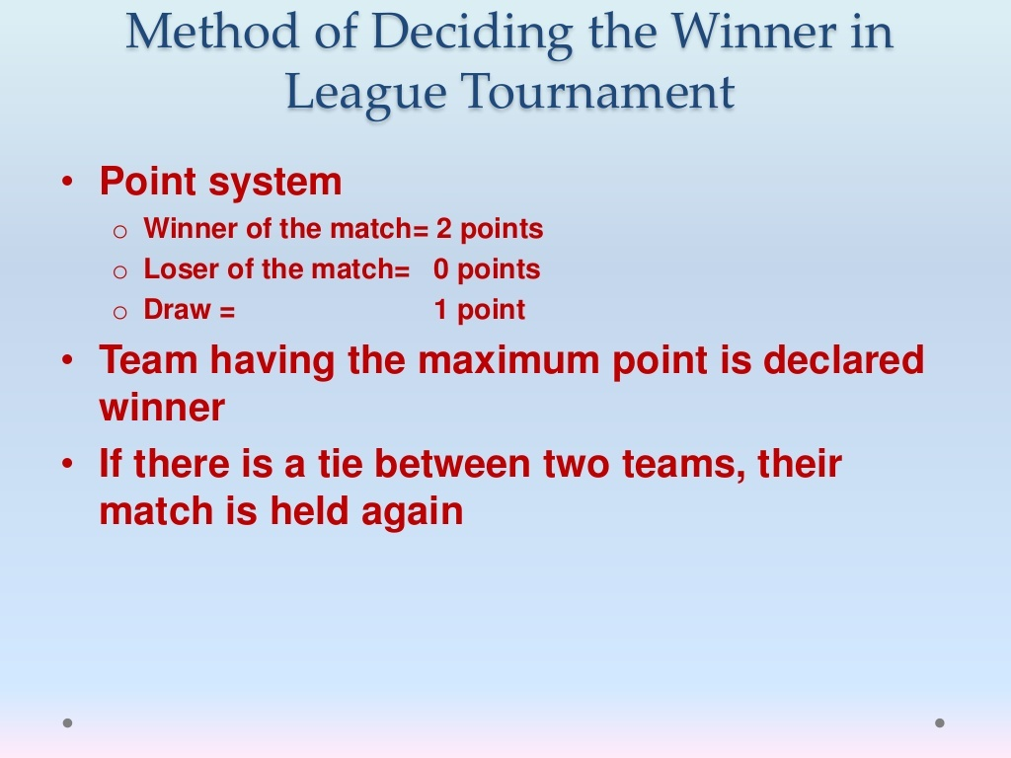

Slide 36
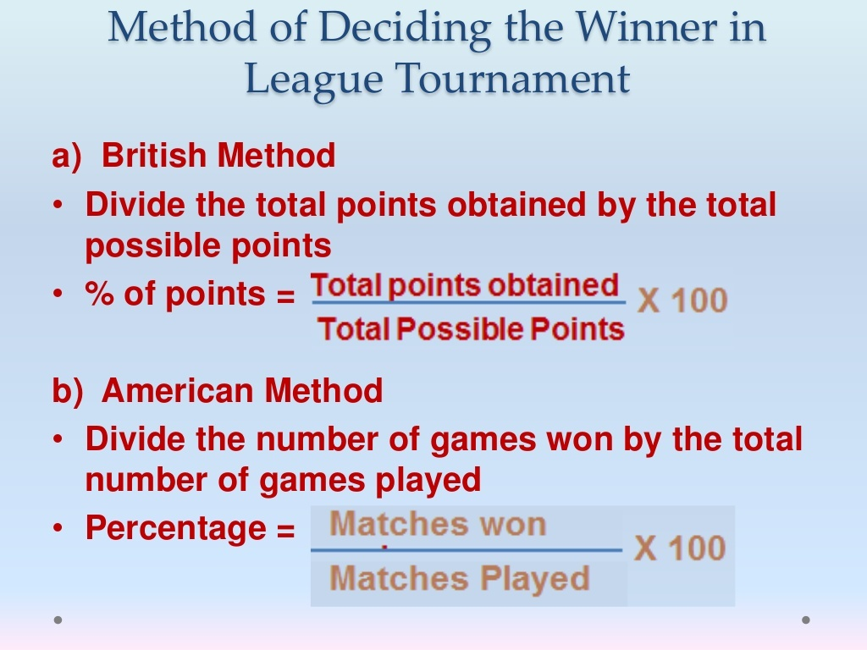

Slide 37
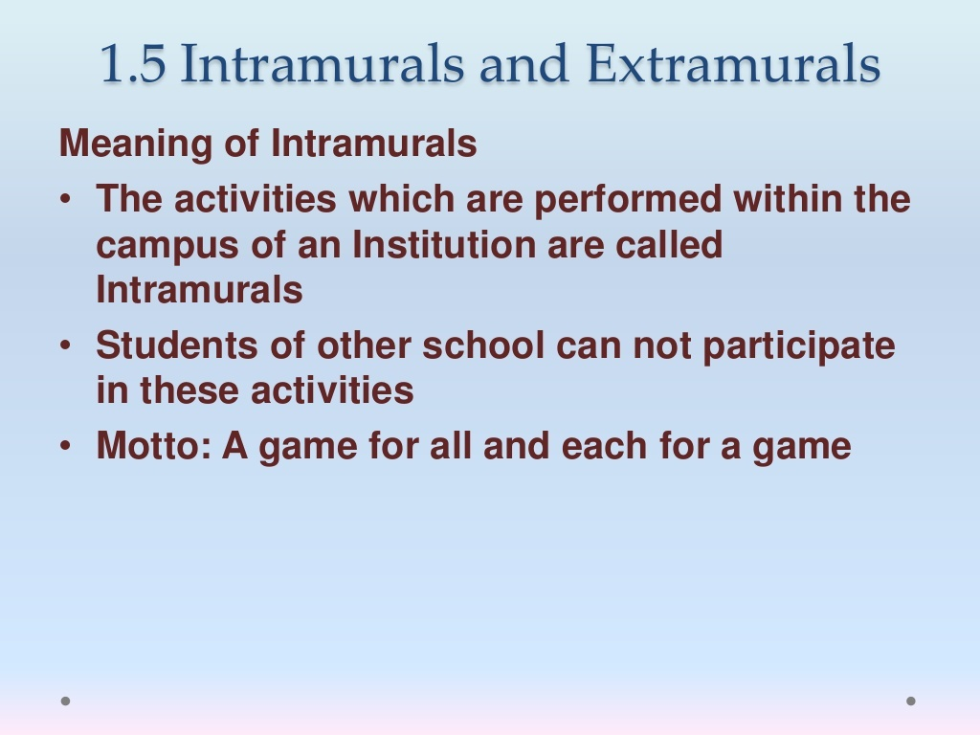

Slide 38


Slide 39
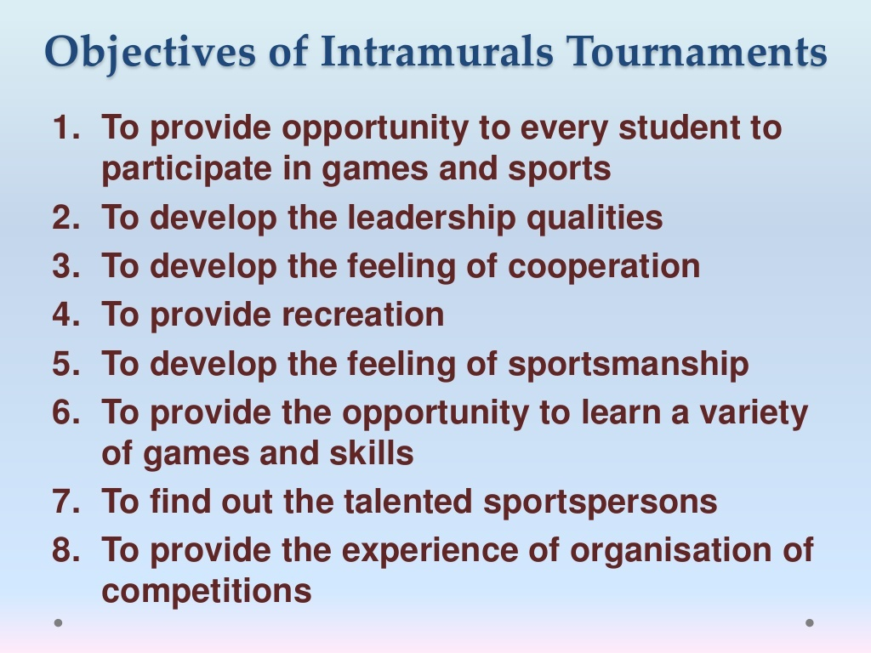

Slide 40
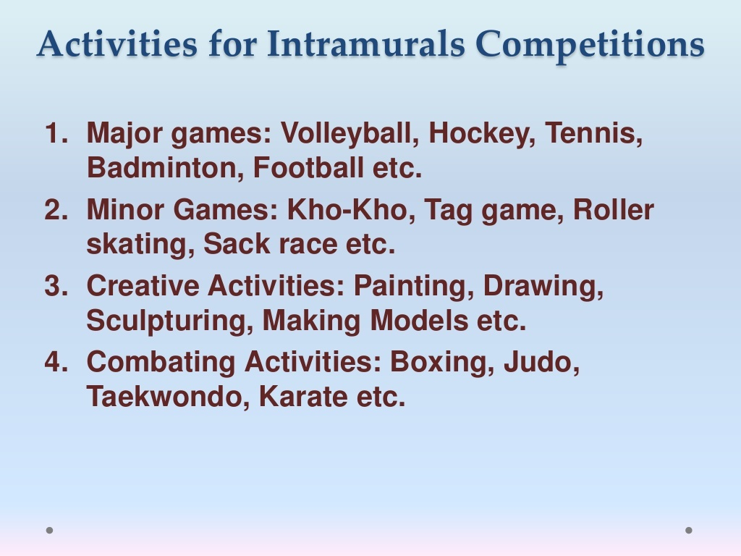

Slide 41
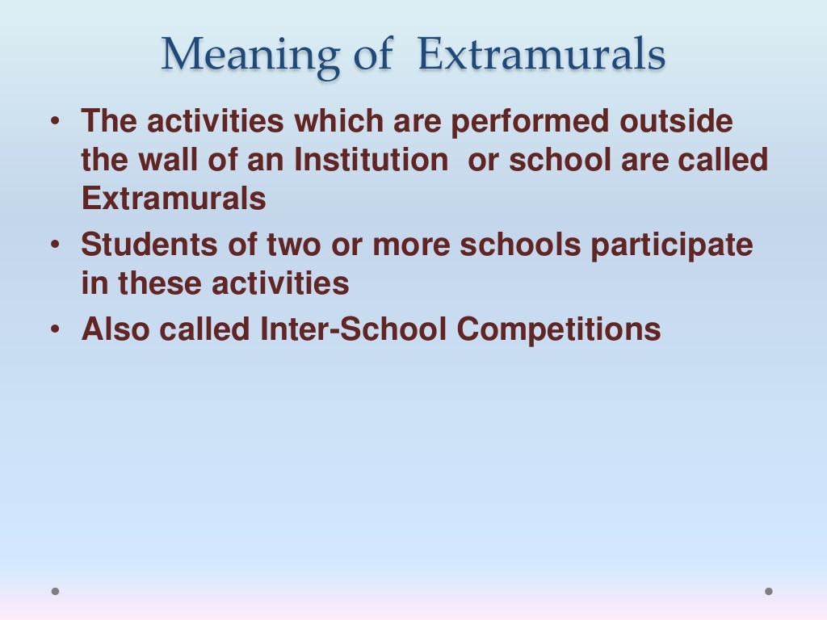

Slide 42
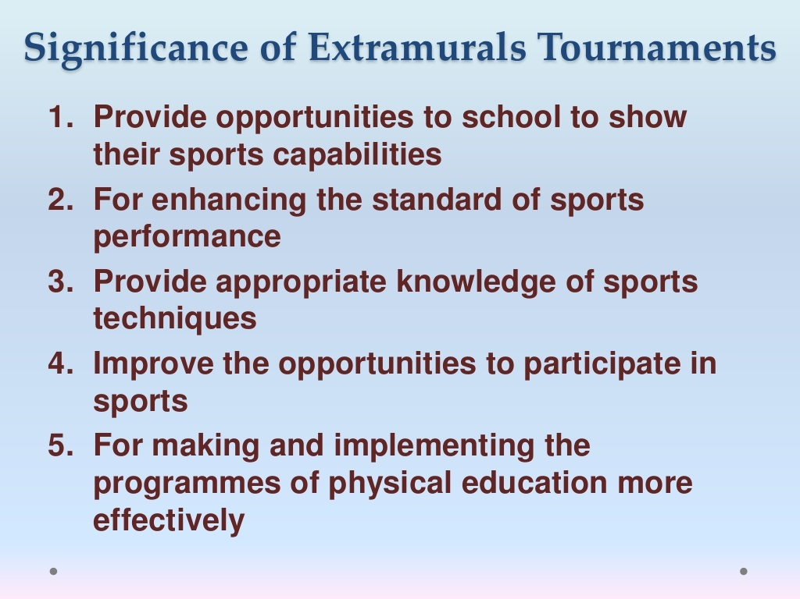

Slide 43
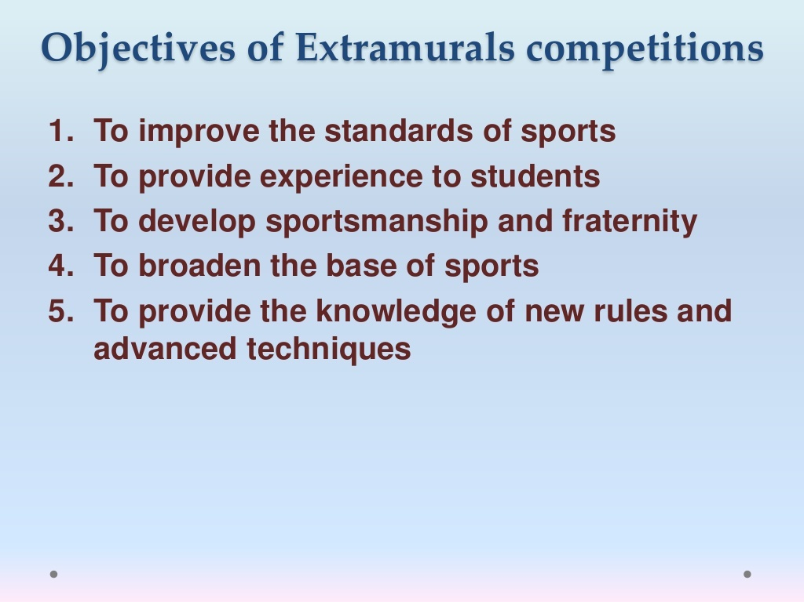

Slide 44
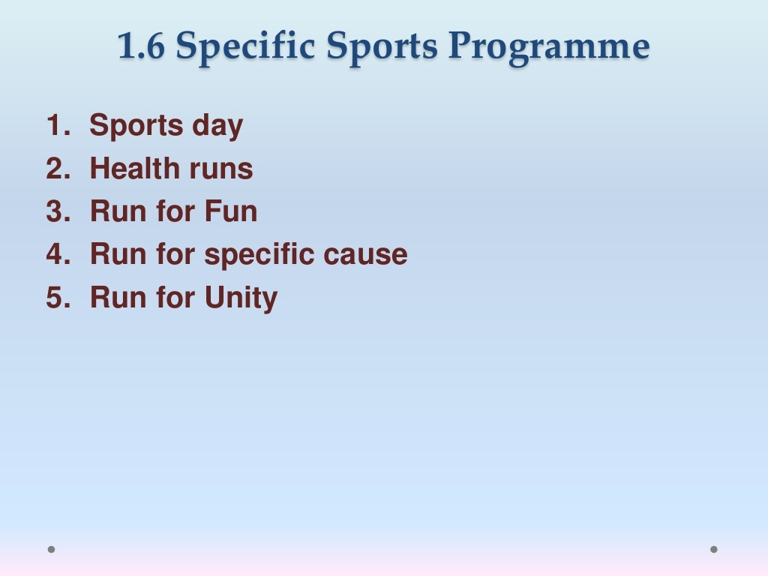

Slide 45
THANKING YOU
ODM EDUCATIONAL GROUP

