Slide 1


TRAINING IN SPORTS
SUBJECT : PHYSICAL EDUCATION
CHAPTER NUMBER: 10
CHAPTER NAME : TRAINING IN SPORTS

Slide 2


WHAT WE EXPECT TO LEARN?
01
Strength & Endurance
02
Speed
03
Flexibility
04
Coordinative Abilities

Slide 3
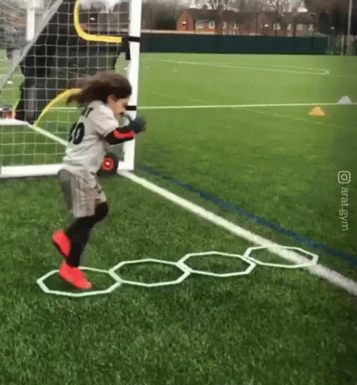
WHAT IS SPORTS TRAINING?
Training means the process of preparation for some task.
Sports training is a planned process which aims at improving a player’s fitness and wellness.
Sports training is the point of view to focus on our game of choice.

Slide 4


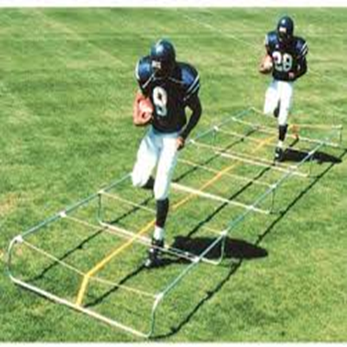
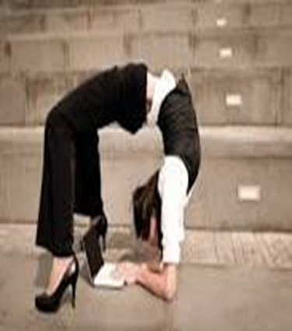
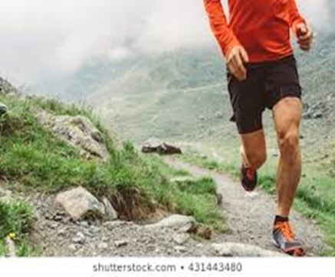
COMPONENTS OF PHYSICAL FITNESS
Strength
Speed
Endurance
Flexibility
Coordinative abilities

Slide 5
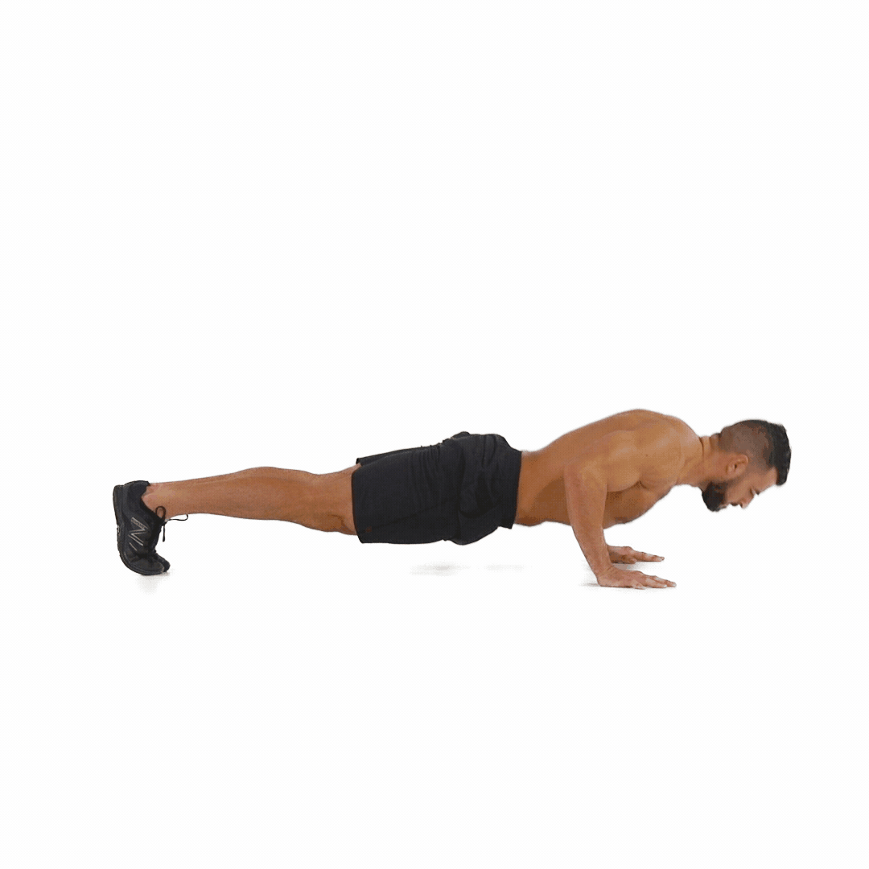
WHAT IS STRENGTH?
Strength is a major component of physical fitness, it also defined as the amount of force a muscle or muscle group can exert. Strength of the body can be measured in pounds/dynes.
It is the ability of muscles to overcome resistance.
Strength of the body can be measured in pounds or dynes.

Slide 6

DEFINITIONS OF STRENGTH
01
According to Barrow and McGee
“Strength is the capacity of the whole body or of any of its parts to exert force.”
02
According to Mathews
“Muscular strength is the force that a muscle or group of muscles can exert against a resistance in one maximum effort.”

Slide 7
THE VARIOUS TYPES OF STRENGTH
STRENGTH
DYNAMIC STRENGTH
MAXIMUM STRENGTH
EXPLOSIVE STRENGTH
STATIC STRENGTH
STRENGTH ENDURANCE

Slide 8
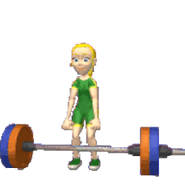
DYNAMIC STRENGTH
Dynamic strength known as Isotonic Strength, because it is related to the movements.
Movements are clearly visible when someone used dynamic strength.
E.g.: Pullups, Push ups, we required dynamic strength.

Slide 9
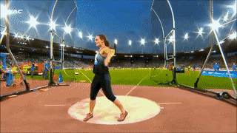
DYNAMIC STRENGTH
MAXIMUM STRENGTH
It is the ability to act against maximum resistance.
Maximum strength is not usually used in majority of sports.
It usually used in those sports in which very heavy resistances have to tackled like weight lifting, shot-put, discuss throw, javelin throw, hammer throw.

Slide 10
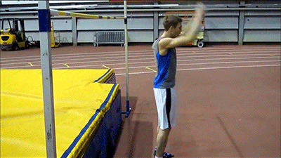
DYNAMIC STRENGTH
EXPLOSIVE STRENGTH
It can be defined as the abilities to overcome resistance with high speed, it is a combination of strength and speed abilities.
Generally used in sprint start, weight lifting, shot put, javelin throw, discuss throw, long jump, high jump, triple jump, pole vault.

Slide 11
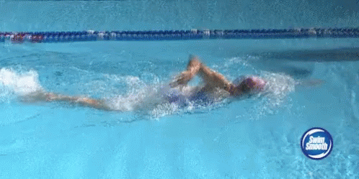
DYNAMIC STRENGTH
ENDURANCE STRENGTH
It can be defined as the ability to overcome resistance or to act against resistance under conditions of fatigue. its commonly used in long distance recess, swimming, road cycling, pole vault and combative sports.

Slide 12
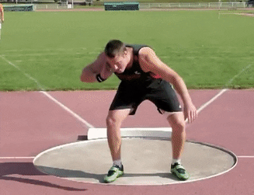
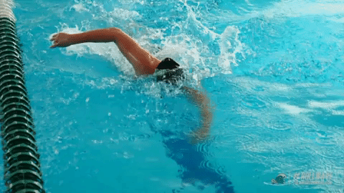
DYNAMIC STRENGTH
MAXIMUM STRENGTH
the abilities to overcome resistance.
EXPLOSIVE STRENGTH
The abilities to overcome resistance with high speed
ENDURANCE STRENGTH
the ability to overcome resistance or to act against resistance under conditions of fatigue
swimming, road cycling
weight lifting, shot-put, discuss throw, javelin throw, hammer throw
long jump, high jump, triple jump, pole vault

Slide 13
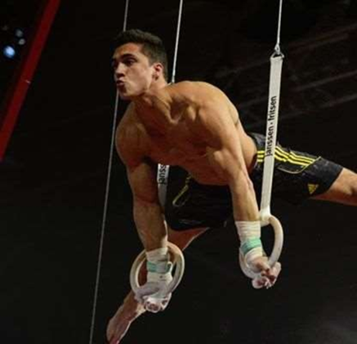
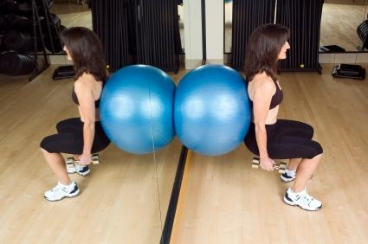
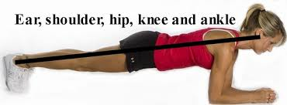
STATIC STRENGTH
Static strength known as Isometric Strength.
It is the ability of muscles to exert the resistance from a stationary position.
It is the ability of muscles to act against resistance.
It measure by Dynamometer.
This types of strength is not seen directly.
It not usually applied in sports but in weight lifting it is applied in phases.

Slide 14


What do you understand the meaning of strength?
Briefly explain about the importance of sports training.
Mention the types of strength, Differentiate between Dynamic & Static strength.
Give any three specific sports examples which involve in Maximum, Explosive & Strength Endurance.
Notes:
NN

Slide 15
THANKING YOU
ODM EDUCATIONAL GROUP

Slide 16
METHODS FOR IMPROVING STRENGTH
ISOTONIC EXERCISES
ISOKINETIC EXERCISES
ISOMETRIC EXERCISES

Slide 17
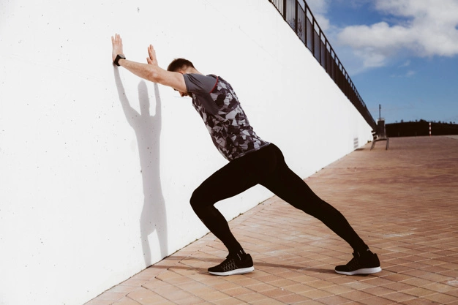
METHODS FOR IMPROVING STRENGTH
ISOMETRIC EXERCISES
Isometric exercise were started by Hytingh and Muller in 1953.
‘Iso’ means ‘Same’ and ‘Metric’ means ‘Length’.
No change in the length of the muscles.
A group of muscles are stretched more than the other group.
Work done cannot be observed.
There are no direct movement.
Require less time and equipment.
Example – pushing the wall, hanging on pole, plank, etc.
Work done = Force X Distance moved

Slide 18
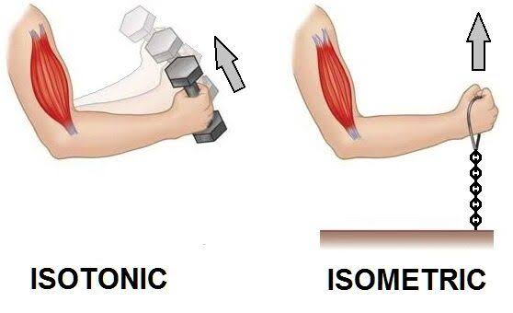
METHODS FOR IMPROVING STRENGTH
ISOTONIC EXERCISES
Isotonic exercise were propounded by D. Loon in 1954.
‘Iso’ means ‘Same’ and ‘Tonic’ means ‘Tension’.
Movements of muscles can be observed directly.
Work is done in these exercises.
Muscles become flexible and tone up.
Length of the muscles can be increased by these exercise.
These are the best for strength development.
These exercise can be done with or without technical equipment.
Example – calisthenics exercise, running, jumping, weight training, etc.

Slide 19
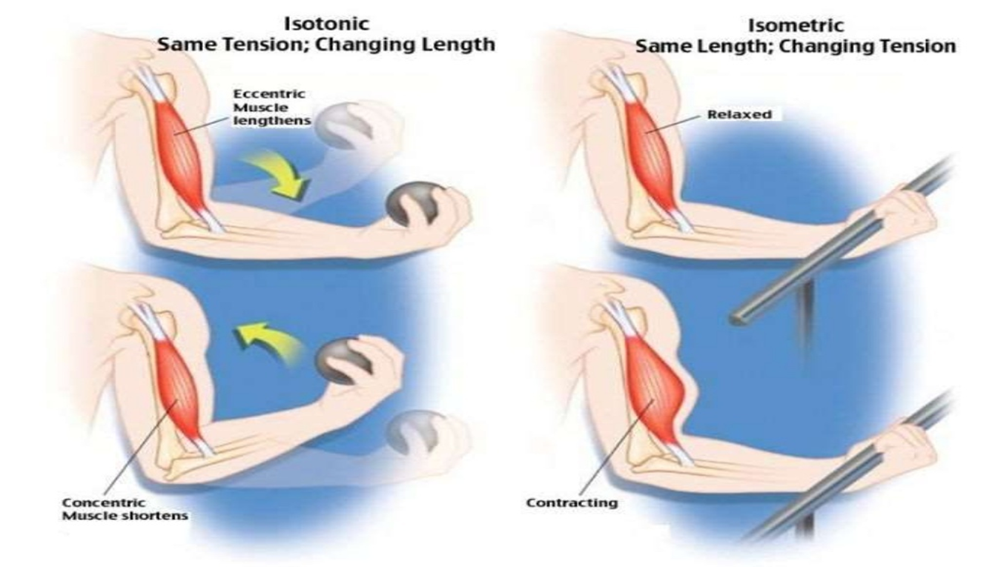
DIFFERENCE BETWEEN ISOTONIC & ISOMETRIC EXERCISES

Slide 20
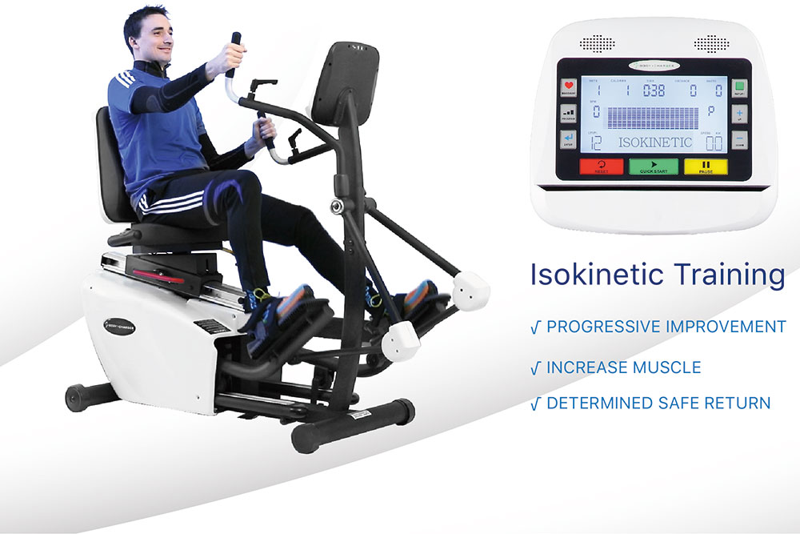
METHODS FOR IMPROVING STRENGTH
ISOKINETIC EXERCISES
These exercise were developed by Perrine in 1968.
‘Iso’ means ‘Same’ and ‘Kinetic’ means ‘Motion’.
These exercises involve a specific type of muscle contraction.
Exercises are done using specially design machine and are combination of isometric and isotonic exercise.
These machines allow for maximum resistance over the complete range of motion.
These types of exercises are usually applied in water-sports such as rowing and swimming.

Slide 21
Explain in detail about the methods to improving Strength ability of an individual.
Differentiate between Isotonic & Isometric Exercises.

Slide 22
THANKING YOU
ODM EDUCATIONAL GROUP

Slide 23
ENDURANCE
SUBJECT : PHYSICAL EDUCATION
CHAPTER NUMBER: 10
CHAPTER NAME : TRAINING IN SPORTS

Slide 24

WHAT IS ENDURANCE?
It is the ability of muscles to sustain the activities for a longer period of time without any fatigue.
Endurance depends on the Slow Twitch Fibres.
Endurance or stamina is measured by the number of Repetitions.

Slide 25
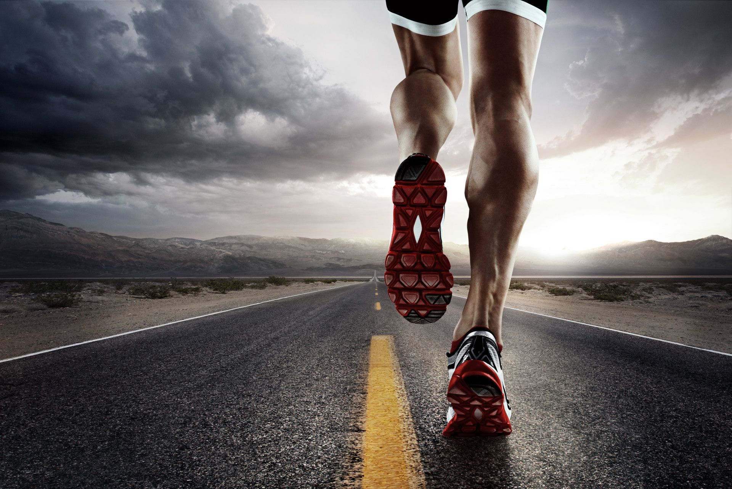
DEFINITIONS OF ENDURANCE
01
According to Barrow and McGee
“Endurance as the result of a physiologic capacity of individual to sustain movement over a period of time.”
02
According to Herre
“Endurance as the ability to resist fatigue.”

Slide 26
TYPES OF ENDURANCE
Short Term
Long Term
ANAEROBIC ENDURANCE
AEROBIC ENDURANCE

Slide 27

DIFFERENCE BETWEEN AEROBIC & ANAEROBIC
AEROBIC
Presence of oxygen
Moderate intensity
ANAEROBIC
Absence of oxygen
High intensity
Long duration
Short duration
Develops stamina
Burns calories during the activity
Develops force
Burns calories even when the body is at rest

Slide 28
TYPES OF ENDURANCE ACCORDING TO
THE NATURE OF ACTIVITY
BASIC ENDURANCE
GENERAL ENDURANCE
SPECIFIC ENDURANCE
THE DURATION OF ACTIVITY
SPEED ENDURANCE
SHORT TERM ENDURANCE
MIDDLE TERM ENDURANCE
LONG TERM ENDURANCE

Slide 29
What is Endurance?
Differentiate between Aerobic & Anaerobic activities.
How to measure core muscles endurance.

Slide 30
THANKING YOU
ODM EDUCATIONAL GROUP

Slide 31

THE NATURE OF ACTIVITY
BASIC ENDURANCE
It is called aerobic endurance.
Large number of body muscles are involved.
The movement is performed at a slow pace for a long duration.
i.e. jogging, walking, slow running, swimming at moderate speed for more thane 30 min.

Slide 32
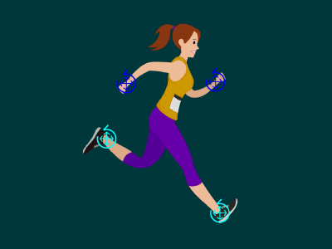
THE NATURE OF ACTIVITY
GENERAL ENDURANCE
Its may be aerobic or anaerobic in nature.
Its may be low or high intensity but for a longer duration.
This duration is must shorter than required for basic endurance activities.
i.e. activities for a long duration without getting tired.

Slide 33

THE NATURE OF ACTIVITY
SPECIFIC ENDURANCE
The ability to resist fatigue caused by a particular sports activity.
The nature of fatigue is different for different sports.
i.e. for wrestler – three round or six min, but For boxer – four round.

Slide 34

THE DURATION OF ACTIVITY
SPEED ENDURANCE
The ability to resist fatigue in activities lasting up to 45 seconds.
Speed endurance in mainly dependent on the power and capacity of energy production.
Example 400 m sprint

Slide 35
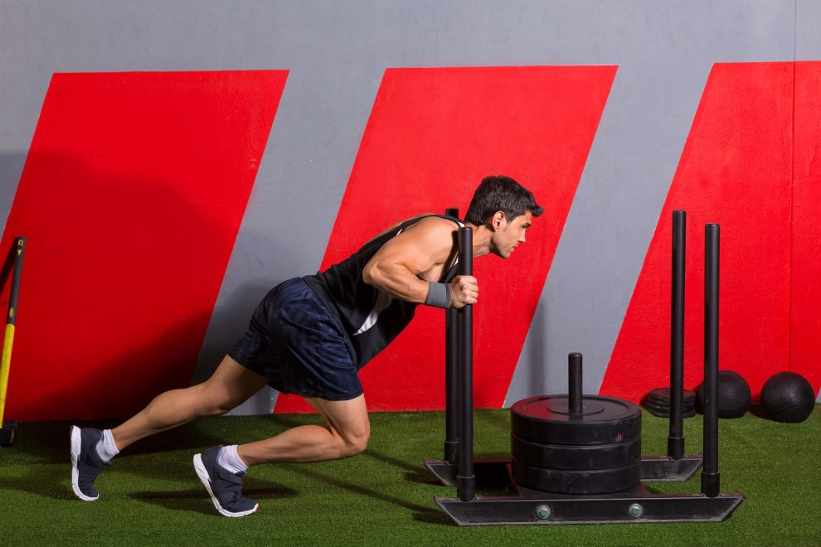
THE DURATION OF ACTIVITY
SHORT TERM ENDURANCE
Activities lasting from about 45 sec to 2 minutes.
This endurance depends to a large extent on strength endurance and speed endurance.
Example - 800 m race

Slide 36
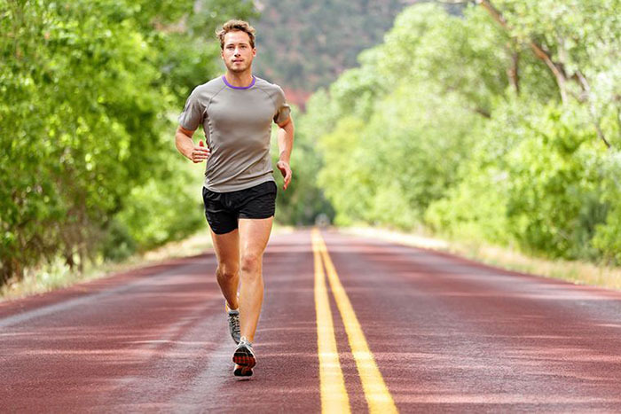
THE DURATION OF ACTIVITY
MIDDLE TERM ENDURANCE
Activities lasting from 2 to 11 minutes.
It also depends on strength endurance and speed endurance but to a limited degree.
Example - 1500 m race

Slide 37
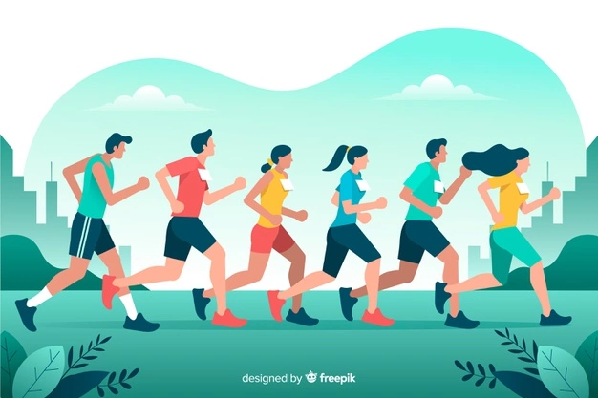
THE DURATION OF ACTIVITY
LONG TERM ENDURANCE
Activities lasting more than 11 minutes.
Example - 5000 M, 10000 M, marathon races etc.

Slide 38
METHODS TO DEVELOP ENDURANCE
METHODS TO DEVELOP ENDURANCE
CONTINUOUS TRAINING
INTERVAL TRAINING
FARTLEK TRAINING

Slide 39
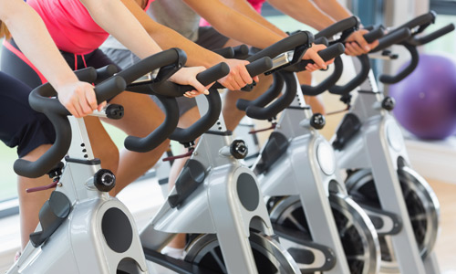
METHODS TO DEVELOP ENDURANCE
CONTINUOUS TRAINING
In this methods of training, an exercise is performed for a long duration without any break.
Intensity remain low because the exercise is done for a longer period.
The rate of heartbeat remains in between 140 – 160 b/m.
The total duration should not be less than 30 minutes.

Slide 40
State continuous training method in brief.
Briefly Explain about Basic, General & Specific Endurance.
What is Speed Endurance?
What is Short Term Endurance?
What is middle Term Endurance?
What is Long Term Endurance?

Slide 41
THANKING YOU
ODM EDUCATIONAL GROUP

Slide 42

CONTINUOUS TRAINING
ADVANTAGES
It increases glycogen in muscles and liver.
It increases the number and size of mitochondria.
It increases the efficiency of heart and lungs.
It improves willpower.
It makes the individual self disciplined and self-confident.

Slide 43
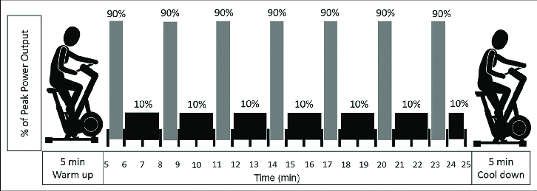
METHODS TO DEVELOP ENDURANCE
INTERVAL TRAINING
Bikila, the famous athletic coach of Finland, introduced this training method in 1920.
The importance of rhythm between work and rest in the method, is called Terrace Training.
Tonney, the German coach says,
Runs at speed of 80 % (150 to 180). In the rest (120 to 140) is the best recovery time for speed endurance.
Its based on “Effort and recovery” principle.

Slide 44
METHODS TO DEVELOP ENDURANCE
INTERVAL TRAINING
400 M RACE
4oo m race with 80 % speed
Walking or jogging until, heart rate comes done 120 to 140 approx.
400 m race 80 % speed
NOTE :- The repetitions depend upon the experience or capability of an athlete.

Slide 45

INTERVAL TRAINING
ADVANTAGES
More workout can be performed in a short duration.
Best for respiratory & circulatory system.
The progress of the athlete can be measured easily.
Athlete achieves peak performance in a short time.
Rectify the errors during recovery phase.
Patience can be increased in athletes.

Slide 46
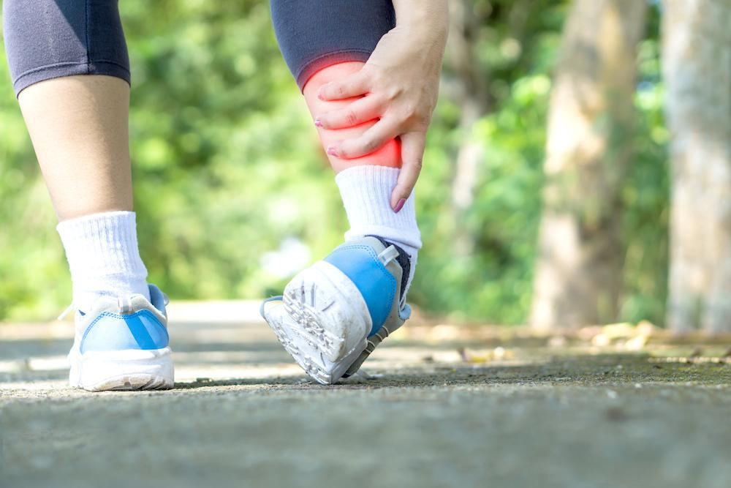
INTERVAL TRAINING
DISADVANTAGES
There are more chances of injuries.
Regular training can lead to heart diseases.
Top performance comes before competition.

Slide 47
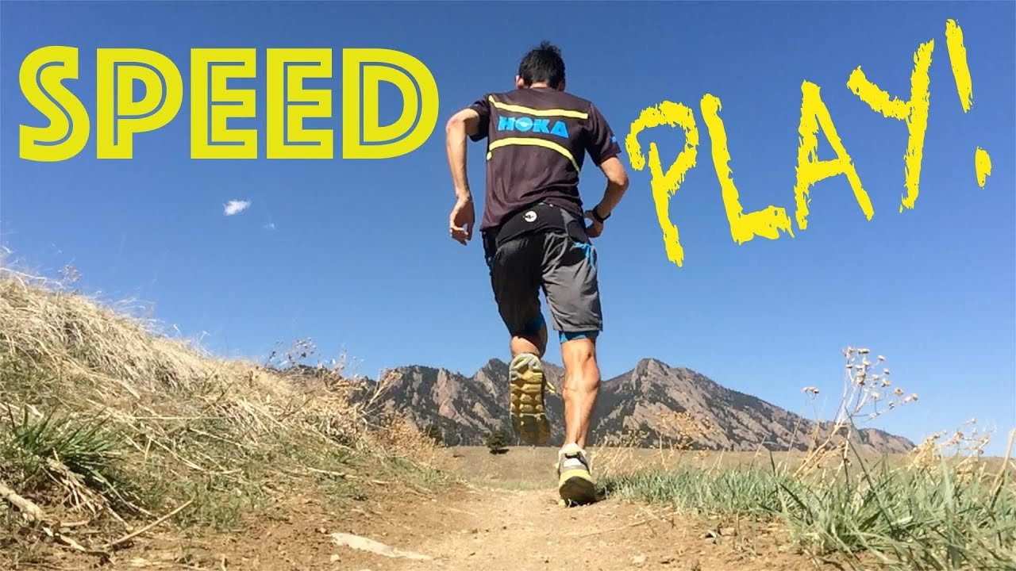
METHODS TO DEVELOP ENDURANCE
FARTLEK TRAINING
Gosta Holmer developed Fartlek Training in 1937.
The word ‘fartlek’ means ‘speed play’. (duration should be 45 minutes).
The heart beat ranges between 140 – 180 per min.
It is a training method that blends continuous training with interval training.
Pace or speed is not pre-planned, can be change according to the surroundings.
(hills, rivers, forests, muddy roads, metal roads and grassy ground)
Self-discipline plays a vital role in fartlek training.

Slide 48
FARTLEK TRAINING
EXAMPLE
Warm-up, jogging or slow running for 5 to 10 min
Hard speed for 1.5 to 2.5 km
Recovery, walking for 5 min
Start of speed work (sprints – 50 to 60 m.)
Easy running 3 or 4 “quick steps”
Fast pace of 1 min.
Full speed uphill for 175 to 200 m.

Slide 49
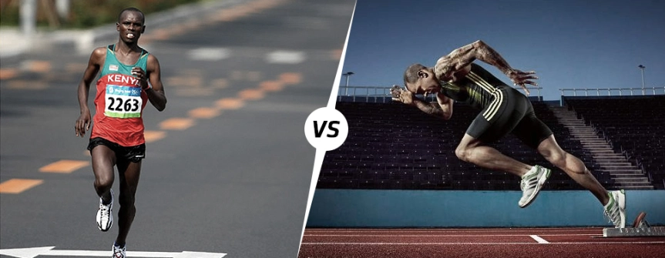
FARTLEK TRAINING
ADVANTAGES
It is good for aerobic (long distance runner) and anaerobic (sprinter) fitness.
Due to the sprinting intervals, it makes the body versatile.
No equipment is required.
It can be easily adapted to the athlete’s need.

Slide 50
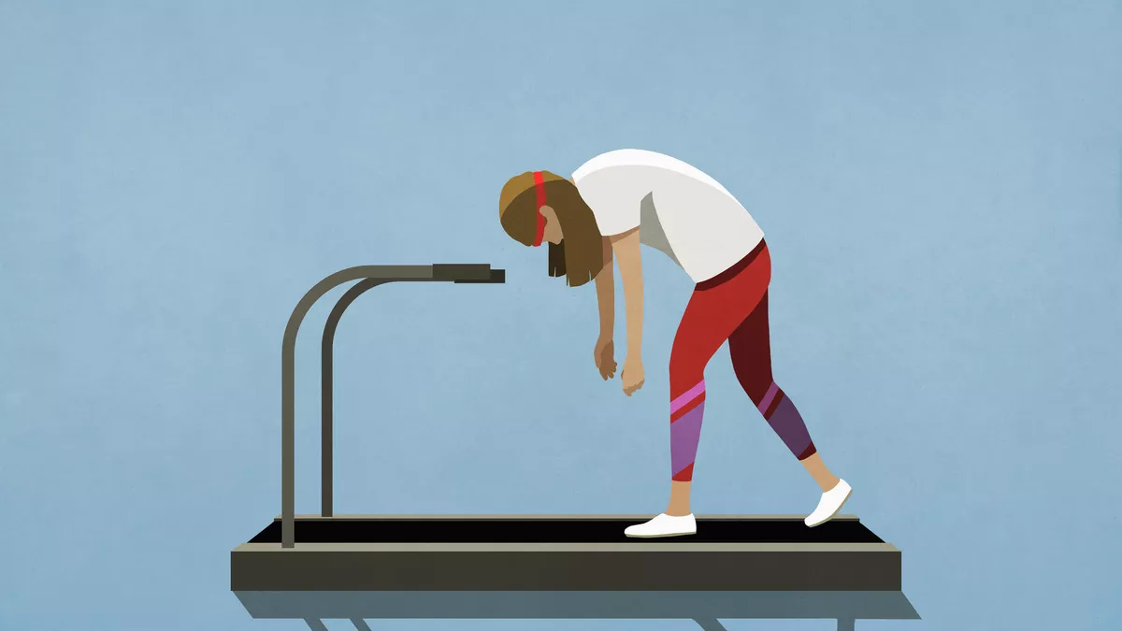
FARTLEK TRAINING
DISADVANTAGES
It is difficult to see how hard the trainee is making efforts.
Sometime the athlete is likely to give up effort.
It may accidents because it is not pre-planned.

Slide 51
Sta

Slide 52
SPEED
SUBJECT : PHYSICAL EDUCATION
CHAPTER NUMBER: 10
CHAPTER NAME : TRAINING IN SPORTS

Slide 53
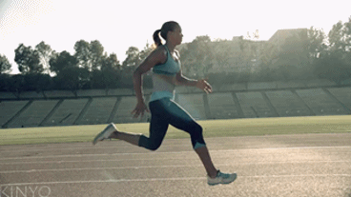
WHAT IS SPEED?
It is the ability or capacity of an individual to perform a movement of the same pattern at faster rate.
Different sports skills require different types of fast movements and quick reactions.

Slide 54
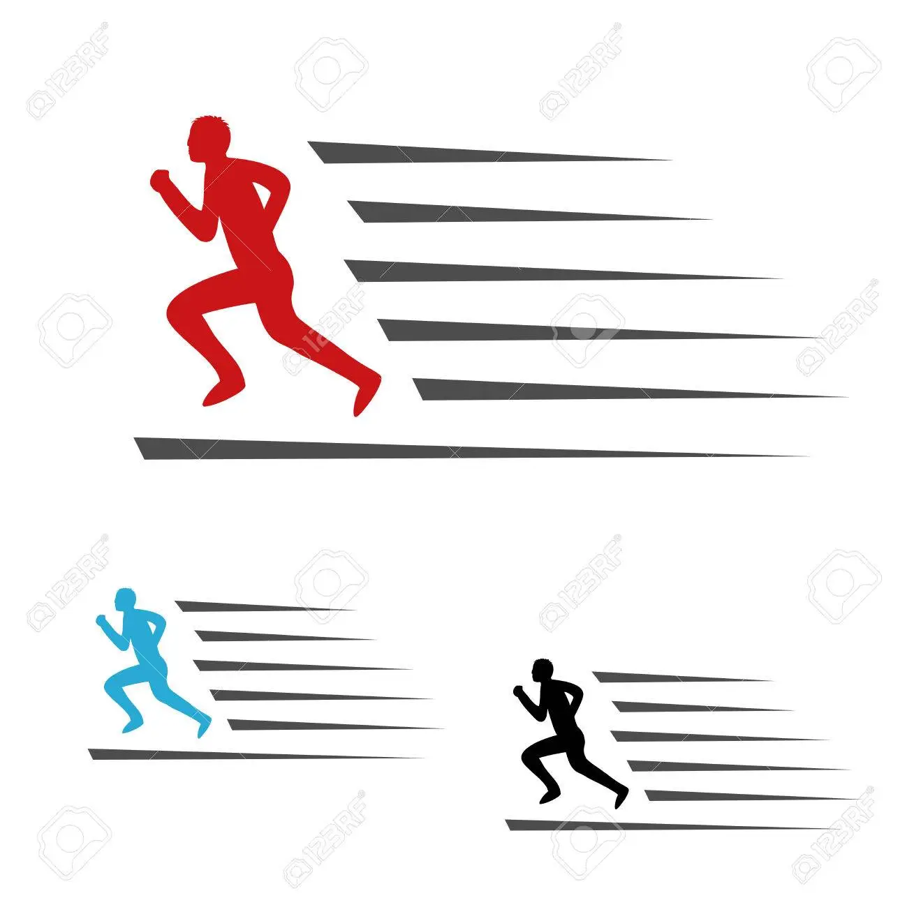
DEFINITIONS OF SPEED
01
According to Barrow and McGee
“The capacity of an individual to perform successive movement of the same pattern at a fast rate.”
02
According to Johnson and Nelson
“The rate at which a person can propel his body or parts of his body.”

Slide 55
TYPES OF SPEED
SIMPLE REACTION ABILITY
COMPLEX REACTION ABILITY
REACTION ABILITY
ACCELERATION ABILITY
MOVEMENT SPEED
LOCOMOTOR ABILITY
SPEED ENDURANCE

Slide 56
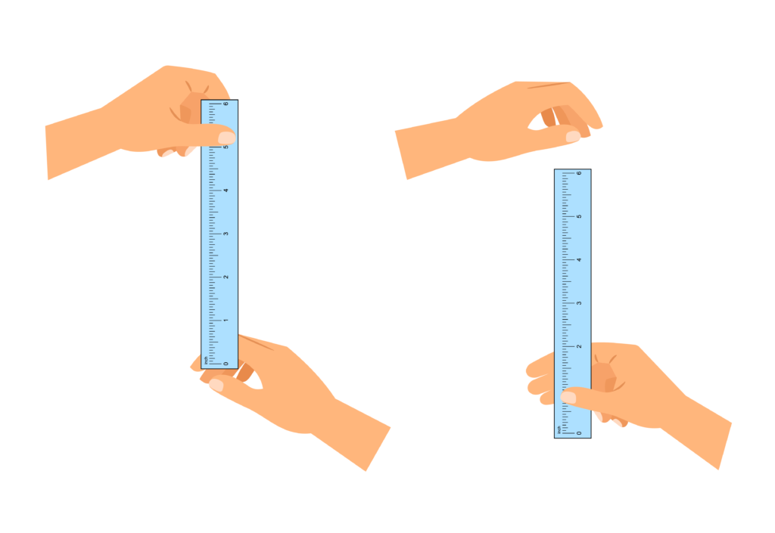
TYPES OF SPEED
REACTION ABILITY
Its also considered a coordination ability.
It is the ability to react effectively and quickly to any action or signal.
In games and sports signals can be of various types such as visual or tactile.

Slide 57
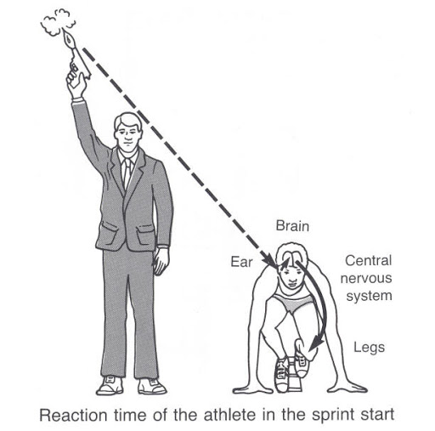
REACTION ABILITY
SIMPLE REACTION ABILITY
It is the ability to react quickly in already determined manner to a known signal.
i.e. the reaction of a racer in the start of sprint races is already known to the racer.

Slide 58
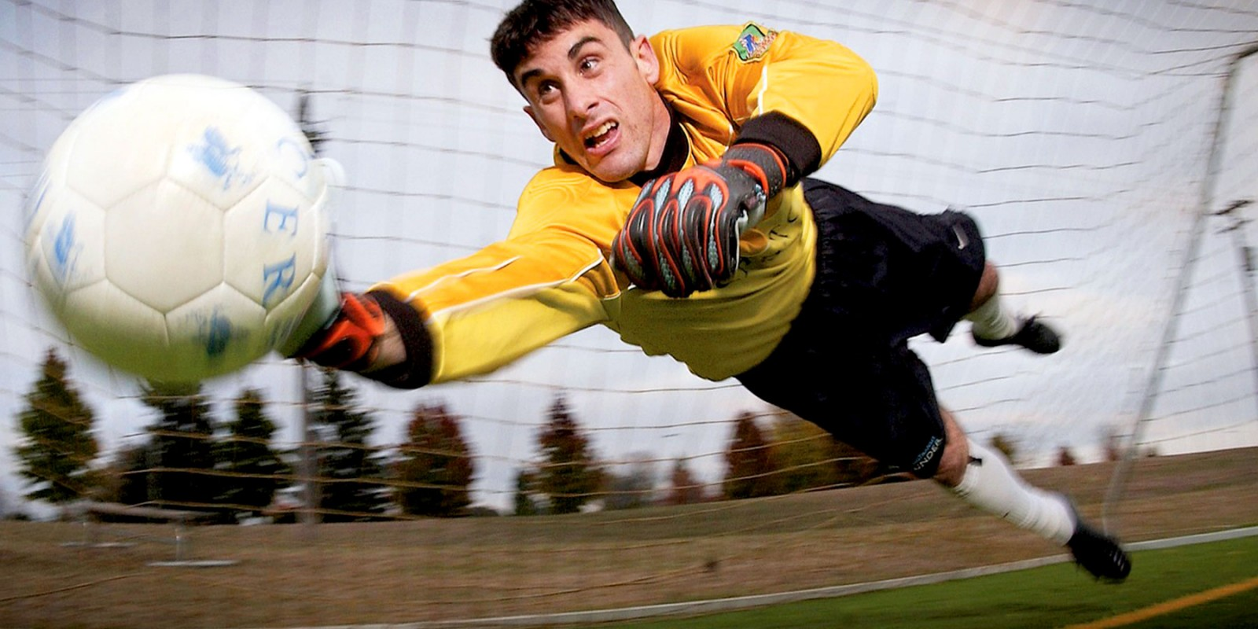
REACTION ABILITY
COMPLEX REACTION ABILITY
It is the ability to react quickly and accurately to undermined or unexpected signals.
i.e. facing a ball in cricket by a batsman.

Slide 59
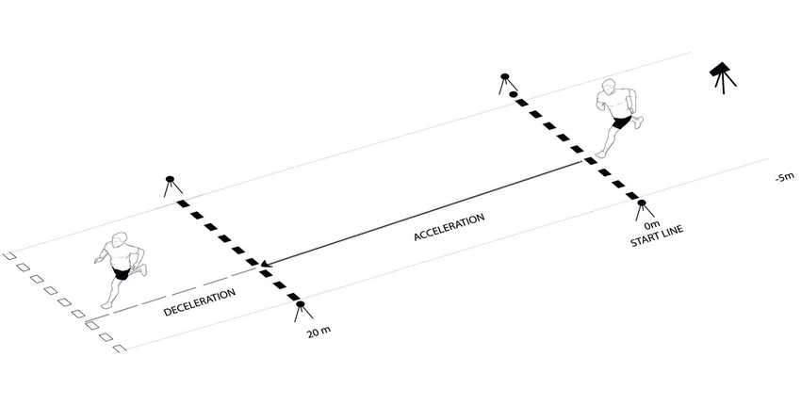
TYPES OF SPEED
ACCELERATION ABILITY
It is the ability to achieve maximum speed from a stationary position or from low speed state.
Sprinters achieve their maximum speed after approximately six seconds.
Its depends upon explosive strength, technique and flexibility.
i.e. sprint races, swimming, hockey, etc.

Slide 60
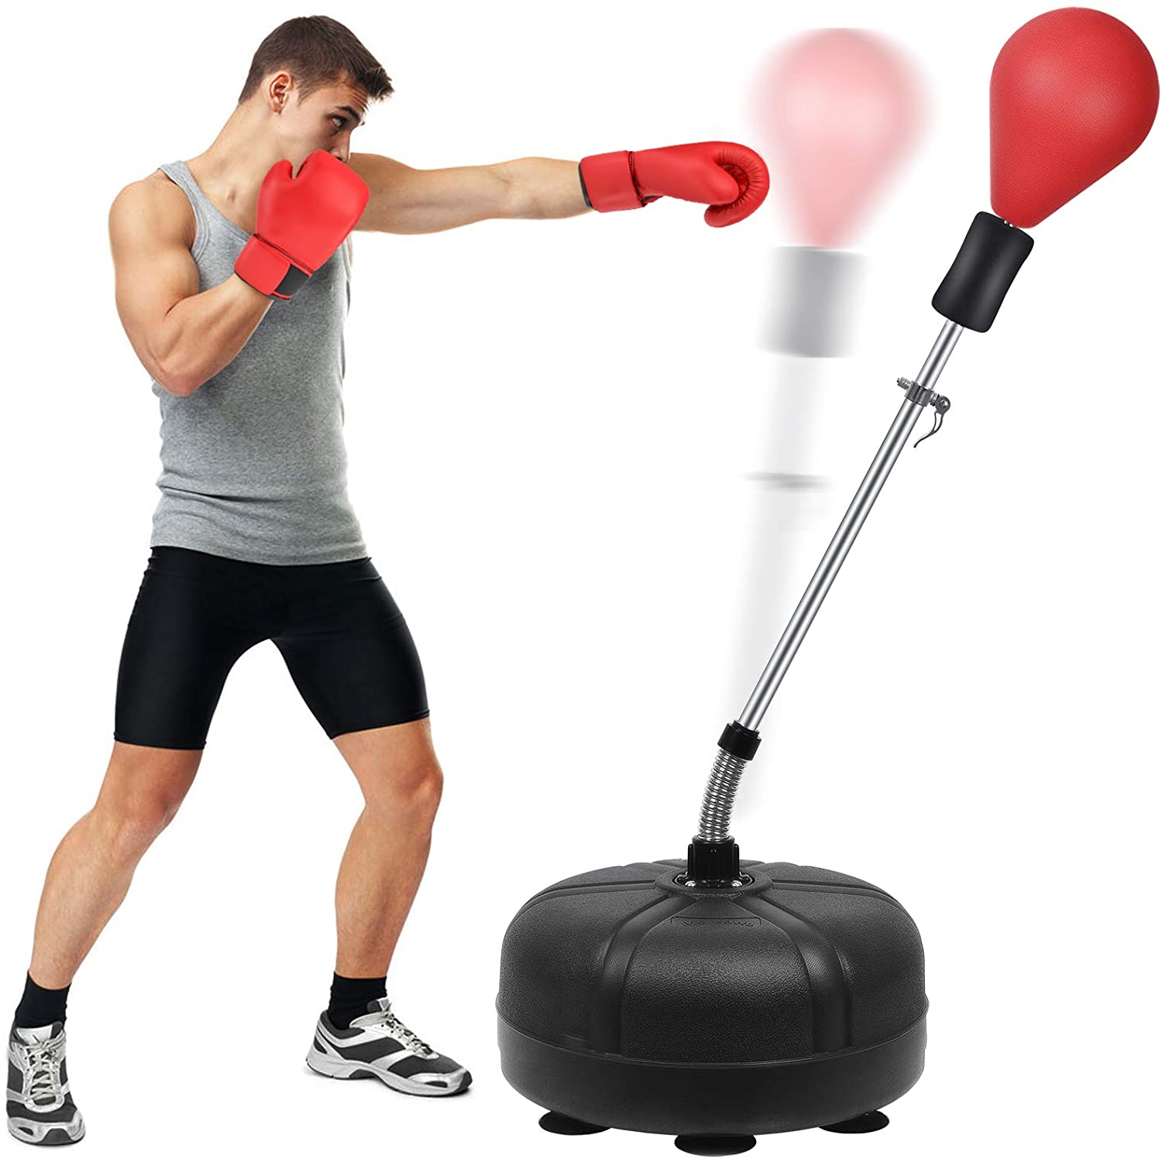
TYPES OF SPEED
MOVEMENT SPEED
It is the ability to do a movement in a minimum time.
It depends upon technique, explosive strength, flexibility and coordinative abilities.
i.e. boxing, wrestling, throws, jumps, etc.

Slide 61
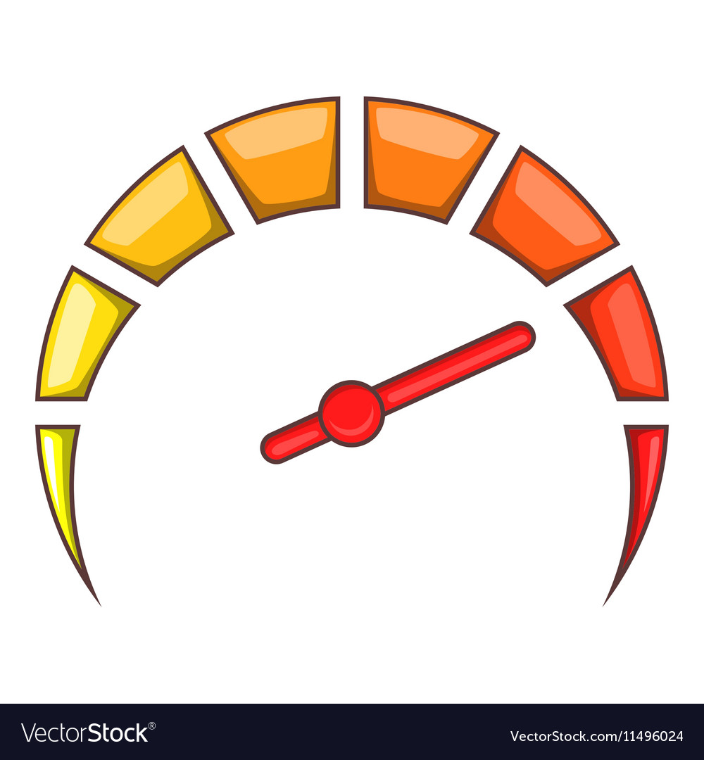
TYPES OF SPEED
LOCOMOTOR ABILITY
It is the ability to maintain maximum speed for maximum time or distance.
This ability is significant in only a few sports events.
i.e. 100 m, 200 m, 400 m, etc.

Slide 62
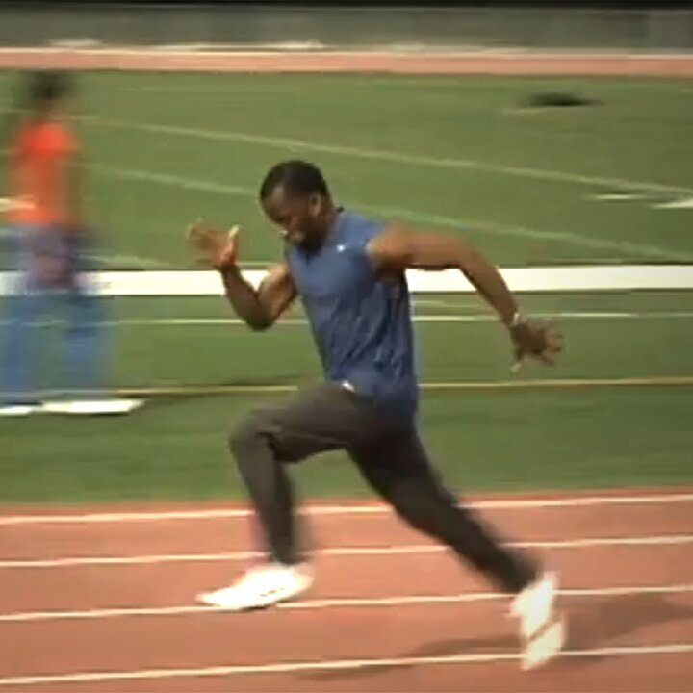
TYPES OF SPEED
SPEED ENDURANCE
It is the ability to perform movements with high speed under conditions of fatigue.

Slide 63
What is Speed? State the role of speed in the field of sports.
Mention the types of speed, differentiate between simple & complex reaction ability.
State the difference between acceleration ability and locomotor ability.

Slide 64
THANKING YOU
ODM EDUCATIONAL GROUP

Slide 65
METHODS TO DEVELOP SPEED
ACCELERATION RUNS
PACE RUNS OR RACES

Slide 66
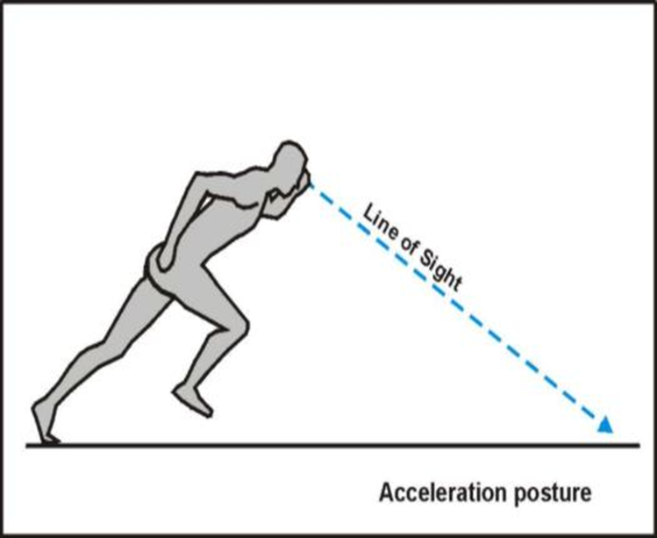
METHODS TO DEVELOP SPEED
ACCELERATION RUNS
This is used to attain maximum speed from stationary position.
These accelerated runs are required over and over again with sufficient intervals between runs.
Sprinters usually achieve their maximum speed in 6 seconds.
50 to 60 M is needed to start, accelerate and maintain maximum speed.
The number of acceleration runs can be fixed according to age, experience, and capacity. (6 to 12 runs)

Slide 67
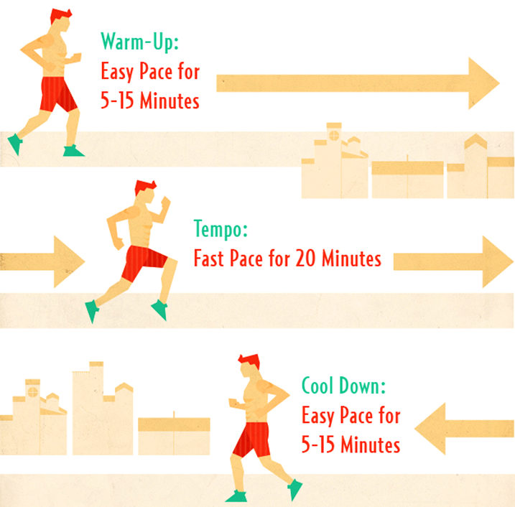
METHODS TO DEVELOP SPEED
PACE RUNS OR RACES
Pace races mean running the whole distance of a race at a constant speed.
800 and above races are included in pace run.
i.e. 800 M race = 1 m 40 sec.
First 400 M =49 sec
Next 400 M = 51 sec.
This procedure is called pace race.
The first part of the race should not be run too fast, otherwise you can’t complete the race.

Slide 68
State any one method to develop speed.
Discuss pace runs as a means to develop speed?

Slide 69
THANKING YOU
ODM EDUCATIONAL GROUP

Slide 70
FLEXIBILITY
SUBJECT : PHYSICAL EDUCATION
CHAPTER NUMBER: 10
CHAPTER NAME : TRAINING IN SPORTS

Slide 71
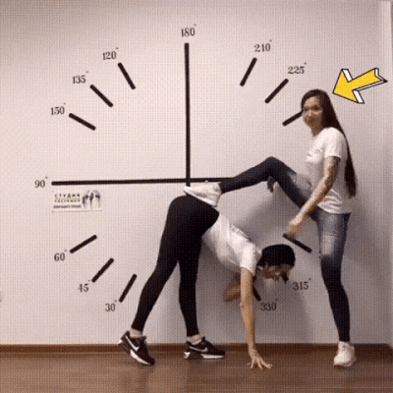
WHAT IS FLEXIBILITY?
Flexibility is the range of motion in a joint or group of joints or the ability to move joints effectively through a complete range of motion.
Flexibility is not only a significant factor in sports but also equally significant for an individual in his/her daily life.

Slide 72
TYPES OF FLEXIBILITY
FLEXIBILITY
Active Flexibility
Static
Dynamic
Passive Flexibility

Slide 73
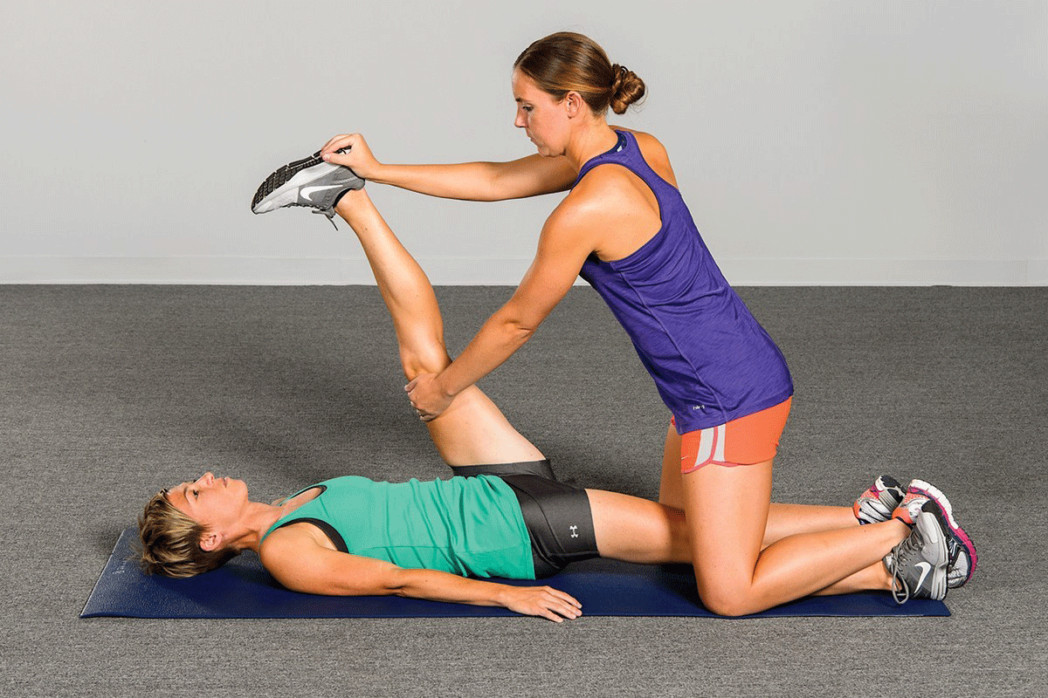
TYPES OF FLEXIBILITY
PASSIVE FLEXIBILITY
The ability to carry out movements to greater distance with the external help.
e. g., stretching exercises with the help of partner.

Slide 74
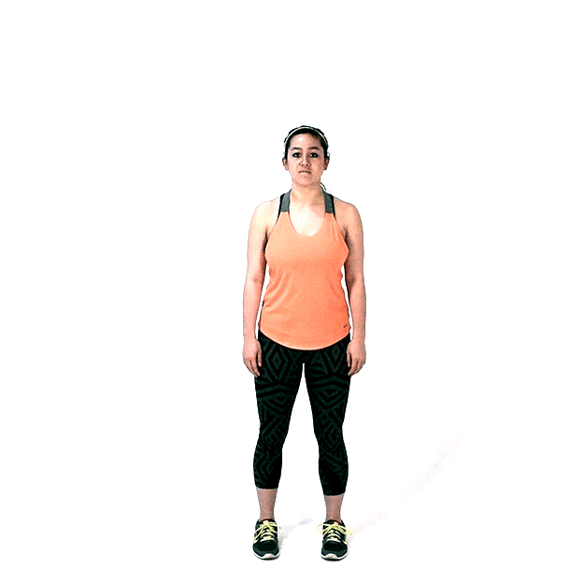
TYPES OF FLEXIBILITY
ACTIVE FLEXIBILITY
The ability to carry out movement to a longer distance without any external help.
e. g. , to do stretch without the help of a partner.

Slide 75
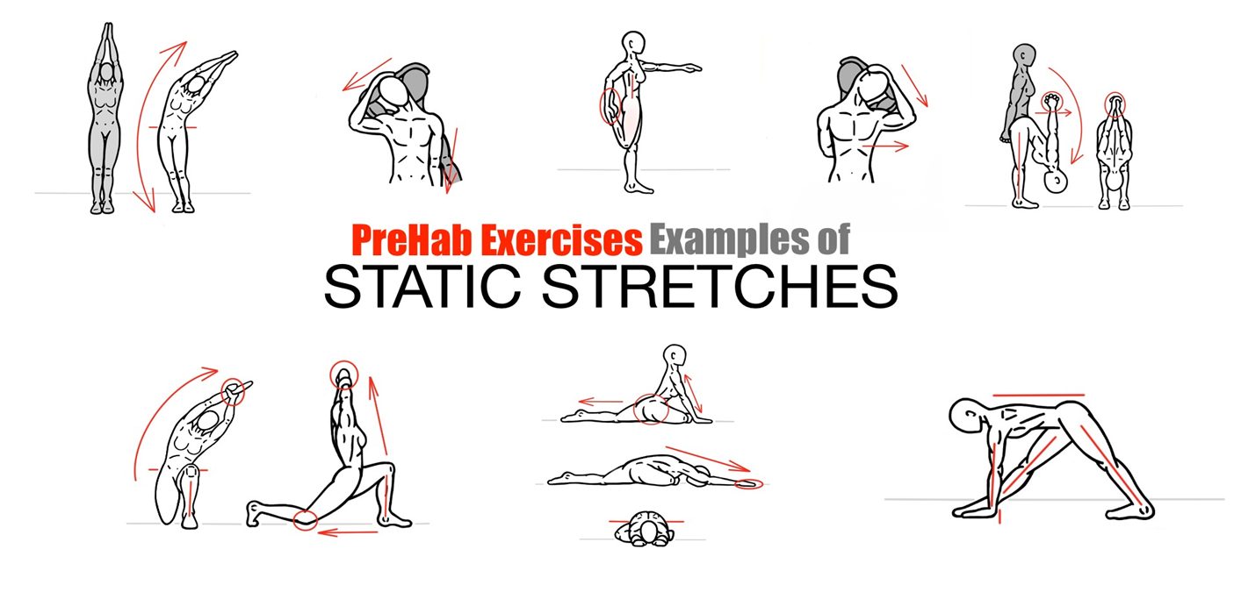
ACTIVE FLEXIBILITY
STATIC FLEXIBILITY
Static flexibility is usually required by a sportsperson when he remains in static position.
It is the ability of muscles /joints to stretch from a stationary position.
e.g., while diving, sitting, lying and in starting position in various sports.

Slide 76
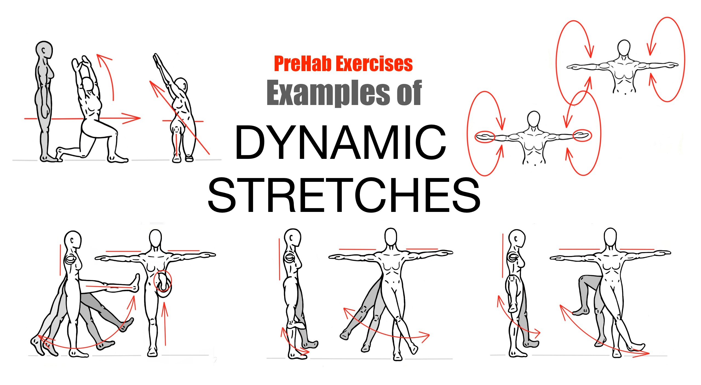
ACTIVE FLEXIBILITY
DYNAMIC FLEXIBILITY
Dynamic flexibility also called kinetic flexibility.
It is the ability to perform dynamic movements of the muscles to bring a limb through its full range of motion in the joints.

Slide 77
What is flexibility? Mention its types.
Discuss any three difference between Static & Dynamic flexibility.

Slide 78
THANKING YOU
ODM EDUCATIONAL GROUP

Slide 79
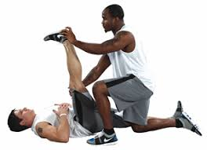
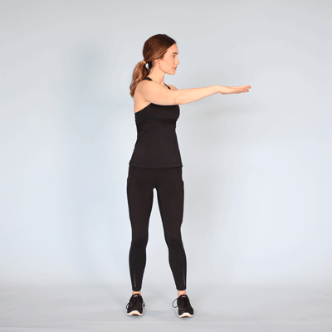
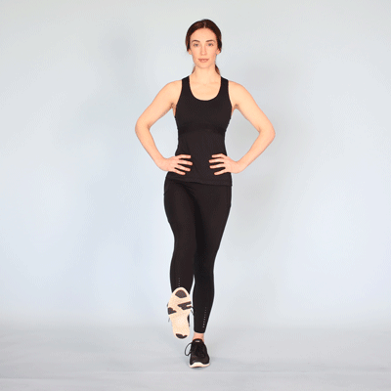
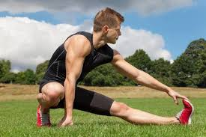
METHODS TO IMPROVE FLEXIBILITY
PNF TECHNIQUE
BALLISTIC METHOD
STATIC STRETCHING METHOD
DYNAMIC STRETCHING METHOD

Slide 80
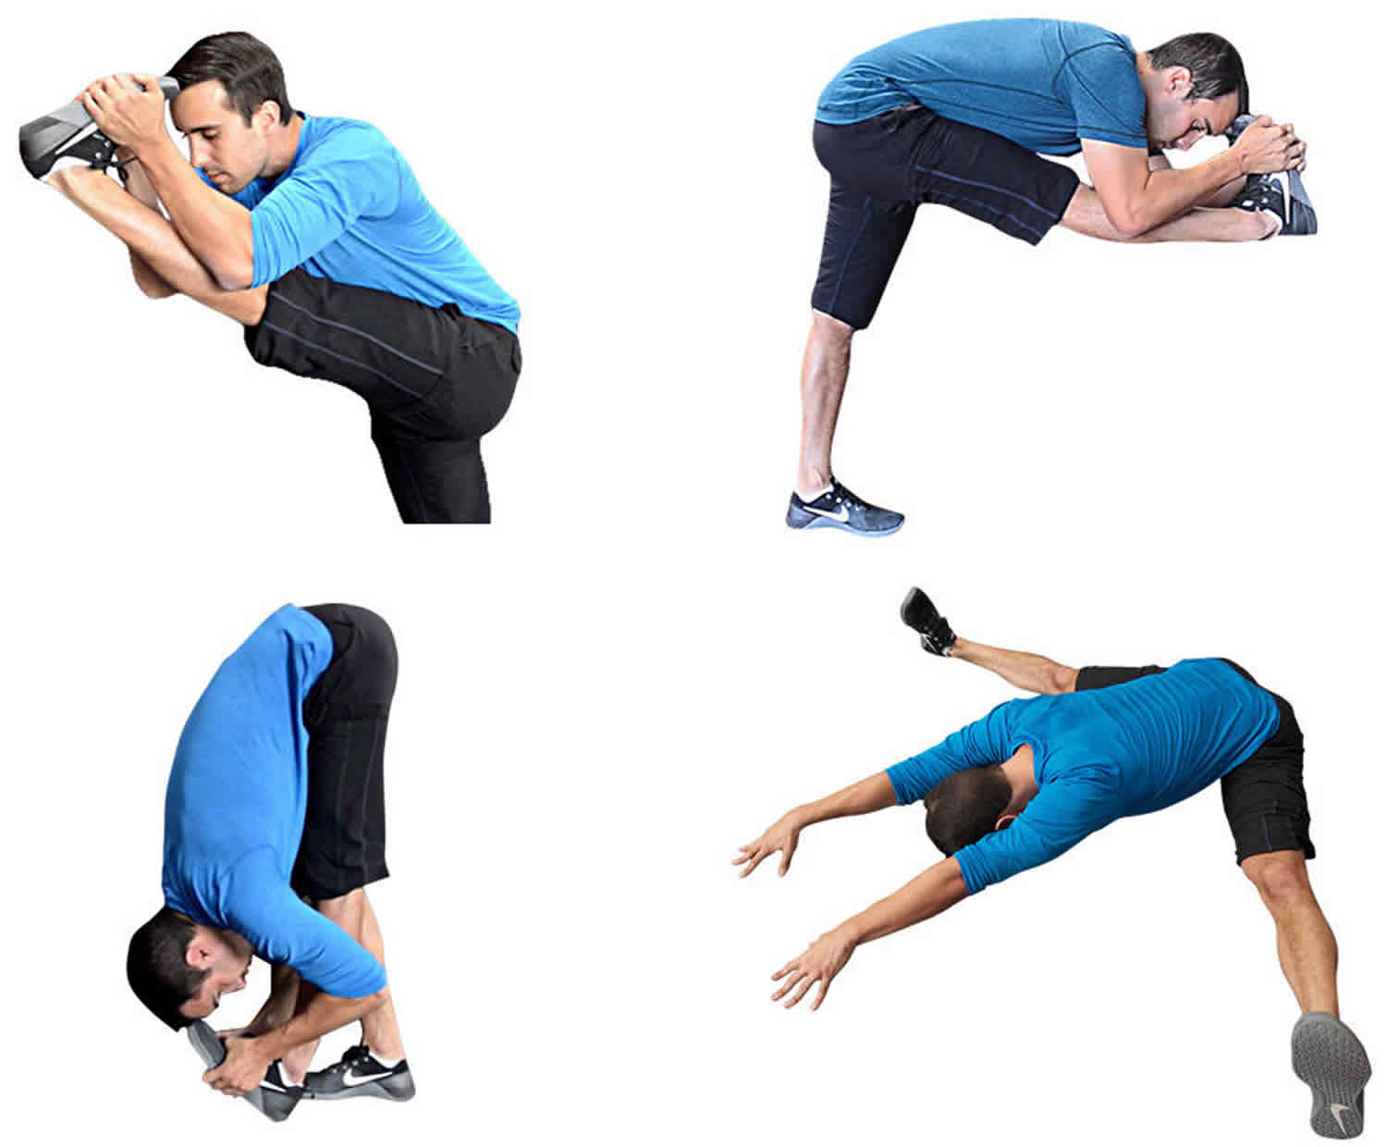
METHODS TO IMPROVE FLEXIBILITY
BALLISTIC METHOD
The movement is performed with a swing in a rhythmic way.
The related joint is stretched with a swing.
Before performing such exercise, appropriate warm-up is essential,(over-stretching)

Slide 81

METHODS TO IMPROVE FLEXIBILITY
STATIC STRETCHING METHOD
The stretch position and holding the position.
It is a part of cooling down.(hold for 10 to 30 seconds)

Slide 82

METHODS TO IMPROVE FLEXIBILITY
DYNAMIC STRETCHING METHOD
Its controlled leg and arms swings that take you gently to the limit of your range of motion.
Start with the movement at half speed for a couple of repetitions and then gradually work up to full speed.

Slide 83
PNF TECHNIQUE
PNF TECHNIQUE
Move into the stretch position
Your partner holds the limb in this stretched position
Push against your partner for 6 to 10 seconds
Your partner then moves the limb further into the stretch until you feel the stretch sensation.
Then again go back to no. (ii) to repeat the same procedure.(repeat 3 to 4 times)

Slide 84

GUIDELINES FOR DEVELOPING FLEXIBILITY
The flexibility of joints can be improved during adolescence.
The flexibility should be performed after a complete warm-up.
It should be performed when the sportsperson is fresh, avoid fatigue.
Sufficient number of repetitions should be performed. (10 – 15)
Jerky movements should be avoided during exercise.
During passive flexibility exercise you must ensure that your partner has experience.

Slide 85
Explain the Procedure of PNF technique.
Differentiate between Ballistic & Static Stretching methods.
Explain the importance of Guidelines must be followed if some one trying to improving flexibility.

Slide 86
THANKING YOU
ODM EDUCATIONAL GROUP

Slide 87
COORDINATIVE ABILITIES
SUBJECT : PHYSICAL EDUCATION
CHAPTER NUMBER: 10
CHAPTER NAME : TRAINING IN SPORTS

Slide 88

WHAT IS COORDINATIVE ABILITIES?
Coordinative abilities are those abilities which stabilized and generalized pattern of motor control.
These abilities help the sportsman to do a group of movements with better quality and effect.
Coordinative abilities primarily depend upon the central nervous system.

Slide 89

Speed
Strength
Flexibility
Endurance
COORDINATIVE ABILITIES MAINLY REQUIRE

Slide 90

DEFINITIONS OF COORDINATIVE ABILITIES
01
According to Zimmerman et al
“Coordination ability are understood as relatively stabilised and generalised patterns of motor control and regulation processes. These enable the sportsman to do a group of movements with better quality and effort.”

Slide 91
TYPES OF COORDINATION ABILITIES
TYPES OF COORDINATION ABILITIES
Orientation Ability
Coupling Ability
Reaction Ability
Balance Ability
Rhythm Ability
Adaptation Ability
Differentiation Ability

Slide 92

TYPES OF COORDINATION ABILITIES
ORIENTATION ABILITY
It is the ability to determine the position of the body and its parts in time and space in relation to gravity, moving objects like ball, opponent, partner, playing field, etc.
It is depends on functional capacity of sensory organs like eyes, kinesthetic sense organs, etc.

Slide 93

TYPES OF COORDINATION ABILITIES
COUPLING ABILITY
It is the ability to combine the movements of different body parts for performing perfect sports movements.
i.e. in boxing, the movements of hands, head, trunk and feet are essential to couple to achieve a certain goal.

Slide 94

TYPES OF COORDINATION ABILITIES
REACTION ABILITY
It is the ability to react immediately or quickly and effectively to a signal.
Simple Reaction Ability
Complex Reaction Ability

Slide 95

TYPES OF COORDINATION ABILITIES
BALANCE ABILITY
It is the ability to maintain balance during the complete body movements and regain balance quickly after the balance-disturbing movements.
i.e. water skiing and performing on the balancing beam.

Slide 96

TYPES OF COORDINATION ABILITIES
RHYTHM ABILITY
It is the ability to observe or perceive the rhythm of a movement and to do the movement with the required rhythm.
Rhythm is not given from outside, the sportsperson uses the rhythm which is already stored in his/her motor memory.
i.e. gymnastics, figure skating, etc.

Slide 97

TYPES OF COORDINATION ABILITIES
ADAPTATION ABILITY
It is the ability to adjust or change the movement effectively on the basis of changes or anticipated changes in the situation.
Its can be sudden or unexpected one.

Slide 98

TYPES OF COORDINATION ABILITIES
DIFFERENTIATION ABILITY
It is the ability to achieve a high degree of accuracy and economy of separate body movements and movement phases in a motor action.

Slide 99
Discuss any three types of coordinative abilities.
Briefly explain different types of coordinative abilities.
Differentiate between simple and complex reaction ability, mention any two importance of reaction ability in field of sports.

Slide 100
COMPONENTS OF PHYSICAL FITNESS | TYPES | METHODS
STRENGTH | Static Strength Dynamic Strength Maximum Strength Explosive Strength Strength Endurance | Isometric Exercises Isotonic Exercises Isokinetic Exercises
ENDURANCE | The Nature of Activity Basic Endurance General Endurance Specific Endurance The Duration of Activity Speed Endurance Short Term Endurance Middle Term Endurance Long Term Endurance | Continuous Training Interval Training Fartlek Training
MIND MAP

Slide 101
COMPONENTS OF PHYSICAL FITNESS | TYPES | METHODS
SPEED | Reaction Ability Simple Reaction Ability Complex Reaction Ability Acceleration Ability Movement Speed Locomotor Ability Speed Endurance | Acceleration Runs Pace Runs or Races
FLEXIBILITY | Passive Flexibility Active Flexibility Static Flexibility Dynamic Flexibility | Ballistic Method Static Stretching Dynamic Stretching PNF Technique (Proprioceptive Neuro-Muscular Facilitation Technique)
MIND MAP

Slide 102
COMPONENTS OF PHYSICAL FITNESS | TYPES | METHODS
COORDINATIVE ABILITIES | Orientation Ability Coupling Ability Reaction Ability Simple Reaction Ability Complex Reaction Ability Balance Ability Rhythm Ability Adaptation Ability Differentiation Ability | Circuit Training (Endurance, Strength along with flexibility and mobility)
MIND MAP

Slide 103
THANKING YOU
ODM EDUCATIONAL GROUP

