Slide 1


ACCOUNTING FOR SHARE CAPITAL
SUBJECT : ACCOUNTANCY
CHAPTER NUMBER:6
CHAPTER NAME :ISSUE OF SHARES

Slide 2
Company Accounts

Slide 3
Meaning of joint stock company
C
O
M
P
A
N
Y
Joint stock company is a voluntary association of persons formed by law for undertaking a business. Its capital is divided into a number of transferable shares.
Lord Justice Lindley defined a company as an “ artificial person created by law with a perpetual succession and a common seal”

Slide 4
Characteristics
C
O
M
P
A
N
Y
Separate legal entity
C
O
M
P
A
N
Y
Limited liability
Separation of ownership and management
Perpetual succession
Capita contributed in the form of shares.
Distribution of profit as dividend.
Common seal is affixed in all forms of the company
Maintenance of books under law.
Annual audit is compulsory.
Free transferability of shares.

Slide 5
Journal Entries on
Issue of Shares

Slide 6
C
O
M
P
A
N
Y
When application money received
Bank a/c Dr
Share application a/c
When application money transferred to share capital
Share application a/c Dr
Share capital a/c
When excess application money refunded
Share application a/c Dr
Bank a/c
When allotment money becomes due
Share allotment a/c Dr
Share capital a/c

Slide 7
When excess application money adjusted to allotment money
Share application a/c Dr
C
O
M
P
A
N
Y
Share allotment a/c
When allotment money received
Bank a/c Dr
Share allotment a/c
When call money becomes due
Share call a/c Dr
Share capital a/c
When call money received
Bank a/c Dr
Share call a/c

Slide 8
Alternate method
C
O
M
P
A
N
Y
Combines Application and allotment account is maintained
When application money received
Bank a/c Dr
Share application and allotment a/c
When application money transferred to share capital
Share application and allotment a/c Dr
Share capital a/c
Receipt of allotment money
Bank a/c Dr
Share application and allotment a/c

Slide 9
C
O
M
P
A
N
Y
CLASSIFICATION OF ISSUE OF SHARES
C
O
M
P
A
N
Y
Issue of shares at par
Issue of shares at premium

Slide 10
ISSUE OF SHARES AT PREMIUM (SEC 52 (1) OF THE COMPANIES ACT,2013.
THE AMOUNT OF PREMIUM RECEIVED SHOULD BE CREDITED TO ‘SECURITIES PREMIUM RESERVE A/C ’ AS PER SCHEDULE III OF THE COMPANIES ACT,2013. IT MUST BE SHOWN SEPARATELY IN THE BALANCE SHEET ON THE EQUITY AND LIABILITIES SIDE UNDER THE HEAD ‘RESERVES AND SURPLUS’.
SPR MAY BE USED FOR THE FOLLOWING PURPOSES:
IN WRITING OFF PRELIMINARY EXPENSES OF THE COMPANY.
FOR WRITING OFF THE EXPENSES,COMMISSION OR DISCOUNT ALLOWED ON ISSUE OF SHARES OR DEBENTURES OF THE COMPANY.
FOR BUY BACK OF ITS OWN SHARES AND OTHER SECURITIES AS PER SEC 68.

Slide 11
ACCOUNTING TREATMENT FOR THE AMOUNT OF SECURITIES PREMIUM RESERVE
THE AMOUNT OF SPR MAY BE CHARGED BY THE COMPANY ON APPLICATION OR ON ALLOTMENT OR EVEN WITH THE CALLS.
DURING APPLICATION
Bank A/c Dr.
To Share Application A/c
Share Application A/c Dr.
To Share Capital A/c
To Securities Premium Reserve
DURING ALLOTMENT
Share Allotment A/c Dr.
To Share Capital A/c
To Securities Premium Reserve
Bank A/c Dr.
To Share Allotment A/c

Slide 12
1. X & Co. Ltd. Was registered with an authorized capital of 5,00,000 equity shares of Rs.10 each. Company issued 2,00,000 equity shares at a premium of Rs.3 per share.
On Application : Rs.4 (including premium Rs.1)
On Allotment : Rs.5 (including premium Rs.1)
On 1st and Final Call : Rs.4 (including premium Rs.1)
All shares were subscribed and all money were duly received.

Slide 13
Calls In Arrears
C
O
M
P
A
N
Y
Some shareholders may fail to pay allotment money or call money. That unpaid amount is called calls in arrears. Company may open a separate account called ‘Calls in Arrears Account’. It is not compulsory to open a separate account.
When separate account is maintained
Calls in arrears a/c Dr
Share allotment a/c or Share call a/c

Slide 14
Calls In Advance
The amount received in advance from shareholders is shown in the Equity and Liabilities part of the Balance Sheet under the head Current Liabilities and sub-head Other Current liabilities of the company
Bank A/c Dr.
To Calls-in-Advance A/c
(Amount received on call-in-advance)
Calls-in-Advance A/c Dr.
To Particular Call A/c
(Calls-in-advance adjusted with the call money due)

Slide 15
QUESTIONS
X Ltd. Received in advance for the first and final call of Rs.2 per share on 1,000 shares in 01.02.2021. The first and final call was due on 15.04.2021 for 10,000 shares. The amount of first and final call was received on 25.04.2021.Journalise.
Sangli Ltd. Issued 20,000 shares of Rs.10 each at a premium of Rs.1,payable as Rs.3 on Application,Rs.4 on allotment (including premium) and balance on first and final call. One shareholder holding 600 shares paid the amount due on first and final call along with the allotment money. Journalise

Slide 16
BOTH CALLS-IN-ARREARS AND CALLS-IN-ADVANCE
XYZ Ltd. With a nominal capital of Rs.50,00,000 in equity shares of Rs.10 each, issued 2,00,000 shares payable as :
On Application : 2.50
On Allotment : 2.50
On First and Final Call : Balance
All money payable on allotment were duly received but one share holder Shivam failed to pay the amount due on allotment on his 2,500 shares, while another shareholder who held 2,000 shares paid for the shares first and final call also.
Give Journal entries up to allotment of shares and show the companies Balance Sheet.

Slide 17
PROBLEM
Konica Limited registered with an authorised equity capital of Rs. 2,00,000 divided into 2,000 shares of Rs. 100 each, issued for subscription of 1,000 shares payable at Rs. 25 per share on application, Rs. 30 per share on allotment, Rs. 20 per share on first call and the balance as and when required. Application money on 1,000 shares was duly received and allotment was made to them. The allotment amount was received in full, but when the first call was made, one shareholder failed to pay the amount on 100 shares held by him and another shareholder with 50 shares, paid the entire amount on his shares. The company did not make any other call. Give the necessary journal entries in the books of the company to record these share capital transactions.

Slide 18
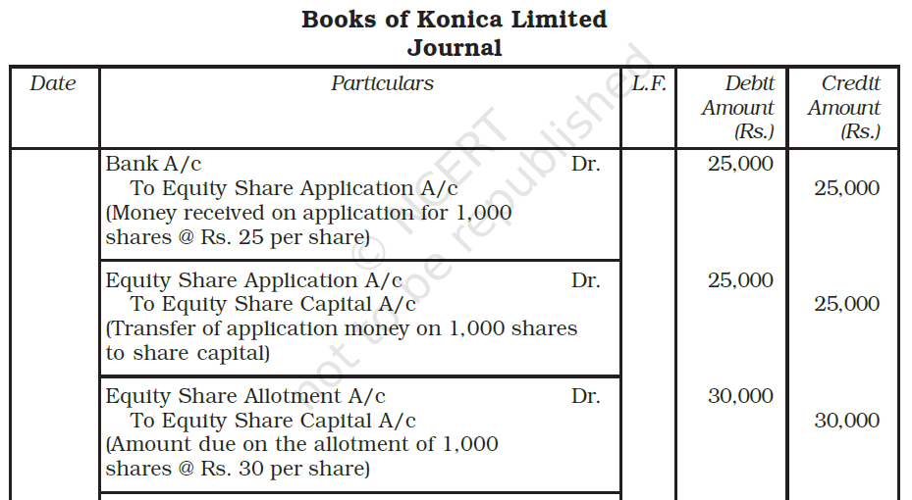
Solution - 3

Slide 19
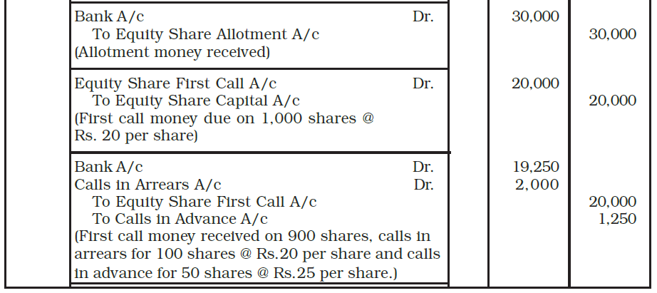
Solution - 3

Slide 20
ACTIVITY
MATCH THE FOLLOWING
1.MAXIMUM DIRECTORS IN PRIVATE ,PUBLIC COMPANY AND OPC | A.12%
2. AMOUNT COLLECTED AS SECURITIES PREMIUM RESERVE CANNOT BE UTILISED FOR……………… AS PER COMPANIES ACT ‘2013 | B. SEC 52(1)
3.INTEREST ON CALLS-IN- ARREARS | C.25%
4. AS PER SEBI GUIDELINES, MINIMUM SUBSCRIPTION IN CASE OF SHARE APPLICATION | D. 15
5.INTEREST ON CALLS –IN-ADVANCE | E.10%
6. MINIMUM CAPITAL FOR PUBLIC COMPANY AS PER COMPANIES ACT ‘2013 | F. FIVE LAKH
7. DEFINITION OF A COMPANY AS PER | G. PURCHASE OF FIXED ASSETS
8. ISSUE OF SHARES AT PREMIUM AS PER | H. SEC 2(20)
9. WHICH CAPITAL NOT SHOWN IN BALANCE SHEET | RESERVES & SURPLUS
10.SPR SHOWN IN BALANCE SHEET UNDER | RESERVE CAPITAL

Slide 21
MULTIPLE CHOICE QUESTIONS
When full amount is due on any call but it is not received, then the short fall is debited to :
(a) Calls-in-advance
(b) Calls-in-arrear
(c) Share Capital
(d) Suspense Account
The difference between subscribed capital and called up capital is called :
(a) Calls-in-arear
(b) Calls-in-advance
(c) Uncalled capital
(d) None of these
Which statement is issued before the issue of shares ?
(a) Prospectus
(b) Articles of Association
(c) Memorandum of Association
(d) All of these
Company can utilise securities premium for :
(a) Writing off loss incurred on revaluation of asset
(b) Issuing fully paid bonus shares
(c) Paying divided
(d) Writing off trading loss

Slide 22
5. When a company issues shares at a premium, amount of premium may be received by the company :
(a) Along with application money
(b) Along with application money
(c) Along with calls
(d) Along with any of the above
6. Share Application Account is :
(a) Personal Account
(b) Real Account
(c) Nominal/ Account
(d) None of these
7. Securities Premium can not be applied :
(a) For paying dividend to members
(b) For issuing bonus shares to members
(c) For writing off preliminary expenses of company
(d) For writing off discount on issue of debentures
8. A joint stock company is :
(a) An artificial legal person
(b) Natural person
(c) A general person
(d) None of these
9. Equity shareholders are :
(a) Customers
(b) Creditors
(c) Debtors
(d) Owners
10. Shares may be issued :
(a) At par value
(b) At Premium
(c) At Discount
(d) Both (a) & (b)

Slide 23
Under Subscription of Shares
Under Subscription: It is a situation when the number of shares applied are less than the number of shares issued for subscription.
Minimum Subscription: As per SEBI Guidelines, minimum subscription is to receive subscription for at least 90% of the shares issued. If the company does not receive minimum subscription, it cannot allot the shares and therefore, it will have to refund the application money to the subscribers.
In this situation, all the applications for shares are accepted, i.e., full allotment is made.
When number of shares applied by the public are less than the number of shares issued or offered to the public it is called as under subscription of shares.
In this case journal entries are made on the number of shares applied and allotted only.

Slide 24
QN -1 = XYZ & Company Ltd. issued 20,000 shares of Rs. 10 each at a premium of 10% payable as follows -
Rs. 5 on Application (including premium)
Rs. 4 on Allotment
Rs. 2 on first and final call
Public applied for 18,000 shares and all were accepted. All the money on allotment and call were duly received.
Pass necessary journal entries and Balance Sheet of the company as per Companies Act,2013.

Slide 25
Over Subscription
When company receives applications for more shares than the number offered to the public for subscription. In such a condition,
3 ALTERNATIVE
(1) they can accept some applications in full and totally reject the others;
(2) they can make a pro-rata allotment to all; and
(3) they can adopt a combination of the above two alternatives.

Slide 26
1st Alternative
REJECTION OF EXCESS APPLICATIONS
THE DIRECTORS REJECT THE EXCESS APPLICATIONS AND REFUND THE EXCESS AMOUNT
(Receiving Entry)
1ST ENTRY -Bank A/c Dr.
To Share Application A/c
(Transfer Entry)
2nd ENTRY - Share Application A/c Dr.
To Share Capital A/c
To Bank A/c (Excess Application Money refunded)

Slide 27
PROBLEMS
Richa Ltd. Invited applications for 50,000 equity shares of Rs.10 each. The whole amount was payable on application. The issue was over-subscribed by 15,000 . The Company accepted applications for 50,000 shares and refunded the excess money. Pass necessary journal entries.
Rupesh Ltd. ,issued a prospectus inviting applications for 40,000 shares of Rs.10 each at a premium of Rs.2 per share,payable as :
On Application – Rs.4
On Allotment – Rs. 5 (including premium) & Balance on 1st & Final Call.
Applications were received for 50,000 shares. The company accepted
applications for 40,000 shares and refunded the excess money. Pass
necessary journal entries.

Slide 28
Pro-rata Allotment
When the directors opt to make a proportionate allotment to all applicants (called ‘pro-rata’ allotment), the excess application money received is normally adjusted towards the amount due on allotment.

Slide 29
2nd Alternative
PRO RATA ALLOTMENT
NO APPLICATION FOR SHARES REFUSED,SHARES ALLOTTED TO THE APPLICANTS ON PROPORTIONATE BASIS
CASE : 1
WHEN A PART OF EXCESS AMOUNT IS ADJUSTED TO AMOUNT DUE ON ALLOTMENT AND BALANCE IS REFUNDED:
Share Application A/c Dr.
To Share Capital A/c (With amount on shares allotted or ISSUED SHARES)
To Share Allotment A/c ( a part of excess adjusted)
To Share Calls A/c ( If mentioned in the question)
To Bank A/c (Balance thereafter refunded)

Slide 30
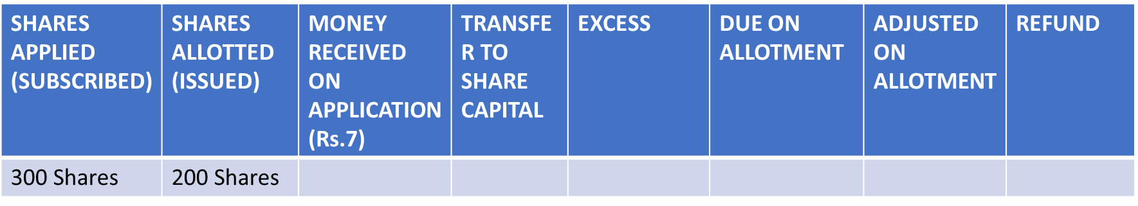
PRO RATA TABLE

Slide 31
WHEN A PART OF EXCESS AMOUNT IS ADJUSTED TO AMOUNT DUE ON ALLOTMENT AND BALANCE IS REFUNDED
1. If the company has allotted only 40 shares (instead of 70 shares),then the surplus amount on application – Rs.3 ;on allotment Rs.2 and on 1st and Final Call – Balance.
Shares were allotted on pro rata basis and surplus application money is to be adjusted towards allotment and balance is refunded . Pass journal entries.

Slide 32
PRO RATA ALLOTMENT IN DIFFERENT CASES
S Ltd. Issued 100 shares of Rs.10 each. The amount is payable as :
On Application : Rs.4
On Allotment :Rs.3
On 1st & Final Call : balance
S Ltd. has decided to make pro rata allotment if shares applied by the public are more than the shares issued and to utilize surplus application money towards allotment. Pass necessary journal entries in each cases:
CASE I – If applications are received for 150 shares.
CASE II – If applications are received for 175 shares.
CASE III – If applications are received for 200 shares.
CASE IV – If applications are received for 220 shares.

Slide 33
PROBLEM
S Ltd. Issued 5,000 shares of Rs.10 each at a premium of Rs.1 per share.The amount is payable as :
On Application – Rs.3
On Allotment - Rs.6 (including premium)
On 1st & Final Call – balance
Applications for 6,000 shares were received. Shares were allotted on pro rata basis and surplus on application to be adjusted towards allotment. How much adjusted towards allotment.
a. Rs.30,000 b. Rs.3,000 c. Rs.25,000 d. Nil

Slide 34
PRO RATA ALLOTMENT IN DIFFERENT CASES
Asif Ltd. Issued 1,000 shares of Rs.10 each. The amount is payable as :
On Application : Rs.4
On Allotment :Rs.3
On 1st & Final Call : balance
Asif Ltd. has decided to make pro rata allotment if shares applied by the public are more than the shares issued and to utilize surplus application money towards allotment and calls. Pass necessary journal entries in each cases:
CASE I – If applications are received for 1,500 shares.
CASE II – If applications are received for 1,750 shares.
CASE III – If applications are received for 2,000 shares.
CASE IV – If applications are received for 2,200 shares.

Slide 35
HOMEWORK
Somu Ltd. Issued 10,000 shares of Rs.10 each. The amount is payable as :
On Application – Rs.6
On Allotment - Rs.1
On 1st & Final Call – balance
Applications for 16,000 shares were received. Shares were allotted on pro rata basis and surplus on application to be adjusted towards allotment and Call money. Pass necessary journal entries.

Slide 36
PRO RATA TABLE
ISSUED SHARES : 200 SHARES @ Rs.10 each , premium of Rs.1 per share
SUBSCRIBED SHARES : 300 SHARES
ON APPLN – 7 ; ON ALLOT -3 (including premium) ; balance on 1st and Final call. Shares were allotted on pro rata basis and surplus application money to be adjusted towards allotment.
SHARES APPLIED (SUBSCRIBED) | SHARES ALLOTTED (ISSUED) | MONEY RECEIVED ON APPLICATION (Rs.7) | TRANSFER TO SHARE CAPITAL | EXCESS | DUE ON ALLOTMENT (Rs.3) | ADJUSTED ON ALLOTMENT | REFUND
300 Shares | 200 Shares | 300 shares x Rs.7 = 2,100 | 200 shares x Rs.7 =1,400 | 700 | 200 shares x 3 = 600 | 600 | 100*
* As per question the excess received on Application to be adjusted towards Allotment, remaining EXCESS to be refunded.

Slide 37
CALCULATION OF AMOUNT NOT RECEIVED ON ALLOTMENT IN CASE OF PRO RATA
WHEN THE SHARES ARE ALLOTTED ON PRO RATA BASIS
ONE/SOME OF THE SHAREHOLDERS OF PRO RATA CATEGORY DEFAULT IN MAKING THE AMOUNT DUE ON ALLOTMENT,THEN IT IS NECESSARY TO COMPUTE THE AMOUNT NOT RECEIVED ON ALLOTMENT:
2 STEPS:
WHEN SHARES ALLOTTED ARE GIVEN | WHEN SHARES APPLIED ARE GIVEN
TOTAL SHARES APPLIED X NO. OF SHARES ALLOTTED TOTAL SHARES ALLOTTED | TOTAL SHARES ALLOTTED X NO. OF SHARES APPLIED TOTAL SHARES APPLIED

Slide 38
CALCULATION OF AMOUNT NOT RECEIVED ON ALLOTMENT IN CASE OF PRO RATA
A company allotted 4,000 shares on pro rata basis to the applicants of 10,000 shares.the amount is payable as Rs. 3 on application, Rs. 5 on allotment and balance on call.
Sagar , was allotted 200 shares failed to pay the allotment money.
Step 1 – Calculation of No. of shares applied by Sagar:
Shares Applied = 200 shares
shares Applied = 10,000 x 200 = 500 shares
4,000

Slide 39
A company issued 10,000 shares and company received applications for 20,000 shares.The amount is payable as Rs.3 on application,Rs.5 on allotment and balance on call. The company made allotment as under : category shares Applied shares Allotted
A 6,000 6,000
B 10,000 4,000
C 4,000 NIL
Shyam of category B ,who was allotted 300 shares failed to pay the allotment money. Calculate the amount due on allotment of shyam

Slide 40
PROBLEM
A company offered shares to the public for subscription. Calculate ‘ Number of shares allotted to Narayan’ in each of the following cases:
CASES | TOTAL SHARES APPLIED BY PUBLIC | TOTAL SHARES ALLOTTED BY COMPANY | SHARES APPLIED BY NARAYAN
CASE I CASE II CASE III | 4000 6000 2000 | 3000 5000 1500 | 30 120 100

Slide 41
PRO RATA IF EXCESS TRANSFER TO 1ST CALL AND BALANCE IF REFUND.
SUBSCRIBED | ISSUED | MONEY RECEIVED ON APPLICATION | TRANSFER TO SHARE CAPITAL | EXCESS | DUE ON ALLOT | TRANSFER TO ALLOT | EXCESS | DUE ON 1ST CALL | TRANSFER TO 1ST CALL | EXCESS | REFUND

Slide 43
MULTIPLE CHOICE QUESTION :01
A Company invited applications for 1,00,000 share and it received applications for 1,50,000 shares. Applications for 30,000 shares were rejected and the remaining were allotted shares on prorate basis. How many shares an applicant for 3,000 shares will be allotted?
( A ) 2,500 shares
(B) 3,600 shares
(C) 4,500 shares
(D) 2,000 shares

Slide 44
MULTIPLE CHOICE QUESTION :02
Di Ltd. had allotted 10,000 shares to the applicants of 14,000 shares on pro-rata basis. The amount payable on application was Rs. 2. Ramesh applied for 420 shares. The number of shares allotted and the amount carried forward for adjustment against allotment money due from Ramesh will be:
60 shares ; Rs. 120
(B) 340 shares; Rs. 160
(C) 320 shares, Rs. 200
(D) 300 shares; Rs. 240

Slide 45
MULTIPLE CHOICE QUESTION:03
If applicants for 80,000 shares were allotted 60,000 shares on prorate basis, the shareholder who was allotted 1,200 shares must have applied for:
(A) 900 Shares
(B) 3,600 Shares
(C) 1,600 Shares
(D) 4,800 Shares

Slide 46
MULTIPLE CHOICE QUESTION : 04
A Company offered 50,000 shares of Rs.10 each at par payable as to Rs. 3 on applications, Rs. 5 on allotment and the balance on final call. Applications were received for 60,000 shares and the allotment was made pro- rata. The excess application money was to be adjusted on allotment and call. How much amount well be transferred from Share Application A/c to share allotment A/c?
(A) Rs. 1,80,000 (B) Rs. 30,000 (C) Rs. 1,50,000 (D) Rs. 50,000

Slide 47
MULTIPLE CHOICE QUESTION : 05
A Company offered 4,000 shares of Rs.10 each at par payable as under:
Rs. 3 on application, Rs.2 on allotment ; on first call Rs. 4 and on final call Rs. 1 per share .
Applications were received for 13,000 shares. Applications for 3,000 shares were rejected and pro-rata allotment was made to the applicants for 10,000 shares. How much amount will be received in cash on first call? Excess application money is adjusted towards amount due on allotment and calls.
(A)Rs. 6,000 (B) Rs. Nil (C) Rs. 16,000 (D) Rs. 10,000

Slide 48
MULTIPLE CHOICE QUESTION : 06
A company issued 4,000 equity shares of Rs. 10 each at par payable as under: On application Rs. 3; on allotment Rs.2 ; On first call Rs.4; on final call Rs. 1 per share.
Applications were received for 10,000 shares. Allotment was made pro-rata. How much amount will be received in cash on allotment?
(A) Rs. 8,000 (B)Rs. 12,000 (C) Nil (D) None

Slide 49
MULTIPLE CHOICE QUESTION : 07
A company issued 5,000 equity shares of Rs. 100 each at par payable as to: Rs. 40 on application; Rs.50 on allotment and Rs. 10 on call.
Applications were received for 8,000 shares. Allotment was made on pro-rata.
How much amount will be received in cash on allotment?
(A) Rs. 2,50,000 (B) Rs. 1,20,000 (C) Rs. 1,30,000 (D) Rs. 50,000

Slide 50
Shares Issued for Consideration Other Than Cash
Vendors against purchase of assets or business:
Entry to be passed is as follows:
If shares are issued for purchase of assets:
Sundry Assets A/c (individually) …Dr.(with the amount of purchase price)
To Vendor’s A/c (with purchase consideration)
If shares are issued for purchase of business:
When a business is purchased, both assets and liabilities are taken over for a consideration which can be equal to, more than or less than the difference between values of assets and liabilities. Entry to be passed in each of these cases is as follows:
If consideration is equal to the difference between the value of assets and liabilities:
Sundry Assets A/c (individually) …Dr. (agreed value)
To Sundry Liabilities (individually) (agreed value)
To Vendor’s A/c (purchase consideration)
if consideration is more than the difference between the value of assets and liabilities, such excess is debited to Goodwill Account
Sundry Assets A/c (individually) …Dr. (agreed value)
Goodwill A/c …Dr. (excess consideration over net assets)
To Sundry Liabilities (individually) (agreed value)
To Vendor’s A/c (purchase consideration)
If consideration is less than the difference between the value of assets and liabilities, such shortfall is credited to Capital Reserve Account:
Sundry Assets A/c (individually) …Dr. (agreed value)
To Sundry Liabilities (individually) (agreed value)
To Vendor’s A/c (purchase consideration)
To Capital Reserve A/c (excess of net assets over consideration)

Slide 51
Accounting Entries for issue of Shares to Vendors when Shares are:
Issued at par:
Vendor’s A/c …Dr. (nominal value of shares allotted)
To Share Capital A/c
Issued at premium:
Vendor’s A/c …Dr. | (purchase consideration)
To Shares A/c To Securities Premium Reserve A/c | (nominal value of shares allotted)

Slide 52
PURCHASE CONSIDERATION OTHER THAN CASH
1.SOMU LTD. PURCHASED THE BUSINESS OF SWAYAM LTD. FOR Rs. 9,00,000 PAYABLE IN FULLY PAID SHARES OF Rs.10 EACH. WHAT ENTRIES WILL BEMADE IN THE BOOKS OF SOMU LTD.IF SUCH ISSUE IS
ISSUED AT PAR
ISSUED AT PREMIUM OF 25 %

Slide 53
PROBLEM
SIRAJ LTD. PURCHASED A RUNNING BUSINESS FROM MOHSIN LTD. FOR A SUM OF Rs. 30,00,000 PAYABLE 40% BY A CHEQUE AND THE BALANCE BY THE ISSUE OF FULLY PAID EQUITY SHARES OF Rs. 100 EACH AT A PREMIUM OF 20%. THE ASSETS AND LIABILITIES CONSISTED OF THE FOLLOWING:
BOOK VALUE AGREED VALUE
BUILDING 10,00,000 16,00,000
PLANT 8,00,000 5,00,000
STOCK 4,00,000 120%
DEBTORS 3,00,000 SUBJECT TO PROVISION FOR DOUBTFUL DEBTS @ 5%
CASH AT BANK 1,20,000 1,20,000
CREDITORS 2,00,000 1,85,000
PASS NECESSARY JOURNAL ENTRIES

Slide 54
ISSUE OF SHARES TO PROMOTERS
1. INCORPORATION EXPENSES/PRELIMINARY EXPENSE A/C Dr.
TO PROMOTERS A/C
(BEING INCORPORATION EXPENSE DUE)
2. PROMOTERS A/C Dr.
To SHARE CAPITAL A/C
(BEING ….. SHARES OF RS. …. EACH ISSUED TO THE PROMOTERS)

Slide 55
ISSUE OF SHARES TO UNDERWRITERS
1. UNDERWRITER COMMISSION A/C Dr.
TO UNDERWRITERS A/C
(BEING UNDERWRITING COMMISSION DUE)
2. UNDERWRITERS A/C Dr.
To SHARE CAPITAL
(BEING ….. SHARES OF RS. …. EACH ISSUED TO THE UNDERWRITERS)

Slide 56
MULTIPLE CHOICE QUESTION :01
A Company purchased a Building for Rs.12,00,000 out of which Rs.2,00,000 were paid in cash. Balance amount was paid by issue of equity shares of T10 each at 25% premium. How many shares will be issued by the Company?
1,00,000 Shares
80,000 Shares
1,20,000 Shares
96,000 Shares

Slide 57
MULTIPLE CHOICE QUESTION :02
If shares of Rs.4,00,000 are issued for purchase of assets of Rs.5,00,000, Rs.1,00,000 will be treated as
Discount
Premium
Profit
Loss

Slide 58
MULTIPLE CHOICE QUESTION :03
A Building was purchased for Rs.9,00,000 and payment was made in Rs.100 shares at 20% premium. Securities Premium Reserve A/c will be
Debited by Rs.1,50,000
Credited by Rs.1,50,000
Debited by Rs.1,80,000
Credited by Rs.1,80,000

Slide 59
MULTIPLE CHOICE QUESTION :04
A company purchased machinery for Rs.1,80,000 and in consideration issued shares at 20% premium. What will be the face value of shares issued:
Rs.1,50,000
Rs.1,44,000
Rs.1,80,000
Rs.2,16,000

Slide 60
C
O
M
P
A
N
Y
FORFEITURE OF SHARES
It means the cancellation of shares when a shareholder fails to pay allotment money or call money. The company has the power to cancel the share after giving a 14 days registered notice to the shareholder to pay the amount with interest. Shares once forfeited becomes the property of the company.

Slide 61
THANKING YOU
ODM EDUCATIONAL GROUP

