Slide 1


ACCOUNTING RATIOS
SUBJECT : ACCOUNTANCY
CHAPTER NUMBER:10
CHAPTER NAME : ACCOUNTING RATIOS

Slide 2
ACCOUNTING RATIOS
A ratio is a mathematical number calculated as a reference to relationship of two or more numbers and can be expressed as a fraction, proportion, percentage and a number of times. Accounting ratios represent relationship between two accounting numbers.

Slide 3
Objectives of Ratio Analysis
1. To know the areas of the business which need more attention;
2. To know about the potential areas which can be improved.
3. To provide a deeper analysis of the profitability, liquidity, solvency and efficiency levels in the business;
4. To provide information for making cross sectional analysis by comparing the performance with the best industry standards; and
5. To provide information derived from financial statements useful for making projections and estimates for the future

Slide 4
Advantages of Ratio Analysis
Advantages of
Ratio Analysis
Helps understand efficacy of decisions
Simplify complex figures and establish relationships
Helpful in comparative analysis
Enables SWOT analysis
Various comparisons
Identification of problem areas

Slide 5
Types of Ratios
Liquidity Ratios
To assess the ability of the business to pay the amount due to stakeholders.
Current Ratio
Liquidity Ratio
Solvency Ratios
To assess its ability to meet its contractual obligations towards stakeholders.
1. Debt-Equity Ratio;
2. Debt to Capital Employed Ratio;
3. Proprietary Ratio;
4. Total Assets to Debt Ratio;
5. Interest Coverage Ratio.
Activity
(Turnover) Ratios
It helps for measuring the efficiency of operations of business based on effective utilisation of resources.
1. Inventory Turnover;
2. Trade Receivable Turnover;
3. Trade Payable Turnover;
4. Investment (Net Assets) Turnover
5. Fixed Assets Turnover; and
6. Working Capital Turnover.
7. Inventory Turn-over Ratio
Profitability Ratios
Analysis of profits in relation to revenue from operations or funds employed
1. Gross Profit Ratio
2. Operating Ratio
3. Operating Profit Ratio
4. Net profit Ratio
5. Return on Investment
6. Return on Net Worth (RONW)
7. Earnings per Share
8. Book Value per Share
9. Dividend Payout Ratio
10. Price Earning Ratio.

Slide 6
LIQUIDITY RATIOS
LIQUIDITY RATIOS
Liquidity Ratio
Current Ratio
Liquidity ratios are calculated to measure the short-term solvency of the business. The two ratios included in this category are Current Ratio and Liquidity Ratio

Slide 7
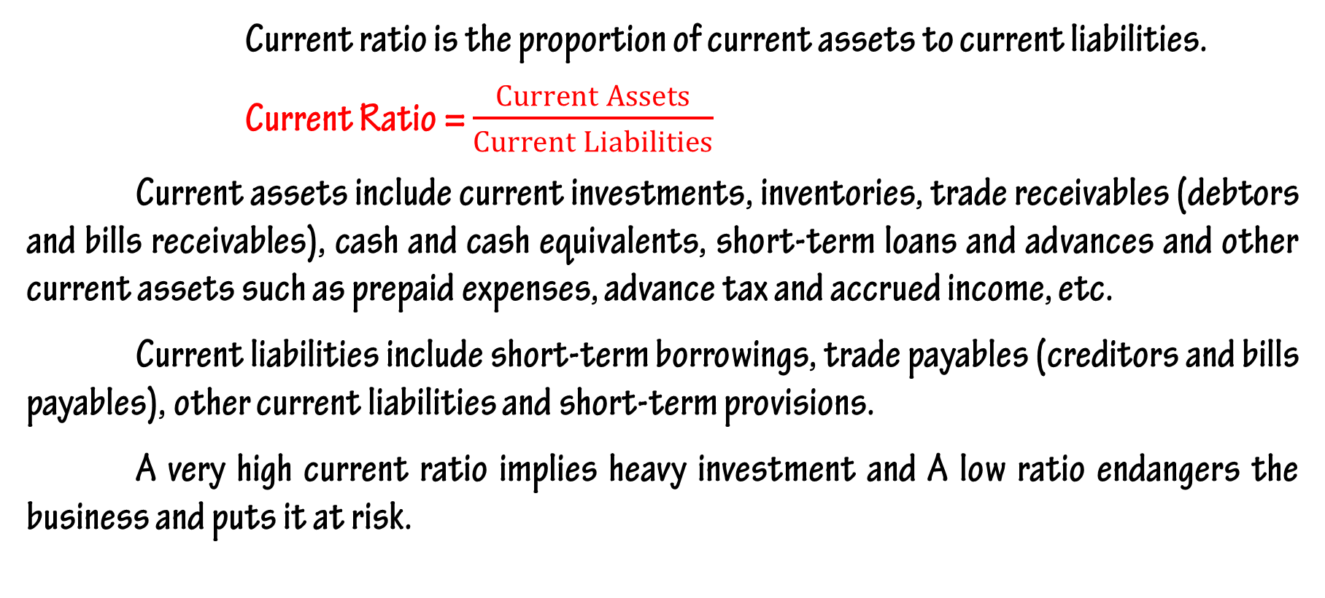
Current Ratio
Current ratio is the proportion of current assets to current liabilities.
Current Ratio = $\frac{Current Assets}{Current Liabilities}$
Current assets include current investments, inventories, trade receivables (debtors and bills receivables), cash and cash equivalents, short-term loans and advances and other current assets such as prepaid expenses, advance tax and accrued income, etc.
Current liabilities include short-term borrowings, trade payables (creditors and bills payables), other current liabilities and short-term provisions.
A very high current ratio implies heavy investment and A low ratio endangers the business and puts it at risk.

Slide 8
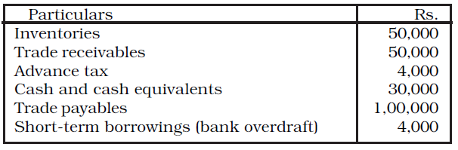
Illustration - 1
Calculate Current ratio from the following information

Slide 9
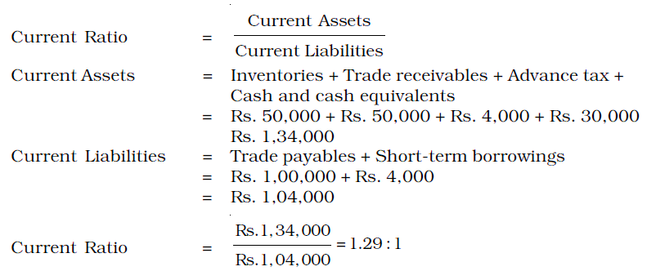
Solution - 1

Slide 10
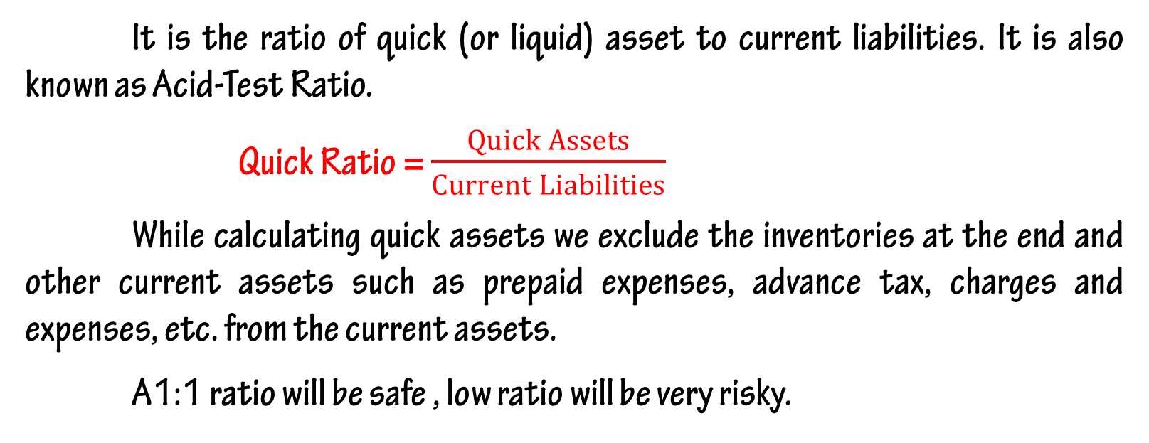
Quick Ratio
It is the ratio of quick (or liquid) asset to current liabilities. It is also known as Acid-Test Ratio.
Quick Ratio = $\frac{Quick Assets}{Current Liabilities}$
While calculating quick assets we exclude the inventories at the end and other current assets such as prepaid expenses, advance tax, charges and expenses, etc. from the current assets.
A1:1 ratio will be safe , low ratio will be very risky.

Slide 11
Illustration - 2
Calculate Quick ratio from the following information

Slide 12
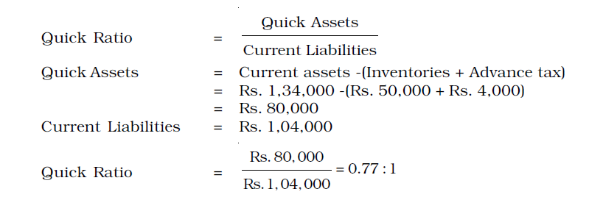
Solution - 2

Slide 13
Illustration - 3
Calculate ‘Liquidity Ratio’ from the following information:
Current Liabilities = Rs. 50,000
Current Assets = Rs. 80,000
Inventories = Rs. 20,000
Advance Tax = Rs. 5,000
Prepaid Expenses = Rs. 5,000

Slide 14
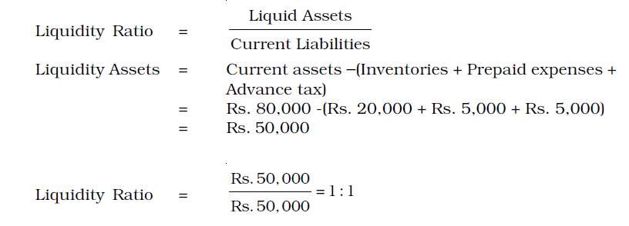
Solution - 3

Slide 15
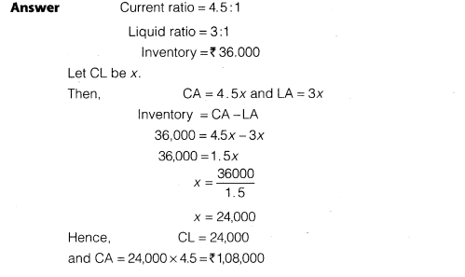
Illustration - 4
Current ratio =4.5:1,quick ratio =3:1, Inventory is Rs.36,000. Calculate the current assets and current liabilities.

Slide 16
SOLVENCY RATIOS
Solvency ratios are calculated to determine the ability of the business to service its debt. The Solvency ratios are ;
1. Debt-Equity Ratio
2. Proprietary Ratio
3. Total Assets to Debt Ratio
4. Interest Coverage Ratio
Solvency ratios
Debt-Equity Ratio
Debt to Capital Employed Ratio
Proprietary Ratio
Total Assets to Debt Ratio
Interest Coverage Ratio

Slide 17
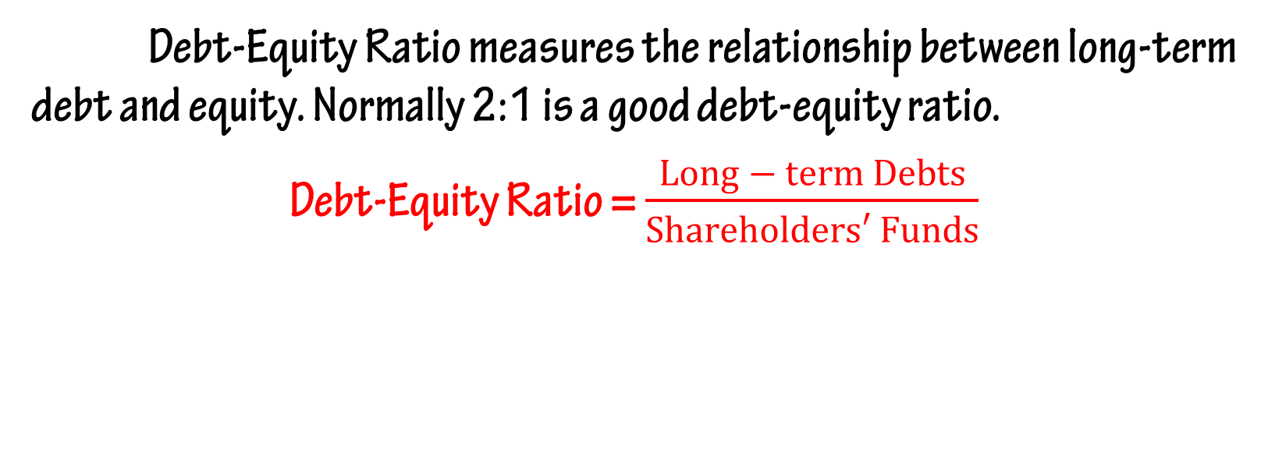
Debt-Equity Ratio
Debt-Equity Ratio measures the relationship between long-term debt and equity. Normally 2:1 is a good debt-equity ratio.
Debt-Equity Ratio = $\frac{Long − term Debts}{Shareholders′ Funds}$

Slide 18
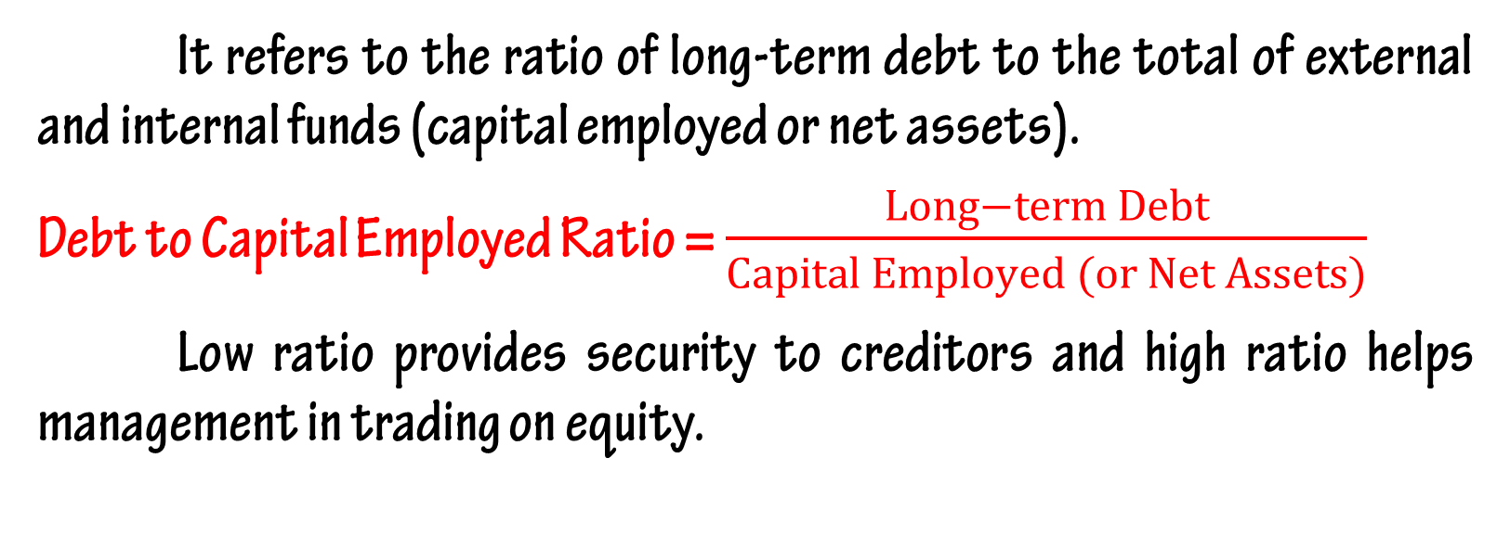
Debt to Capital Employed Ratio
It refers to the ratio of long-term debt to the total of external and internal funds (capital employed or net assets).
Debt to Capital Employed Ratio = $\frac{Long−term Debt}{Capital Employed (or Net Assets)}$
Low ratio provides security to creditors and high ratio helps management in trading on equity.

Slide 19
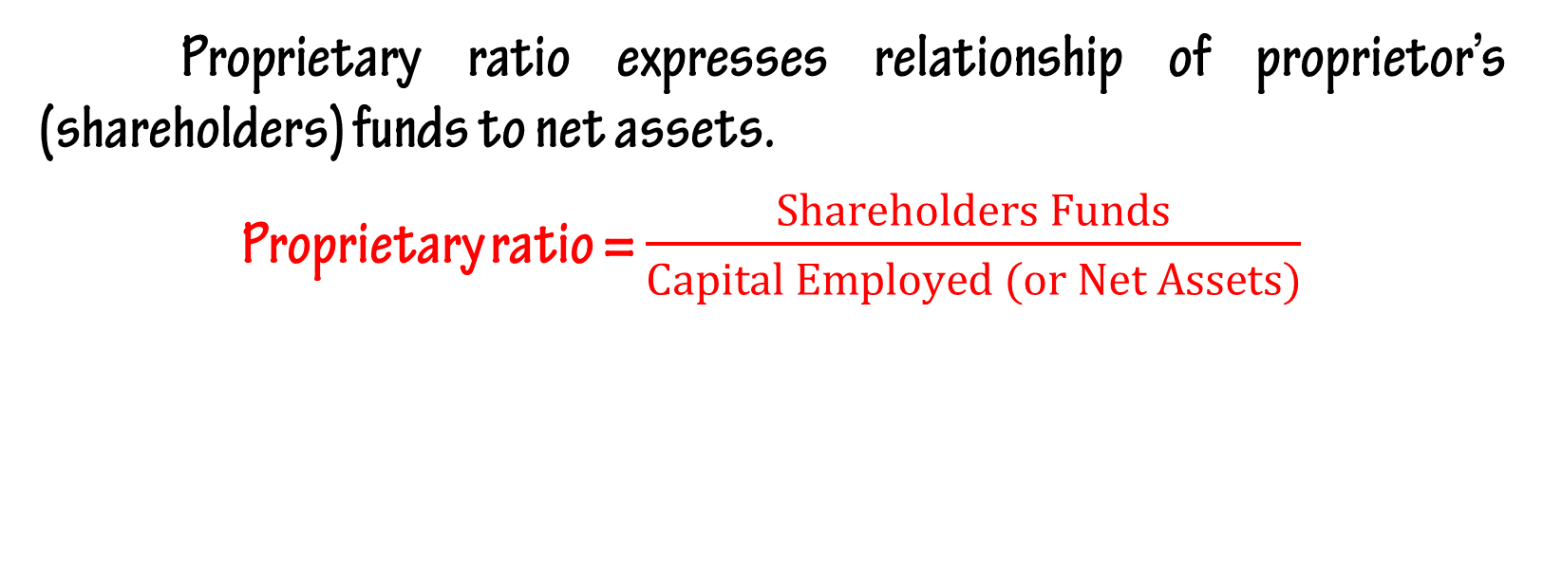
Proprietary Ratio
Proprietary ratio expresses relationship of proprietor’s (shareholders) funds to net assets.
Proprietary ratio = $\frac{Shareholders Funds}{Capital Employed (or Net Assets)}$

Slide 20
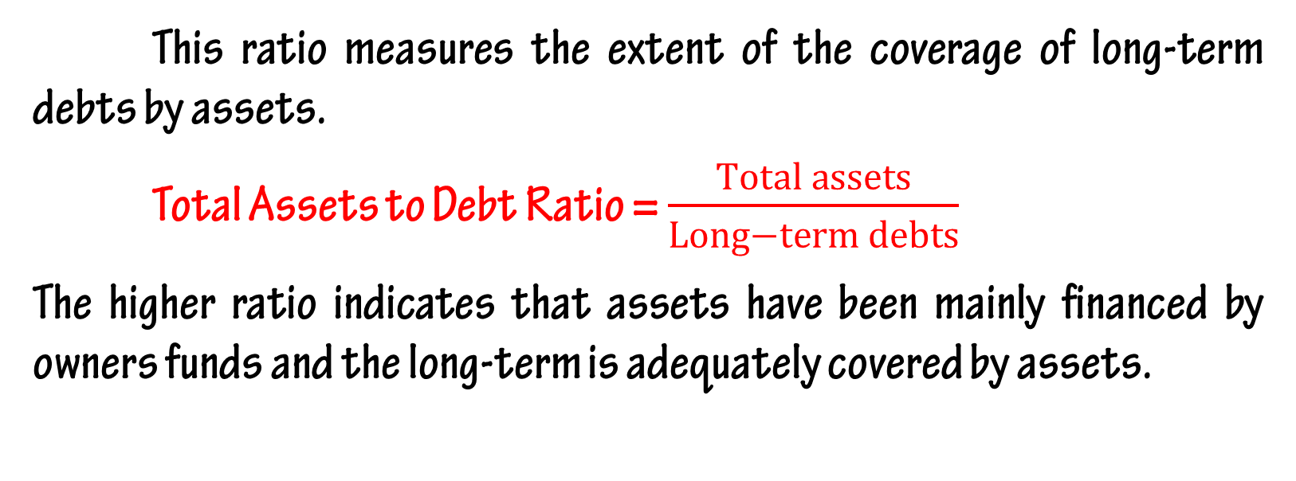
Total Assets to Debt Ratio
This ratio measures the extent of the coverage of long-term debts by assets.
Total Assets to Debt Ratio = $\frac{Total assets}{Long−term debts}$
The higher ratio indicates that assets have been mainly financed by owners funds and the long-term is adequately covered by assets.

Slide 21
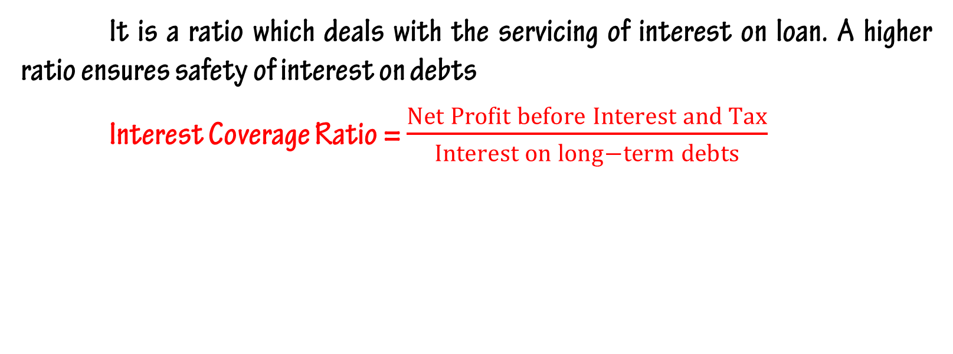
Interest Coverage Ratio
It is a ratio which deals with the servicing of interest on loan. A higher ratio ensures safety of interest on debts
Interest Coverage Ratio = $\frac{Net Profit before Interest and Tax}{Interest on long−term debts}$

Slide 22
ACTIVITY (OR TURNOVER) RATIO
These ratios indicate the speed at which, activities of the business are being performed. The activity ratios are ;
1. Inventory Turnover
2. Trade Receivable Turnover
3. Trade Payable Turnover
4. Investment (Net Assets) Turnover
5. Fixed Assets Turnover
6. Working Capital Turnover.
ACTIVITY (OR TURNOVER) RATIO
Inventory Turnover
Trade Receivable Turnover
Trade Payable Turnover
Investment (Net Assets) Turnover
Fixed Assets Turnover
Working Capital Turnover.

Slide 23
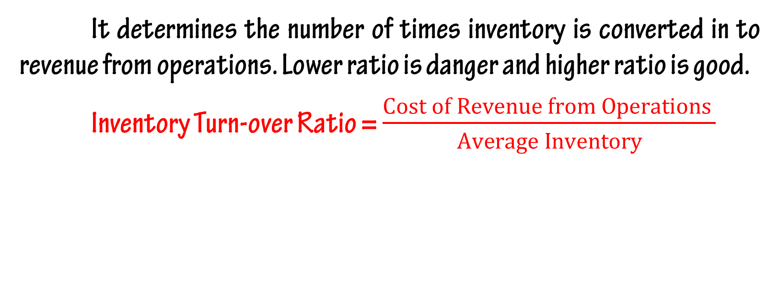
Inventory Turn-over Ratio
It determines the number of times inventory is converted in to revenue from operations. Lower ratio is danger and higher ratio is good.
Inventory Turn-over Ratio = $\frac{Cost of Revenue from Operations }{Average Inventory}$

Slide 24
Illustration - 1
From the following information, calculate inventory turnover ratio :
Inventory in the beginning = 18,000
Inventory at the end = 22,000
Net purchases = 46,000
Wages = 14,000
Revenue from operations = 80,000
Carriage inwards = 4,000

Slide 25
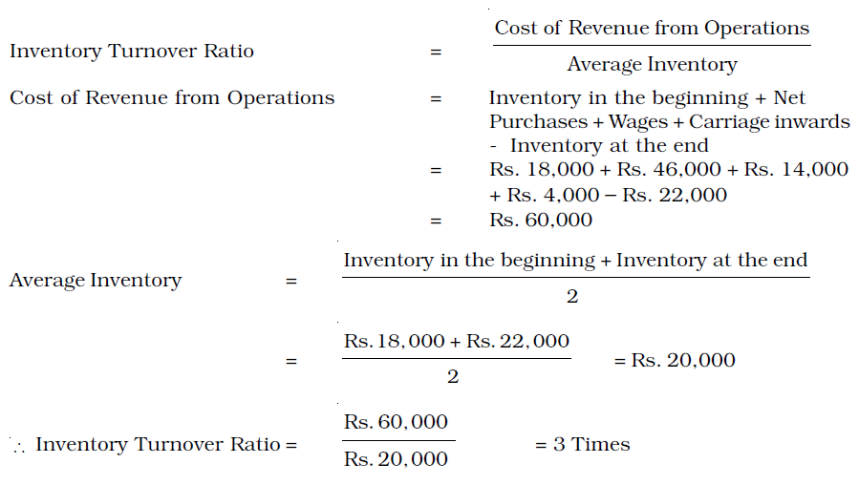
Solution - 1

Slide 26
Illustration - 2
From the following information, calculate inventory turnover ratio :
Revenue from operations = 4,00,000
Average Inventory = 55,000
Gross Loss Ratio = 10%

Slide 27
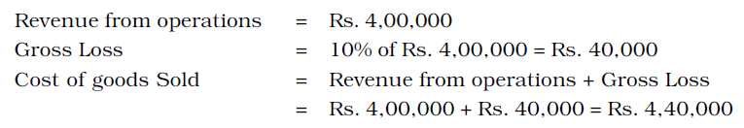
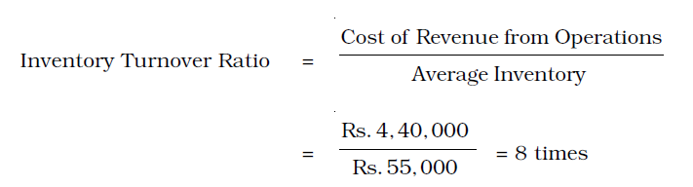
Solution -2

Slide 28
Illustration - 3
A trader carries an average inventory of Rs. 40,000. His inventory turnover ratio is 8 times. If he sells goods at a profit of 20% on Revenue from operations, find out the profit.

Slide 29
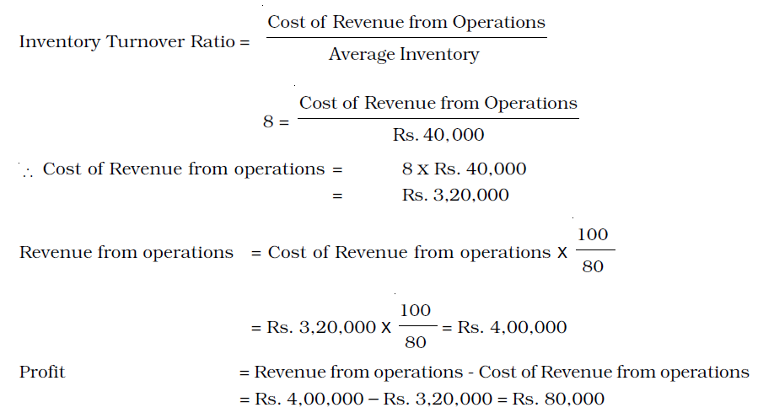
Solution -3

Slide 30
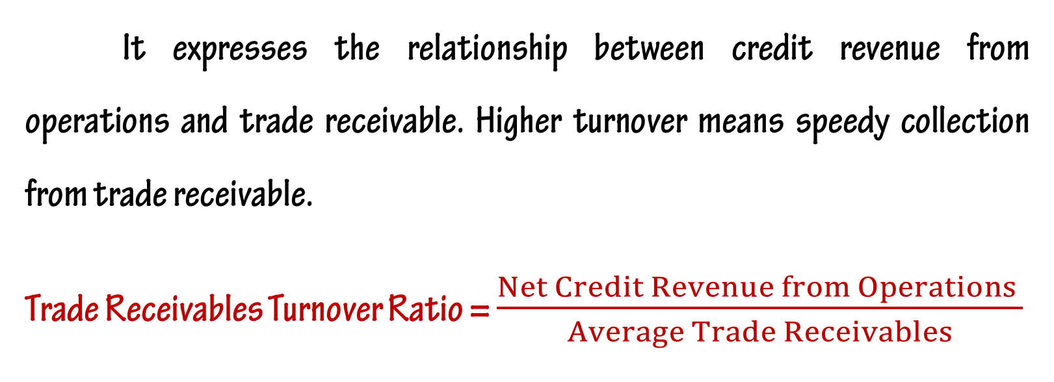
Trade Receivables Turnover Ratio
It expresses the relationship between credit revenue from operations and trade receivable. Higher turnover means speedy collection from trade receivable.
Trade Receivables Turnover Ratio = $\frac{Net Credit Revenue from Operations }{Average Trade Receivables}$

Slide 31
Illustration – 1
Calculate the Trade Receivables Turnover Ratio from the following information:
Total Revenue from Operations Rs.4,00,000
Cash Revenue from Operations 20% of Total Revenue from operations
Trade Receivables as at 1.4.2013 Rs.40,000
Trade Receivables as at 31.3.2014 Rs.1,20,000

Slide 32
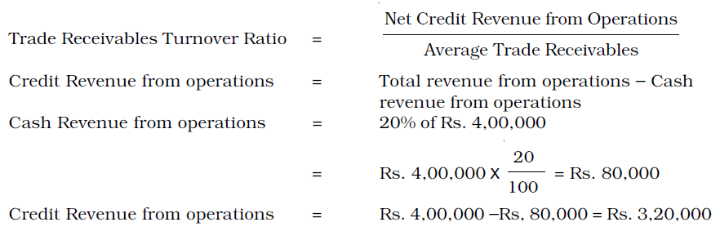
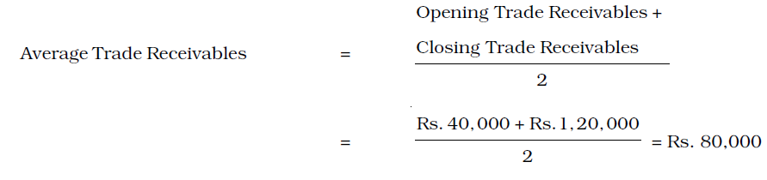
Solution – 1

Slide 33
Illustration – 2
Calculate Debtors Turnover Ratio if Closing Debtors are Rs. 40,000; Opening Debtors Rs. 60,000; Cash Sales is 25% of Credit Sales and Total Sales are Rs. 2,00,000.

Slide 34
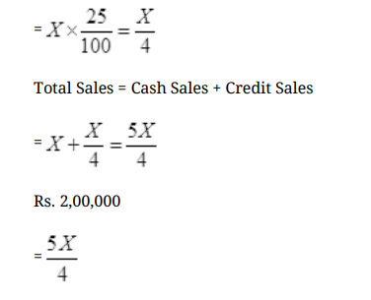
Solution – 2
Cash Sales = 25% of Credit Sales
Let the Credit Sales be Rs. X
Then Cash Sales is 25% of X

Slide 35
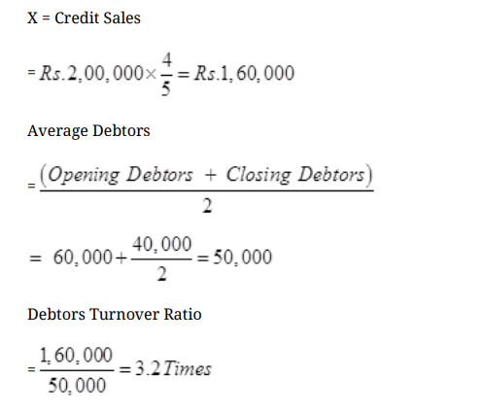
Solution – 2

Slide 36
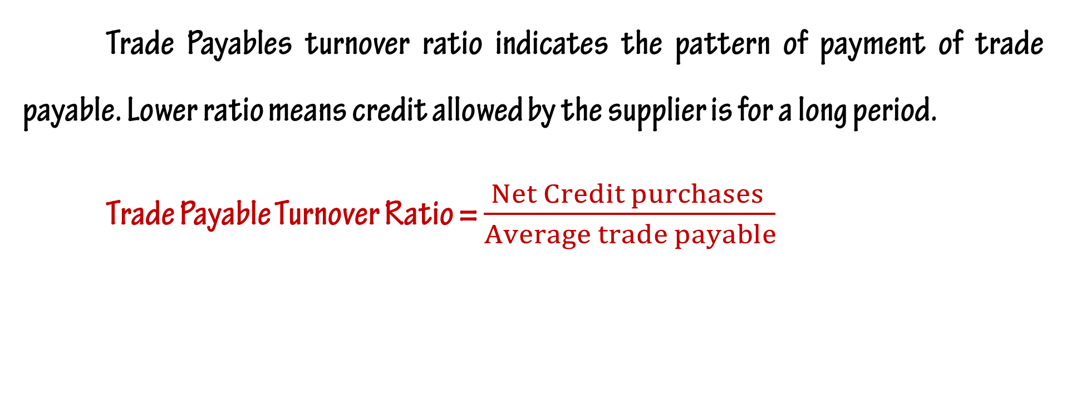
Trade Payable Turnover Ratio
Trade Payables turnover ratio indicates the pattern of payment of trade payable. Lower ratio means credit allowed by the supplier is for a long period.
Trade Payable Turnover Ratio = $\frac{Net Credit purchases }{Average trade payable}$

Slide 37
Illustration - 1
Calculate the Trade Payables Turnover Ratio from the following figures:
Rs.
Credit purchases during 2013-14 = 12,00,000
Creditors on 1.4.2013 = 3,00,000
Bills Payables on 1.4.2013 = 1,00,000
Creditors on 31.3.2014 = 1,30,000
Bills Payables on 31.3.2014 = 70,000

Slide 38
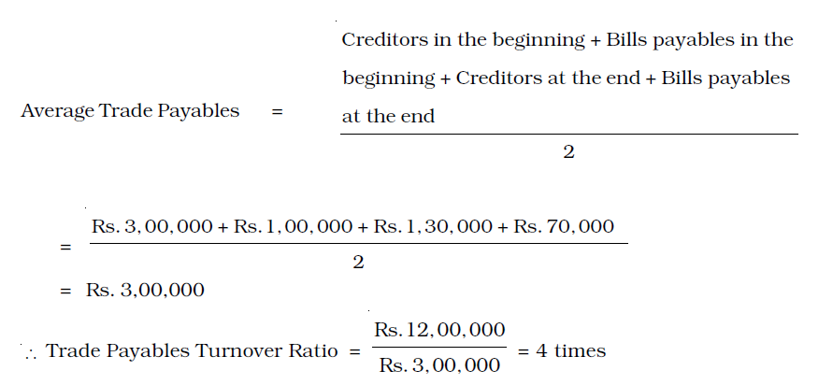
Solution - 1

Slide 39
Illustration - 2
From the following information, calculate –
(i) Trade Receivables Turnover Ratio
(ii) Average Collection Period
(iii) Trade Payable Turnover Ratio
(iv) Average Payment Period
Given :
(Rs.)
Revenue from Operations 8,75,000
Creditors 90,000
Bills Receivable 48,000
Bills Payable 52,000
Purchases 4,20,000
Trade Receivables 59,000

Slide 40
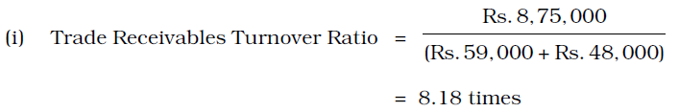
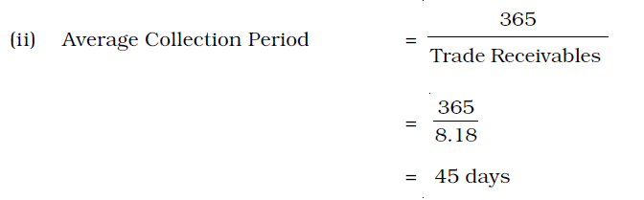
Solution - 2

Slide 41
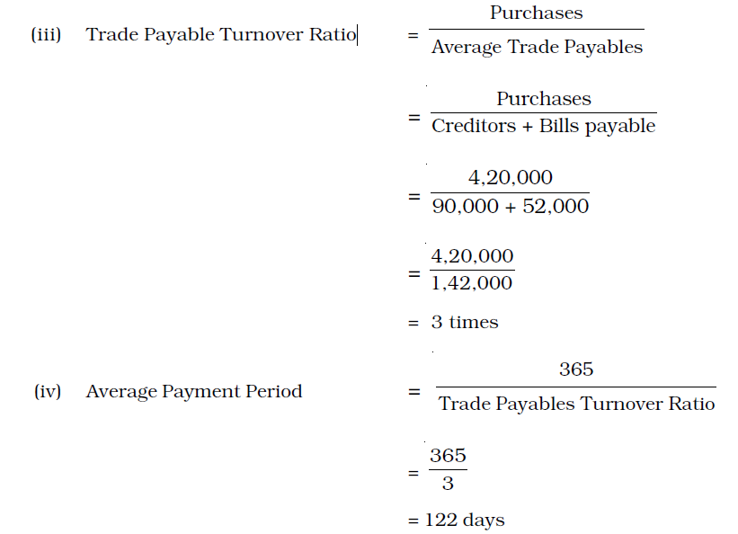
Solution - 2

Slide 42
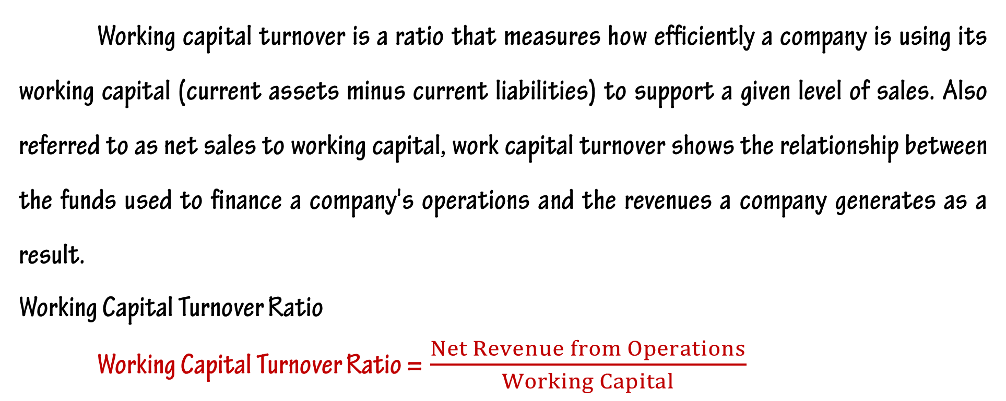
Working Capital Turnover Ratio
Working capital turnover is a ratio that measures how efficiently a company is using its working capital (current assets minus current liabilities) to support a given level of sales. Also referred to as net sales to working capital, work capital turnover shows the relationship between the funds used to finance a company's operations and the revenues a company generates as a result.
Working Capital Turnover Ratio
Working Capital Turnover Ratio =$\frac{Net Revenue from Operations}{Working Capital}$

Slide 43
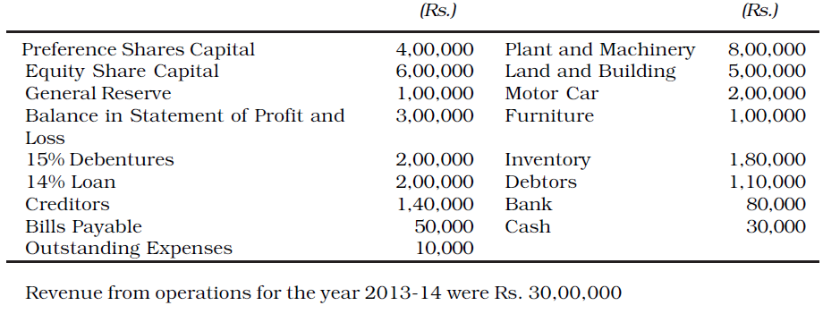
Illustration - 1
From the following information, calculate Working Capital Turnover Ratios :

Slide 44
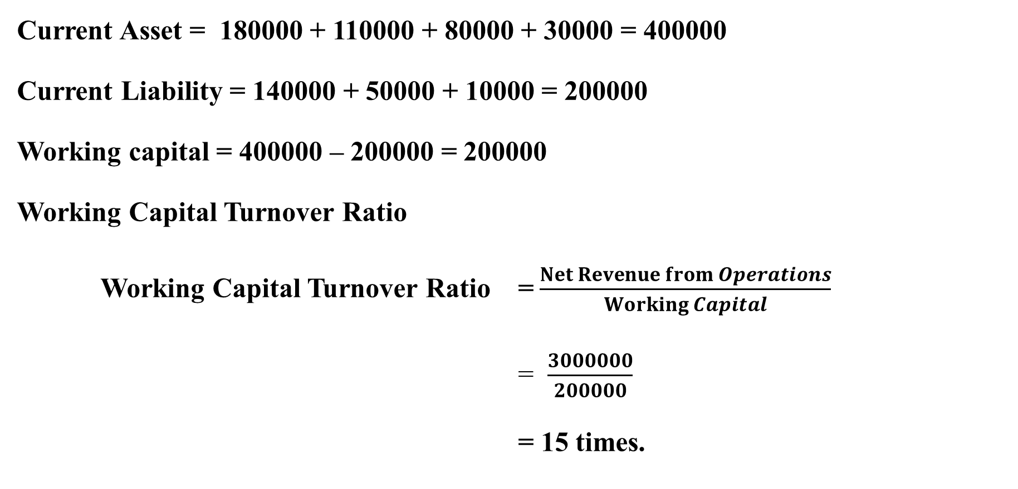
Solution - 1
Current Asset = 180000 + 110000 + 80000 + 30000 = 400000
Current Liability = 140000 + 50000 + 10000 = 200000
Working capital = 400000 – 200000 = 200000
Working Capital Turnover Ratio
Working Capital Turnover Ratio =$\frac{Net Revenue from Operations}{Working Capital}$
= $\frac{3000000}{200000}$
= 15 times.

Slide 45
Illustration - 2
Compute Working Capital Turnover Ratio from the following information:
Rs.
Cash Sales 1,30,000
Credit Sales 3,80,000
Sales Return 10,000
Liquid Assets 1,40,000
Inventory 90,000
Current Liabilities 1,05,000

Slide 46
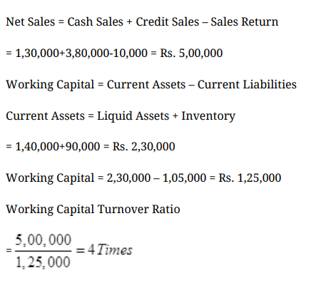
Solution - 2

Slide 47
PROFITABILITY RATIOS
Profitability ratios are calculated to analyse the earning capacity of the business. The profitability ratios are ;
1. Gross Profit Ratio
2. Operating Ratio
3. Operating Profit Ratio
4. Net profit Ratio
5. Return on Investment (ROI)
or Return on Capital Employed (ROCE)
6. Return on Net Worth (RONW)
7. Earnings per Share
8. Book Value per Share
9. Dividend Payout Ratio
10. Price Earning Ratio

Slide 48
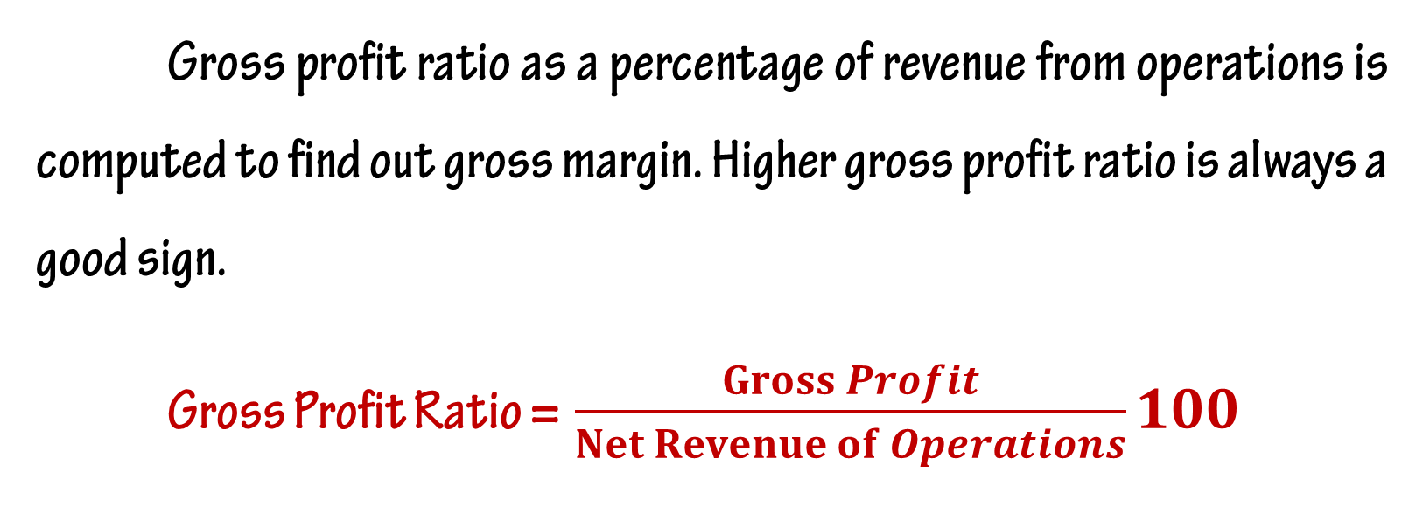
Gross Profit Ratio
Gross profit ratio as a percentage of revenue from operations is computed to find out gross margin. Higher gross profit ratio is always a good sign.
Gross Profit Ratio =$\frac{Gross Profit}{Net Revenue of Operations}100$

Slide 49
Illustration - 1
Following information is available for the year 2013-14, calculate gross profit ratio:
Rs.
Cash Revenue from Operations 25,000
Credit 75,000
Purchases : Cash 15,000
Credit 60,000
Carriage Inwards 2,000
Salaries 25,000
Decrease in Inventory 10,000
Return Outwards 2,000
Wages 5,000

Slide 50
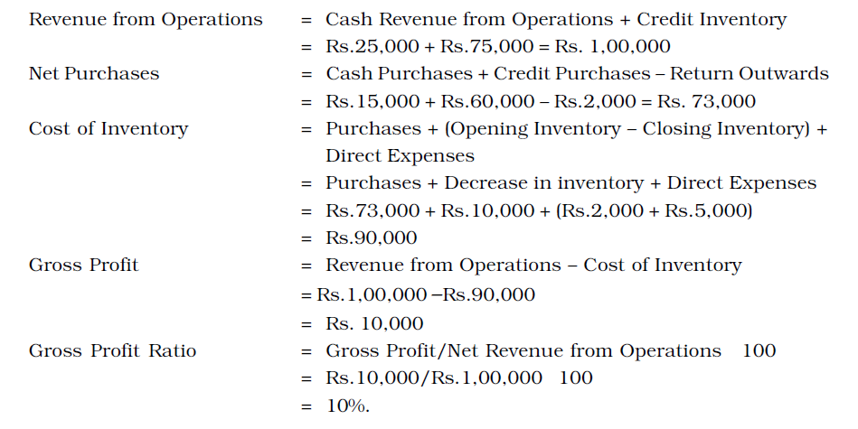
Solution - 1

Slide 51
Illustration -2
Calculate ‘Gross Profit Ratio’ from the following information:
Rs.
Net Revenue from Operations 80,000
Cost of Revenue from Operations 60,000
Operating Expenses 10,000
Indirect Expenses 60,000

Slide 52
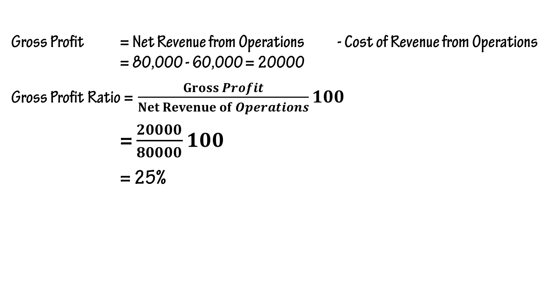
Solution -2
Gross Profit = Net Revenue from Operations - Cost of Revenue from Operations = 80,000 - 60,000 = 20000
Gross Profit Ratio =$\frac{Gross Profit}{Net Revenue of Operations}100$
= $\frac{20000}{80000}100$
= 25%

Slide 53
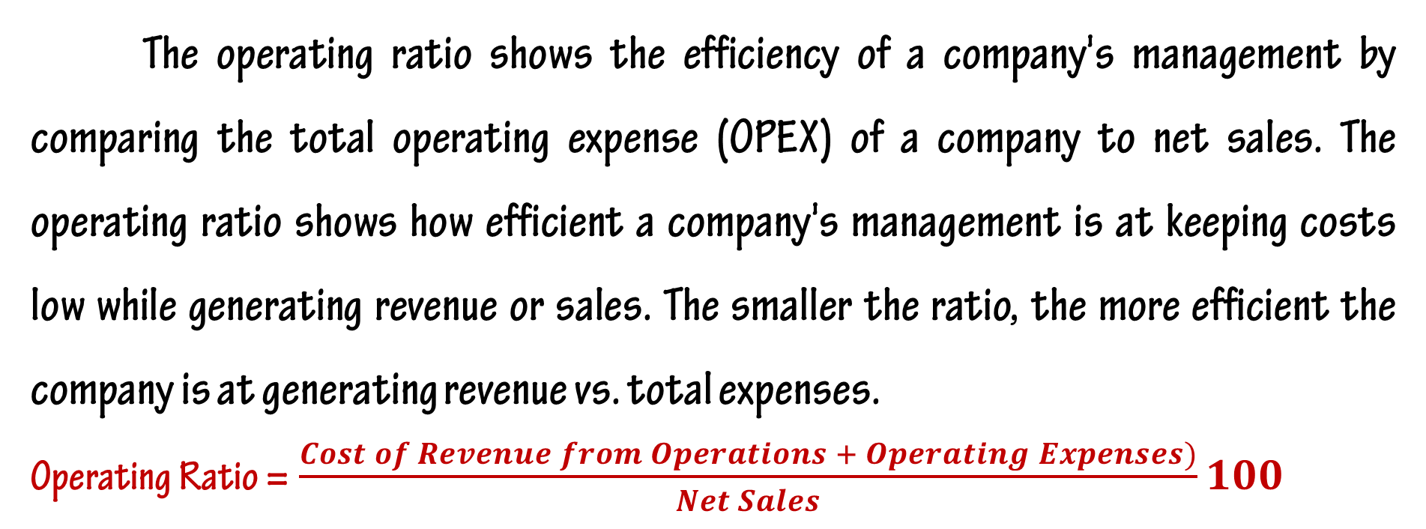
Operating Ratio
The operating ratio shows the efficiency of a company's management by comparing the total operating expense (OPEX) of a company to net sales. The operating ratio shows how efficient a company's management is at keeping costs low while generating revenue or sales. The smaller the ratio, the more efficient the company is at generating revenue vs. total expenses.
Operating Ratio =$\frac{Cost of Revenue from Operations + Operating Expenses)}{Net Sales}100$

Slide 54
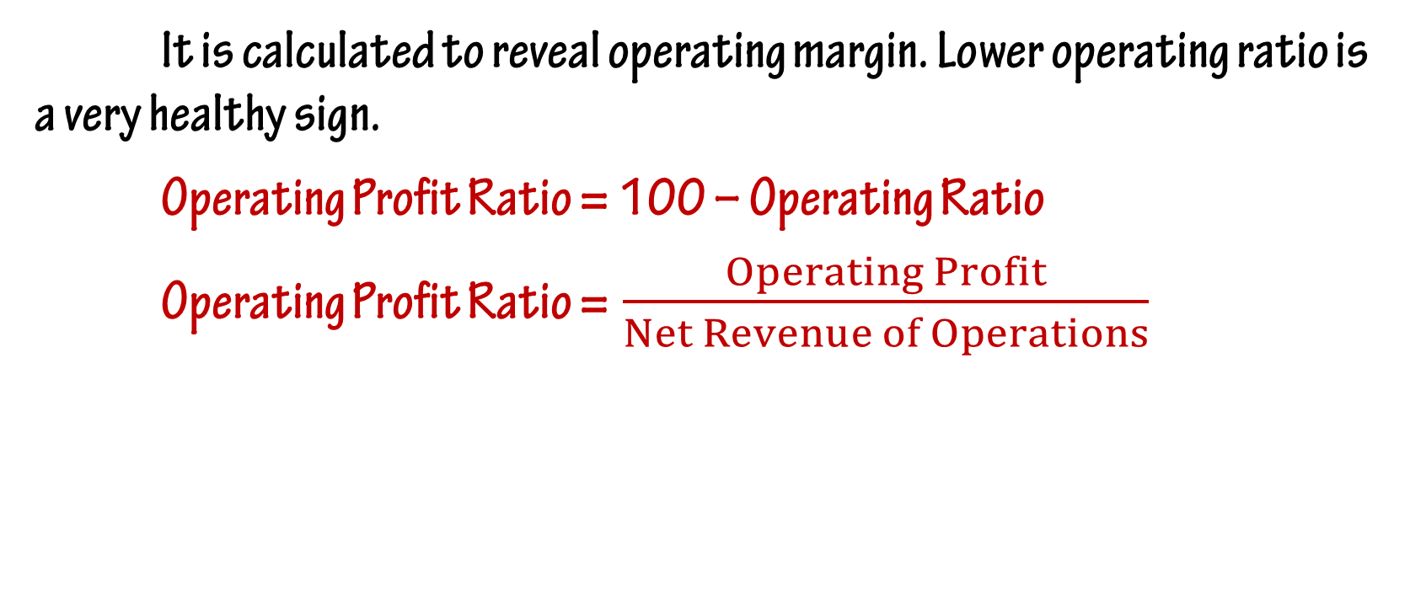
Operating Profit Ratio
It is calculated to reveal operating margin. Lower operating ratio is a very healthy sign.
Operating Profit Ratio = 100 – Operating Ratio
Operating Profit Ratio =$\frac{Operating Profit}{Net Revenue of Operations}$

Slide 55
Illustration - 1
Calculate ‘Operating Profit Ration’ and ‘Operating Ratio’ from the following information:
Rs.
Net Revenue from Operations 80,000
Cost of Revenue from Operations 60,000
Operating Expenses 10,000
Indirect Expenses 60,000

Slide 56
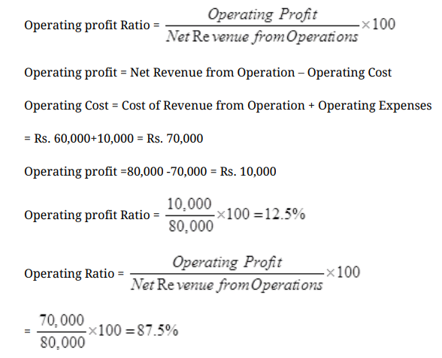
Solution - 1

Slide 57
Illustration - 2
Given the following information:
Rs.
Revenue from Operations 3,40,000
Cost of Revenue from Operations 1,20,000
Selling expenses 80,000
Administrative Expenses 40,000
Calculate Gross Profit Ratio and Operating Ratio.

Slide 58
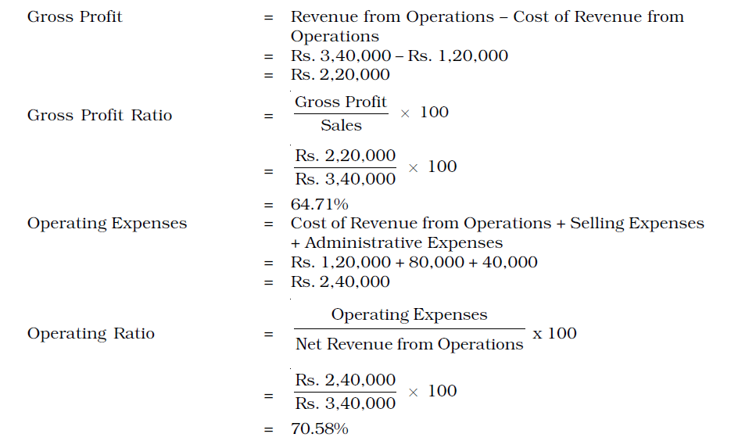
Solution - 2

Slide 59
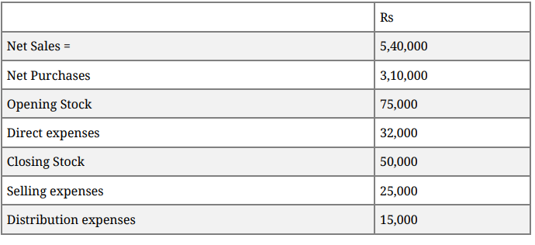
Illustration - 3
Calculate Operating ratio—

Slide 60
Solution - 3
Cost of sales = Opening stock + Net purchases + direct expenses-closing stock
= 75000 + 3,10,000+32,000-50,000 = 3,67,000
Operating expenses = Selling expenses + Distribution expenses
= 25000+15000 = 40,000
Operating ratio = 3,67,000+40,000/5,40,000 X 100 = 75.37%

Slide 61
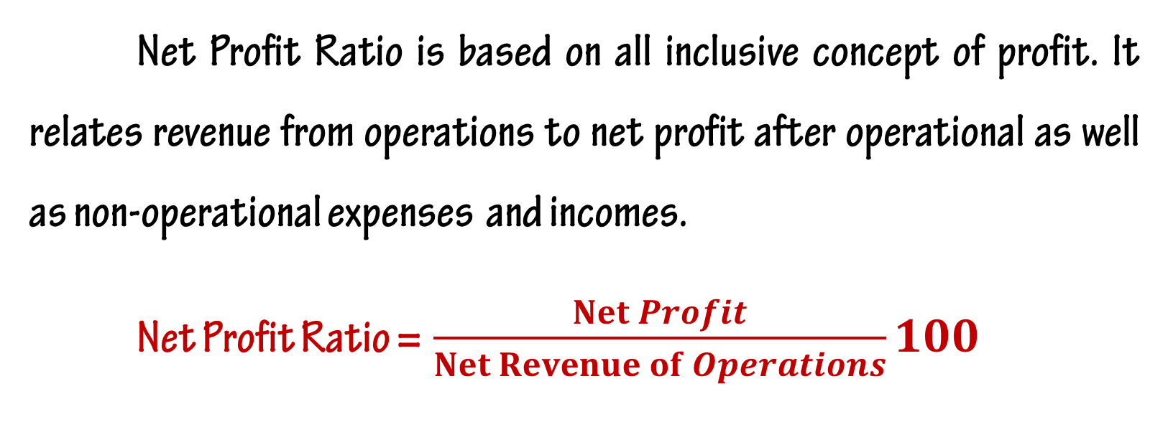
Net Profit Ratio
Net Profit Ratio is based on all inclusive concept of profit. It relates revenue from operations to net profit after operational as well as non-operational expenses and incomes.
Net Profit Ratio =$\frac{Net Profit}{Net Revenue of Operations}100$

Slide 62
Illustration – 1
Calculate ‘Net Profit ration’ from the following Information:
Rs.
Net Revenue from Operations 80,000
Cost of Revenue from Operations 60,000
Operating Expenses 10,000
Indirect Expenses 6,000
Indirect Income 4,000

Slide 63
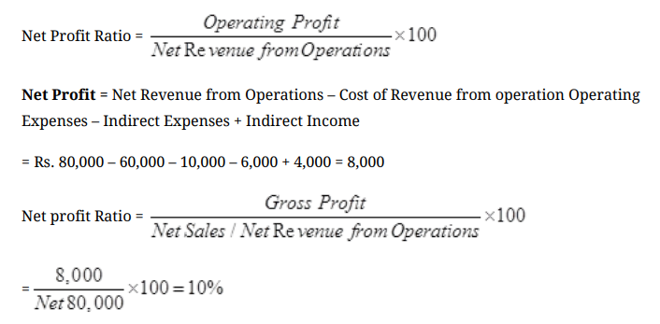
Solution – 1

Slide 64
Illustration -2
Gross profit ratio of a company was 25%. Its credit revenue from operations was Rs. 20,00,000 and its cash revenue from operations was 10% of the total revenue from operations. If the indirect expenses of the company were Rs. 50,000, calculate its net profit ratio.

Slide 65
Solution -2
Cash Revenue from Operations = Rs.20,00,000 × 10/90 = Rs.2,22,222
Hence, total Revenue from Operations are = Rs.22,22,222
Gross profit = .25 × 22,22,222 = Rs. 5,55,555
Net profit = Rs.5,55,555 – 50,000
= Rs.5,05,555
Net profit ratio = Net profit/Revenue from Operations × 100
= Rs.5,05,555/Rs.22,22,222 × 100
= 22.75%.

Slide 66
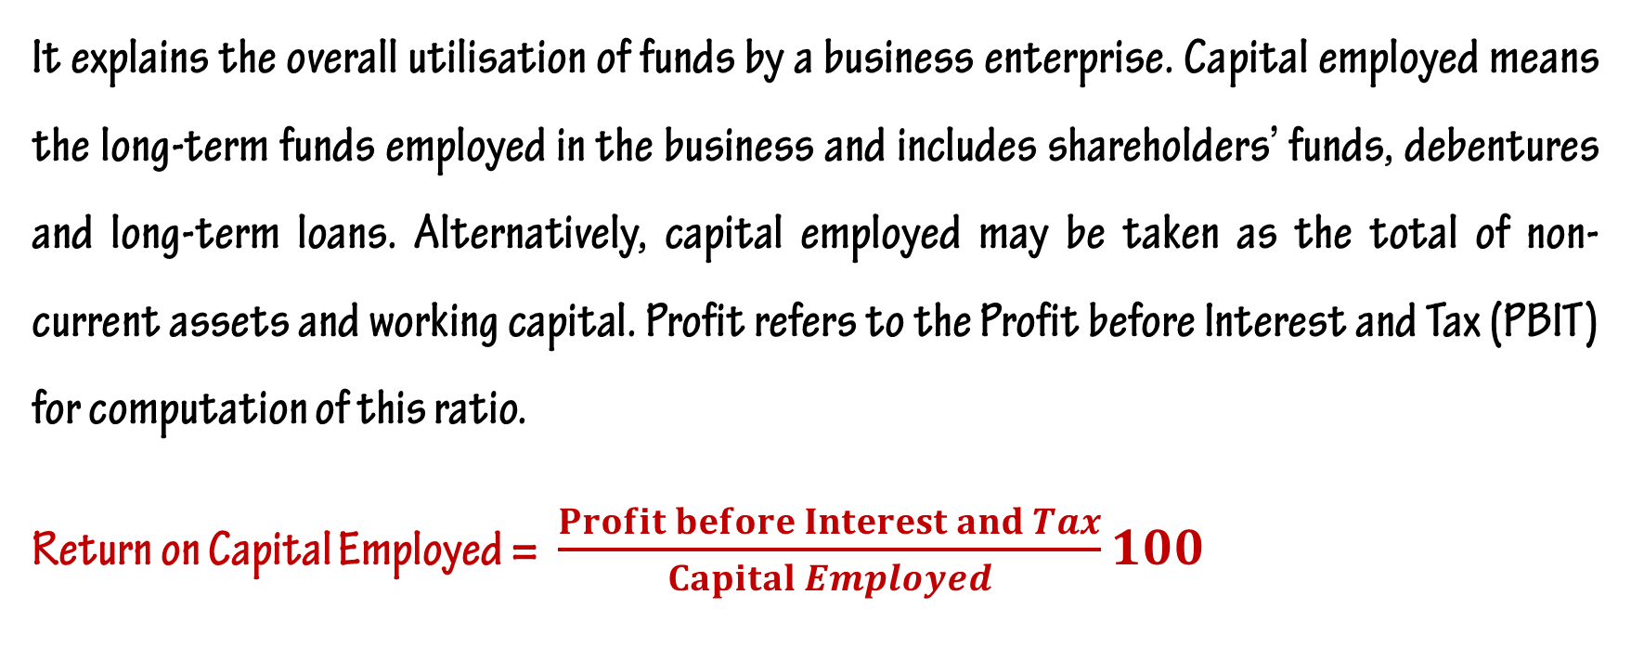
Return on Capital Employed or Investment (ROCE or ROI)
It explains the overall utilisation of funds by a business enterprise. Capital employed means the long-term funds employed in the business and includes shareholders’ funds, debentures and long-term loans. Alternatively, capital employed may be taken as the total of non-current assets and working capital. Profit refers to the Profit before Interest and Tax (PBIT) for computation of this ratio.
Return on Capital Employed = $\frac{Profit before Interest and Tax}{Capital Employed}100$

Slide 67
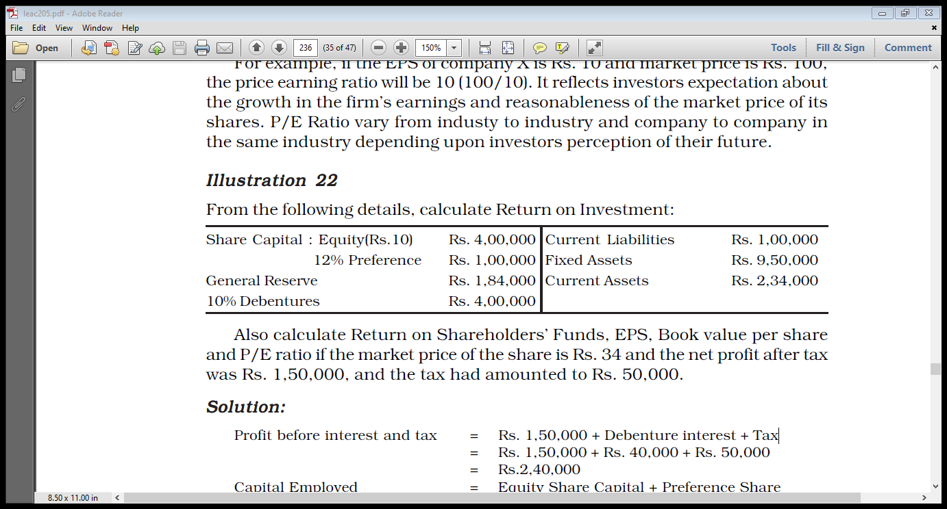
Illustration - 1
From the following details, calculate Return on Investment: the net profit after tax was Rs. 1,50,000, and the tax had amounted to Rs. 50,000.

Slide 68
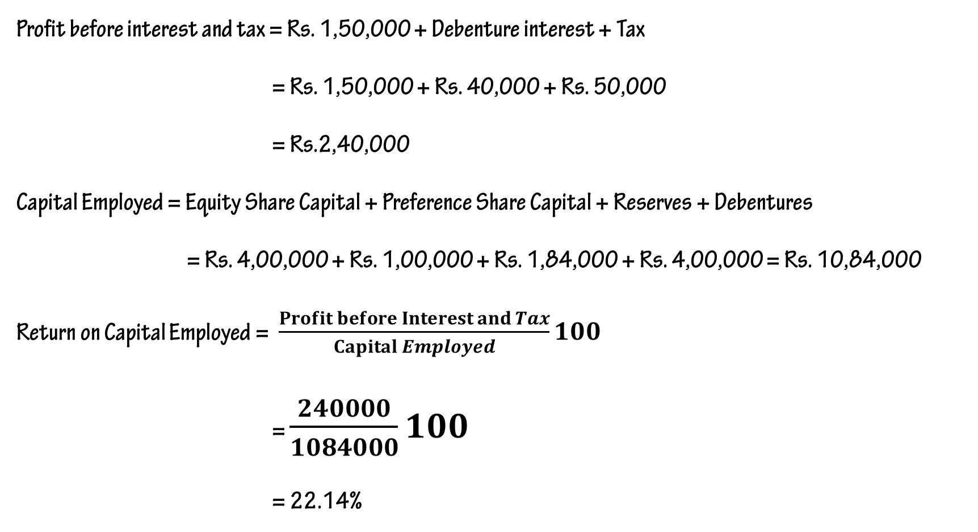
Solution - 1
Profit before interest and tax = Rs. 1,50,000 + Debenture interest + Tax
= Rs. 1,50,000 + Rs. 40,000 + Rs. 50,000
= Rs.2,40,000
Capital Employed = Equity Share Capital + Preference Share Capital + Reserves + Debentures
= Rs. 4,00,000 + Rs. 1,00,000 + Rs. 1,84,000 + Rs. 4,00,000 = Rs. 10,84,000
Return on Capital Employed = $\frac{Profit before Interest and Tax}{Capital Employed}100$
= $\frac{240000}{1084000}100$
= 22.14%

Slide 69
Illustration - 2
Calculate ‘Return on Investment’ with the following information:
Rs.
Net Profit after interest and Tax 2,10,000
Rate of income Tax30%
Shareholders’ Funds 13,00,000
12% Long term Debts 1,00,000
10% Debentures 2,00,000

Slide 70
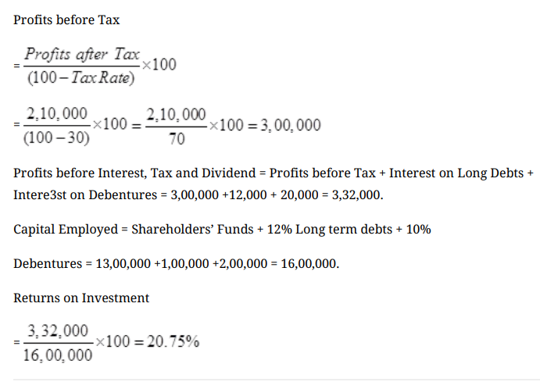
Solution - 2

Slide 71
Additional Problems

Slide 72
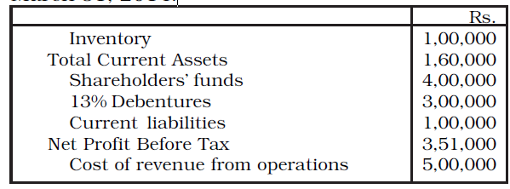
Illustration – 1
Following information is given by a company from its books of accounts as on March 31, 2014:

Slide 73
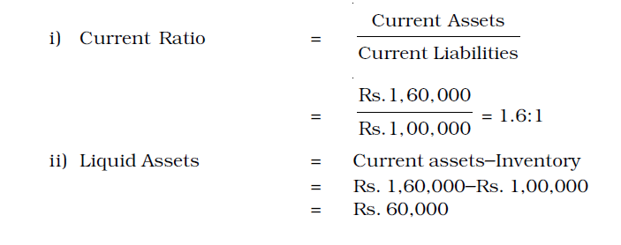
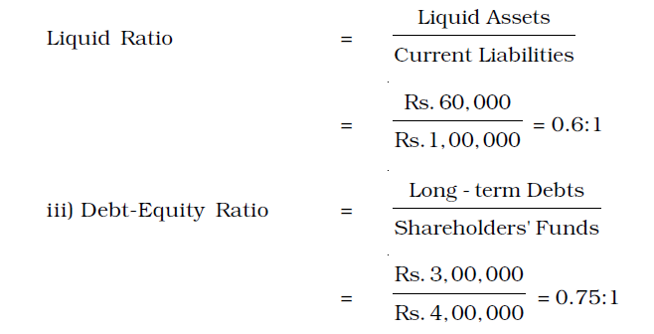
Solution – 1

Slide 74
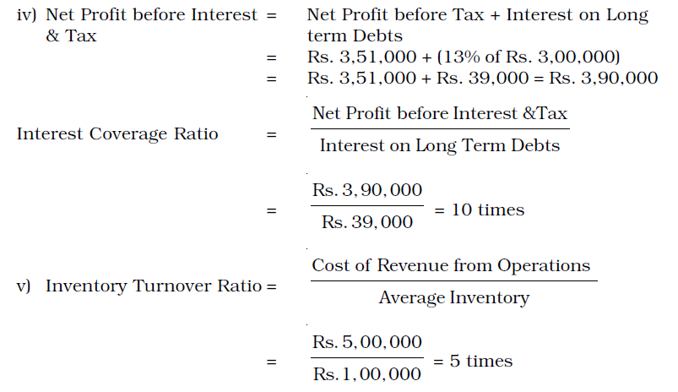
Solution – 1

Slide 75
Illustration - 2
Calculate ‘Return on Investment’ and ‘Debt-Equity Ratio’ from the following information:
Rs.
Net Profit after interest and Tax 6,00,000
10 % Debentures 10,00,000
Tax Rate 40 %
Capital Employed 80,00,000

Slide 76
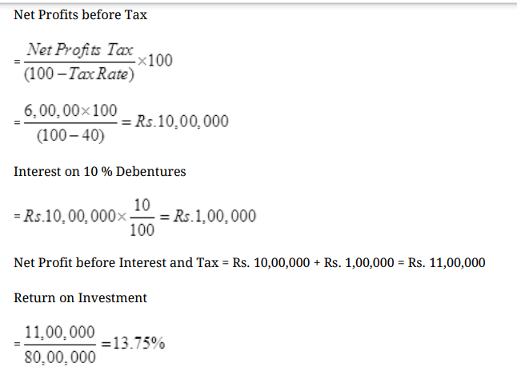
Solution - 2

Slide 77

Solution - 2

Slide 78
THANKING YOU
ODM EDUCATIONAL GROUP

