Slide 1


ACCOUNTING FOR PARTNERSHIP FIRM
SUBJECT : ACCOUNTANCY
CHAPTER NUMBER:02
CHAPTER NAME : ACCOUNTING FOR PARTNERSHIP FIRM:BASIC CONCEPTS

Slide 2
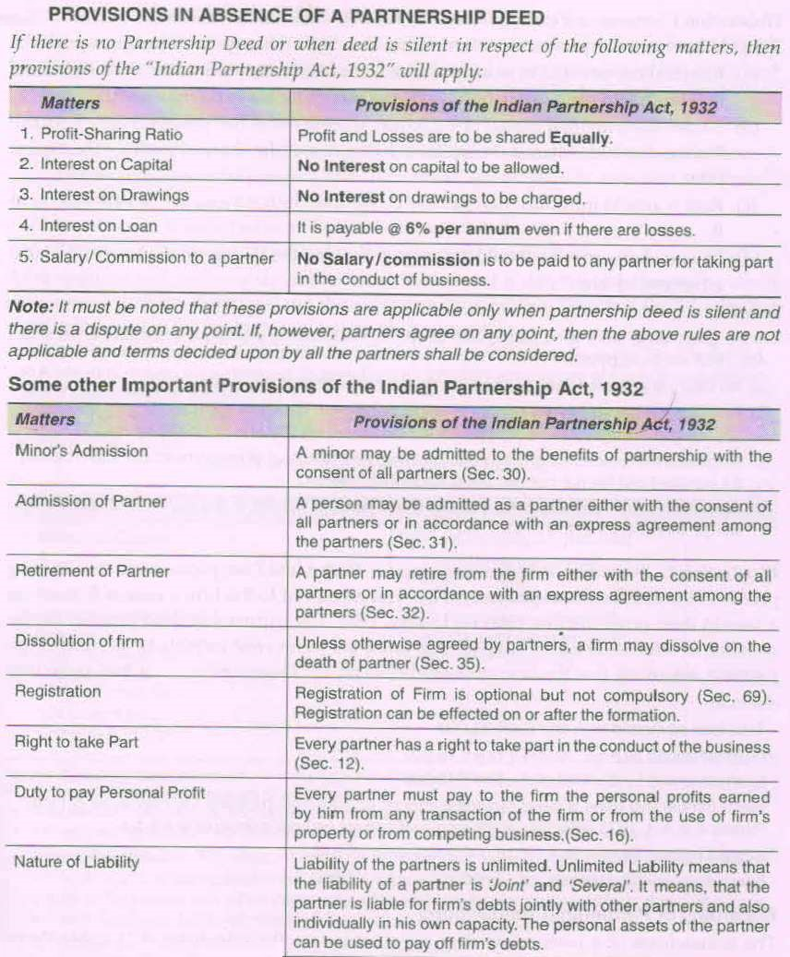

Slide 3
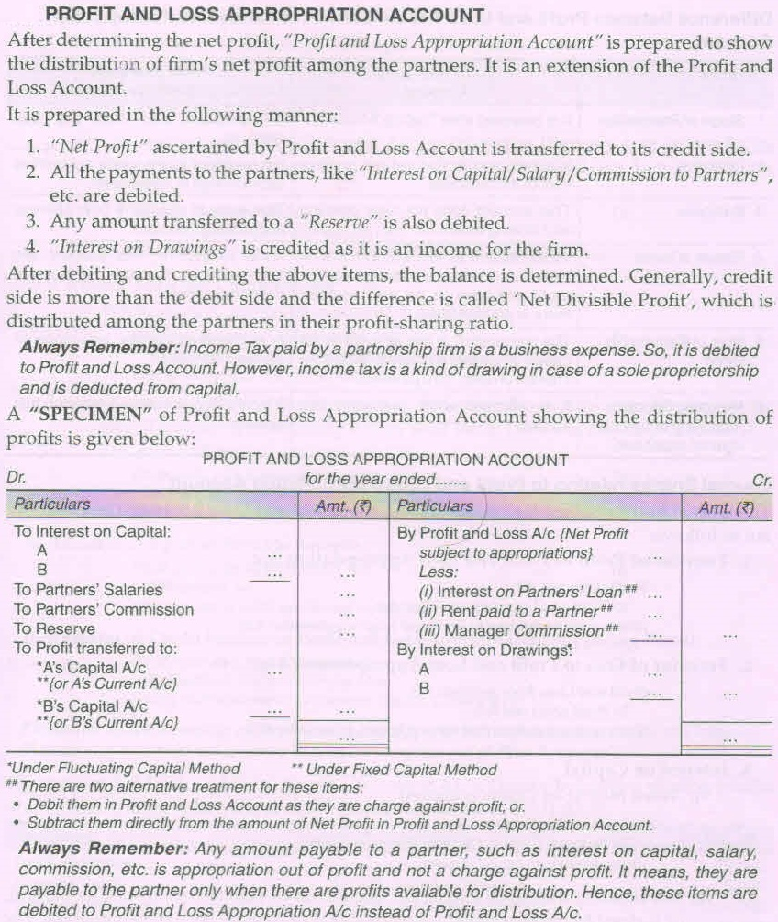

Slide 5
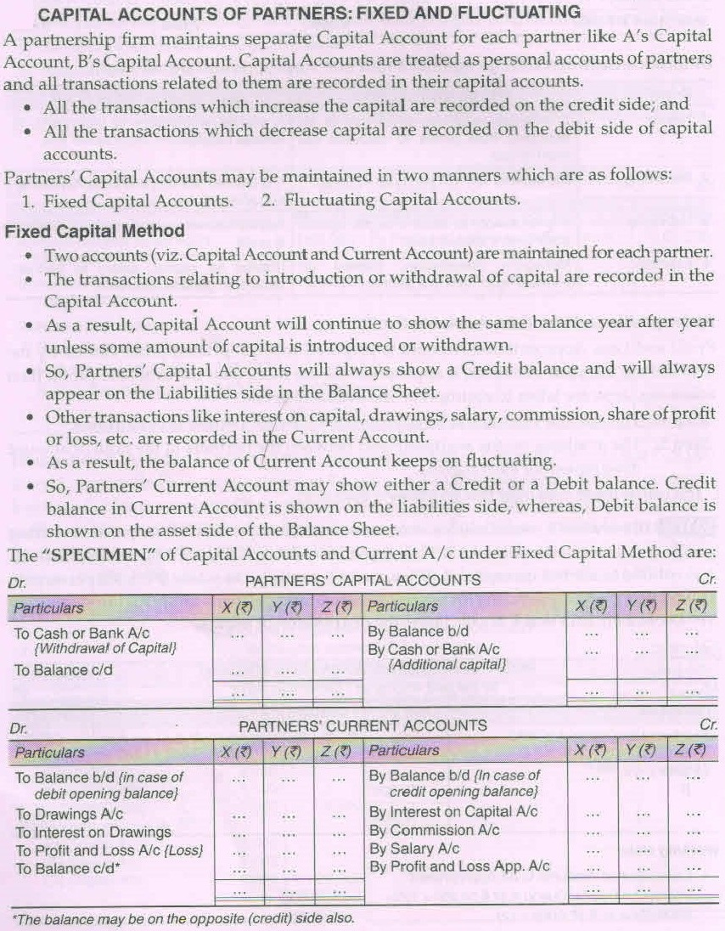

Slide 7
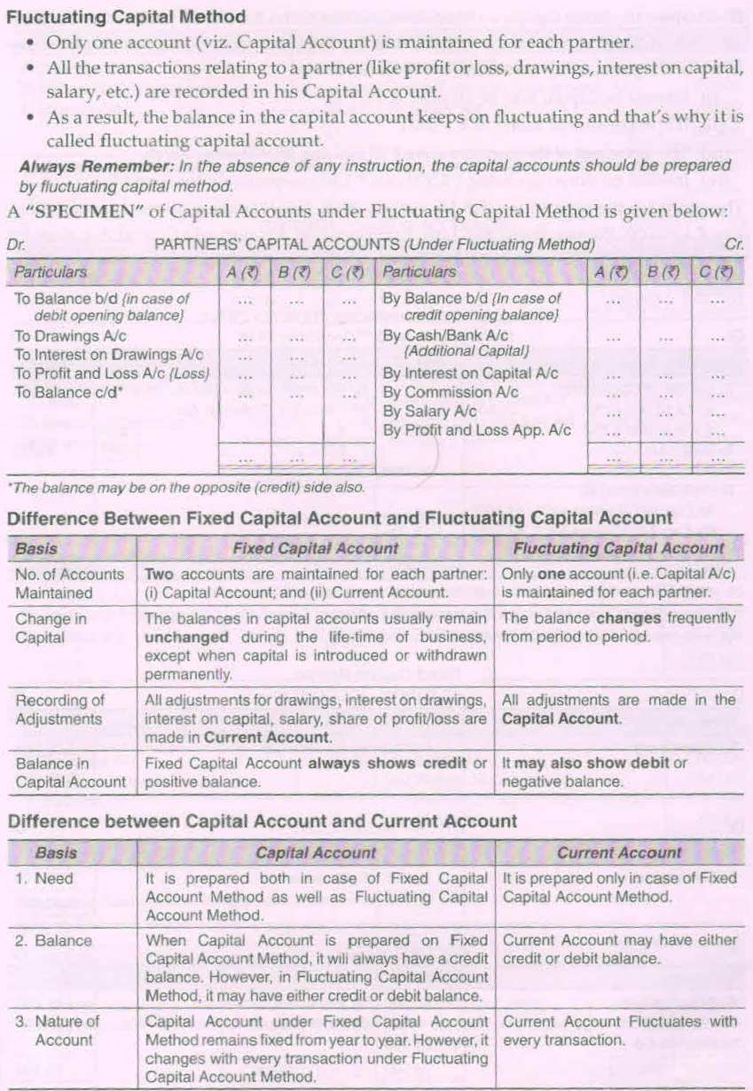

Slide 9
Calculation of interest on capital & Interest on Drawings

Slide 10
Calculation of interest on capital
Interest on capital is paid to the partners as a compensation for their capital contribution to the firm. Interest on capital is an expenses for the firm and gain for partners individually. Interest on capital is to be allowed to the partners only if the partnership deed provides for it. The interest on capital is allowed considering three important factors rate, amount and period. Following are the different ways of calculating interest on capital;

Slide 11
Situation – 1 When There Is No Addition To Or Withdrawal From Capital During The Year.
Sathish and Ram are partners sharing profit and losses equally. Their capitals on 1st January 2013 were 25000and 30000. Calculate interest on capital at 6% per annum for the year ending 31st December 2013.
Interest on capital of Sathish = 25000 ×6 /100 = 1500
Interest on capital of Ram = 30000 ×6 /100 = 1800

Slide 12
Situation – 2 When There Is Additional Capital Contribution During The Accounting Year
Santosh and Raju started partnership business on 1st January 2010 by contributing Rs.50000 And Rs. 40000 as initial capital. During the year 2010 Santosh introduced Rs. 15000 as additional capital on 1st June and Raju introduced Rs. 10000 on 1st August. The interest on capital is allowed @6% p.a. accounts are closed on December 31st every year. Calculate interest on capital to be allowed to Santosh and Raju for the year 2010.

Slide 13
Solution
Interest on capital of Santhosh
6% on 50000n for one year = 50000 × 6/100 = 3000
6% 0f 15000 for 7 months = 15000 × 6/100 × 7/12 = 525
Total interest on Capital of Santhosh = 3000 + 525 = 3525
Interest on capital of Raju
6% on 40000n for one year = 40000 × 6/100 = 2400
6% 0f 10000 for 5 months = 10000 × 6/100 × 5/12 = 250
Total interest on Capital of Raju = 2400 + 250 = 2650

Slide 14
Situation - 3 If opening balance is not given
In this case we have to Calculate opening capital , for this we should add items such as drawings, interest on drawings ,share of loss ,if any with capital at the end of year and to subtract items such as partner’s salary, commission , share of profit , additional capital ,etc.

Slide 15
Illustration
Asha and Deepa are partners in a textile business. There capital at the end of the year were Rs. 45000 and Rs.30000 respectively. During the year 2012 Asha’s drawings and Deepa’s drawings were Rs.6000 and Rs.7000 respectively. Interest on drawings charged were Rs.300 and Rs.200. Asha had been credited with a salary of Rs.2500 and Deepa with a commission of Rs. 4000. Profit during the year after making the above mentioned adjustments were Rs. 20000. Calculate interest on capital @6% for the year ending 31st December 2012.

Slide 16
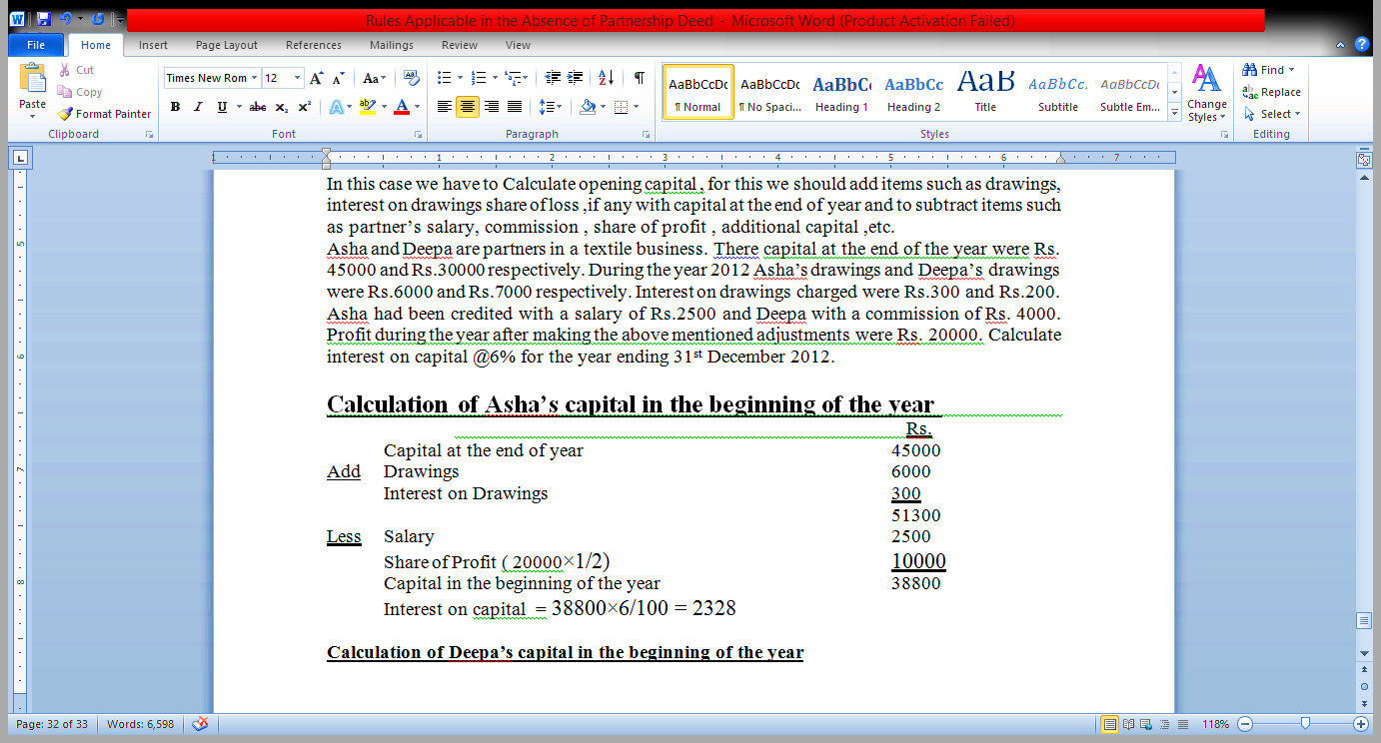

Slide 17
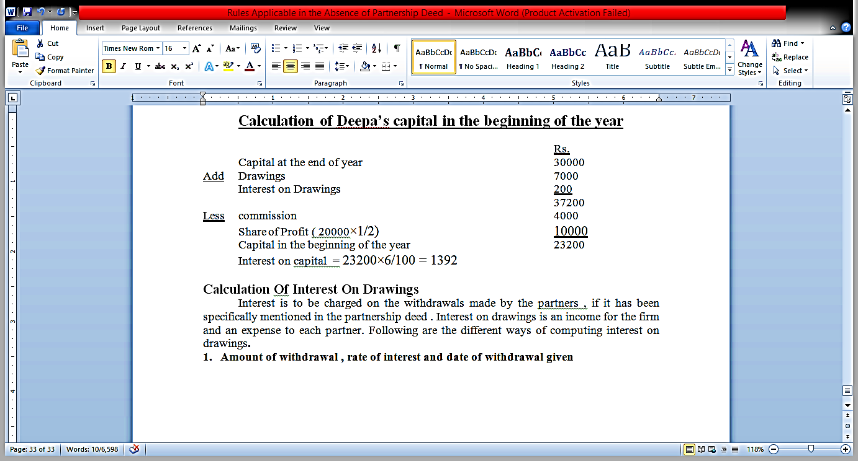

Slide 18
Calculation Of Interest On Drawings

Slide 19
Calculation Of Interest On Drawings
Interest is to be charged on the withdrawals made by the partners , if it has been specifically mentioned in the partnership deed . Interest on drawings is an income for the firm and an expense to each partner.

Slide 20
1. Amount of withdrawal , rate of interest and date of withdrawal given
Year end of a firm is 31st December , Rahul a partner withdraws Rs.5000 on 1st July. Calculate the interest on drawings at 8% per annum.
Interest on Drawings = 5000×8×6 = 525
100×12

Slide 21
2.Date of withdrawal not given , amount and rate of interest given.
If the date of drawings is not given , it may assumed that drawings were made evenly throughout the year. In such a case interest should be for six months on the whole amount.
Raghav a partner withdraws Rs.7000 in a year and interest is chargeable on the drawings at 12% per annum. Calculate interest on drawing.
Interest on Drawings = 7000×12×6 = 420
100×12

Slide 22
3.When different amount withdrawn at different intervals
If the date of drawings and the different amounts withdrawn are clearly stated , the interest may be calculated with the help of Simple method or product method. Let us look at the two methods with illustration

Slide 23
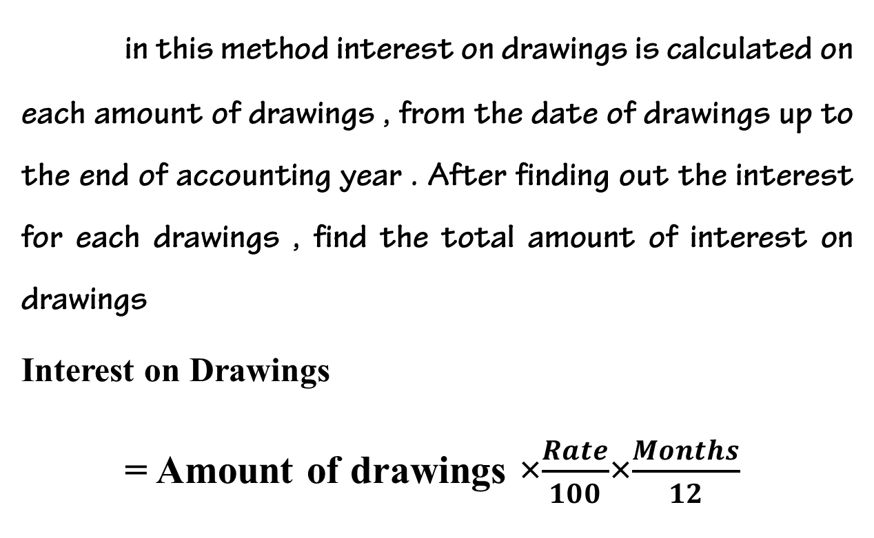
A) Simple Method
in this method interest on drawings is calculated on each amount of drawings , from the date of drawings up to the end of accounting year . After finding out the interest for each drawings , find the total amount of interest on drawings
Interest on Drawings
= Amount of drawings ×$\frac{Rate}{100}$×$\frac{Months}{12}$

Slide 24
Illustration
Rajan a partner in a firm, withdrew the following amounts during the year 2019
Rs.
February 1 2000
May 1 5000
June 30 2000
October 31 6000
December 31 2000
The interest on drawings is to be charged @15% p.a. Assuming the accounting year closes on December 31. Calculate interest on drawings chargeable to the partner.

Slide 25
Solution
Date | Amount | Period | Interest
February 1 | 2000 | 11 | 2000 × 15/𝟏𝟎𝟎× 11/𝟏𝟐 = 275
May 1 | 5000 | 8 | 5000 × 15/𝟏𝟎𝟎 × 8/𝟏𝟐 = 500
June 30 | 2000 | 6 | 2000 × 15/𝟏𝟎𝟎× 6𝟏𝟐 = 150
October 31 | 6000 | 2 | 6000 × 15/𝟏𝟎𝟎× 2/𝟏𝟐 = 150
December 31 | 2000 | 0 | 2000× 15/𝟏𝟎𝟎× 0/𝟏𝟐 = 0
Total Interest on Drawings |  |  | 1075

Slide 26
b) Product Method
Calculate the time period between the date of withdrawal and the date of closing the accounts in each case of drawings.
Multiply the period so calculated by the respective amount of drawings. This is called the product.
Add up the various products.
Calculate interest for one month on the sum of products at the rate of percentage.

Slide 27
Illustration
Rajan a partner in a firm, withdrew the following amounts during the year 2019
Rs.
February 1 2000
May 1 5000
June 30 2000
October 31 6000
December 31 2000
The interest on drawings is to be charged @15% p.a. Assuming the accounting year closes on December 31. Calculate interest on drawings chargeable to the partner.

Slide 28
Solution
Date | Amount | Period | Product
February 1 | 2000 | 11 | 22000
May 1 | 5000 | 8 | 40000
June 30 | 2000 | 6 | 12000
October 31 | 6000 | 2 | 12000
December 31 | 2000 | 0 | 0
Total |  |  | 86000
Interest on drawings = Sum of Products × Rate of Interest × 1
100 12
= 86000 × 15 × 1
100 12
= 1075

Slide 29
4. Fixed amount withdrawn every month
If a partner withdraws a fixed amount at regular intervals, the interest on drawings can be calculated on the basis of average period. The calculation of average period depends upon whether the fixed amount is withdrawn on the first day of each month , middle of the month or at the end of each month.
Average period =
Time Left After First Drawings + Time Left After Last Drawings
2

Slide 30
a) Fixed amount withdrawn on the first day of the month.
If the fixed amount is withdrawn on the first day of each month, the average period will be calculated as follows;
Average period = 12+ 1
2
= 6½
Thus interest on the whole amount of drawings is to be calculated for 6½ months at the agreed rate.

Slide 31
Illustration
Devan a partner in a firm withdraws Rs. 3000 p.m. regularly only the first day of every month. Interest is paid at 12% per annum. Calculate interest on drawings.
Total Drawings = 3000 × 12 = 36000
Interest on Drawings = 36000 × 12 × 6½
100 12
= 2340

Slide 32
b) Fixed amount withdrawn on the last day of the month.
If the fixed amount is withdrawn on the last day of each month, the average period will be calculated as follows;
Average period = 11+ 0
2
= 5½
Thus interest on the whole amount of drawings is to be calculated for 5½ months at the agreed rate.

Slide 33
illustration
Biju a partner in a firm withdraws Rs. 6000 p.m. regularly only the last day of every month. Interest is paid at 12% per annum. Calculate interest on drawings.
Total Drawings = 6000 × 12 = 72000
Interest on Drawings = 72000 × 12 × 5½
100 12
= 3960

Slide 34
c) Fixed amount withdrawn in the middle of the month.
If the fixed amount is withdrawn in the middle of each month, the average period will be calculated as follows;
Average period = 12
2
= 6
Thus interest on the whole amount of drawings is to be calculated for 6 months at the agreed rate.

Slide 35
Illustration
Rajan a partner in a firm withdraws Rs. 12000 p.m. regularly in the middle of every month. Interest is paid at 12% per annum. Calculate interest on drawings.
Total Drawings = 12000 × 12 = 144000
Interest on Drawings = 144000 × 12 × 6
100 12
= 8640

Slide 36
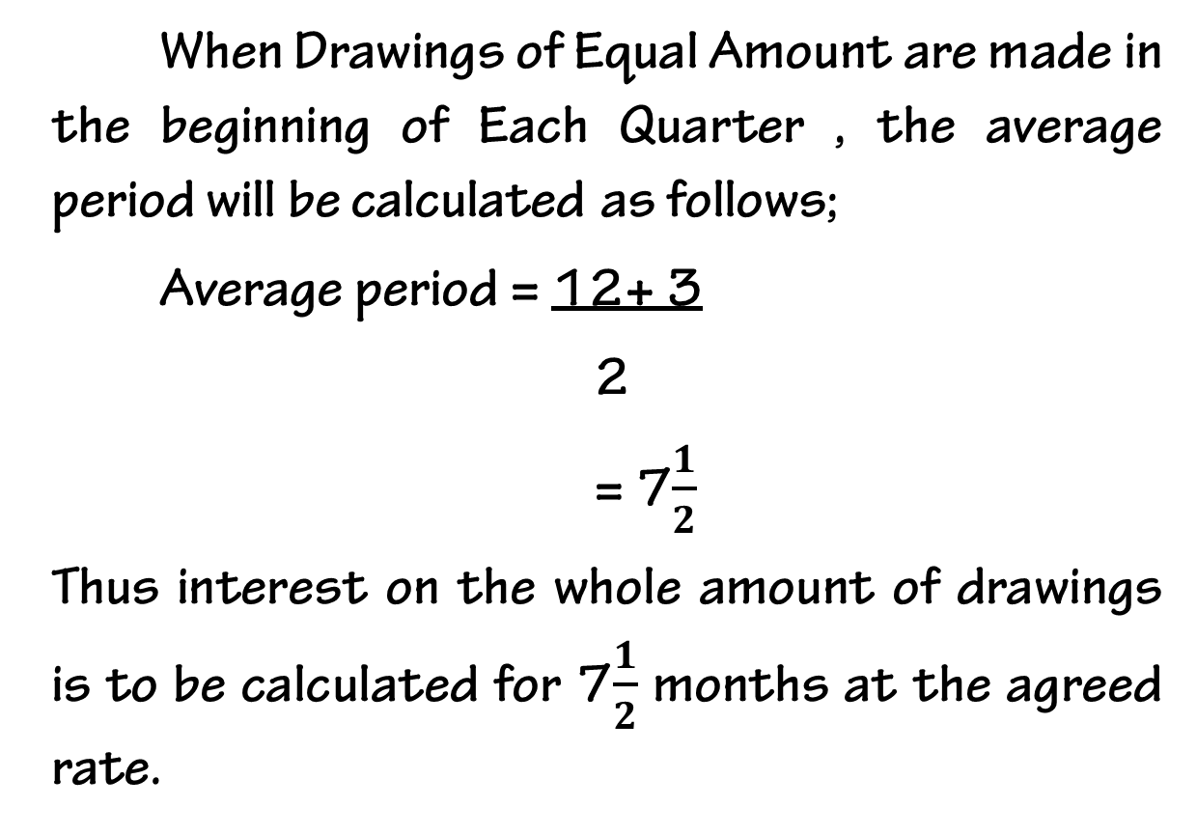
D) When Drawings of Equal Amount are made in the beginning of Each Quarter
When Drawings of Equal Amount are made in the beginning of Each Quarter , the average period will be calculated as follows;
Average period = 12+ 3
2
= 7$\frac{1}{2}$
Thus interest on the whole amount of drawings is to be calculated for 7$\frac{1}{2}$ months at the agreed rate.

Slide 37
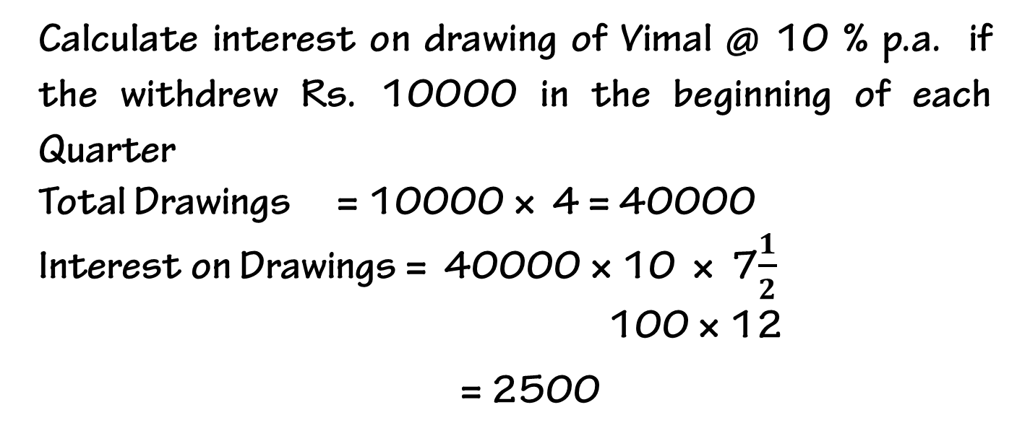
Illustration
Calculate interest on drawing of Vimal @ 10 % p.a. if the withdrew Rs. 10000 in the beginning of each Quarter
Total Drawings = 10000 × 4 = 40000
Interest on Drawings = 40000 × 10 × 7$\frac{1}{2}$ 100 × 12
= 2500

Slide 38
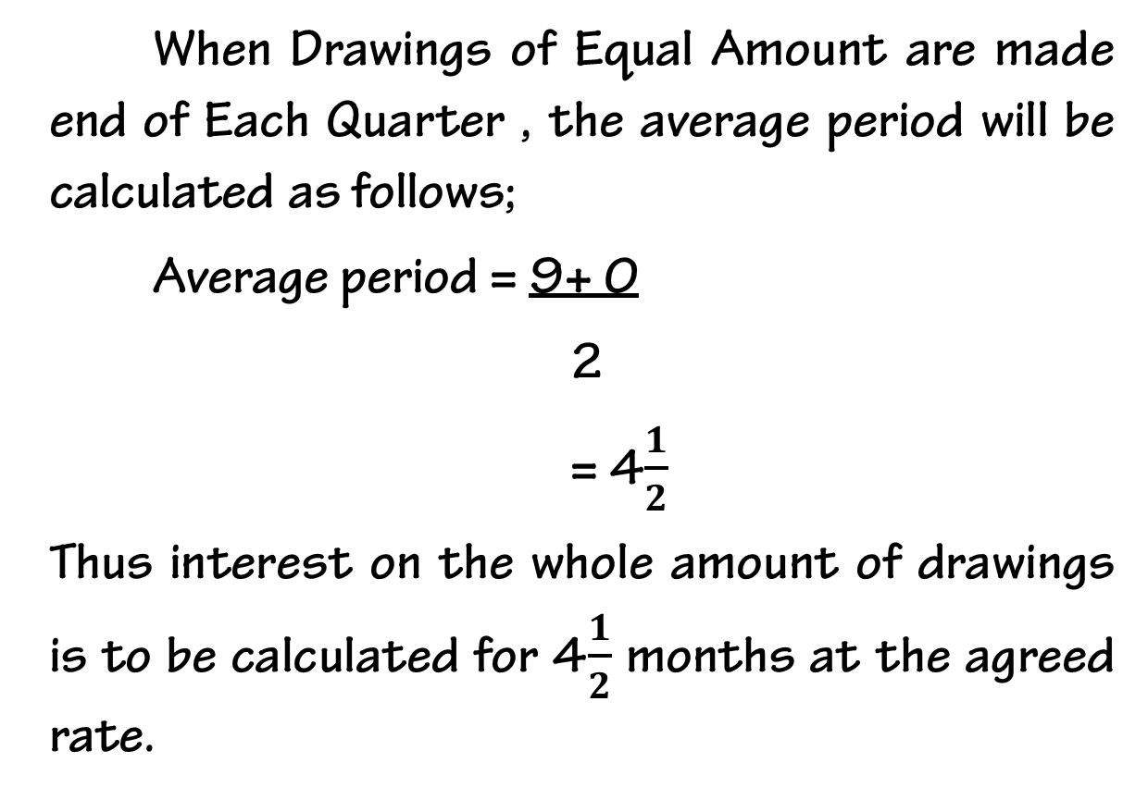
E) When Drawings of Equal Amount are made AT THE END of Each Quarter
When Drawings of Equal Amount are made end of Each Quarter , the average period will be calculated as follows;
Average period = 9+ 0
2
= 4$\frac{1}{2}$
Thus interest on the whole amount of drawings is to be calculated for 4$\frac{1}{2}$ months at the agreed rate.

Slide 39
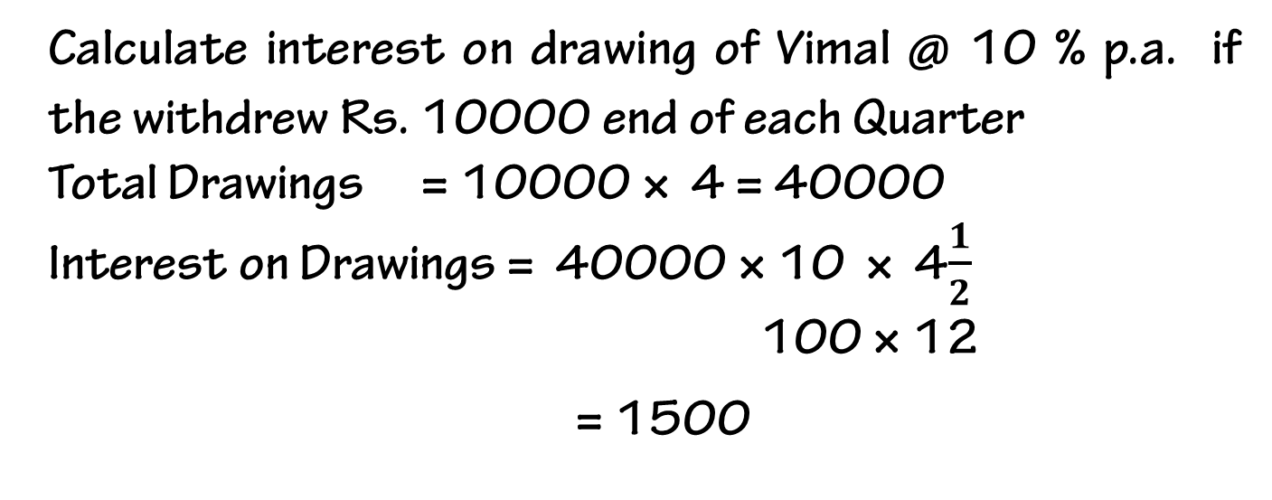
Illustration
Calculate interest on drawing of Vimal @ 10 % p.a. if the withdrew Rs. 10000 end of each Quarter
Total Drawings = 10000 × 4 = 40000
Interest on Drawings = 40000 × 10 × 4$\frac{1}{2}$ 100 × 12
= 1500

Slide 40
F) When Drawings of Equal Amount are made DURING MIDDLE of Each Quarter
When Drawings of Equal Amount are made during the middle of Each Quarter , the average period will be calculated as follows;
Average period = 10.5+ 1.5
2
= 6
Thus interest on the whole amount of drawings is to be calculated for 6 months at the agreed rate.

Slide 41
Illustration
Calculate interest on drawing of Vimal @ 10 % p.a. if the withdrew Rs. 10000 during the middle of each Quarter
Total Drawings = 10000 × 4 = 40000
Interest on Drawings = 40000 × 10 × 6 100 × 12
= 2000

Slide 42
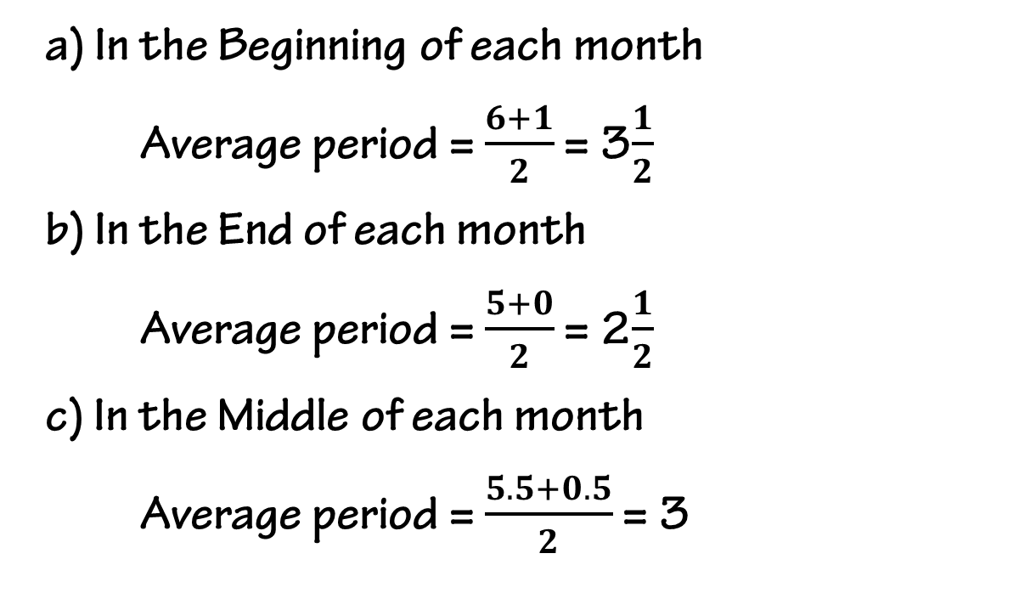
G) When Drawings of Equal Amount are only DURING a period of 6 month ending 31st March
a) In the Beginning of each month
Average period = $\frac{6+1}{2}$ = 3$\frac{1}{2}$
b) In the End of each month
Average period = $\frac{5+0}{2}$ = 2$\frac{1}{2}$
c) In the Middle of each month
Average period = $\frac{5.5+0.5}{2}$ = 3

Slide 43
Illustration
Calculate interest on drawing of Vimal @ 10 % p.a. For monthly drawings for 6 months (Last 6 months) Rs. 10000
a) In the Beginning of each month
b) In the End of each month
c) In the Middle of each month

Slide 44
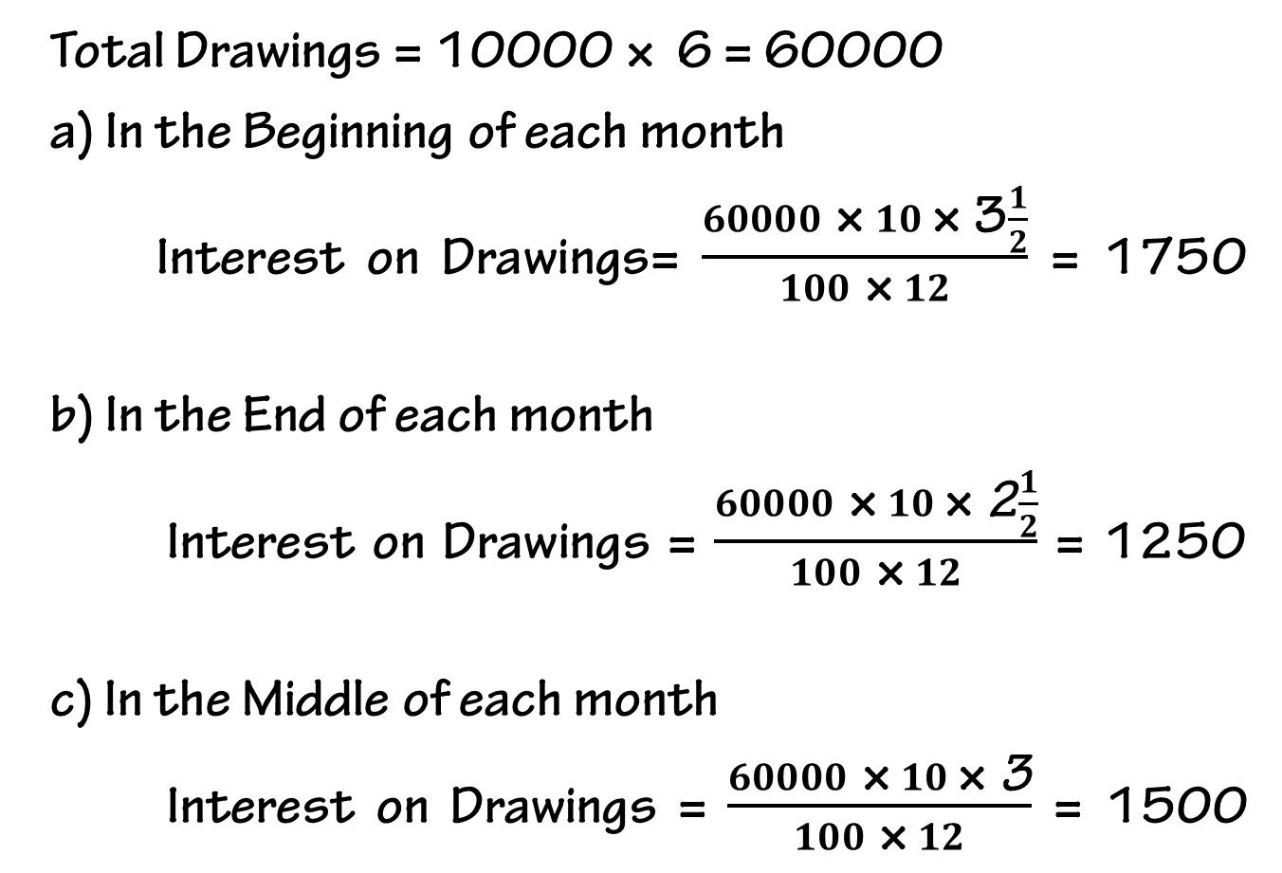
Solution
Total Drawings = 10000 × 6 = 60000
a) In the Beginning of each month
Interest on Drawings= $\frac{60000 \text{×} 10 \text{×} \text{3}\frac{1}{2}}{100 \text{×} 12}$ = 1750
b) In the End of each month
Interest on Drawings = $\frac{60000 \text{×} 10 \text{× }\text{2}\frac{1}{2}}{100 \text{×} 12}$ = 1250
c) In the Middle of each month
Interest on Drawings = $\frac{60000 \text{×} 10 \text{× }\text{3}}{100 \text{×} 12}$ = 1500

Slide 45
Calculation Of Interest On Drawings

Slide 46
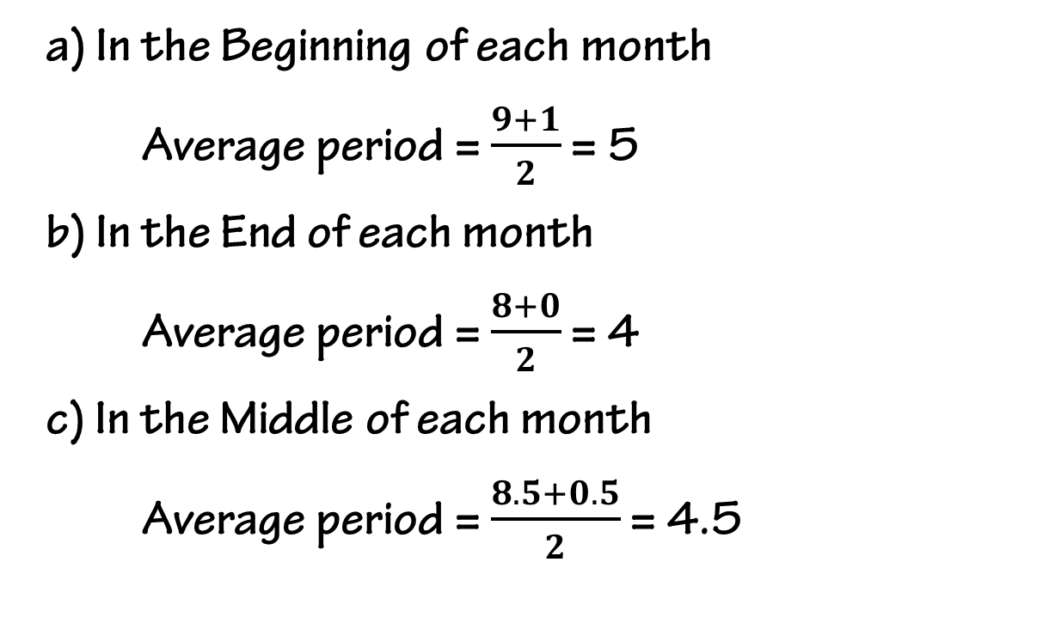
H) When Drawings of Equal Amount are only DURING a period of 9 month ending 31st March
a) In the Beginning of each month
Average period = $\frac{9+1}{2}$ = 5
b) In the End of each month
Average period = $\frac{8+0}{2}$ = 4
c) In the Middle of each month
Average period = $\frac{8.5+0.5}{2}$ = 4.5

Slide 47
Illustration
Calculate interest on drawing of Amal @ 10 % p.a. For monthly drawings for 9 months (Last 9 months) Rs. 5000
a) In the Beginning of each month
b) In the End of each month
c) In the Middle of each month

Slide 48
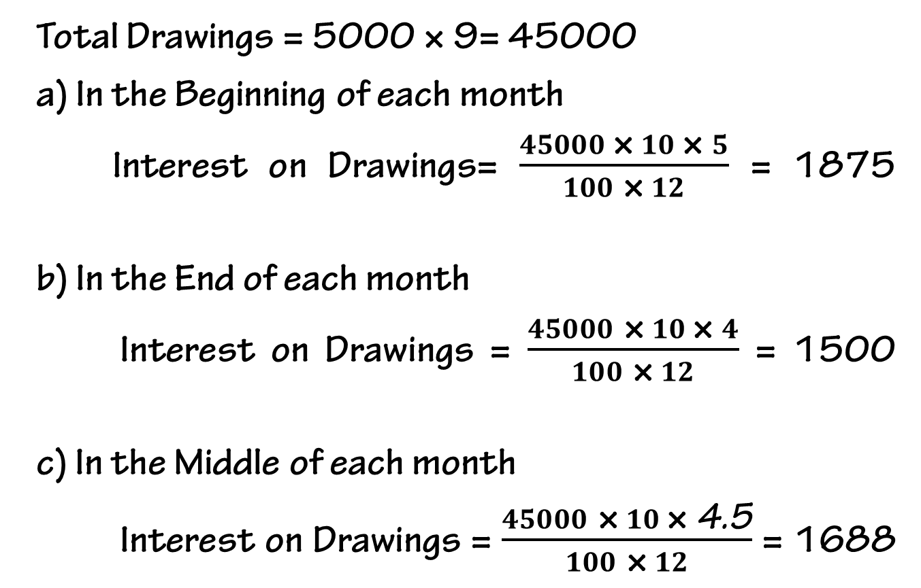
Solution
Total Drawings = 5000 × 9= 45000
a) In the Beginning of each month
Interest on Drawings= $\frac{45000 \text{×} 10 \text{×} 5}{100 \text{×} 12}$ = 1875
b) In the End of each month
Interest on Drawings = $\frac{45000 \text{×} 10 \text{× }4}{100 \text{×} 12}$ = 1500
c) In the Middle of each month
Interest on Drawings = $\frac{45000 \text{×} 10 \text{× }\text{4.5}}{100 \text{×} 12}$ = 1688

Slide 49
H) When the rate of interest is given with the word Per annum (P.A.) & without Per annum
When the rate of interest is given without the word Per annum (P.A.), interest on drawings will be calculated with out considering the time and date of drawing.
When the rate of interest is given with the word Per annum (P.A.) but the time and date of drawing is not given, interest on drawings will be calculated by taking 6 months as average period

Slide 50
Illustration
Calculate interest on drawings for the following cases
If Remya has withdrawn Rs.25000 during the year and interest charged @10% p.a.
If Divya has withdrawn Rs.25000 during the year and interest charged @10%

Slide 51
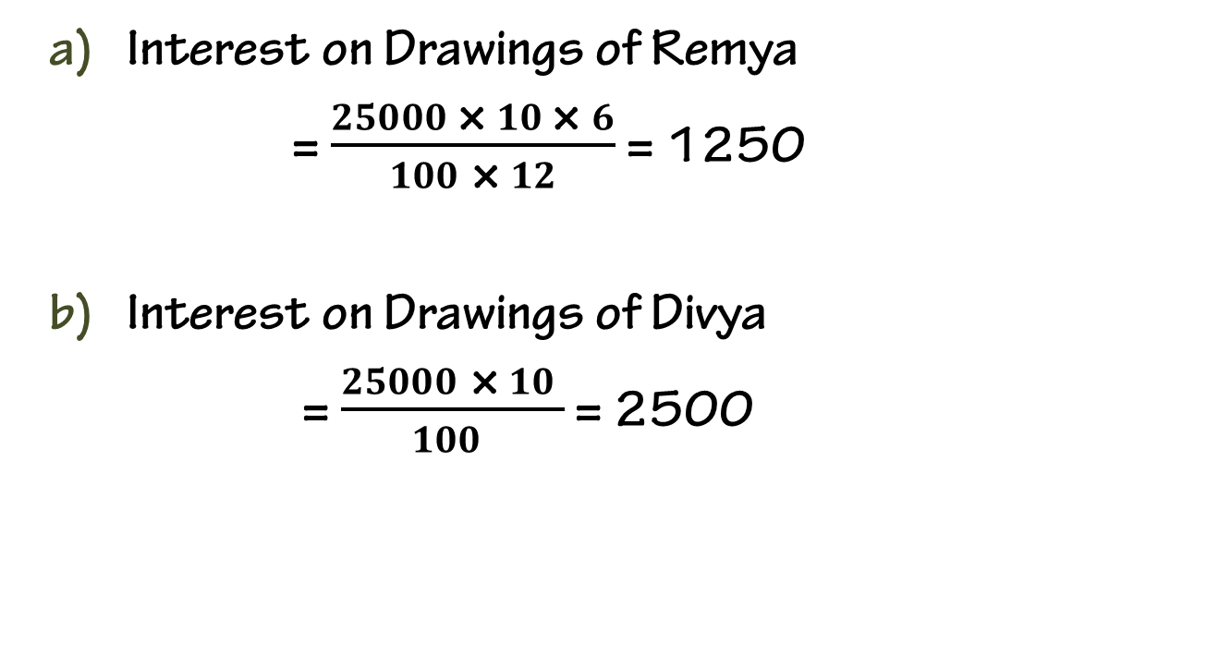
Solution
Interest on Drawings of Remya
= $\frac{25000 \text{×} 10 \text{×} 6}{100 \text{×} 12}$ = 1250
Interest on Drawings of Divya
= $\frac{25000 \text{×} 10 }{100 }$ = 2500

Slide 52
Manager’s Commission on Net Profits
Some times the manager is to be allowed a certain percentage of net profits as his commission . The amount is to be calculated on two ways ;
On profits before charging such commission
On Profits after charging such commission

Slide 53
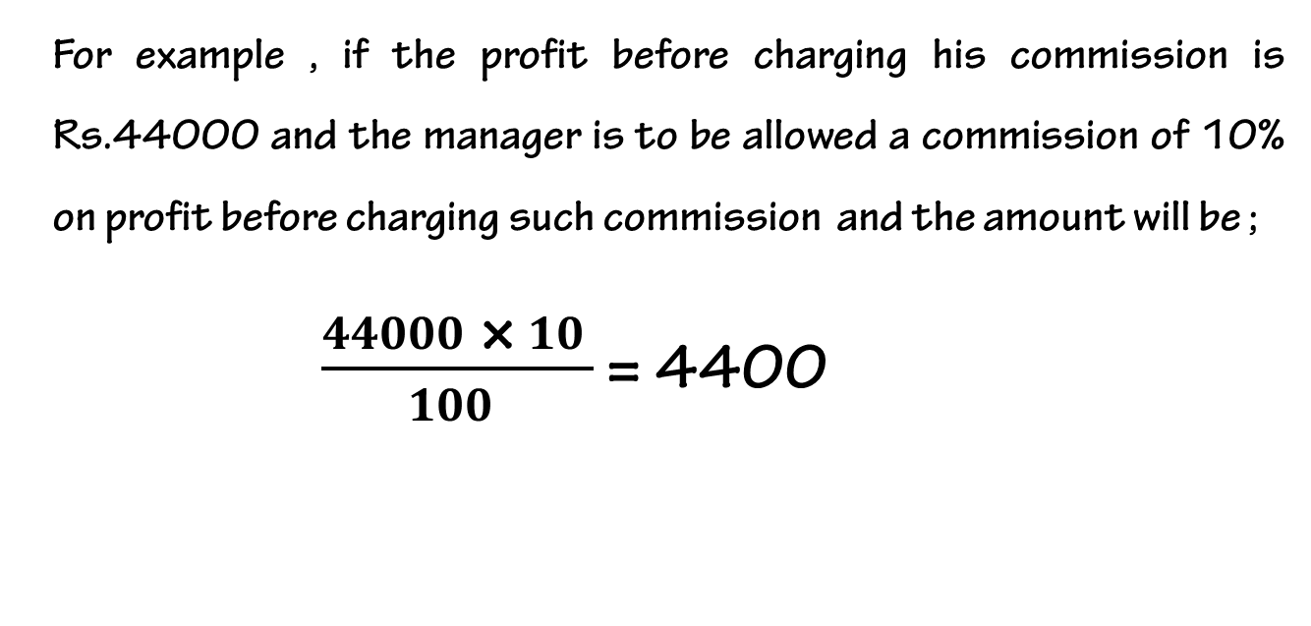
On profits before charging such commission
For example , if the profit before charging his commission is Rs.44000 and the manager is to be allowed a commission of 10% on profit before charging such commission and the amount will be ;
$\frac{44000 \text{×} 10 }{100 }$ = 4400

Slide 54
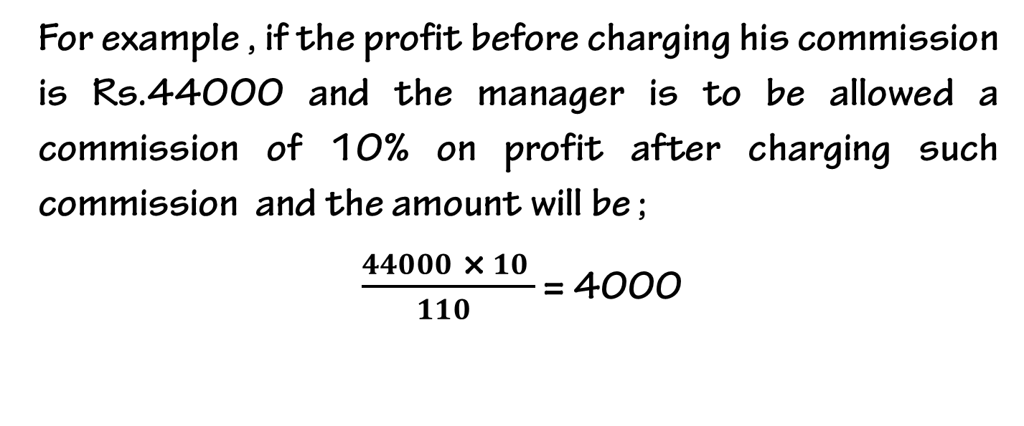
On Profits after charging such commission
For example , if the profit before charging his commission is Rs.44000 and the manager is to be allowed a commission of 10% on profit after charging such commission and the amount will be ;
$\frac{44000 \text{×} 10 }{110 }$ = 4000

Slide 55
Adjustments Related to interest on partners loan
It is a charge against profits. It is provided irrespective of profits or loss. It will also be provided in the absence of Partnership Deed @ 6% per annum. The following entries are passed to record the interest on partner’s loan:
For allowing Interest on loan:
Interest on Partner’s Loan A/c Dr.
To Partner’s Loan A/c
(Being interest on loan allowed @___% p.a.)
For transferring Interest on Loan to Profit and Loss A/c:
Profit and Loss A/c Dr.
To Interest on Loan A/c
(Being interest on loan transferred to P & L A/c)

Slide 56
Adjustments Related to rent to a partner
It is a charge against profits. It is not debited in Profit and loss appropriation account, instead of that it is debited to Profit & Loss account
For transferring Partner’s Rent to Profit and Loss A/c:
Profit and Loss A/c Dr.
To Partner’s Rent A/c
(Being Partner’s Rent transferred to P & L A/c)

Slide 57


Slide 58
THANKING YOU
ODM EDUCATIONAL GROUP

