Slide 1


ACCOUNTING FOR NOT-FOR-PROFIT ORGANISATION
SUBJECT : ACCOUNTANCY(XII)
CHAPTER NUMBER:01
CHAPTER NAME :NOT-FOR-PROFIT ORGANISATION

Slide 2
Accounting for Not-for-Profit Organisation-Introduction

Slide 3


List of Not-for-Profit Organisations

Slide 4
Not-for-Profit Organization
A “Not-for-Profit” organization is a group, which is organized for the purpose of social, religious, charitable, educational, athletic, literary, political or other such activities. The people involved in the “Not-For-Profit” organization cannot use it to make personal financial gain. Their main aim is to provide service to a specific group or the public at large. Normally, they do not manufacture, purchase or sell goods and may not have credit transactions.

Slide 5
Objectives of Accounting for Not-For-Profit Organisations
To evaluate the performance of organizations in terms of achieving their goals for which they were created.
To judge whether those organizations are appropriating the funds with three E’s viz. economically, effectively and efficiently.
To examine the compliance of rules, regulations, bye-laws in the organizations.
For obtaining grants from government departments.
To submit annual accounts to the Registrar with whom they are registered.

Slide 6
Characteristics of Non-Profit Organisation
It is formed for providing service.
These are organised as Charitable organisations.
These organisations are managed by Executives elected by members.
These organisations are getting funds from donations and grants-in-aid.
They earn reputation in society through social welfare activities.

Slide 7
Accounting Records of Not-for-Profit Organisations
The Not-for-Profit Organisations are also required to prepare financial statements at the end of the each accounting period. the final accounts of a ‘not-for-profit organisation’ consist of the following:
(i) Receipt and Payment Account
(ii) Income and Expenditure Account, and
(iii) Balance Sheet.

Slide 8
Receipt and Payment Account
It is prepared at the end of the accounting year on the basis of cash receipts and cash payments recorded in the cash book. It is a summary of cash and bank transactions under various heads. Receipt and Payment Account gives summarized picture of various receipts and payments, irrespective of whether they pertain to the current period, previous period or succeeding period or whether they are of capital or revenue nature.

Slide 9
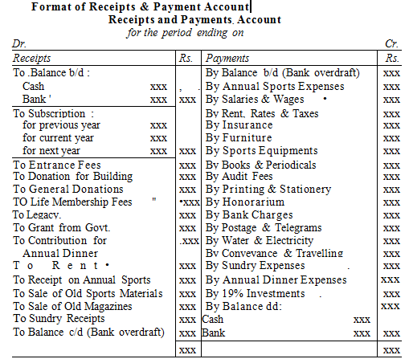

Slide 10
Income and Expenditure Account
It is the summary of income and expenditure for the accounting year. It is just like a profit and loss account prepared on accrual basis in case of the business organisations. It includes only revenue items and the balance at the end represents surplus or deficit.

Slide 11
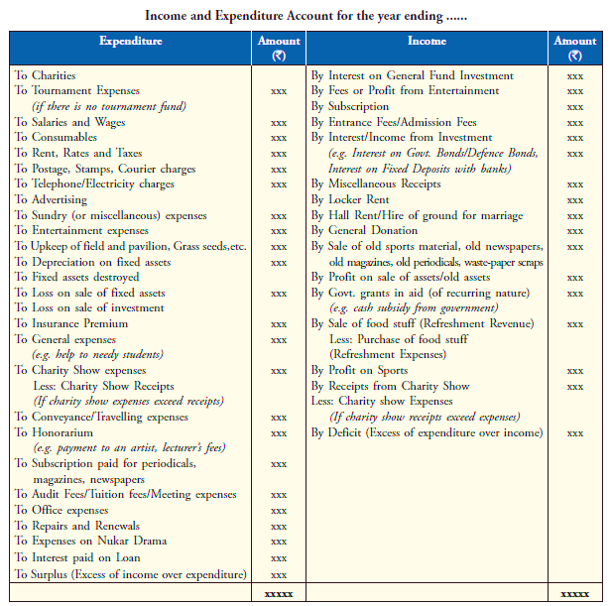

Slide 12
Balance Sheet
Not-for-Profit Organisations prepare Balance Sheet for ascertaining the financial position of the organisation. The preparation of their Balance Sheet is on the same pattern as that of the business entities. It shows assets and liabilities as at the end of the year.

Slide 13
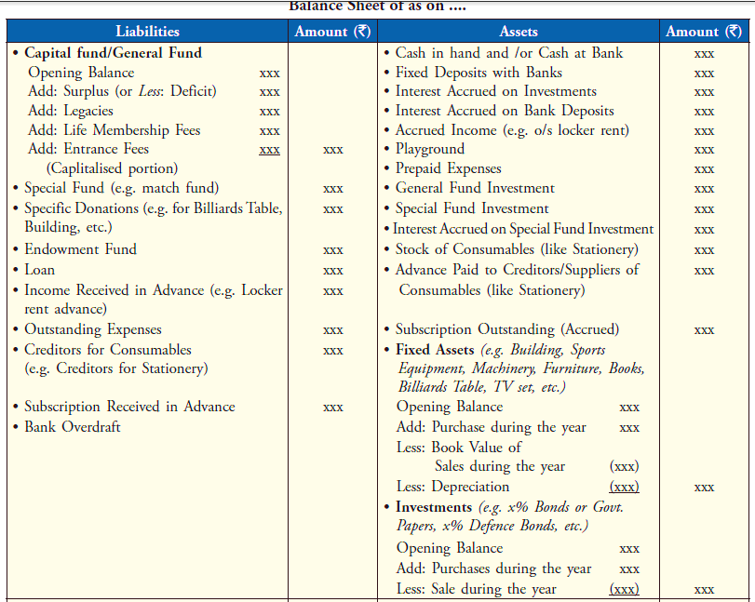

Slide 14
Entrance Fees
Entrance fee is called Admission fee. It is a fee paid by members at the
time of joining a not-for-profit organization.
1. It is an item of recurring nature.
2. Generally Entrance fees is treated as income.

Slide 15
Legacy
Legacy represents the amount of property received by organization under a will on death of the contribution. In other words we can say that legacies are the donations made by a person at his own will, so the donation is called legacy.

Slide 16
Grant
Grant is an aid issued by a Govt agency to any Not-for- profit organization for specific purpose or general purpose. Specific Grant should be capitalized & General grant may be treated as Revenue income and shown on credit side of Income & Expenditure Account.

Slide 17
Donation
Donation is the amount received by Not-for-profit Organization from any person or institution without any consideration and not periodically.
General: If donation received is not for a specific purpose and can be utilized for any purpose, it is known as general donation.
Specific : If donation is received for a particular purpose and can be utilized for the same purpose only it is known as specific donation such as Donation for Building.

Slide 18
Life Membership Fee
Life Membership Fee is the fee received from those members who do not pay periodic fee or subscription but pay a lump sum amount to become life time members. It can be shown by adding to capital fund or separately on the liabilities side of Balance sheet.

Slide 19
Honorarium
Honorarium is an amount paid to a person (other than employee) for rendering some special services for Not-for-profit organization. It is treated as an expense of Not-for-profit organization.

Slide 20
Subscription
Subscription is the amount payable by members of Not- for- profit Organization for renewal of membership periodically.
1. It is recurring in nature.
2. It is treated as Revenue Receipt.

Slide 21
Calculation of Subscription to be shown in the Income and Expenditure Account for current year.
Particulars | Amount
Subscription received during the year Add: Outstanding Subscription (at the end of Current Year) Prepaid or advance (at the beginning Of previous year) Less: Outstanding Subscription (at the beginning of Current Year) Prepaid or Advance (at the end of current year)
Amount of subscription to be shown in Income & Exp. A/C

Slide 22
Calculation of Subscription to be shown in the Income and Expenditure Account for current year.
Dr Subscription Account Cr
Particulars | Amount | Particulars | Amount
To Bal. b/d (outstanding Subscription at the Beginning) To Income & Expenditure A/C (Balancing Figure) To Bal. c/d ((Prepaid Subscription at the end) |  | By Bal. b/d (Prepaid Subscription at the Beginning) By Receipts & Payment A/C By Bal. c/d (Outstanding subscription at the end)

Slide 23
Illustration -1
Calculate the amount of subscription to be credited to Income & Expenditure a/c for the yr. 2007-08.
Subscription received during 2007-08 50,000
Subscription outstanding on 31-3-08 8,000
Subscription outstanding on 1-04-07 6,000

Slide 24
Solution
Particulars | Amount
Subscription received during the year Add: Outstanding Subscription (at the end of Current Year) Less: Outstanding Subscription (at the beginning of Current Year) | 50000 8000 6000
Amount of subscription to be shown in Income & Exp. A/C | 52000

Slide 25
Illustration -2
Mumbai Club received subscription during the yr. 2005-06 1,50,000
Subscription received on 31-3-05 4,500
Subscription received on 31-3-06 - 5,100
Subscription outstanding on 31-3-06 for 2005-06 - 3,800
Subscription outstanding 2004-05 - 6,000
Calculate the subscription to be taken to Income & Exp. a/c for 2005 06.

Slide 26
Solution
Particulars | Amount
Subscription received during the year Add: Outstanding Subscription (at the end of Current Year) Prepaid or advance (at the beginning Of previous year) Less: Outstanding Subscription (at the beginning of Current Year) Prepaid or Advance (at the end of current year) | 150000 3800 4500 6000 5100
Amount of subscription to be shown in Income & Exp. A/C | 147200

Slide 27
Illustration
Particulars | Amount
Total Salaries paid in 2006-07 Outstanding salaries on 31-3-07 Prepaid salary on 31-3-06 Outstanding on 31-3-06 Prepaid on 31-3-07 | 10200 750 1200 900 600

Slide 28
Solution
Particulars | Amount
Total Salaries paid in 2006-07 Add: - Outstanding salaries on 31-3-07 Prepaid salary on 31-3-06 Less:- Outstanding on 31-3-06 Prepaid on 31-3-07 | 10200 750 1200 900 600
Salaries dr. to Income & Exp. A/c for 2006-07 | 10650

Slide 29
Calculation Of Stationary To Be Shown In Income And Expenditure Account
Particulars | Amount
Amount paid to creditors for stationary during current year Add: Opening Stock of stationary Closing Creditors of Stationary Prepaid or advance (Beginning of previous year) Less: Closing Stock of stationary Opening Creditors of Stationary Prepaid or Advance (End of current year)
Amount of Stationary to be shown in Income & Exp. A/C

Slide 30
Illustration -4
Calculate Cricket Material Consumed during the yr. 2008.
Stock of Cricket equipments on 1.1.2008 Rs. 1,000
Stock of Cricket equipments on 31.12.2008 Rs. 1,500
Cricket equipments purchased during the yr. Rs. 4,150

Slide 31
Solution
Particulars | Amount
Opening Stock on 1.1.2008 Add: Purchases during the yr. Total Cricket Equipment Less: Closing Stock | 1,000 4,150
 | 5,150 1,500
Cricket equipment consumed During the yr. | 3,650

Slide 32
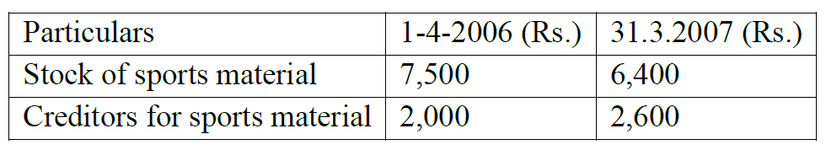
Illustration -5
Calculate the sports material to be debited to Income & Expenditure a/c. For the yr. ended 31-3-2007 on the basis of the following information:
Amount paid for sports material during the yr. was Rs.19,000

Slide 33
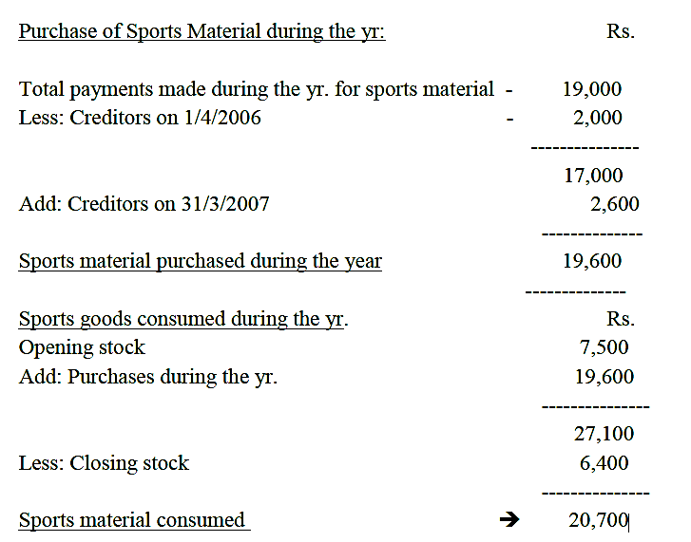
Solution

Slide 34
Illustration -6
From the following particulars of M/s. Jalaram Charity Hospital, prepare Income & Expenditure a/c & the balance sheet as on 31st March 2007.
Receipts | Rs. | Payments | Rs.
To Cash in hand 1/4/06 | 7,130 | By Medicines | 30,590
To Subscriptions | 47,996 | By Doctor‟s Honorarium | 9,000
To Donations | 14,500 | By salaries | 27,500
To Interest on Bank Fixed Deposit For full yr. | 7,000 | By Petty expenses | 461
 |  | By Equipments | 15,000
To charity show proceeds | 10,450 | By charity show expenses | 750
 |  | Cash in hand 31/3/2007 | 3,775
 | 87,076 |  | 87,076

Slide 35
Illustration -6
Additional information: | 1/4/2006 Rs. | 31.3.2007 Rs.
Subscription due | 240 | 280
Subscription received in advance | 64 | 100
Stock of medicines | 8810 | 9740
Estimated value of equipment Building (Cost less depreciation) | 21200 40000 | 31600 38000

Slide 36
Solution
Income & Expenditure A/c (Year ended on 31st March 2007)
Expenditure | Rs. | Income | Rs.
To Medicines consumed Opening stock 8810 Add: Purchases 30590 Less: Closing. stock 9740 | 29660 | By Subscriptions 47996 Add: O/S ( of 2007 ) 280 Adv in 2006 64 Less: O/S ( of 2006 ) 240 Adv of 2008 100 | 48000
To Doctor‟s honorarium | 9000 | By Donations | 14500
To salaries | 27500 | By Interest on Bank FD | 7000
To petty expenses | 461 | By charity show proceeds | 10450
To expenses charity show | 750
To Depreciation: Equipment | 4600
Building | 2000
To Surplus | 5979
 | 79950 |  | 79950

Slide 37
Solution
Working Notes: -
1. Bank Deposit = Rs.7000 x 100
----------------- = Rs.100000
7
2. Depreciation has been calculated on the basis of :
(Opening balance of the Asset + Purchases of Assets during the yr.)
- the Closing balance of the Asset

Slide 38
Solution
Balance Sheet as at 31.3.2006
Liabilities | Rs. | Assets | Rs.
Advance Subscription | 64 | Cash | 7130
Capital Fund (Bal. fig.) | 177316 | Subscription o/s | 240
 |  | Stock of Medicines | 8810
 |  | Bank Fixed Deposit | 100000
 |  | Equipments | 21200
 |  | Building | 40000
 | 177380 |  | 177380

Slide 39
Solution
Balance Sheet as at 31.3.2007
Liabilities | Rs. | Assets | Rs.
Advance Subscription | 100 | Cash in Hand | 3775
Capital Fund 177316 |  | Subscription o/s | 280
Add: Surplus 5979 | 183295 | Stock of Medicines | 9740
 |  | Bank Fixed Deposit | 100000
 |  | Equipments Op. 21200
 |  | + Purchases 15000 - Depreciation 4600 | 31600
 |  | Building 40000
 |  | - Depreciation 2000 | 38000
 | 183395 |  | 183395

Slide 40
Illustration -7
Prepare Income & Expenditure A/c & Balance Sheet of Leo Club Mumbai for the yr. ended 31st Dec. 2007 from the following:
Receipts | Rs. | Payments | Rs.
Cash in hand b/d | 4500 | Salaries (11 months) | 1100
Subscriptions: 2006 – 100 2007- 2400 2008 - 200 | 2700 | Tournament exp. | 1600
 |  | Investments | 1000
 |  | Furniture | 400
Sale of old furniture (Costing Rs.200) | 140 | Stationery | 1200
Tournament Receipts | 2000 | Sports expenses | 15000
Sports Fund | 10000 | Misc. expenses | 200
Donations for Sports | 3000 | Rent paid up-to Feb. 2009 | 1400
 |  | Cash in hand | 440
 | 22340 |  | 22340

Slide 41
Illustration -7
The club has 300 members each paying an annual subscription of Rs.10.
Rs.70 are still outstanding for the yr.2006. In 2006, 10 members had paid their subscription for 2007 in advance. Stock of stationery in 2006 was Rs.100 & in 2007 Rs.140.
On 1-1-2007, club owned Land & Building valued at Rs.20,000 & furniture of Rs.1300. Interest accrued on investment @6% p.a. for 3 months.

Slide 42
Solution
Income & Expenditure A/c (Year ended on 31st Dec.2007)
Expenditure | Rs. | Income | Rs.
To Loss on sale of furniture | 60 | By Subscriptions 2700 Less: O/s (2006) 100 Less: Advance (2008) 200 Add: Advance (2006) 100 Add: O/s 500 | 3000
To sports expenses | 2000
To Salaries 1100 |  | By Tournament Receipts | 2000
Add: Outstanding 100 | 1200 | By Accrued interest | 15
To Tournament exp. | 1600 | By Deficit | 2405
To stationery Op. Stock 100
Add: Purchases 1200
Less: Closing stock 140 | 1160
To Misc. Exp. | 200
To Rent 1400 Less: Prepaid 200 | 1200
 | 7420 |  | 7420

Slide 43
Solution
Balance Sheet as at 31.12.2006
Liabilities | Rs. | Assets | Rs.
Advance Subscription | 100 | Cash in hand | 4500
Capital Fund (Bal fig) | 25970 | Subscription o/s | 170
 |  | Stock of stationery | 100
 |  | Furniture | 1300
 |  |  | 20000
 | 26070 |  | 26070

Slide 44
Solution
Balance Sheet as at 31.12.2007
Liabilities | Rs. | Assets | Rs.
Advance Subscriptions | 200 | Cash in hand | 440
Salary o/s | 100 | Prepaid Rent | 200
Capital Fund 25970 Less: Deficit 2405 | 23565 | Subscription 500 Add: O/s 70 | 570
 |  | Accrued Interest | 15
 |  | Stock of stationery | 140
 |  | Investment | 1000
 |  | Furniture 1300 Add: Purchase 400 Less: Sold 200 | 1500
 |  | Land & Building | 20000
 | 23865 |  | 23865

Slide 45
THANKING YOU
ODM EDUCATIONAL GROUP

