Slide 1


ISSUE AND REDEMPTION OF DEBENTURES
SUBJECT : ACCOUNTANCY
CHAPTER NUMBER:07
CHAPTER NAME : ISSUE AND REDEMPTION OF DEBENTURES

Slide 2
Issue of Debentures at Premium
When the debentures are issued at more than their face value, they are said to have been issued at premium.
For example, if a debenture of Rs.100 is issued at Rs.110, Rs.10 is the premium, which is a gain to the Company.
This premium should not be treated as a revenue profit as it is not an income arising from the normal course of business operations. It is a capital profit and should, therefore, be used in writing off the capital losses, such as discount on issue of shares and debentures, premium on redemption of debentures, preliminary expenses, goodwill, patents etc.
As stated earlier, the name of 'Share Premium A/c' has been changed to `Securities Premium Reserve A/c'. Since the Debentures are also securities, Debentures Premium should also be credited to 'Securities Premium Reserve A/c'.
"Securities Premium Reserve A/c" is shown on the equity and liabilities side of the balance sheet under the head "Reserves and Surplus".

Slide 3
QUESTION-1
Rohan Chemicals Ltd. of Mumbai issued 1,00,00,000, 10% Debentures of Rs. 100 each at a premium of 10% payable as Rs.40 on application and !70 on allotment. Debentures are redeemable on March 31, 2020. Record necessary entries to record issue of debentures assuming that the issue is fully subscribed and all the money due is received.
QUESTION-2
Traditional Products Ltd. offered 2,00,000, 8% Debentures of Rs.500 each at a premium of 10% payable as Rs.200 on application (including premium) and balance on allotment, redeemable at par after 8 years. But applications are received for 3,00,000 debentures and the allotment is made on pro-rata basis. All the money due on application and allotment is received. Record necessary entries regarding issue of debentures.

Slide 4
Issue of Debentures at Discount
When the Company issues debentures at a price which is less than their face or nominal value, the debentures are said to have been issued at a discount. There are no restrictions in the Companies Act regarding the maximum limit for discount on debentures.
Discount or Loss on Issue of Debentures is a capital loss. It should be written off in the year it occurs. It can be written off by debiting to Securities Premium Reserve Account or from General Reserve ,Statement of Profit or Loss.
Following entry is passed for writing off discount or loss on issue of debentures :
Securities Premium Reserve A/c Dr.
Or
General Reserve Dr.
Or
Statement of Profit & Loss Dr.
To Discount/Loss on Issue of Debentures A/c
Discount being a loss, is recorded in the books of the Company by debiting "Discount on Issue of Debentures A/c".
Discount is generally recorded at the time of allotment entry.

Slide 5
QUESTION-1
Surya Ltd. issued 2,500, 15% Debentures of Rs.100 each at a discount of 10 % payable as follows: Rs. 25 on application; Rs.25 on allotment ; Rs.25 on allotment and the balance on First Call.
Applications were received for 2,000 debentures and the allotment was made. All the moneys were duly received. Expenses on issue of debentures amounted to Rs.10,000.
Pass journal entries (for first year only). Company decided to write off all capital losses in the first year itself
QUESTION-2
On 15-2-2020, A Ltd. invited applications for issue of 1,00,000 9% debentures of Rs100 each at a discount of 6%, redeemable at par after 3 years. The full amount was payable on application and the debentures were issued on 15-3-2020.
R Ltd. issued 10,000, 12% Debentures of Rs.100 each at a discount of 5%.
Pass Journal entries for above transactions. Ignore writing off discount on issue of debentures.

Slide 6
ISSUE OF DEBENTURES FOR CONSIDERATION OTHER THAN CASH
Issue of Debentures for consideration other than cash means that the company has not received amount (in cash or by cheque) against the debentures issued. Debentures may be issued for consideration other than cash in the following situations:
Issue of Debentures to Promoters: A company may allot debentures to the promoters for rendering services for incorporating the company. The entries passed are:
Incorporation Expenses or Preliminary Expenses A/c ...Dr.
To Promoters' A/c
(Incorporation Expenses Payable)
Promoters' A/c ...Dr.
To ...% Debentures A/c
(...% Debentures allotted to promoters)

Slide 7
Issue of Debentures to Underwriters: Underwriters undertake to subscribe the securities that are not subscribed by the public for a fee. A company may allot Debentures to the underwriters in payment of their fees. The entries passed are:
Underwriting Commission A/c ... Dr.
To Underwriters' A/c
(Underwriting commission payable)
Underwriters' A/c ...Dr.
To ...% Debentures A/c
(Debentures issued to underwriters)
QUESTION-1
Audi cars Ltd. Issued 2000; 10% Debentures of Rs. 100 each credited as fully paid to the promoters
for their services and issued 1,000; 10% debentures of Rs.100 each credited as fully paid to the
underwriters for their underwriting commission . Journalise.

Slide 8
Issue of Debentures to Vendors: Debentures may also be issued to vendors against purchase of assets or business. The Journal entries passed are:
When assets are purchased:
Sundry Assets A/c ...Dr. [With the agreed value of assets taken over]
To Vendor's A/c
(Purchase of sundry assets)
When a business is purchased:
When a business is purchased, it means assets and also the liabilities have been taken over. The purchase consideration payable may be:
equal to the Net Assets; or
more than the Net Assets; or
less than the Net Assets.

Slide 9
Purchase Consideration
Purchase Consideration is the amount agreed to be paid for taking over the business from another enterprise. Purchase consideration may be given in the question, otherwise it will be equal to Net Assets (i.e., Agreed value of Assets taken - Agreed amount of Liabilities assumed).
Example. Star Ltd. has acquired from sun Ltd. assets of Rs.25,00,000 and liabilities of Rs.7,50,000. In this case, purchase consideration on Net Assets is Rs.17,50,000 (i.e., Rs. 25,00,000 – Rs.7,50,000).
Treatment of Difference between Purchase Consideration and Net Assets
Accounting Entries: Accounting entries in each of the above situations are as follows:
When purchase consideration is equal to the net assets (i.e., difference between the value of assets and liabilities):
Sundry Assets A/c (Individually) ...Dr. [With the agreed value of assets]
To Sundry Liabilities A/c (individually) [With the agreed value of liabilities]
To Vendor's A/c [With the purchase consideration]
Case | Accounting Treatment
When Purchase Consideration is more than Net Assets. When Net Assets are more than Purchase Consideration. | The excess of Purchase Consideration over Net Assets is debited to Goodwill Account. The excess of Net Assets over Purchase Consideration is credited to Capital Reserve Account.

Slide 10
When purchase consideration is more or less than the net assets (i.e., difference between the value of assets and value of liabilities), the difference (if Purchase consideration is more than Net Assets) is debited to Goodwill Account or the difference (if Purchase Consideration is less than Net Assets) is credited to Capital Reserve. The entry is:
Sundry Assets A/c (Individually) ...Dr. [With the agreed value of assets]
Goodwill A/c* ...Dr. [With the excess of purchase consideration over
the value of assets less the value of liabilities]
To Sundry Liabilities A/c (Individually) [With the agreed value of liabilities]
To Vendor's A/c [With the purchase consideration]
To Capital Reserve A/c* [With excess value of Net Assets
over purchase consideration]
*Either Goodwill or Capital Reserve will appear.

Slide 11
Issue of Debentures for Consideration other than Cash
Sometimes a Company purchases some assets from the vendor and instead of paying the vendor in cash, the Company may decide to issue debentures to the vendor in payment of purchase consideration. Such an issue of debentures to vendors is known
as issue of debentures for consideration other than cash. Debentures can be issued to vendors at par, at a premium or at a discount. Following entries will be passed for this purpose :
1. On purchase of assets :
Assets A/c Dr.
To Vendor's A/c
2.I. For the issue of debentures to vendor at par :
Vendor's A/c Dr.
To Debentures A/c
II. For the issue of debentures to vendor at premium :
Vendor's A/c
To Debentures A/c
To Securities Premium Reserve A/c
III. For the issue of debentures to vendor at discount :
Vendor's A/c Dr.
Discount on Issue of Debentures A/c Dr.
To Debentures A/c

Slide 12
QUESTION-1
A company purchased assets of the book value of Rs.9,90,000 from another Co. It was agreed that the purchase consideration be paid by issuing 11% Debentures of Rs.100 each. Assume that the debentures have been issued (i) at par, (ii) at a premium of 10%, and (iii) at a discount of 10%.
Give necessary journal entries in the books of purchasing company.
QUESTION-2
R Limited took over assets of Rs.5,60,000 and creditors of Rs.80,000 from S Limited. R Limited issued 8% debentures of Rs.20 each at a premium of 20% as purchase consideration, to S Limited. Calculate the amount of purchase consideration, number of debentures issued by R Limited and pass the necessary journal entries in the books of R Limited from the above mentioned informations.

Slide 13
Issue of Debentures as Collateral Security
Sometimes, when a Company takes a loan from a Bank or from some other party, the Company may have to issue debentures as a subsidiary or secondary security in addition to the principal security. In other words, collateral security means secondary security in addition to the principal security. The bank or the other persons to whom such debentures are issued as collateral security will not be entitled to any interest on these debentures. They are entitled to get interest on the original loan advanced by them. If a default is made either in the payment of interest or in the payment of principal debt, the lender will first realise its debt from the principal security. But if the full amount of debt is not realised from the principal security, it may claim all the rights of a debenture holder.
As soon as the Company pays the final instalment of loan, it can take its debentures back. There are two methods of dealing with such debentures in the books of accounts of the Company :

Slide 14
First Method : In this method, no entry need to be passed in the books of the Company, as the debentures are not actually issued, but only given away as collateral security. As such, under this method, entry is passed only for taking a loan. If the loan is taken from a bank, the entry will be:
Bank A/c Dr.
To Bank Loan A/c
On the equity and liabilities side of the balance sheet, a note is appended below the loan that the
loan is secured by the issue of debentures as collateral security.
QUESTION-1
A Company had Rs.10,00,000, 12% Debentures outstanding as on 1st April, 2019. During the year company took a loan of Rs.2,00,000 from the State Bank of India for which the Company placed with the bank debentures for Rs.2,50,000 as Collateral Security. Pass journal entries, if any. Also show how the Debentures and Bank Loan will appear in the Company's Balance Sheet as at 31st March, 2020.

Slide 15
Second Method : In this method, the entry for issuing debentures as Collateral Security is also recorded with the entry for taking the loan.
1. On taking a loan :
Bank A/c Dr.
To Bank Loan A/c
2. On issuing the debentures as collateral security :
Debentures Suspense A/c Dr.
To Debentures A/c
In the Balance Sheet, Debentures Suspense A/c will be shown as a deduction from the Debentures
Account on the equity and Liabilities side. As and when the loan is repaid, both the entries passed
above are reversed.
QUESTION-2
A Company had Rs.10,00,000, 12% Debentures outstanding as on 1st April, 2019. During the year company took a loan of Rs.2,00,000 from the State Bank of India for which the Company placed with the bank debentures for Rs.2,50,000 as Collateral Security. Pass journal entries, if any. Also show how the Debentures and Bank Loan will appear in the Company's Balance Sheet as at 31st March, 2020.

Slide 16
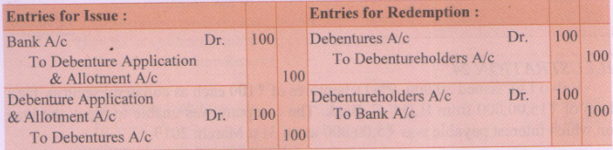
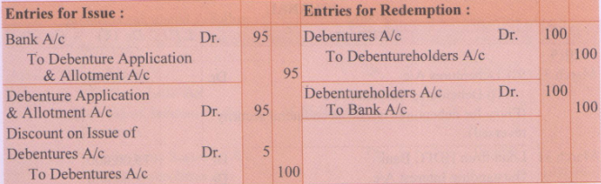
Accounting for Issue of Debentures Considering the Terms and Conditions of Redemption
Debentures may be redeemed either at par or at premium, according to the terms laid down at the time of issue. After taking into account the three possibilities of issue (i.e. , at par, at discount, at premium) and two possibilities of redemption (i. e. , at par or at premium) a Company can issue debentures from the following six types :
When debentures are issued at par and are redeemable at par : For example, if a debenture of Rs. 100 is issued at Rs. 100 and is redeemable at Rs.100, the following entries will be passed :
When debentures are issued at a discount and are redeemable at par : For example, if a debenture of Rs. 100 is issued at Rs.95 and is redeemable at Rs.100, the following entries will be passed :

Slide 17
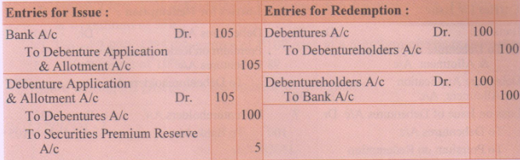
`Discount on issue' is a capital loss and will be written off from Securities Premium (if it exists) or
from General Reserve (if it exists) or from Statement of Profit & Loss in the year in which it
occurs.
When debentures are issued at a premium and are redeemable at par : For example, if a debenture of Rs.100 is issued at Rs.105 and is redeemable at Rs.100, the following entries will be passed :
Securities Premium Reserve A/c has a credit balance and is a capital profit, to be shown on the equity and liabilities side under the head, "Reserves and Surplus".

Slide 18
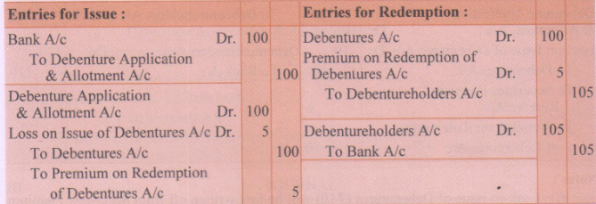
When debentures are issued at par and are redeemable at a premium : Sometimes the debentures are issued with the specific condition that the Company will pay a premium at the time of their redemption. Although, such premium will be paid at the time of actual redemption, but as it is a known loss, the Company records such loss at the time of issue by debiting an account called, "Loss on issue of debentures A/c". It is done in keeping with the convention of conservatism.
For example, if a debenture of Rs.100 is issued at Rs.100 and is redeemable at Rs.105, the following entries will be passed :

Slide 19
Loss on issue of debentures A/c' is a loss on account of promise to pay debentures 100 at premium at the time of their redemption. This is a capital loss and is written off from Security Premium Reserve or from General Reserve or from Statement of Profit & 100 Loss in the year it occurs. The entry for writing off will be :
Statement of Profit and Loss Dr.
To Loss on Issue of Debentures A/c
`Premium on Redemption of Debentures A/c' is a Personal Account and shows a credit balance. It is a liability on the part of the Company and appears under the head: Non-Current Liabilities' under sub-head 'Other Long term Liabilities' on the equity and liability side of the balance sheet each year, until the debentures are repaid. At the time of redemption of debentures, this account is debited and closed off

Slide 20
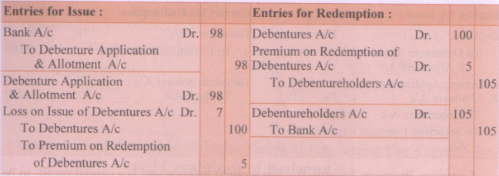
When debentures are issued at a discount and are redeemable at a premium: For example, if a debenture of Rs.100 is issued at Rs.98 and is redeemable at Rs.105, the following entries will be passed :
Both, the amount of discount allowed Rs.2 and premium on redemption Rs.S are capital losses and therefore, grouped together and debited to loss on issue' as Rs.7.

Slide 21
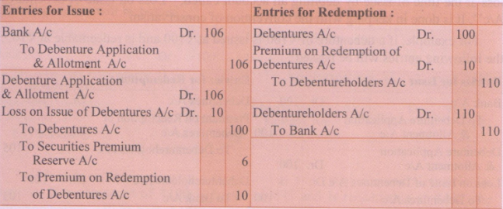
When debentures are issued at premium and are redeemable at a premium: For example, if a debenture of Rs.100 is issued at Rs.106 and is redeemable at Rs.110, the following entries will be passed :
Notes :
(1) Loss on issue of Debentures (Rs.10) will be first written off from Securities Premium
Reserve of ? Rs.6 and the remaining ?4 from Statement of Profit & Loss.
(2) Premium on Redemption will be shown under the head "Non-Current Liabilities" under the
sub-head 'Other Long-term Liabilities'.
Note : Debentures cannot be redeemed at discount, although a Company may redeem its
debentures by purchasing them in the open market at a discount.

Slide 22
QUESTION-1
Give journal entries for the issue of debentures in the following conditions.
Issued 2,000, 12% debentures of Rs.100 each at par, redeemable also at par.
Issued 2,000, 12% debentures of Rs.100 each at a discount of 2%, redeemable at par.
Issued 2,000, 12% debentures of Rs. 100 each at a premium of 5%, redeemable at par.
Issued 2,000, 12% debentures of Rs.100 each at par but redeemable at 5% premium.
Issued 2,000, 12% debentures of Rs.100 each at a discount of 2%,redeemable at a premium of 5%
Issued 2,000, 12% debentures of Rs.100 each at a premium of 5%,redeemable at a premium of 10%
Ignore writing off discount. Loss on issue of debentures

Slide 23
QUESTION-2
On 2-3-2016, L and B Ltd. issued Rs.35, 9% debentures of 2500 each.
Pass necessary Journal entries for the issue of debentures in the following situations :
When debentures were issued at 5% discount, redeemable at I0%, premium.
When debentures were issued at 12% premium, redeemable at 6% premium. Ignore writing off loss on issue of debentures.
QUESTION-3
On 1st April, 2018, R.J. Ltd. issued Rs.10,00,000 9% debentures of Rs.100 each at a discount of 10%. These debentures were redeemable at a premium of 5% after four years. Pass necessary journal entries and prepare 9% Debenture Account and Loss on Issue of Debentures A/c.

Slide 24
Interest on Debentures
Interest on debentures is usually paid half-yearly. Interest on debentures is a charge against the profits of the Company. It has to be paid regularly even if the Company suffers a loss or does not earn profit. The rate of interest payable on debentures is prefixed on debentures. For example, if the rate of interest is 9% p.a., the name given to debentures will be '9% debentures'. As per Income Tax Act, a Company is required to deduct income tax at the prescribed rate from the gross amount of debenture interest before any amount is paid to the debenture holders. The tax thus deducted is to be deposited in Government Account on behalf of the debenture holders.
While preparing the final accounts for an accounting period, provision must be made for any accrued interest on the very date of preparing the balance sheet. Accrued interest may be of two types :
Interest accrued and due :If a Company pays interest on debentures half-yearly on 30th June and 31st December, while preparing the balance sheet on 31stMarch, 2018, if the interest for the period ending 31st Dec., 2017 remains unpaid, it will be called 'Interest accrued and due'.
interest accrued but not due :If a Company pays interest on debentures half-yearly on 30th June and 31st December, while preparing the balance sheet on 31st March, 2018, the interest for the period from 1st January 2018 to 31st March, 2018 will be called 'Interest accrued but not due'.

Slide 25
Both the types of accrued interest as discussed above, will be shown in the current liabilities in the balance sheet.
Following entries are passed for interest on debentures :
When interest is due and tax is deducted at source (TDS) :
Interest on Debentures A/c Dr.
To Debenture holders A/c
To TDS Payable A/c
(Interest due to debenture holders and tax deducted at source)
When interest is paid to the debenture holders :
Debenture holders A/c Dr.
To Bank A/c
(Payment of interest)
On payment of tax deducted at source :
TDS Payable A/c Dr.
To Bank A/c
(Depositing the amount of TDS in Government Account)
On transfer of debenture interest to Statement of Profit and Loss at the end of the year :
Statement of Profit & Loss Dr.
To Interest A/c
(Interest transferred to Statement of P & L)

Slide 26
QUESTION-1
On 1.4.2015, J.K. Ltd. issued 8,000, 9% debentures of Rs.1,000 each at a discount of 6%, redeemable at a premium of 5% after three years. The company closes its books on 31st March every year. Interest on 9% debentures is payable on 30th September and 31st March every year. The rate of tax deducted at source is 10%. Pass necessary journal entries for the year ended 31.3.2016.
QUESTION-2
On 1-4-2017, Fast Computers Ltd. issued 20,000, 6% debentures of Rs.100 each at a discount of 4% redeemable at a premium of 5% after three years. The amount was payable as follows :
On application Rs.50 per debenture.
Balance on allotment.
Fast Computers has a balance of Rs.50,000 in Securities Premium Reserve and Rs.1,00,000 in General Reserve. Profit for the year was Rs.75,000.
Pass the journal entries for issue of debentures and writing off the loss on issue of debentures.

Slide 27
THANKING YOU
ODM EDUCATIONAL GROUP

