Slide 1


DISSOLUTION OF PARTNERSHIP FIRM
SUBJECT : ACCOUNTANCY
CHAPTER NUMBER:05
CHAPTER NAME : DISSOLUTION OF PARTNERSHIP FIRM

Slide 2
Dissolution Of Partnership Firm
INTRODUCTION

Slide 3
Dissolution of a firm
According to Section 39 of the partnership Act 1932, the dissolution of partnership between all the partners of a firm is called the dissolution of the firm. It will lead to the breaking of relationship between all the partners of a firm. This brings an end to the existence of firm, and no business is transacted after dissolution except the activities related to closing of the firm .

Slide 4
Dissolution of Partnership
Dissolution of Partnership refers to terminal of old partnership agreement (i.e., Partnership Deep) and a reconstruction the firm. It may take place on
(1) Change in existing profit sharing ratio among partners;
(2) Admission of a new partner
(3) Retirement of a partner;
(4) Death of a partner;
(5) Insolvency of a partner;
(6) Completion of the venture, if partnership is formed for that; and
(7) Expiry of the period of partnership, if partnership is for a specific period of time;

Slide 5
Dissolution by Agreement
A firm is dissolved :
With the consent of all the partners .
In accordance with a contract between the partners.

Slide 6
Compulsory Dissolution
A firm is dissolved compulsorily in the following cases:
When all the partners or all but one partner, become insolvent, rendering them incompetent to sign a contract.
When the business of the firm becomes illegal.
When some event has taken place which makes it unlawful for the partners to carry on the business of the firm in partnership .

Slide 7
On The Happening Of Certain Contingencies
Subject to contract between the partners, a firm is dissolved
If constituted for a fixed term, by the expiry of that term.
If constituted to carry out one or more ventures, by the completion thereof .
By the death of a partner.
By the adjudication of a partner as an insolvent.

Slide 8
Dissolution by Notice:
In case of partnership at will, the firm may be dissolved if any one of the partners gives a notice in writing to the other partners, signifying his intention of seeking dissolution of the firm.

Slide 9
Dissolution by Court
At the suit of a partner, the court may order a partnership firm to be dissolved on any of the following grounds:
when a partner becomes insane;
when a partner becomes permanently incapable of performing his duties as a partner
when a partner is guilty of misconduct which is likely to adversely affect the business of the firm
when a partner persistently commits breach of partnership agreement
when a partner has transferred the whole of his interest in the firm to a third party
when the business of the firm cannot be carried on except at a loss
when, on any ground, the court regards dissolution to be just and equitable.

Slide 10
Accounting Treatment Of Dissolution
On dissolution of a firm, the following accounts are opened to close the books of the firm .
• Realisation Account;
• Partner’s Loan Account;
• Partner’s Capital Accounts; and
• Cash or Bank Account.

Slide 11
Realisation Account
It is nominal account opened on the dissolution of a firm to ascertain the profit or loss on realization of assets and payment of outsider’s liabilities. This account is closed by transferring the balance (i.e., profit or loss on realization) to partner’s capital accounts.

Slide 12
FORMAT OF REALISATION ACCOUNT
Particular | Rs | Particular | Rs
To sundry Assets A/c (Excluding cash or bank balance. Fictitious assets. Dr. balance of P & Lac, Dr. balance of partner’s Capital/current A/cs, Loans to partners) To Cash/Bank A/c (Amount paid for discharging Liabilities-recorded and unrecorded) To Cash Bank A/c (Expenses on Realisation) To Partner’s Capital A/c (Liabilities taken over by a Partner commission payable to him or any expenses payable to him) To Partner’ Capital A/cs (For transferring profit on Realisation) |  | By Sundry Liabilities A/c (Excluding Cr. Balance of P & L A/c, Reserves, Partners’ Capital/Current A/cs, Loan from partner and Bank Overdraft) By provision on any Assets A/c (Such as provision for Depreciation, Provision for Doubtful Debts, Joint Life Policy Reserve etc.) By Cash/Bank A/c (Amount received on realization of assets-recorded and unrecorded)

Slide 13
Preparation Of Partner Capital Accounts
After the Transfer of
· Undistributed profits and reserves
· Profit on Realisation
· Any liability taken over by any partner
And
· Undistributed losses and fictitious assets
· Loss on realization
· Any assets taken over by any partner
The balance of partners’ capital A/c’s are closed by transferring balances to bank.

Slide 14
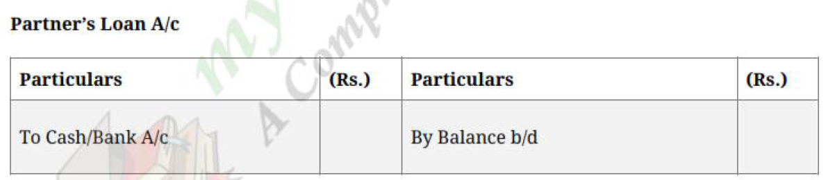
Preparation of Partners’ Loan Account
If a partner has given any loan to firm, his loan will be paid After payment of all the outside liabilities : but Before making any payment to partners on account of capital
Partner’s Loan A/c Dr.
To Cash/Bank A/c
(Being loan of a partner paid)

Slide 15
Partners’ Capital Account
Dr Cr
Date | Particular | Amount Rs. | Date | Particular | Amount Rs
 | Drawings Interest on drawings Accumulated Loss Profit & loss Appropriation a/c (Share of loss in case of loss) Realisation ( Asset taken) Realisation ( Realisation loss) Cash / Bank ( Excess cash paid) |  |  | Balance b/d Assets Cash/Bank/ (Additional Capital introduced) Interest on Capital Salary Commission P&l Appropriation a/c (Share of profit in case of profit) Accumulated profit Realisation ( Liabilities taken) Realisation ( Realisation Profit) Cash / Bank ( Brought in by partners
 |  | xxxx |  |  | xxxx

Slide 16
Preparation Of Memorandum Balance Sheet
If a balance sheet on the date of dissolution is not given in the question, there is always advisable to prepare Memorandum Balance Sheet on the date of dissolution to ascertain the amount of balancing figure.

Slide 17
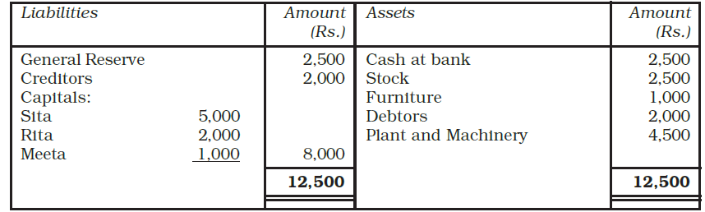
Illustration - 1
Sita, Rita and Meeta are partners sharing profit and losses in the ratio of 2:2:1,Their balance sheet as on March 31, 2017 is as follows:
Balance Sheet of Sita, Rita and Meeta as on March 31, 2017

Slide 18
Illustration - 1
They decided to dissolve the business. The following amounts were realised:
• Plant and Machinery Rs.4,250, Stock Rs.3,500, Debtors Rs.1850, Furniture 750.
• Sita agreed to bear all realisation paid by the firm expenses. For the service Sita is paid Rs.60.
• Actual expenses on realisation paid by the firm amounted to Rs.450.Creditors
• paid 2% less. There was an unrecorded assets of Rs.250, which was taken over by Rita at Rs.200.
Prepare the necessary accounts to close the books of the firm.

Slide 19
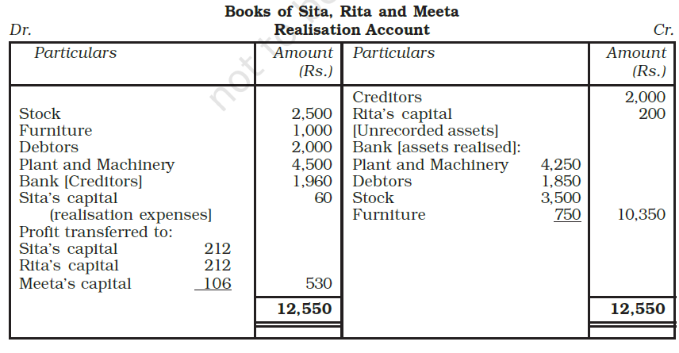
Solution - 1

Slide 20
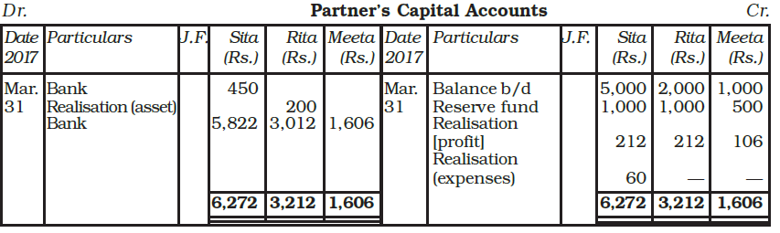
Solution - 1

Slide 21
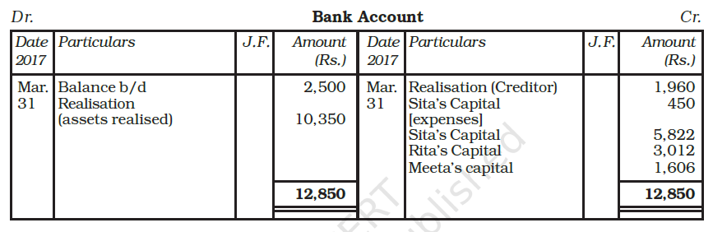
Solution - 1

Slide 22
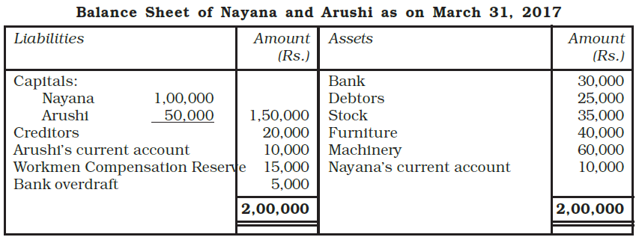
Illustration - 2
Nayana and Arushi were partners sharing profits equally Their Balance Sheet as on March 31, 2017 was as follows:

Slide 23
Illustration - 2
The firm was dissolved on the above date:
1. Nayana took over 50% of the stock at 10% less on its book value, and the remaining stock was sold at a gain of 15%. Furniture and Machinery realised for Rs.30,000 and Rs.50,000 respectively;
2. There was an unrecorded investment which was sold for Rs. 34,000;
3. Debtors realised 90% only and Rs.1,200 were recovered for bad debts written-off last year;
4. There was an outstanding bill for repairs which had to be paid for Rs.2,000.
Record necessary journal entries and prepare ledger accounts to close the
books of the firm.

Slide 24
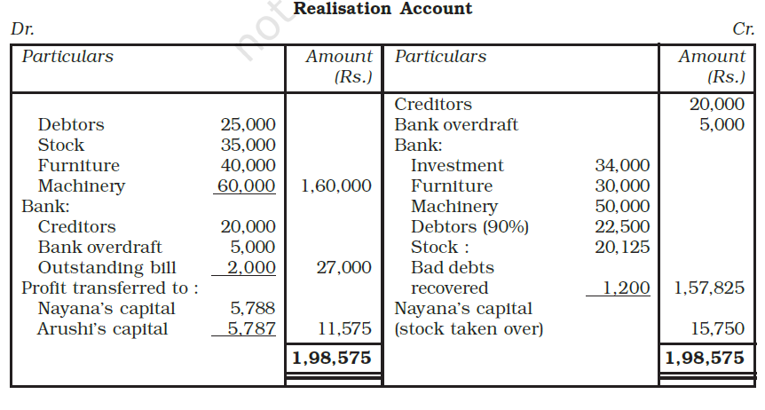
Solution -2

Slide 25
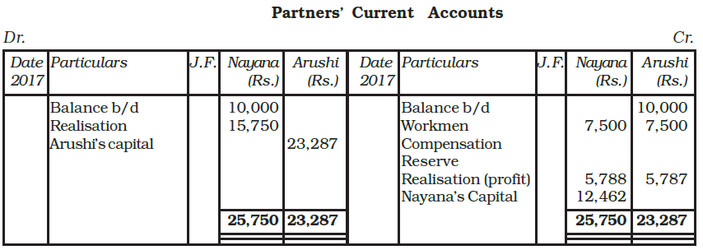
Solution -2

Slide 26
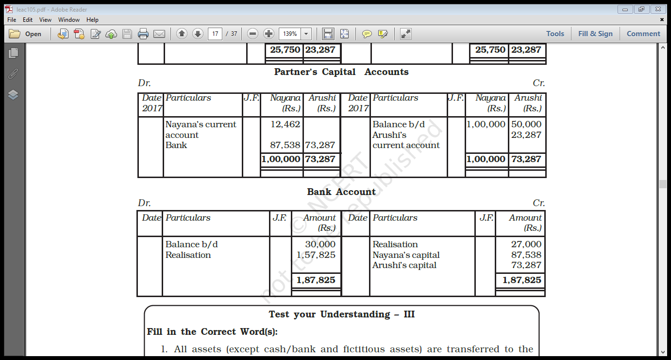
Solution -2

Slide 27
Solution -2

Slide 28
Illustrations - 3
Following is the Balance Sheet of X and Y, who share profits and losses the ratio of 4 : 1, as at 31st March, 2015.
Particulars | (Rs.) | Particulars | (Rs.)
Sundry Creditors Bank Overdraft X’s Wife Loan Y’s Loan Investment Fluctuation fund Capital X Y | 8,000 6,000 8,000 3,000 5,000 50,000 40,000 | Bank Debtors 17,000 Less :Provision (2,000) Stock Investments Buildings Goodwill Profit and Loss A/c | 20,000 15,000 15,000 25,000 25,000 10,000 10,000
 | 1,20,000 |  | 1,20,000

Slide 29
Illustrations - 3
The firm dissolved on the above date and the following arrangement were decided upon
(i)X agreed to pay off his wife’s loan.
(ii) Debtors of Rs 5,000 proved bad.
(iii) Other assets realized – Investment 20% less; and Goodwill at 60%
(iv) One of the creditors for Rs. 5,000 Was paid only Rs. 3,000
(v) Building were auctioned for Rs. 30,000 and auctioneer’s commission amounted to Rs.1,000.
(vi) Y took over part for Stock at Rs. 4,000 (being 20% less that the book value) Balance stock realized 50%.
(vii) Realisation expenses amounted to Rs. 2,000.
Prepare Realisation A/c, Partner’s Capital A/cs and Bank A/c

Slide 30
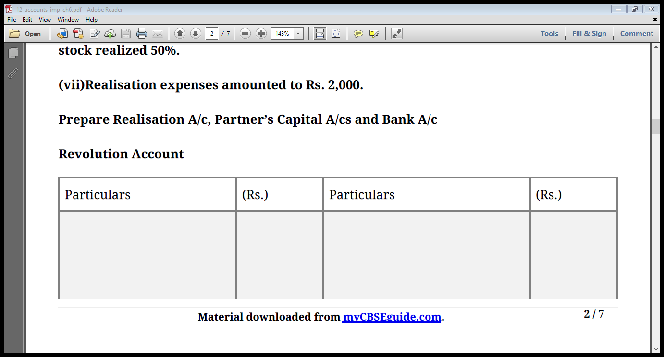
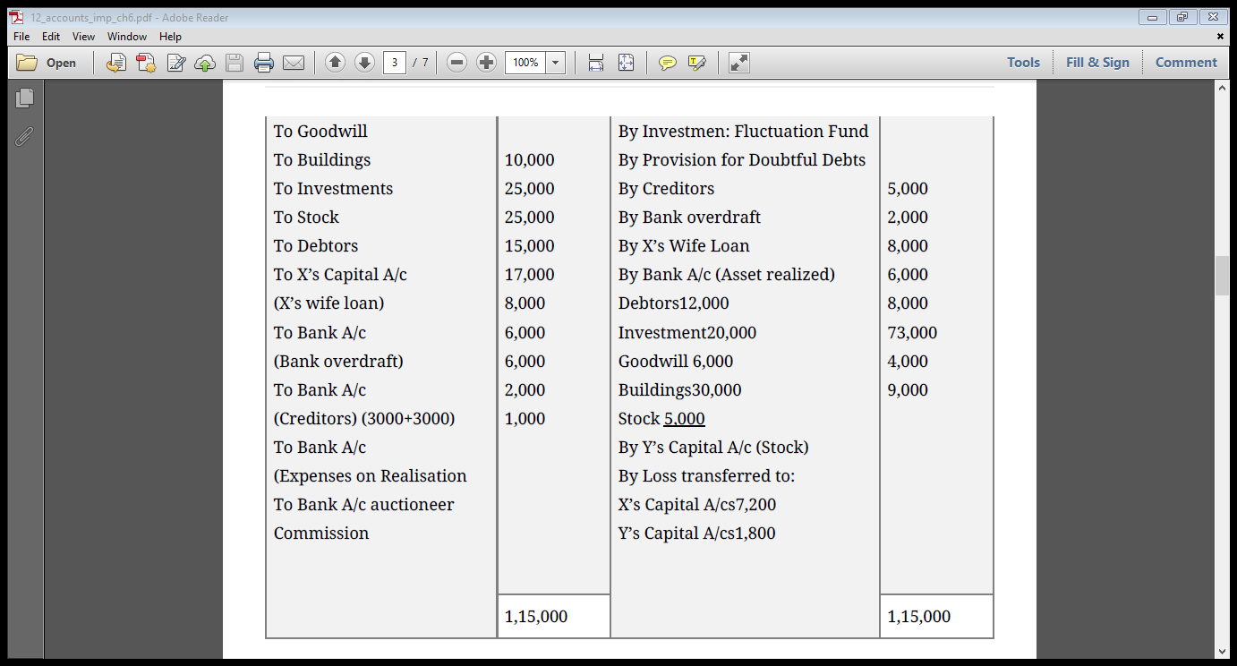
Solution - 3
Realisation a/c

Slide 31
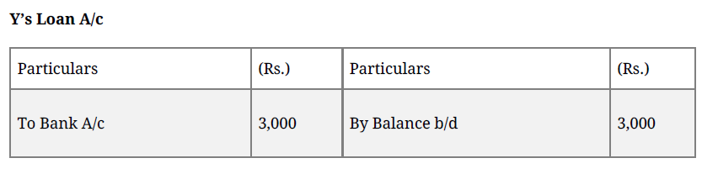
Solution - 3

Slide 32
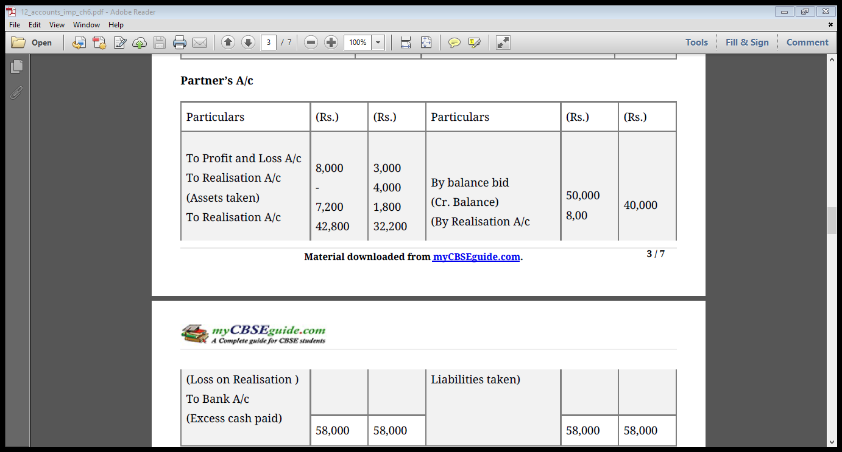
Solution - 3
Capital a/c

Slide 33
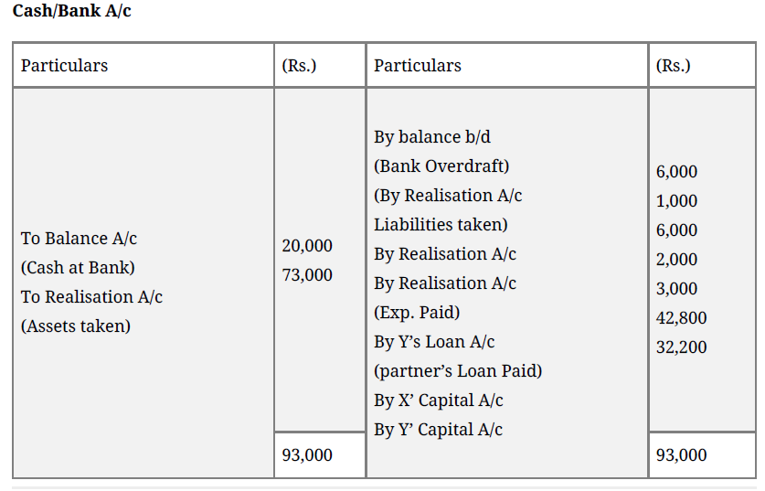
Solution - 3

Slide 34
Illustration - 4
A, B and C commenced business on 1st January 2008 with capitals of Rs 50,000, 40,000 and Rs 30,000 respectively. Profits and losses are shared in the ratio of 4:3:3. During 2008 and 2009 they made profit of Rs 20,000 and Rs 25000 respectively. Each partner withdrew Rs 5000 per year. On 31st December 2009, they decided to dissolve the firm. Creditors and cash on that date were Rs 12,000 and Rs 2000 respectively. The Assets realized Rs 1,50,000. Creditors were settled for Rs 11,500 and realization expenses were Rs 500. Prepare Realisation a/c, Capital accounts and Cash account.

Slide 35
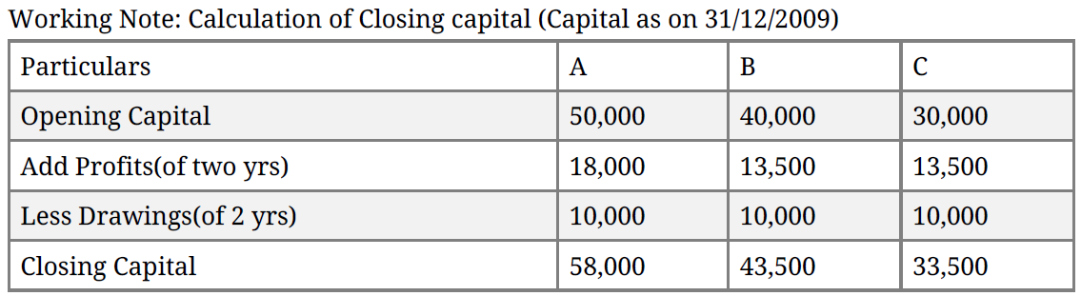
Solution - 4

Slide 36
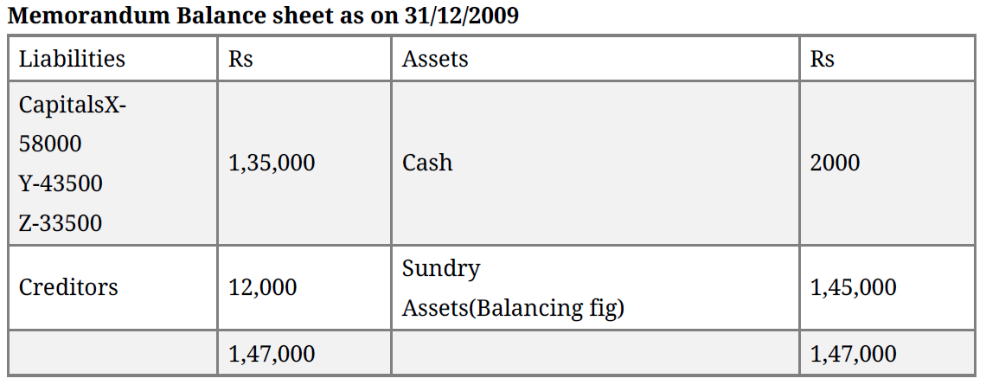
Solution - 4

Slide 37
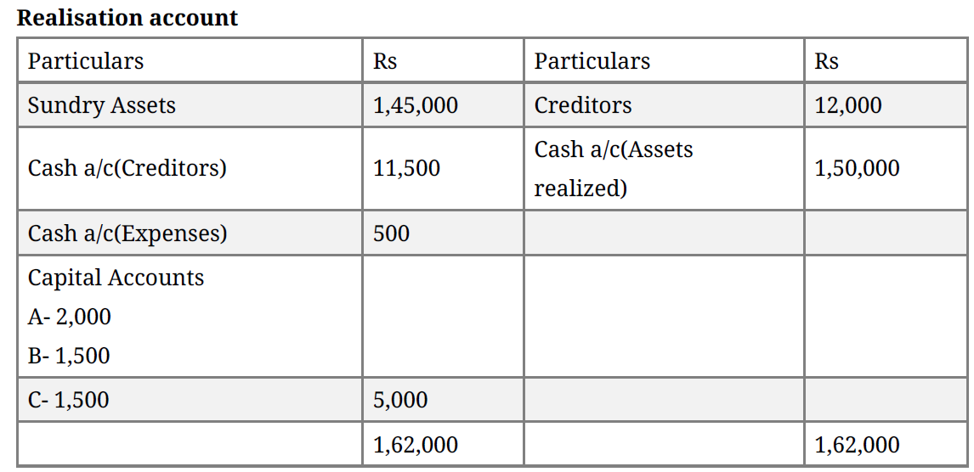
Solution - 4

Slide 38
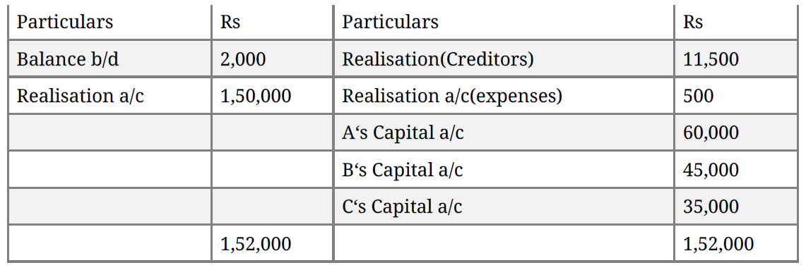
Solution - 4
Cash account

Slide 39
Final Account Board Exam Questions

Slide 40
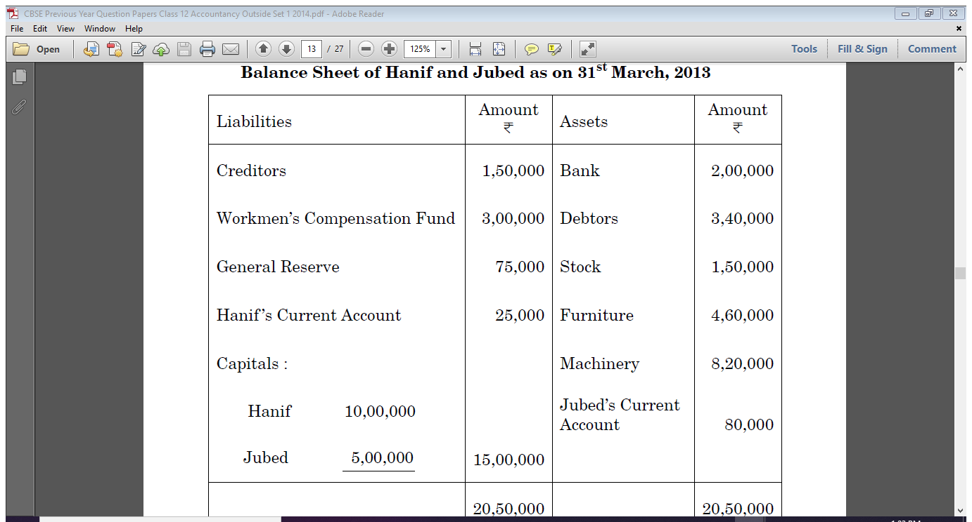
Hanif and Jubed were partners in a firm sharing profits in the ratio of their capitals. On 31st March, 2013 their Balance Sheet was as follows :
2014 Question - 1

Slide 41
2014 Question - 1
On the above date the firm was dissolved.
(i) Debtors were realised at a discount of 5%. 50% of the stock was taken over by Hanif at 10% less than the book value. Remaining stock was sold for RS. 65,000.
(ii) Furniture was taken over by Jubed for RS. 1,35,000. Machinery was sold as scrap for RS. 74,000.
(iii) Creditors were paid in full.
(iv) Expenses on realisation RS. 8,000 were paid by Hanif.
Prepare Realisation Account.

Slide 42
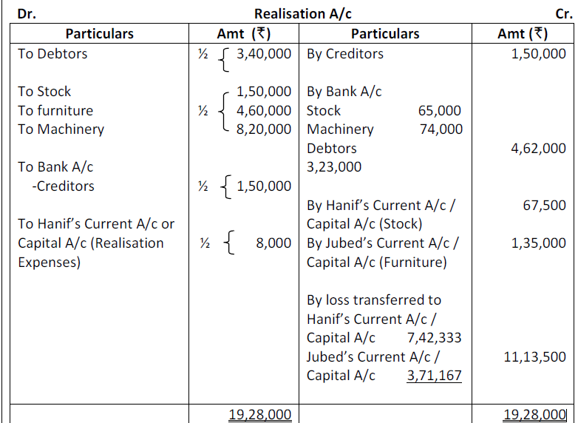
Solution - 1

Slide 43
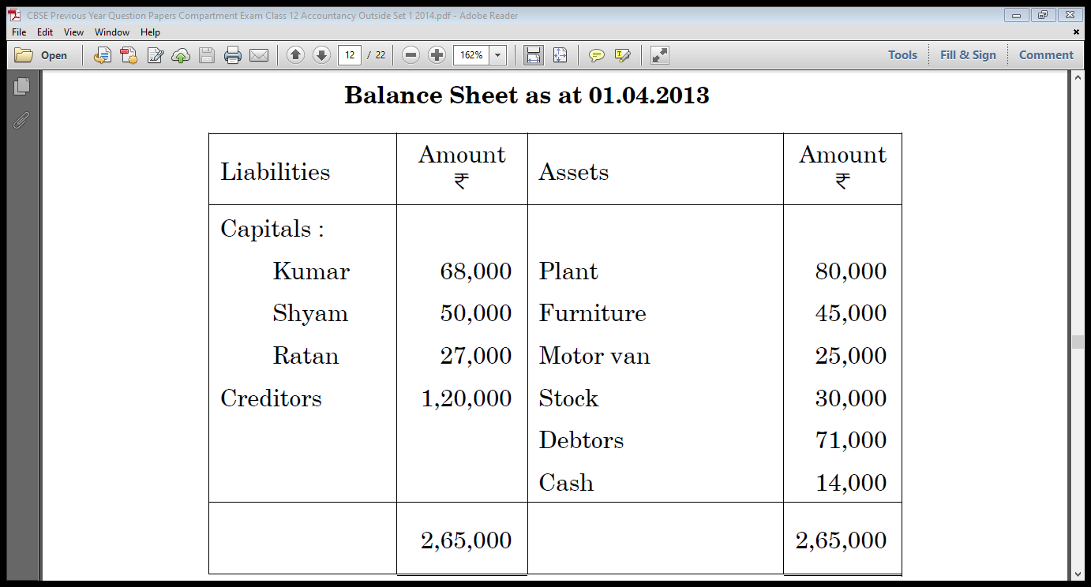
Kumar, Shyam and Ratan were partners in a firm sharing profits in the ratio of 5 : 3 : 2 respectively. They decided to dissolve the firm with effect from 01-04-2013. On that date the Balance Sheet of the firm was as follows :
2014 Compartment Question - 2

Slide 44
2014 Compartment Question - 2
The dissolution resulted in the following :
(i) Plant of Rs. 40,000 was taken over by Kumar at an agreed value of Rs. 45,000 and remaining plant realised Rs. 50,000.
(ii) Furniture realised Rs. 40,000.
(iii) Motor van was taken over by Shyam for Rs. 30,000.
(iv) Debtors realised Rs. 1,000 less.
(v) Creditors for Rs. 20,000 were untraceable and the remaining creditors were paid in full.
(vi) Realisation expenses amounted to Rs. 5,000.
Prepare the Realisation Account, Capital Accounts of Partners and Bank Account of the firm.

Slide 45
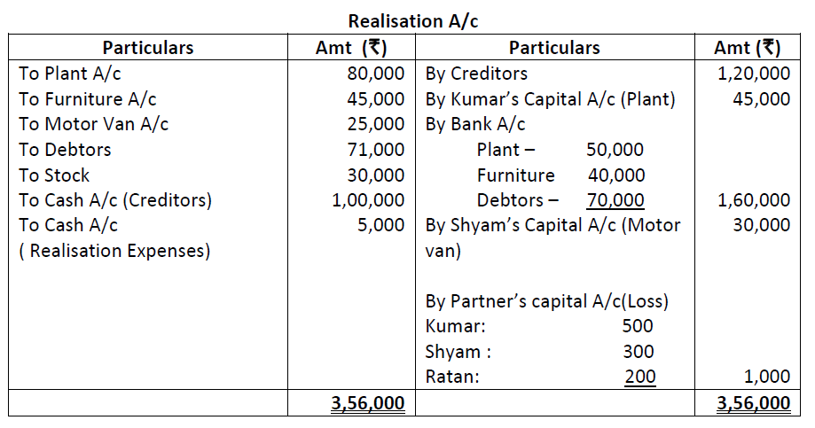
2014 Compartment Solution - 2

Slide 46
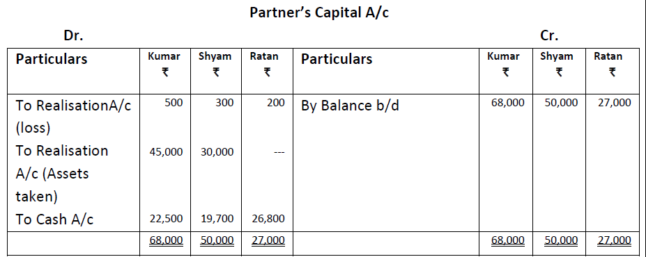
2014 Compartment Solution - 2

Slide 47
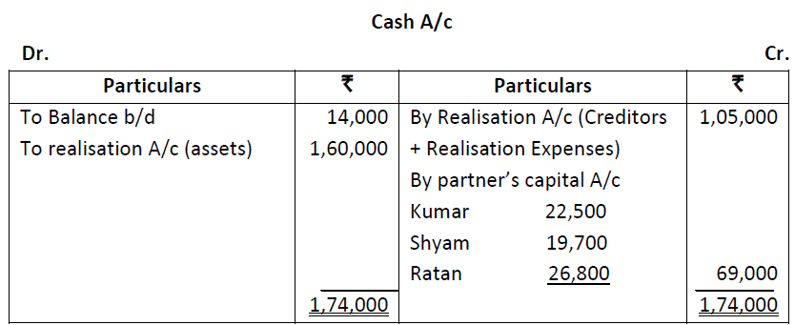
2014 Compartment Solution - 2

Slide 48
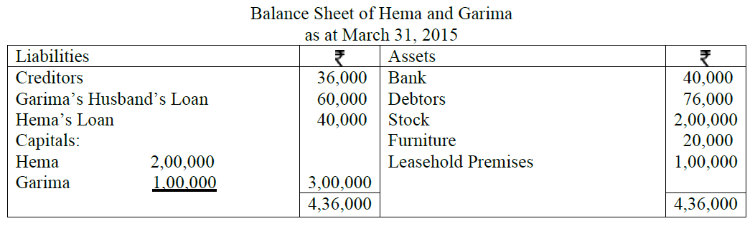
Hema and Garima were partners in a firm sharing profits in the ratio of 3:2 . On March 31, 2015, their Balance Sheet was as follows:
2016 Sample Question - 3

Slide 49
2016 Sample Question - 3
On the above date the firm was dissolved. The various assets were realized and liabilities were settled as under:
(i) Garima agreed to pay her husband’s loan.
(ii) Leasehold Premises realized Rs.1,50,000 and Debtors Rs.2,000 less.
(iii) Half the creditors agreed to accept furniture of the firm as full settlement of their claim and remaining half agreed to accept 5% less.
(iv) 50% Stock was taken over by Hema on cash payment of Rs.90,000 and remaining stock was sold for Rs.94,000.
(v) Realisation expenses of Rs.10,000 were paid by Garima on behalf of firm.
(vi) Pass necessary journal entries for the dissolution of the firm.

Slide 50
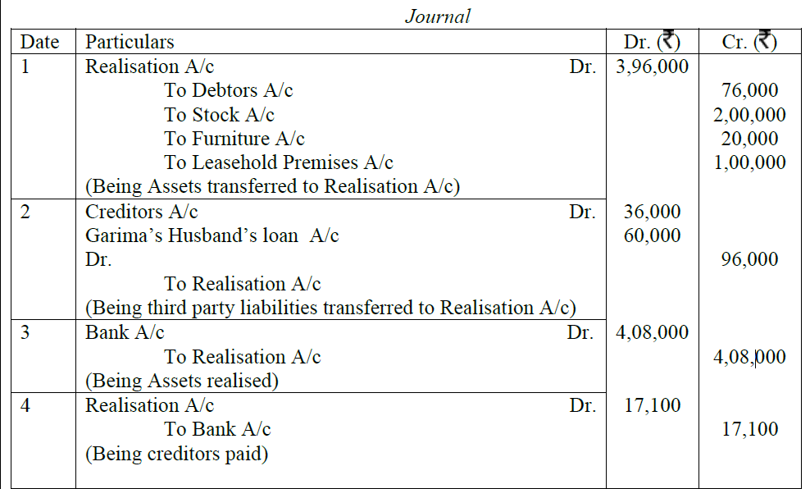
2016 Sample Solution - 3

Slide 51
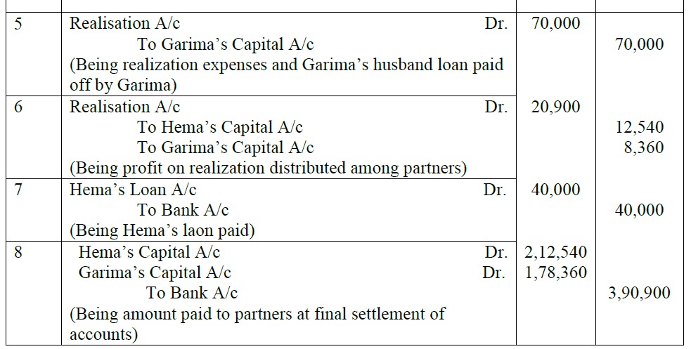
2016 Sample Solution - 3

Slide 52
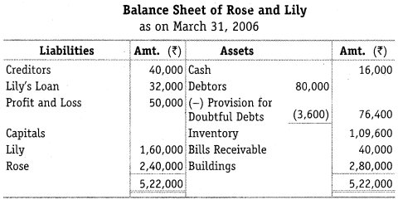
Rose and Lily shared profits in the ratio of 2:3. Their Balance Sheet on March 31, 2006 was as follows:
Question - 4

Slide 53
Question - 4
Rose and Lily decided to dissolve the firm on the above date. Assets (except bills receivables) realised Rs. 4,84,000. Bills receivable were taken over by Rose at Rs. 33,000. Creditors agreed to take Rs 38,000. Cost of realisation was Rs 2400. There was a Motor Cycle in the firm which was brought out of the firm’s money, was not shown in the books of the firm. It was now sold for Rs 10,000. There was a continigent liability in respect of outstanding electric bill of Rs 5,000. Show realisation account, partners’ capital account, loan account and cash account.

Slide 54
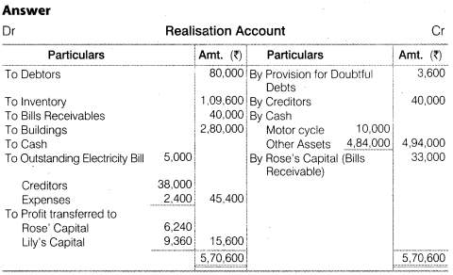
Solution - 4

Slide 55
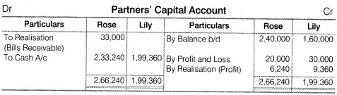
Solution - 4

Slide 56

Solution - 4

Slide 57
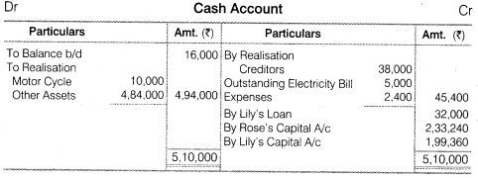
Solution - 4

Slide 58
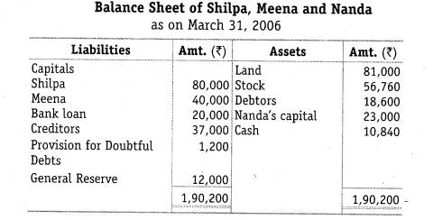
Shilpa, Meena and Nanda decided to dissolve their partnership on March 31,2006. Their profit sharing ratio was 3:2:1 and their Balance Sheet was as under:
Question - 5

Slide 59
Question - 5
The stock of value of Rs. 41,660 are taken over by Shilpa for Rs. 35,000 and she agreed to discharge bank loan. The remaining stock was sold at Rs. 14,000 and debtors amounting to Rs. 10,000 realised Rs. 8,000. land is sold for Rs. 1,10,000. The remaining debtors realised 50% at their book value. Cost of realisation amounted to Rs. 1,200. There was a typewriter not recorded in the books worth Rs. 6,000 which were taken over by one of the Creditors at this value. Prepare Realisation a/c , Capital a/c and Cash a/c.

Slide 60
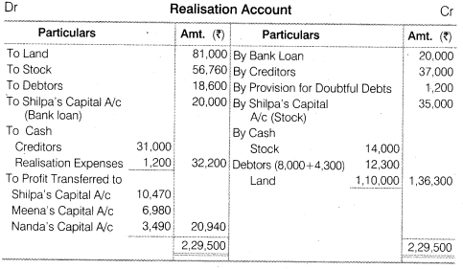
Solution - 5

Slide 61
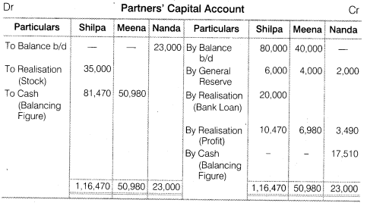
Solution - 5

Slide 62
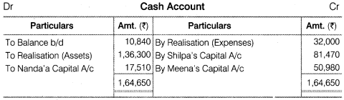
Solution - 5

Slide 63
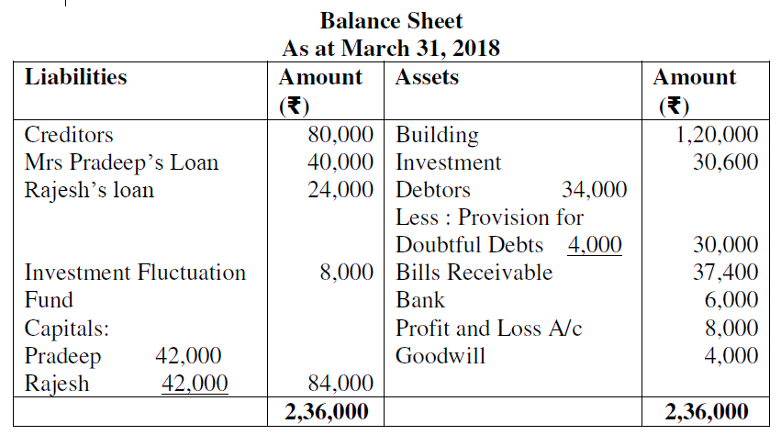
Pradeep and Rajesh were partners in a firm sharing profits and losses in the ratio of 3:2. They decided to dissolve their partnership firm on 31st March, 2018. Pradeep was deputed to realize the assets and to pay off the liabilities. He was paid ₹ 1,000 as commission for his services. The financial position of the firm on 31st March, 2018 was as follows:
Question - 6

Slide 64
Question - 6
Following terms and conditions were agreed upon:
i. Pradeep agreed to pay off his wife’s loan.
ii. Half of the debtor’s realized ₹ 12,000 and remaining debtors were used to pay off 25% of the creditors.
iii. Investment sold to Rajesh for ₹ 27,000
iv. Building realized ₹ 1,52,000
v. Remaining creditors were to be paid after two months, they were paid immediately at 10% p.a. discount
vi. Bill receivables were settled at a loss of ₹ 1,400
vii. Realization expenses amounted to ₹ 2,500
Prepare Realization Account.

Slide 65
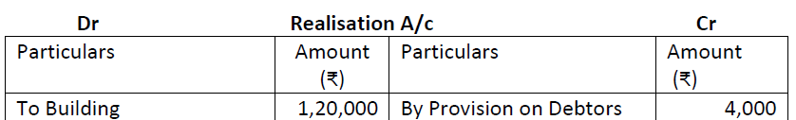
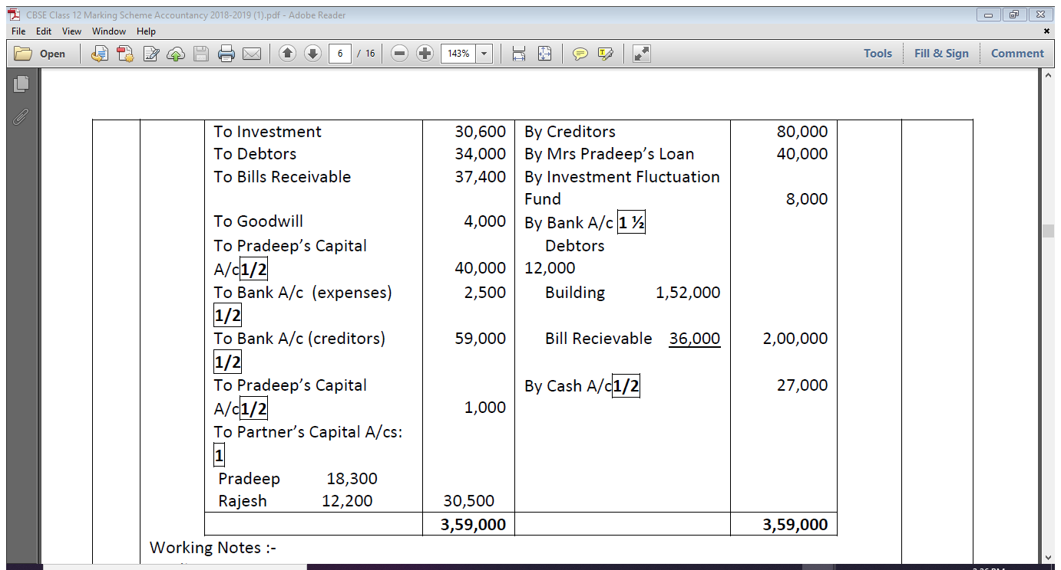
Solution - 6

Slide 66
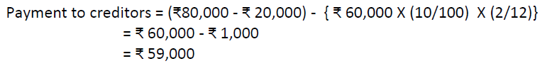
Solution - 6

Slide 67
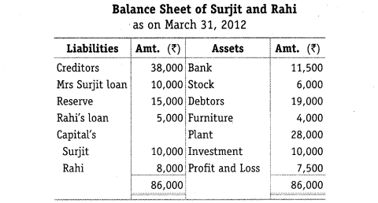
Surjit and Rahi were sharing profits (losses) in the ratio of 3:2, their Balance Sheet as on March 31, 2004 is as follows:
Question - 7

Slide 68
Question - 7
The firm was dissolved on March 31, 2006 on the following terms:
1. Surjit agreed to take the investments at Rs. 8,000 and to pay Mrs. Surojit’s loan.
2. Other assets were realised as follows:
Stock Rs.5,000
Debtors Rs. 18,500
Furniture Rs. 4,500
Plant Rs. 25,000
3. Expenses on realisation amounted to Rs. 1,600.
4. Creditors agreed to accept Rs. 37,000 as a final settlement. You are required to prepare Realisation account, Partner’s Capital account and Bank account

Slide 69
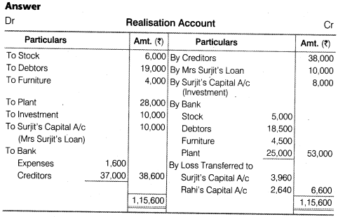
Solution - 7

Slide 70
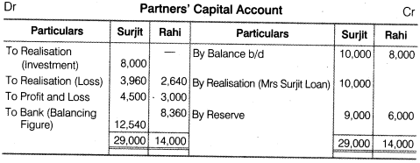
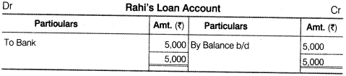
Solution - 7

Slide 71
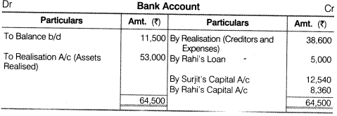
Solution - 7

Slide 72
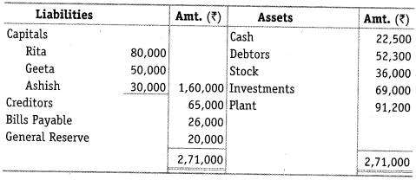
Question - 8
Rita, Geeta and Ashish were partners in a firm sharing profits/losses in the ratio of 3:2:1. On March 31, 2006 their balance sheet was as follows:

Slide 73
Question - 8
On the date of above mentioned date the firm was dissolved:
1. Rita was appointed to realise the assets. Rita was to receive 5% commission
on the rate of assets (except cash) and was to bear all expenses of realisation,
2. Assets were realised as follows: Rs.
Debtors 30,000
Stock 26,000
Plant 42,750
3. Investments were realised at 85% of the book value,
4. Expenses of realisation amounted to Rs. 4,100,
5. Firm had to pay Rs. 7,200 for outstanding salary not provided for earlier,
6. Contingent liability in respect of bills discounted with the bank was also materialised and paid off Rs. 9,800,
Prepare Realisation account, Capital Accounts of Partner’s and Cash Account.

Slide 74
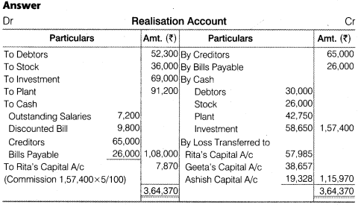
Solution - 8

Slide 75
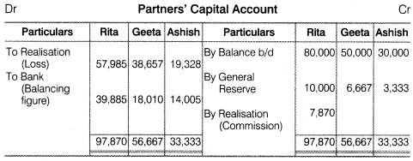
Solution - 8

Slide 76
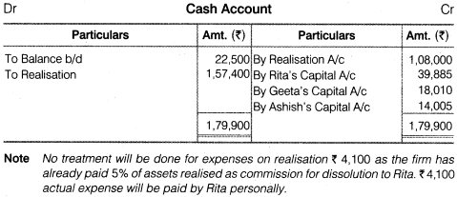
Solution - 8

Slide 77
THANKING YOU
ODM EDUCATIONAL GROUP

