Slide 1


ACCOUNTING FOR PARTNERSHIP FIRM
SUBJECT : ACCOUNTANCY
CHAPTER NUMBER:03
CHAPTER NAME : ACCOUNTING FOR PARTNERSHIP FIRM:CHANGE IN PSR

Slide 2
CONCEPT OF RECONSTITUTION OF THE FIRM
Partnership comes into existence as a result of an agreement among the partners of a firm to share the profits of the legal business. Whenever there is any change in the partnership agreement, then the existing agreement comes to an end and a new agreement comes into existence and the firm continues.
In other words, any change in existing agreement of partnership is "Reconstitution of the Firm".
Reconstitution of a partnership firm means any change in existing agreement among the partners. "Reconstitution of the firm" can take place due to any one of the following reasons:
Change in the Profit-Sharing Ratio among the existing partners
Admission of new partner
Retirement of an existing partner (If firm is continued by the remaining partners)
Death of a partner (If firm is continued by the remaining partners)
Amalgamation or merger of two partnership firms
This chapter deals with reconstitution of partnership firm on account of change in profit-sharing ratio among the existing partners.

Slide 3
2. DETERMINATION OF SACRIFICING RATIO AND GAINING RATIO
When the partners decide to change their profit-sharing ratio, then the new ratio may result in gain to some partner(s) and loss to some others at the same time. So, at the time of change in profit-sharing ratio, it is important to determine new profit-sharing ratio, sacrificing ratio and gaining ratio.
Before we proceed with determination of these ratios, let us first understand meaning of certain
important terms.
Some Important Terms
Old Ratio: The ratio in which partners were sharing profits and losses before reconstitution of the firm is known as old ratio.
Sacrificing Partners: The partners whose share have decreased due to change in profit-sharing ratio are known as Sacrificing Partners.
Gaining Partners: The partners whose share have increased due to change in profit-sharing ratio are known as Gaining Partners.
Sacrificing Ratio: The ratio in which the partner(s) surrender their shares of profit in fair, hir of other partner(s), is known as sacrificing ratio.
Sacrificing Ratio = Old Share - New Share
Gaining Ratio: The ratio in which the partner(s) acquire the share from other partner(s), is known as gaining ratio.
Gaining Ratio = New Share - Old Share
New Profit-Sharing Ratio: It is the ratio in which all the partners share the future profits and losses.

Slide 4
QUESTION-1
A, B and C are partners sharing profits and losses equally. It was decided in future that C will get 1 /5th share in profit. Calculate the new profit-sharing ratio and sacrifice / gain of the partners.
QUESTION-2
A, B and C are partners sharing profits and losses in the ratio of 3:2:1. As per new agreement, C acquires 1/6th share from A. Compute new profit-sharing ratio and sacrifice and gain of the partners.
QUESTION-3
X, Y and Z are partners sharing profits and losses in the ratio of 4:3:3. As per 3.4 new agreement, Z acquires 1 /10th share, equally from X and Y. Compute new profit-sharing WI ratio and sacrifice and gain of the partners.

Slide 5
ACCOUNTING TREATMENT OF GOODWILL
When the partners decide to change their profit-sharing ratio, then the gaining partner should compensate the sacrificing partner by paying the proportionate amount of goodwill in the gaining ratio.
Amount of Compensation Payable = Value of Firm's Goodwill x Share of Profit Gained
The following entry is passed to adjust goodwill:
In case of Fluctuating Capitals:
Gaining Partners' Capital A/c (In gaining ratio) Dr.
To Sacrificing Partners' Capital A/c (In sacrificing ratio)
(Being the adjustment made for goodwill on change in profit-sharing ratio)
In case of Fixed Capitals:
Gaining Partners' Current A/c (In gaining ratio) Dr.
To Sacrificing Partners' Current A/c (In sacrificing ratio)
(Being the adjustment made for goodwill on change in profit-sharing ratio)
Always Remember: Unless otherwise stated, the partners' capitals should be assumed to be
fluctuating. Current Accounts are to be used only in case of Fixed Capitals.

Slide 6
QUESTION-1
Anita, Asha and Amrit are partners sharing profits in the ratio of 3:2:1 respectively. From 1st January 2010, they decided to share profits in the ratio of 2:3:1. The partnership deed provides that in the event of any change in profit sharing ratio, the goodwill should be valued at three years' purchase of the average of five years profits. The profits and losses of the preceding five years are:
Showing the working clearly, give the necessary journal entry to record the above change.
QUESTION-2
Kumar, Gupta and Kavita were partners in a firm sharing profits and losses equally. The firm was engaged in the storage and distribution of canned juice and its godowns were located at three different places in the city. Each godown was being managed individually by Kumar, Gupta and Kavita. Because of increase in business activities at the godown managed by Gupta, he had to devote more time. Gupta demanded that his share in the profits of the firm be increased, to which Kumar and Kavita agreed. The new profit-sharing ratio was agreed to be 1:2:1. For this purpose, the goodwill of the firm was valued at two years' purchase of the average profits of last five years. The profits of the last five years were as follows:
You are required to:
Calculate the goodwill of the firm.
(ii) Pass necessary Journal Entry for the treatment of goodwill on change in profit-sharing ratio of Kumar, Gupta and Kavita.

Slide 7
PAGE NO 3.10 PENDING

Slide 8
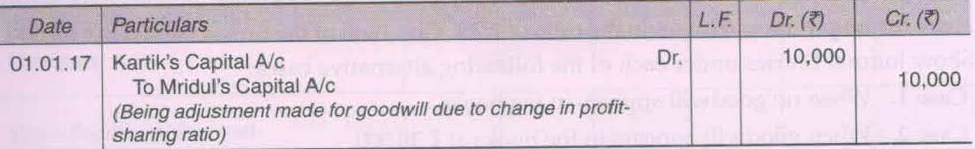
A, B and C are partners sharing profits and losses equally. They decided to share future profits and losses in the ratio of 2:2:1. Goodwill of the firm is valued at 60,000. Show Journal Entries under each of the following alternative cases: Case 1. When no goodwill appears in the books. Case 2. When goodwill appears in the books at 30,000.
Mridul and Kartik are partners sharing profits and losses equally. With effect from 1st January, 2017, they agreed to change their profit-sharing ratio. The partnership deed provides that in the event of any change in profit-sharing ratio, the goodwill should be valued at two years' purchase of the average of last three years profits. The profits and losses of the preceding three years were: 2014 - 35,000; 2015 - 28,000; 2016 -Z 27,000. The partners passed the following Journal Entry to give effect to the adjustment for goodwill:
Calculate the individual partner's gain or sacrifice due to change in ratio and new profit-sharing ratio.

Slide 9
ACCOUNTING TREATMENT OF ACCUMULATED PROFITS AND RESERVES
If the firm is having Reserves or/and Accumulated profits in the Balance Sheet at the time of change in profit-sharing ratio, then there can be "Two Accounting Treatment":
Two Accounting Treatments of Accumulated Profits and Reserves
When Reserves are not to be shown in future in the new Balance Sheet
When Reserves are to be shown in future in the new Balance Sheet
When Reserves are not to be shown in future in the new Balance Sheet
The accumulated profits and reserves appearing in the Balance Sheet on the date of change in profit-sharing ratio had been earned before the reconstitution of the firm by the partners in their old ratio. So, before the profit-sharing ratio changes, such accumulated profits and reserves are distributed among the existing partners in their old ratio and will not be shown in the new Balance Sheet. They are transferred to Partners' Capital Accounts (in case of fluctuating capitals) or Current Accounts (in case of fixed capitals) in their old profit-sharing ratio.
The Journal Entries will be:
For Transfer of Reserves and Accumulated Profits
General Reserve/Other Reserve A/c Dr.
Profit and Loss A/c Dr.
Workmen Compensation Reserve A/c`** Dr.
Investment Fluctuation Reserve A/c** Dr.
To Partners' Capital (or Current) A/c (In Old Ratio)
(Being the balance in reserves or/and accumulated profits transferred to capital (or current) accounts of partners in their old ratio)

Slide 10
For Transfer to Accumulated Losses:
Partners' Capital (or Current) A/c (In Old Ratio) Dr.
To Profit and Loss A/c
To Deferred Revenue Expenditure A/c
(Being the accumulated losses and deferred revenue expenditure transferred to capital (or current) accounts of partners in their old ratio)
**Treatment of Workmen Compensation Reserve and Investment Fluctuation Reserve is discussed
separately in the forthcoming examples.
QUESTION-1

Slide 11
Workmen Compensation Reserve (WCR)
Workmen Compensation Reserve is a reserve created out of firm's profit to meet the liability towards workmen (workers), if any, that may arise in future. At the time of change in profit-sharing ratio, it is treated as under:
Nothing is mentioned or No liability is expected to arise: In such a case, entire amount of Workmen Compensation Reserve is transferred to Partners' Capital (or Current) Account in their old profit-sharing ratio.
Workmen Compensation Reserve A/c Dr.
To Partners' Capital (or Current) A/c (In Old Ratio)
(Being workmen compensation reserve transferred to capital (or current) accounts of partners in
their old ratio)
When there is a liability for Workmen Compensation: In such a case, treatment of Workmen Compensation Reserve depends on the amount of liability. There can be three possible cases:
If expected liability is less than Workmen Compensation Reserve: WCR to the extent of liability is used to make provision for such liability and balance is distributed among the partners in the old ratio.
Workmen Compensation Reserve A/c Dr.
To Provision for Workmen Compensation Claim A/c
To Partners' Capital (or Current) A/c (In Old Ratio)
(Being surplus of workmen compensation reserve transferred to capital (or current) accounts of partners in their old ratio)

Slide 12
If expected liability is equal to Workmen Compensation Reserve: Entire WCR is used to make provision for such liability and nothing is left for distribution among the partners.
Workmen Compensation Reserve A/c Dr.
To Provision for Workmen Compensation Claim A/c
(Being the provision made for Workmen Compensation Claim)
If expected liability is more than Workmen Compensation Reserve:
Entire WCR is used to make provision for such liability; and
Shortage is met out of Revaluation Account; and
Loss on such revaluation is transferred to Partners' Capital (or Current) Account in their old ratio.
Workmen Compensation Reserve A/c Dr.
Revaluation A/c Dr.
To Provision for Workmen Compensation Claim A/c
(Being the provision made for Workmen Compensation Claim and shortfall charged to Revaluation Account)
Partners' Capital (or Current) A/c (In Old Ratio) Dr.
To Revaluation A/c
(Being the loss on revaluation transferred to capital (or current) accounts of partners in their old ratio)
Always Remember: 'Workmen Compensation Reserve "is a reserve created to pay off compensation to workers in case of an accident. If no compensation is payable or expected at the time of reconstitution of firm. then the entire amount of such reserve is distributed among the partners in their old ratio.

Slide 13
QUESTION-1
A and B are partners sharing profits and losses in the ratio of 3:2. On 01.04.2017, they decide to share future profits and losses equally. On that date, "Workmen Compensation Reserve" appears at in the Balance Sheet at Rs. 10,000. Show the accounting treatment in each of the following alternative cases:
Case I: If there is no other information.
Case II: If a claim on account of Workmen compensation is estimated at Rs. 4,000.
Case III: If a claim on account of Workmen compensation is estimated at Rs. 10,000.
Case IV: If a claim on account of Workmen compensation is estimated at Rs. 12,000.

Slide 14
Investment Fluctuation Reserve (IFR)
Investment Fluctuation Reserve is a reserve created out of profits to adjust the difference between the book value and market value of investments. At the time of change in profit-sharing ratio, it is treated as:
Nothing is mentioned or No change in book value of investments: In such a case, entire amount of Investment Fluctuation Reserve is transferred to Partners' Capital (or Current) Account in their old profit-sharing ratio.
Investment Fluctuation Reserve A/c Dr.
To Partners' Capital (or Current) A/c (In Old Ratio)
(Being investment fluctuation reserve transferred to capita! (or current) accounts of partners in their old ratio)
When there is a decrease in book value of investments: In such a case, treatment of Investment Fluctuation Reserve depends on the quantum of decrease. There can be three possible cases:
If fall in book value is less than Investment Fluctuation Reserve: IFR to the extent of fall in book value is used to reduce the value of investments and balance is distributed among the partners in the old ratio.
Investment Fluctuation Reserve A/c Dr.
To Investments A/c
To Partners' Capital (or Current) A/c an Old Ratio)
(Being fall in the book value of investments adjusted through investment fluctuation reserve and surplus is transferred to capital (or current) accounts of partners in their old ratio)

Slide 15
If fall in book value is equal to Investment Fluctuation Reserve: Entire IFR is used to reduce the value of investments and nothing is left for distribution among the partners.
Investment Fluctuation Reserve A/c Dr.
To Investments A/c
(Being the fall in book value of investments adjusted through investment fluctuation reserve)
If fall in book value is more than Investment Fluctuation Reserve:
Entire IFR is used to reduce the value of investments; and
Shortage is met out of Revaluation Account; and
Loss on such revaluation is transferred to Partners' Capital (or Current) Account in their old ratio
.
Investment Fluctuation Reserve A/c Dr.
Revaluation A/c Dr.
To Investments A/c
(Being the fall in book value of investments adjusted through investment fluctuation reserve and shortfall charged to Revaluation Account)
Partners' Capital (or Current) A/c (In Old Ratio) Dr.
To Revaluation A/c (
Being the loss on revaluation transferred to capital (or current) accounts of partners in their old ratio)

Slide 16
When there is an increase in book value of investments: In such a case:
Entire IFR is distributed to partners; and
Increase in value is recorded through Revaluation Account; and
Profit on such revaluation is transferred to Partners' Capital (or Current) Account in their old ratio.
Investment Fluctuation Reserve A/c Dr.
To Partners' Capital (or Current) A/c (In Old Ratio)
(Being investment fluctuation reserve transferred to capital (or current) accounts of partners in their old ratio)
Investments A/c Dr.
To Revaluation
(Being the value of investment brought up to market value)
Revaluation A/c Dr.
To Partners' Capital (or Current) A/c {In Old Ratio)}
(Being the profit on revaluation transferred to capital (or current) accounts of partners in their old ratio)

Slide 17
QUESTION-1
A anare partners sharing profits and losses in the ratio of 2:3. On 01.04.17, they decided to share future profits and losses in the ratio of 2:1. An extract of their Balance Sheet as at 31st March, 2017 is as follows:
EXTRACT OF BALANCE SHEET AS AT 31st MARCH, 2017
Show the accounting treatment in each of the following alternative cases:
Case I: If no other information is given
Case II: If the market value of investments is Rs.97,000.
Case III: If the market value of investments is Rs.95,000.
Case IV: If the market value of investments is Rs.92,000.
Case V: If the market value of investments is Rs.1,10,000.
QUESTION-2
A, B and C are partners sharing profits and losses equally. With effect from 1st April, 2017, they agreed to share profits and losses in the ratio of 2:2:1. They decided to record the effect of the following, without effecting their book values.
General Reserve 50,000
Profit and Loss Account (Cr.) Rs. 20,000
Investment Fluctuation Reserve Rs.10,000
Workmen Compensation Reserve Rs.12,000
Advertisement Suspense Account Rs.2,000
Pass an adjustment entry, assuming no liability is expected on account of workmen compensation and market value of investments is also assumed to be equal to the book value. The capitals of the partners are fixed.

Slide 18
REVALUATION OF ASSETS AND REASSESSMENT OF LIABILITIES
When there is a change in the profit-sharing ratio (PSR) of existing partners, then the assets 5:3:2. and liabilities of the firm are revalued. They are revalued because if there is any change (increase ces: or decrease) in the value of assets and liabilities, then such change belongs to the period prior to change in PSR. Hence, any profit or loss arising on such revaluation must be shared by the old partners in prefer their old profit-sharing ratio.
So, the assets and liabilities are revalued due to the following reasons:
To show the assets and liabilities at their current/correct values.
To ensure that no partner is at an advantage or disadvantage due to change in the will be value of assets and liabilities.
To record unrecorded assets and liabilities at their proper values, if any.
Two Methods for Revaluation of Assets and Liabilities
Revaluation of assets and liabilities may be given effect in two different ways:
When revised values are to be recorded in the books.
When revised values are not to be recorded in the books.
When Revised Values are to be recorded in the books
When assets are to be recorded at their revised values, then revaluation of assets and liabilities is done with the help of an account titled Revaluation Account' or 'Profit and Loss Adjustment Account'.

Slide 19
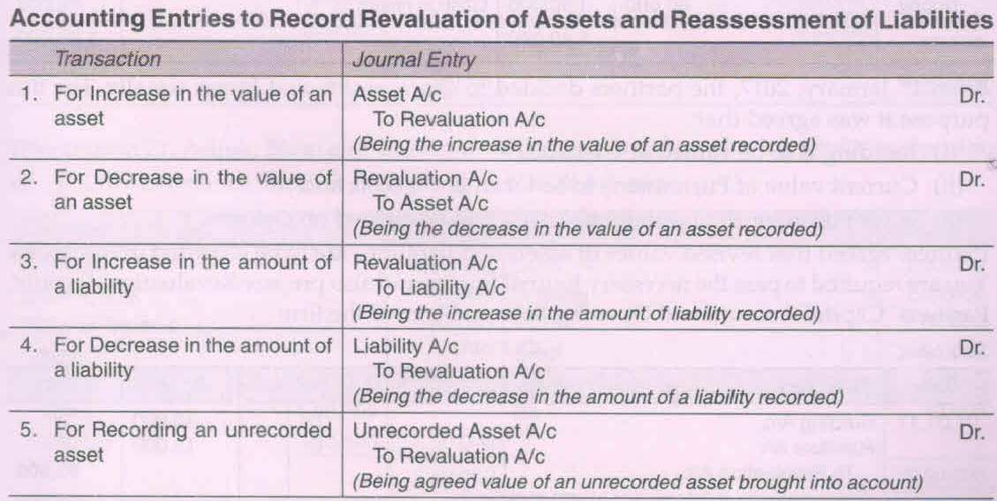
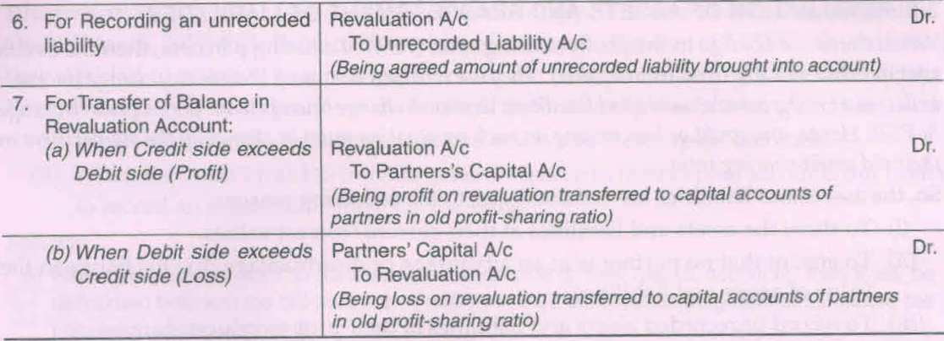

Slide 20
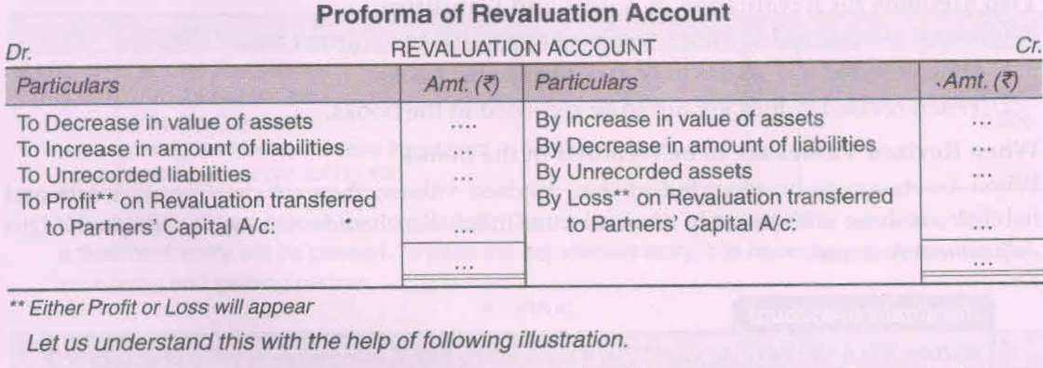
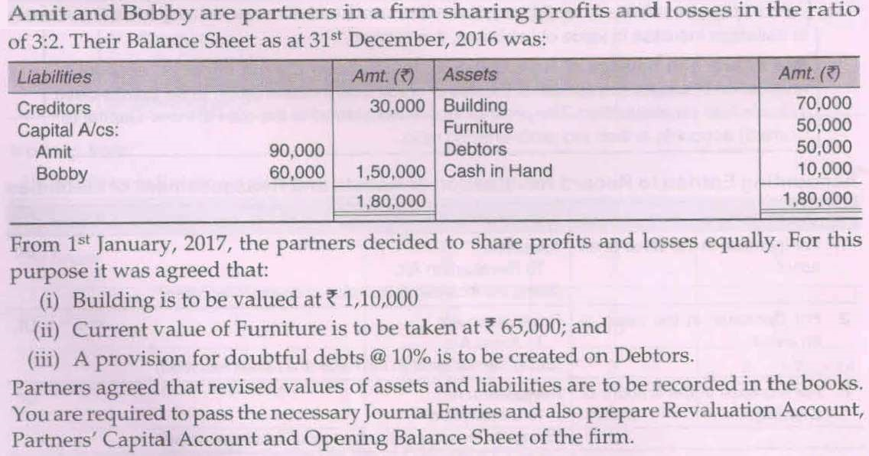
QUESTION-1

Slide 21
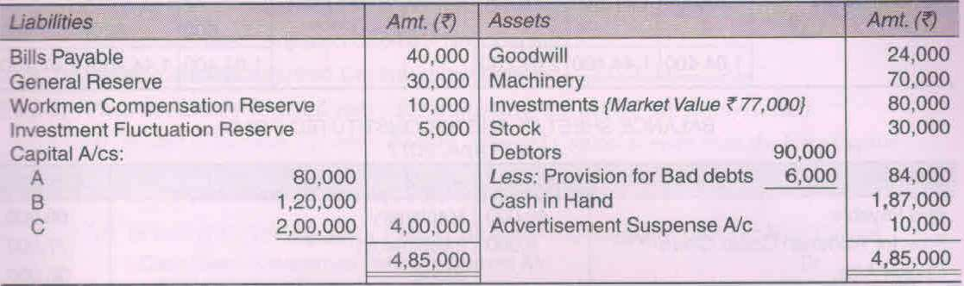
QUESTION-2
A, B and C are partners sharing profits and losses in the ratio of 2:2:1. Their Balance Sheet as at 31st March, 2017 was:
From 1st April, 2017, the partners decided to share profits equally. They have agreed upon the following terms:
Goodwill is to be valued at two years' purchase of average profit of last 3 completed years. The profits were: 2014-15: Rs.70,000; 2015-16: : Rs.75,000; 2016-17: : Rs.80,000.
Machinery is to be depreciated by : Rs.10,000 and stock is found undervalued by : Rs.5,000.
Provision for Doubtful Debts is to be made equal to 10% of the Debtors.
Claim on account of Workmen Compensation is : Rs.6,000.
Determine the sacrifice and gain made by each partner. Also prepare Revaluation Account, Partners'
Capital Accounts and the Balance Sheet of the new firm.

Slide 22
Adjustment of Capitals
At the time of change in profit-sharing ratio, it may be agreed between the partners that their capitals he adjusted as per agreement. The following steps are needed in adjusting the capitals of the partners:
Step 1. Calculate present adjusted capital of the partners, i.e., capital after making adjustments for
goodwill, reserves, accumulated profits/losses and profit and loss on revaluation, etc.
Step 2. Calculate Total Capital of the reconstituted firm (if not given in the question) as
Total Capital = Sum Total of Adjusted Capitals of all Partners
Step 3. Calculate New Capital of the partners, i.e. divide Total Capital in their new profit-sharing
ratio. New Capital of each Partner = Total Capital of the Firm x New share of Each
Partner
Step 4. Calculate the surplus or deficit by comparing the new capital (determined in Step 3) and
present adjusted capital (determined in Step 1).
Surplus = Present Adjusted Capital > New Capital
Deficit = Present Adjusted Capital < New Capital
Step 5. Pass necessary Journal entry for adjusting the above surplus/deficit.
In case of Surplus, i.e. when Present Adjusted Capital is more than the New Capital
Concerned Partner's Capital A/c Dr.
To Cash/Bank/Concerned Partner's Current A/c
In case of Deficit, i.e. when Present Adjusted Capital is less than the New Capital
Cash/Bank/Concerned Partner's Current A/c Dr.
To Concerned Partner's Capital A/c

Slide 23
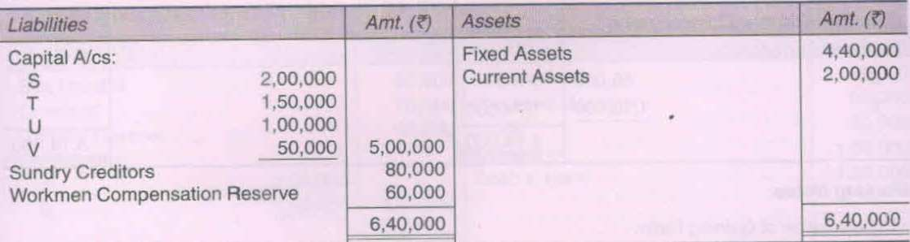
QUESTION-1
S, T, U and V were partners in a firm sharing profits in the ratio of 4:3:2:1. On 01.04.2016, their Balance Sheet was as follows:
From the above date, partners decided to share the future profits in 3:1:2:4 ratio. For this purpose, the goodwill of the firm was valued at Rs.90,000. The partners also agreed for the following:
The claim for workmen compensation has been estimated at Rs.70,000.
To adjust the capitals of the partners according to new profit-sharing ratio by opening Partners' Current Accounts. Prepare Revaluation Account, Partners' Capital Accounts and the Balance Sheet of the reconstituted firm.

Slide 24
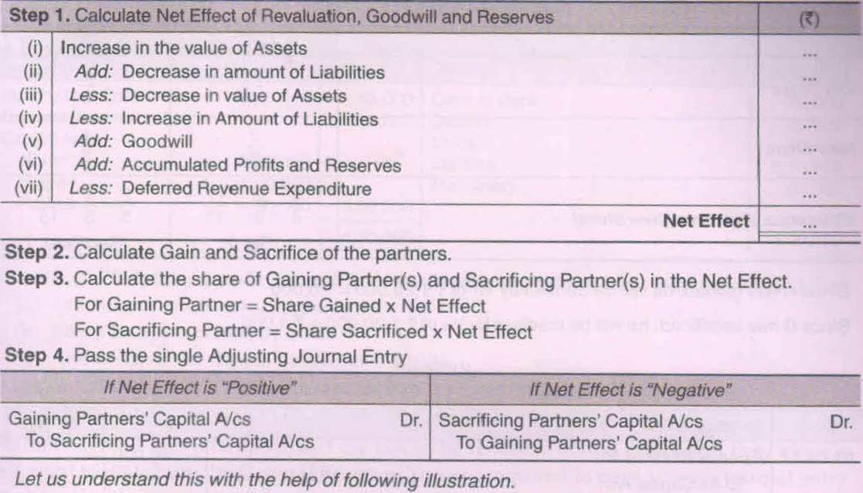
When Revised Values are NOT to be recorded in the books
When the partners decide to record the net effect of revaluation of assets and liabilities without affecting the old figures of assets and liabilities, then a single adjusting entry involving the capital accounts of gaining partners and sacrificing partners is passed. The following steps may be taken in this regard:

Slide 25
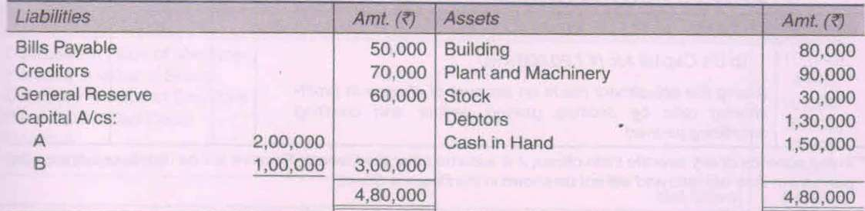
QUESTION-1
A and B are partners in a firm sharing profits and losses in the ratio of 3:2. Their Balance Sheet as at 31st March, 2017 was:
From 1st April, 2017, the partners decided to share profit in the ratio of 2:1. For this purpose it was agreed that:
Creditors amounting to Rs.3,000 are no longer required to be paid.
Building should be devalued at Rs.1,20,000.
A provision of 10% be made on debtors for had and doubtful debts.
The goodwill of the firm should be valued at Rs.90,000.
Pass the necessary Journal Entries to give effect to the above stated agreement without opening the
Revaluation Account. Also prepare the Capital Account of the Partners and Balance Sheet of the
reconstituted firm.

Slide 27

THANKING YOU
ODM EDUCATIONAL GROUP

