Slide 1


ACCOUNTING FOR PARTNERSHIP FIRM
SUBJECT : ACCOUNTANCY
CHAPTER NUMBER:02
CHAPTER NAME : ACCOUNTING FOR PARTNERSHIP FIRM:FUNDAMENTALS

Slide 2
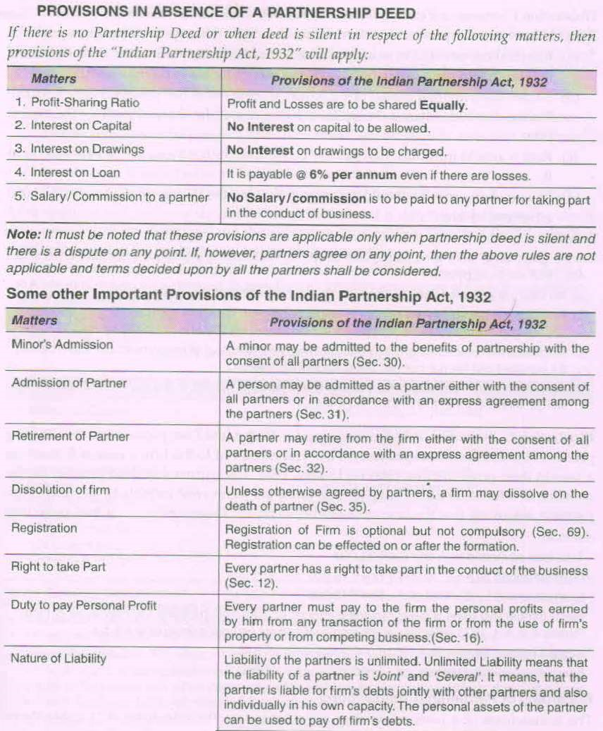

Slide 3
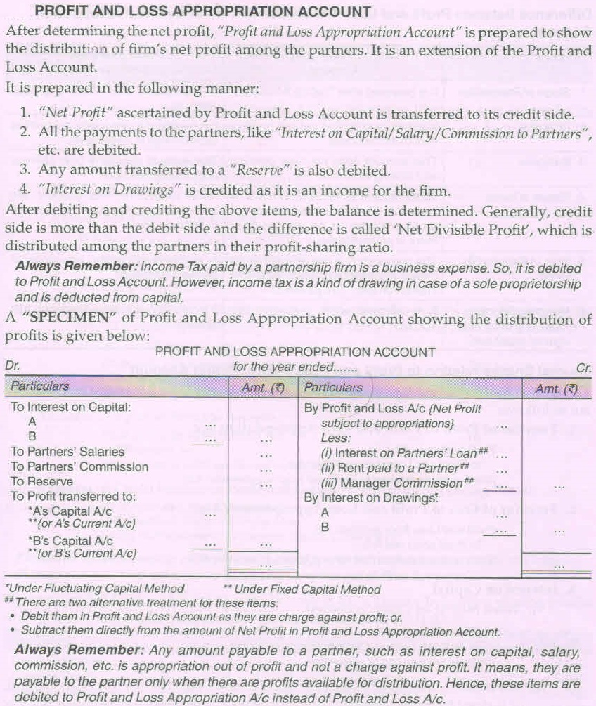

Slide 5
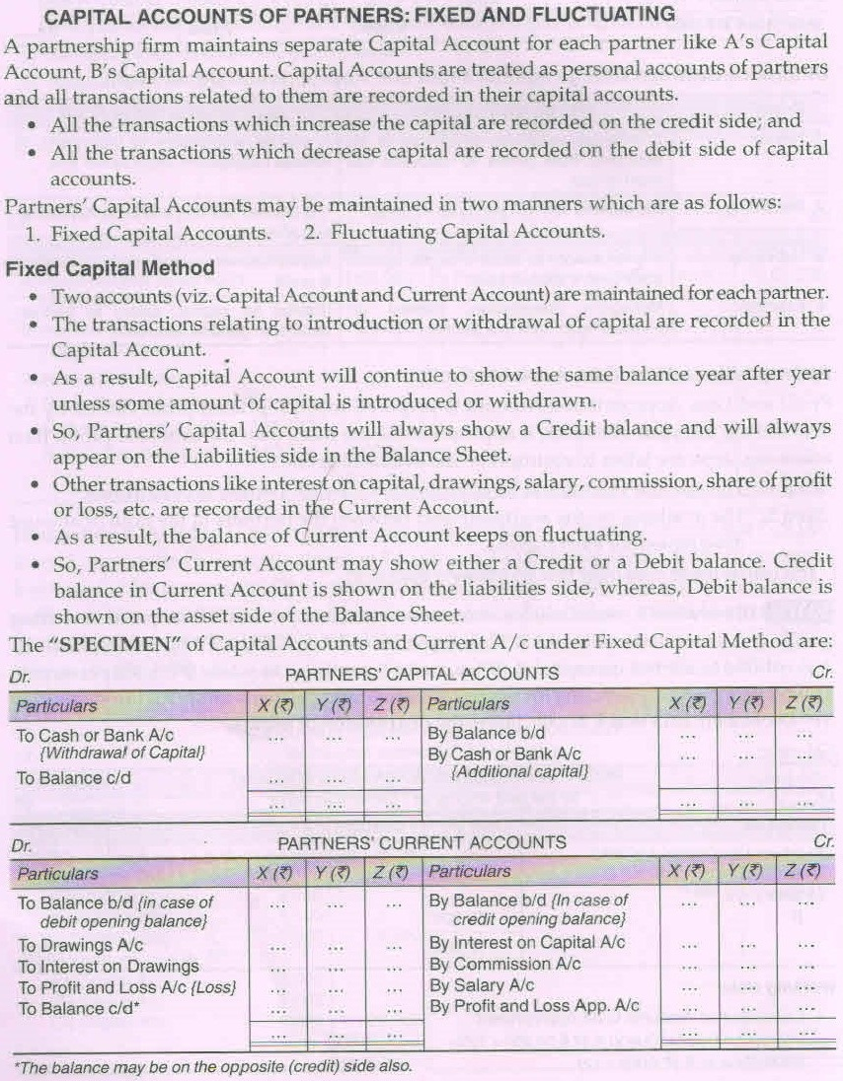

Slide 7
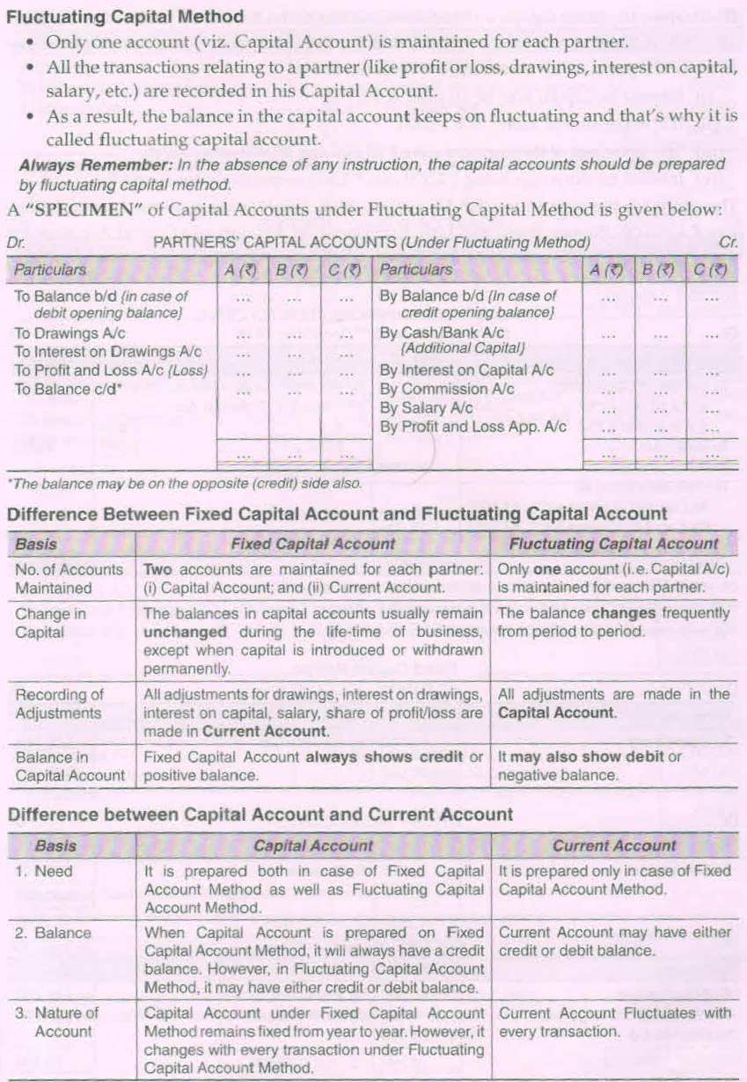

Slide 9
FILL IN THE BLANKS
1. Interest on loan taken by a partner is recorded on of Profit and Loss Account.
2. Interest on Capital are under the Fixed Capital Account method is credited to _ .
3.In the absence of partnership deed rate of interest on partner loan will be .
4. If drawings of equal amount are made in the beginning of every month for 9 month ending 31st March, then interest on drawing will be calculated for an average period for Months.
5.The maximum numbers of partners in case of limited liability partnership is .
6. If partner’s capital is fixed interest on drawing will be recorded on __________.
7. Profit and Losses are to be shared in irrespective of their capital contribution.
8. Interest at the rate of is to be allowed on a partner’s loan to the firm.
In the absence of the date of withdrawal, interest should be charged for month on the whole amount.
10. Manager’s commission is a against profits.
11. Interest on partner’s loan is not credited to the partner’s _.
12. Goodwill is an assets.

Slide 10
TRUE OR FALSE
Remembering
1. The nature of Profit and Loss Account is real.
2. Registration of partnership is optional.
3. A body corporate can be a partner in partnership firm.
4. Sleeping partner are those who do not take part in conduct of the business.
Understanding
5. When the Partnership agreement is silent about the treatment of interest on capital then it will be treated as charge on profit.
6. Fixed capital always shows Debit balance.
7. When a partnership firm gives loan to its partner then interest on loan will be debited in profit and loss account.
8. In case of fixed capital account method drawing out of capital is shown in partner current account.
9. Manager’s commission is shown in Profit and Loss Appropriation Account.
10. Interest as a charge means interest on capital is to be allowed whether the firm has earned profit or incurred loss.

Slide 11
TRUE OR FALSE
Analysis & Evaluation
1. Business of the firm can be conducted even by one partner.
2. Unless otherwise specified, the partners have to share profits and losses in proportion of the capital contributed by them.
3. In the absence of Partnership deed, partners are entitled to interest on capital.
4. Interest on loan advanced by a partner to the firm shall be paid even if there are losses in the business.
5. Under Fixed Capital method, any addition to capital will be shown in Partner’s Capital Account.
6. Liability of the partner is limited.
[ R ] Which section of the partnership act defines partnership as the relation between person who have agreed to share the profit of the business carried on by all or any of them acting for all?
Section 61
Section 130
Section 4
Section 48

Slide 12
UNDERSTANDING
[ U ] Rani and Sham is partner in a firm. They are entitled to interest on their capital but the net profit was not sufficient for paying his interest, then the net profit will be disturbed among partner in
a. 1 : 2
b. Profit Sharing Ratio
c. Capital Ratio
Equally
[ U ] Which one of the following items is recorded in the Profit and Loss appropriation account
Interest on Loan
Partner Salary
c. Rent paid to Partner’s
d. Managers Commission
[ U] A,B and C were partner in a firm sharing Profit in the ratio of 3:2:1 during the year the firm earned profit of Rs. 84,000.
Calculate the amount of Profit or Loss transferred to the capital A/c of B.
a. Loss Rs. 87,000
b. Profit Rs. 87,000
c. Profit Rs.28,000
d. Profit Rs.14,000

Slide 13
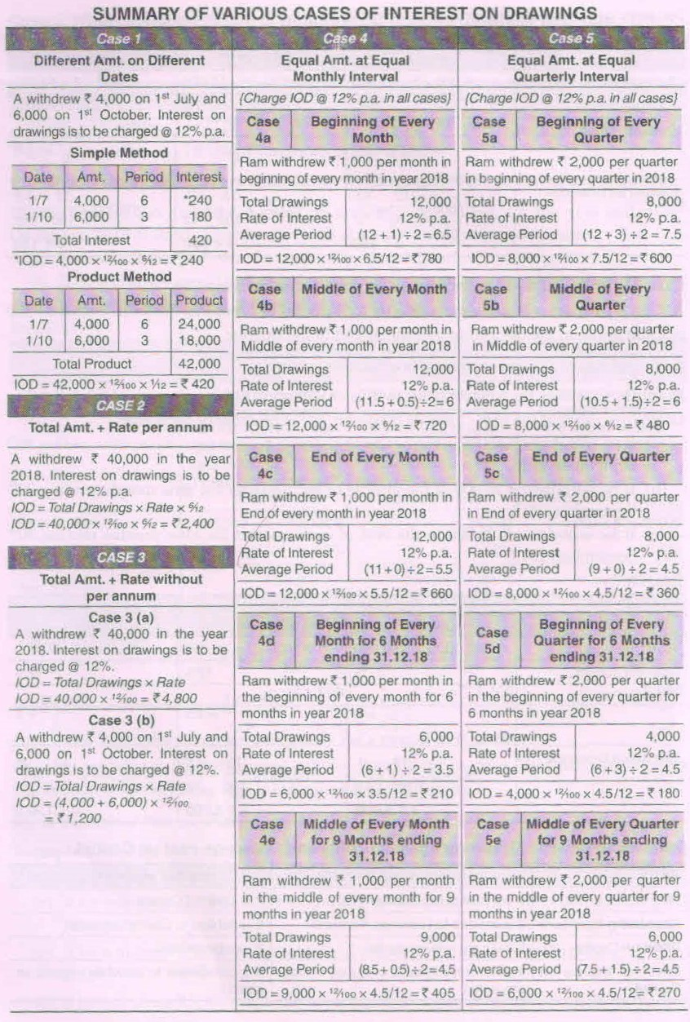

Slide 16
1. A and B are Partners .A drew Rs 32,000 .If the rate of Interest on Drawing is 12% per annum then will amount of interest on drawing .
2. A drew Rs 50,000 during the year. If the rate of Interest on Drawing is 10% then will be the amount of Interest on Drawing .
3. [R] If the partner carries on the business that is similar to firm competition with the firm and profit earned from it, the profit
Shall be retained by the partner
Shall be paid to firm
c. Can be retained or gained to the firm
d. Both (a) or (b)
4. [ R ] The relation of the partner with the firm is that of
a. An owner
b. An agent and A Principal
c. An agent
d. Manager

Slide 17
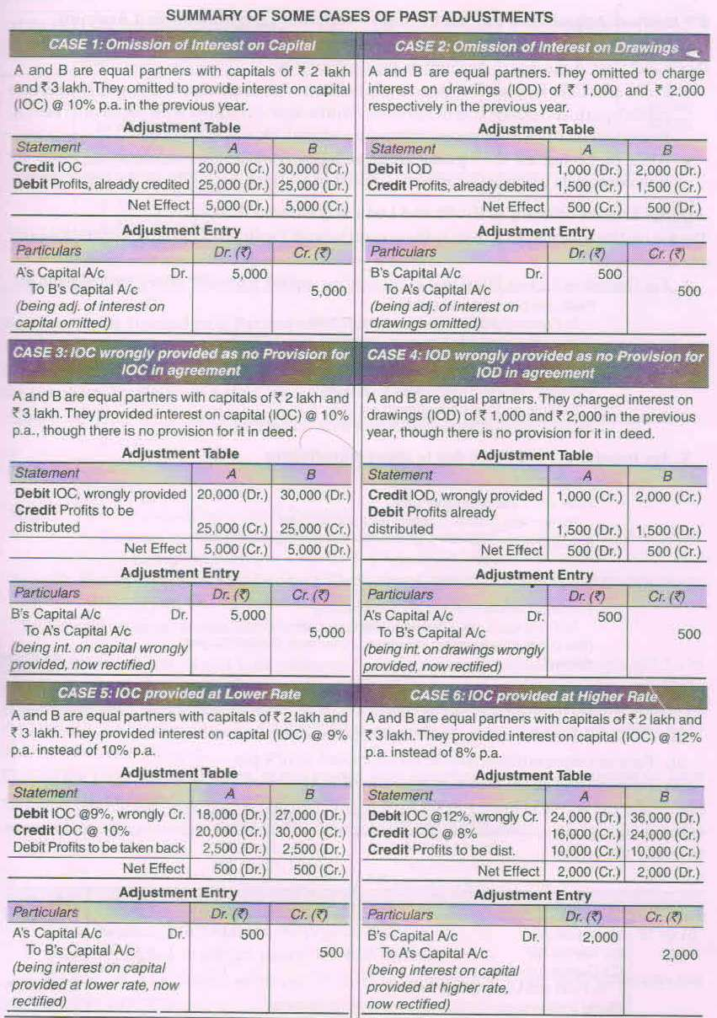

Slide 19
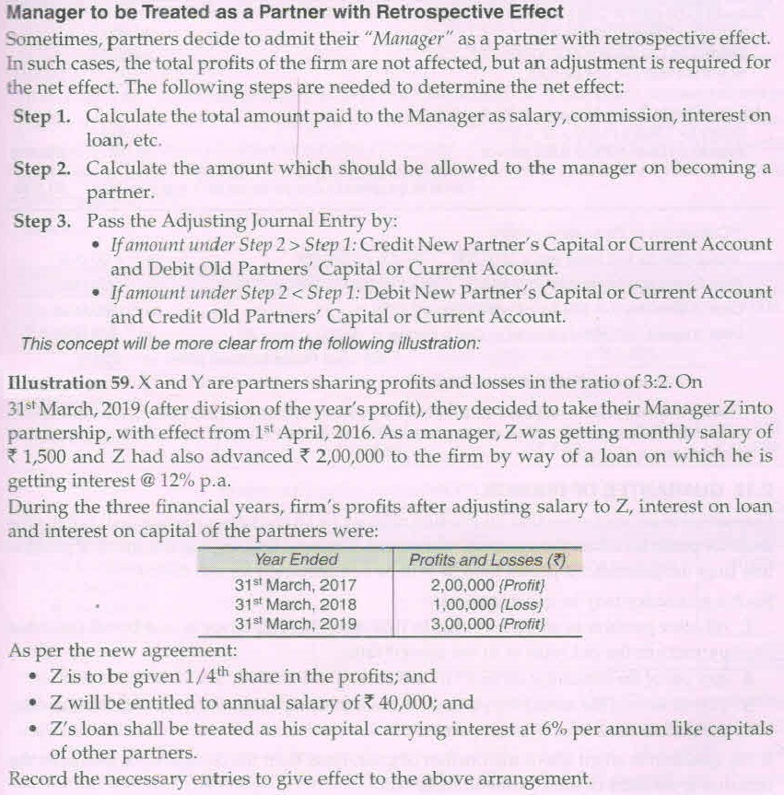

Slide 20
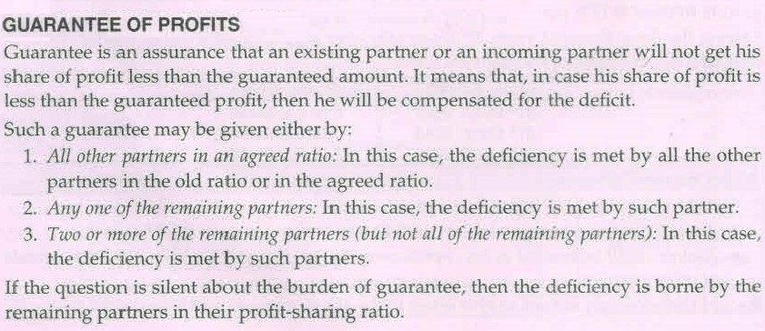

Slide 21
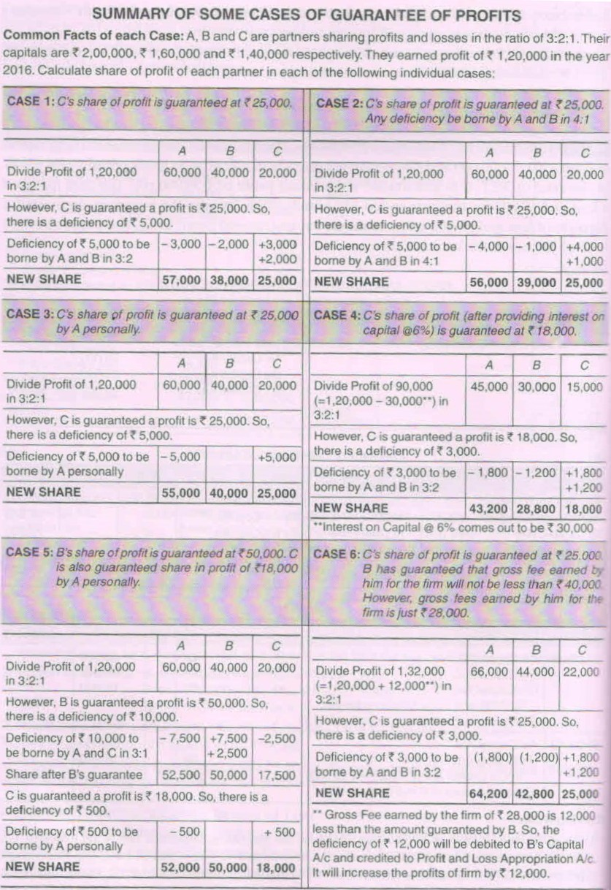

Slide 23
THANKING YOU
ODM EDUCATIONAL GROUP

