Slide 1


TOOLS OF FINANCIAL ANALYSIS
SUBJECT : ACCOUNTANCY
CHAPTER NUMBER:09
CHAPTER NAME : COMPARATIVE AND COMMON SIZE STATEMENTS

Slide 2
ANALYSIS OF FINANCIAL STATEMENTS
It is the process of simplification of financial informations through analysis, interpretations and generalization.

Slide 3
Objectives of Financial Analysis
To assess the current profitability and operational efficiency of the firm
To ascertain the relative importance of different components of the financial position of the firm.
To identify the reasons for change in the profitability/financial position of the firm.
To judge the ability of the firm to repay its debt and assessing the short-term as well as the long-term liquidity position of the firm.

Slide 4
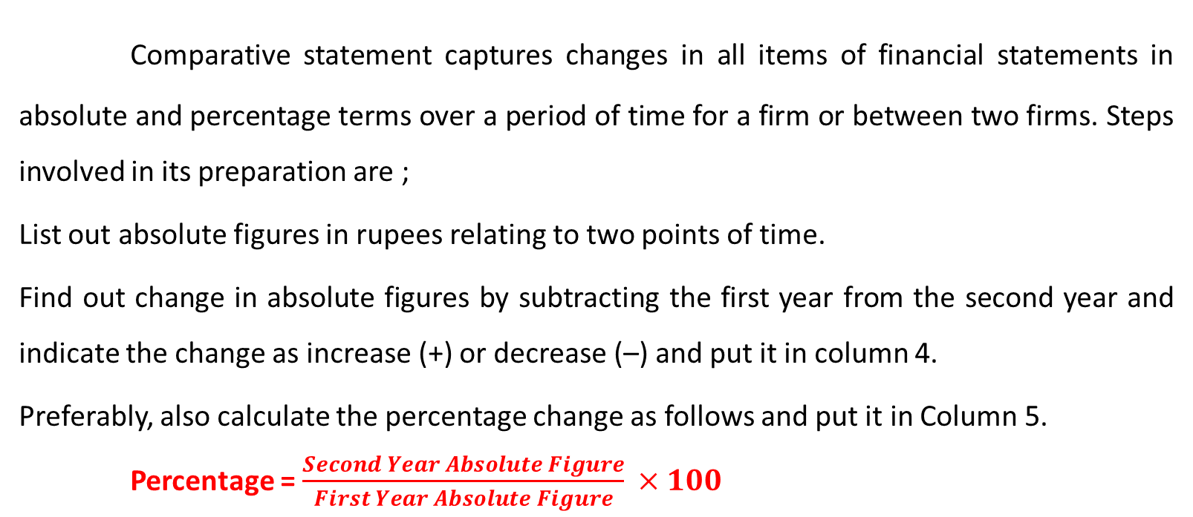
Comparative Statements
Comparative statement captures changes in all items of financial statements in absolute and percentage terms over a period of time for a firm or between two firms. Steps involved in its preparation are ;
List out absolute figures in rupees relating to two points of time.
Find out change in absolute figures by subtracting the first year from the second year and indicate the change as increase (+) or decrease (–) and put it in column 4.
Preferably, also calculate the percentage change as follows and put it in Column 5.
Percentage = $\frac{Second Year Absolute Figure}{First Year Absolute Figure} ×100$

Slide 5
Format of Comparative Statements of Profit and Loss
Particulars | First Year | Second Year | Absolute Increase (+) or Decrease (–) | Percentage Increase (+) or Decrease (–)
1 | 2 (Rs) | 3 (Rs.) | 4 (Rs) | 5 (%)
I.Revenue from operations II.Add: Other incomes III.Total Revenue (I+II) IV.Less: Total Expenses V. Profit before tax(III-IV) Less: Tax VI.Profit after tax

Slide 6
Common Size Statement
Common size statement expresses all items of a financial statement as a percentage of some common base such as revenue from operations for statement of profit and loss and total assets for balance sheet. It also known as component percentage statement. Steps involved in its preparation are ;
List out absolute figures in rupees at two points of time, say year 1, and year 2.
Choose a common base (as 100).
For all items of Col. 2 and 4 work out the percentage of that total.

Slide 7
Common Size Statement
Particulars | Absolute Amounts |  | Percentage of Net Sales
 | Year - 1 | Year – 2 | Year - 1 | Year – 2
Net Sales (Less) Cost of goods sold
Gross Profit (Less) Operating Expenses
Operating Income (Less) Non-operating Expenses
Profit

Slide 8
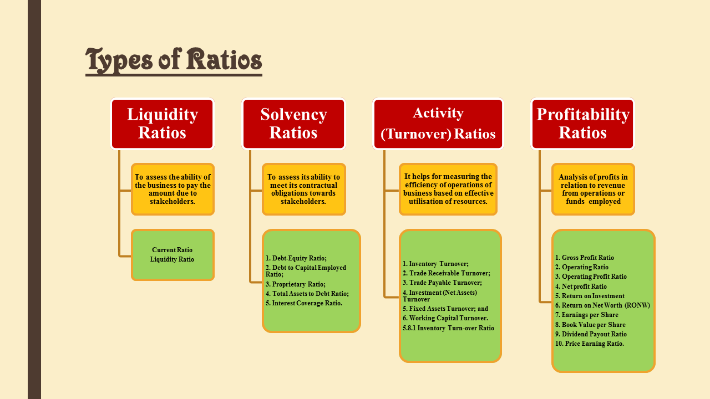
Ratio Analysis
Ratio analysis is a tool of financial analysis which involves the methods of calculating and interpreting financial ratios in order to assess the strengths and weaknesses in the performance of a business enterprise.

Slide 9
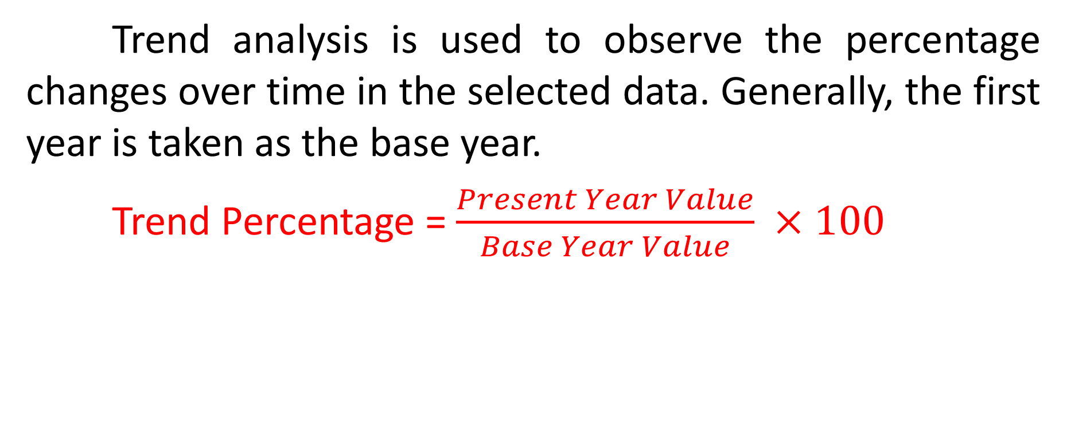
Trend Analysis
Trend analysis is used to observe the percentage changes over time in the selected data. Generally, the first year is taken as the base year.
Trend Percentage = $\frac{Present Year Value}{Base Year Value} ×100$

Slide 10
Cash Flow Analysis
Cash Flows
Cash from Operating Activities
Cash from Financing Activities
Cash from Investing Activities
It refers to the analysis of actual movement of cash into and out of an organization.

Slide 11
THANKING YOU
ODM EDUCATIONAL GROUP

