Slide 1


LIFELINES OF NATIONAL ECONOMY
INTRODUCTION
SUBJECT : GEOGRAPHY
CHAPTER NUMBER: 07
CHAPTER NAME : LIFELINES OF NATIONAL ECONOMY

Slide 2
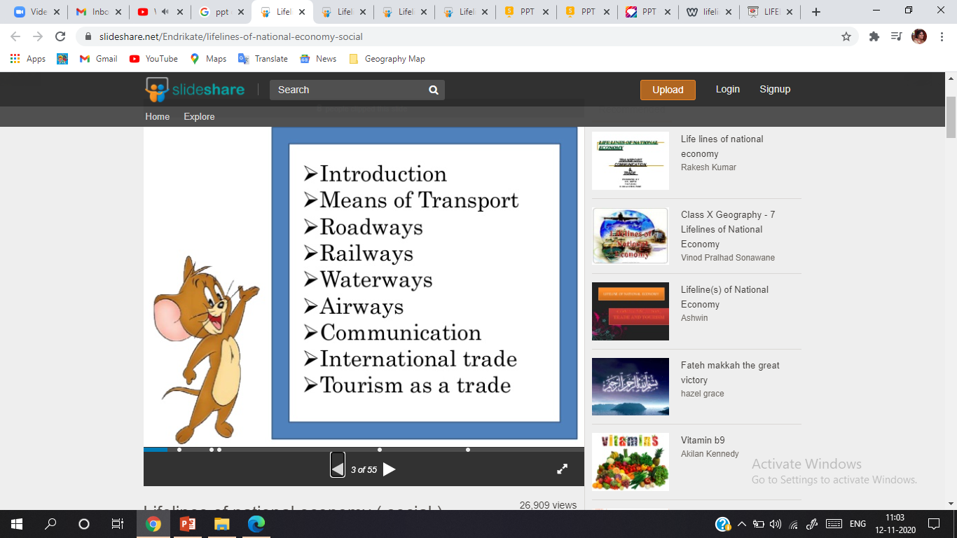
CONTENT

Slide 3
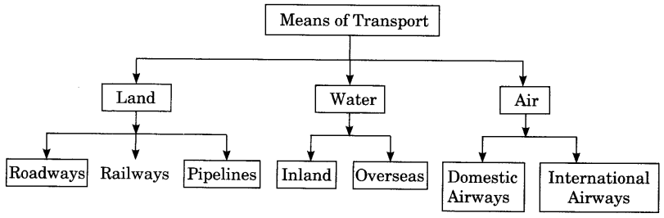
INTRODUCTION
MEANS OF TRANSPORT AND ITS ROLE
Goods and services do not move from supply locales to demand locales on their own. The movement of these goods and services from their supply locations to demand locations necessitates the need for transport.
Efficient means of transport are pre-requisites for fast development.
Modern means of transport and communication serve as life lines of our nation and its modern economy.

Slide 4
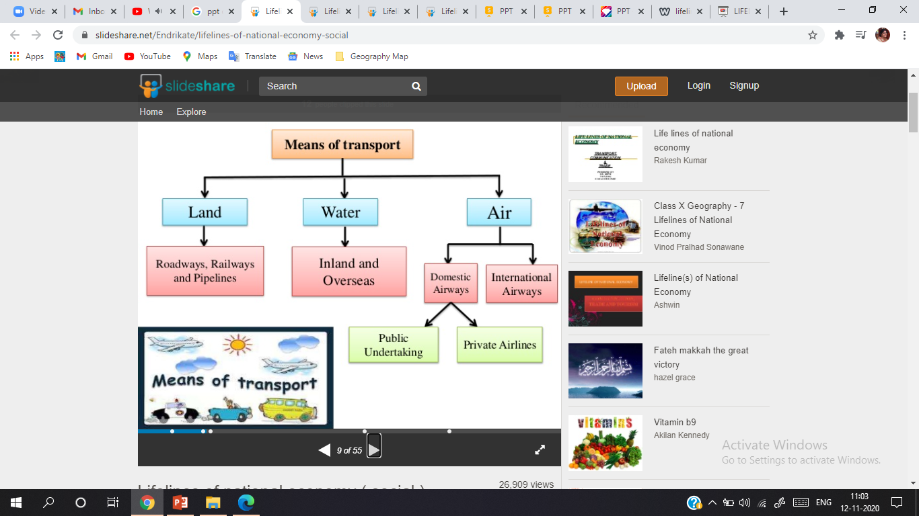

Slide 5
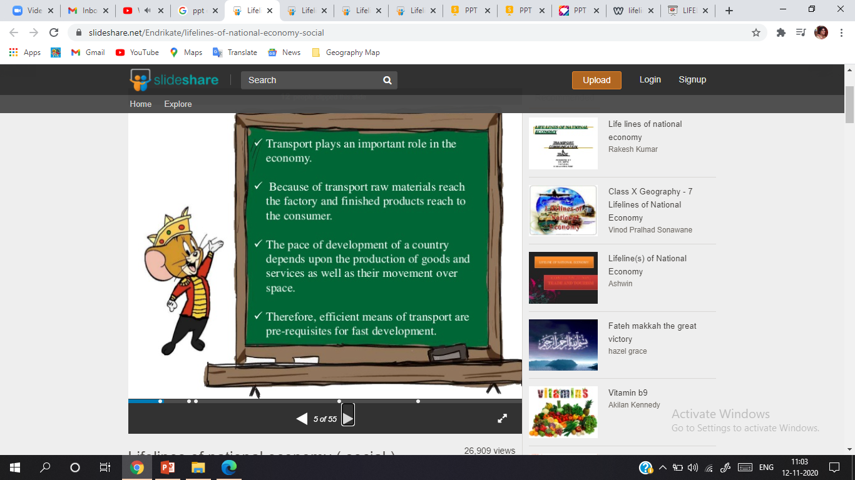

Slide 6
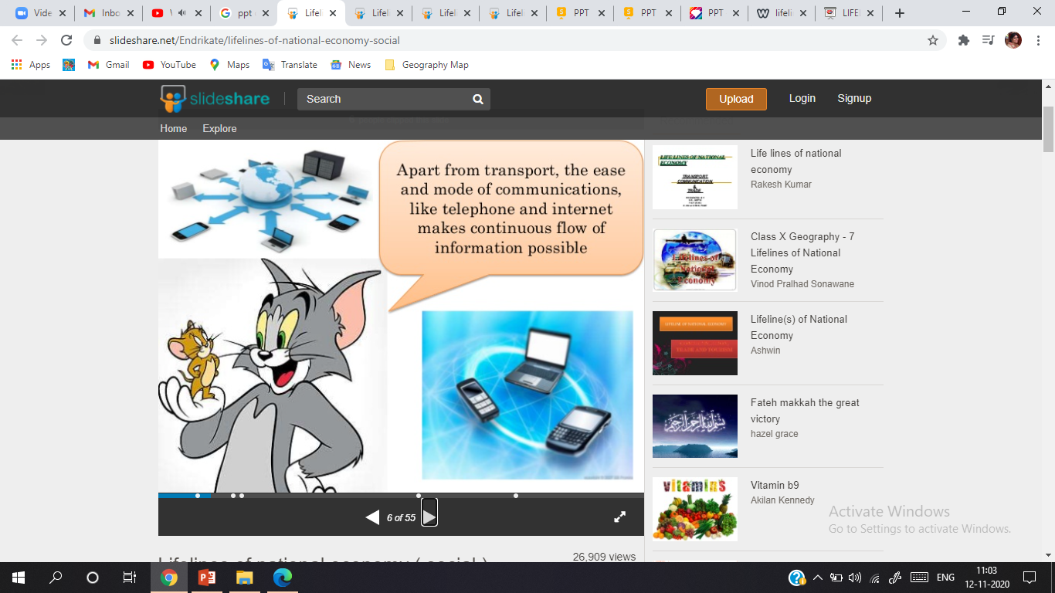

Slide 7
TRANSPORT
ROADWAYS
India has one of the largest road networks in the world, aggregating to about 2.3 million km at present. In India, roadways have preceded railways. They still have an edge over railways in view of the ease with which they can be built and maintained.
The growing importance of road transport vis-à-vis rail transport is rooted in the following reasons;
construction cost of roads is much lower than that of railway lines,
roads can traverse comparatively more dissected and undulating topography,
roads can negotiate higher gradients of slopes and as such can traverse mountains such as the Himalayas,
road transport is economical in transportation of few persons and relatively smaller amount of goods over short distances,
It also provides door-to-door service, thus the cost of loading and unloading is much lower,
road transport is also used as a feeder to other modes of transport such as they provide a link between railway stations, air and sea ports.
In India, roads are classified in the following six classes according to their capacity. Look at the map of the National Highways and find out about the significant role played by these roads.

Slide 8
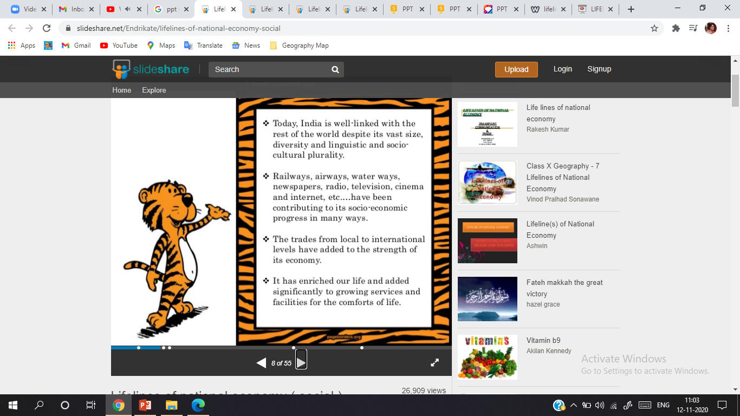

Slide 9
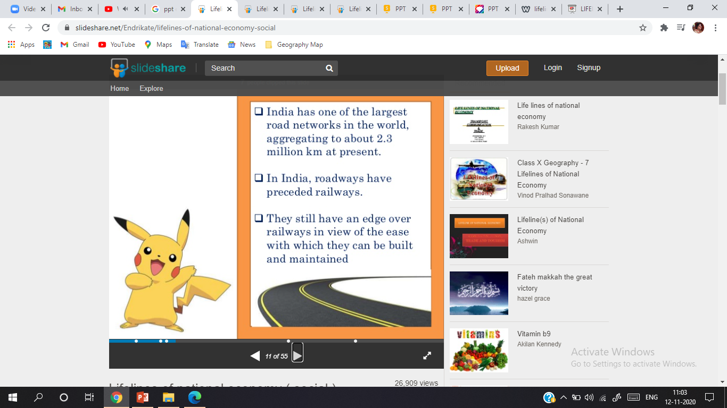

Slide 10
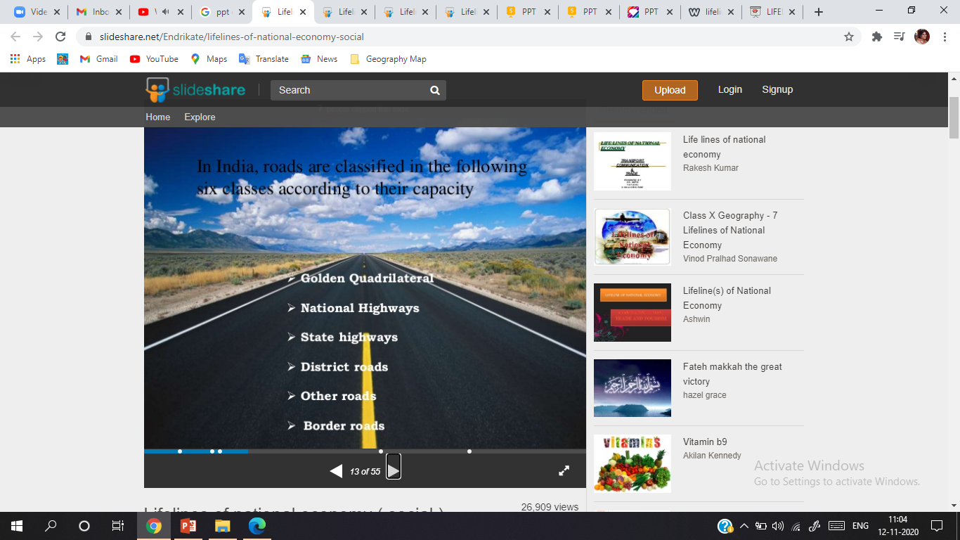

Slide 11
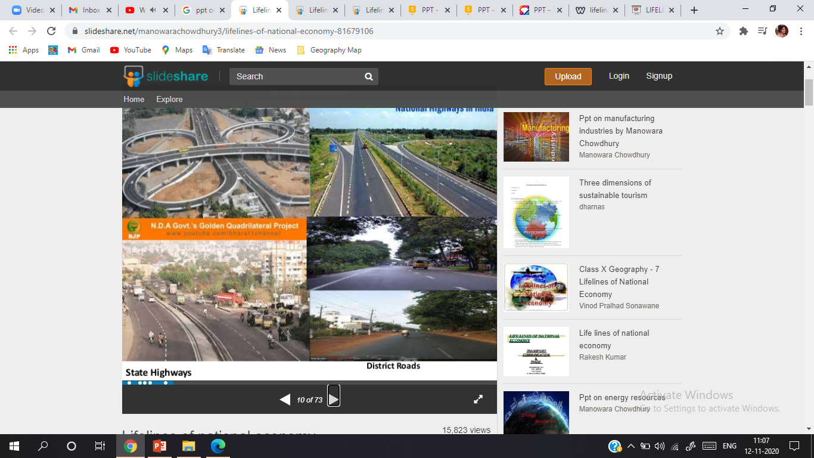
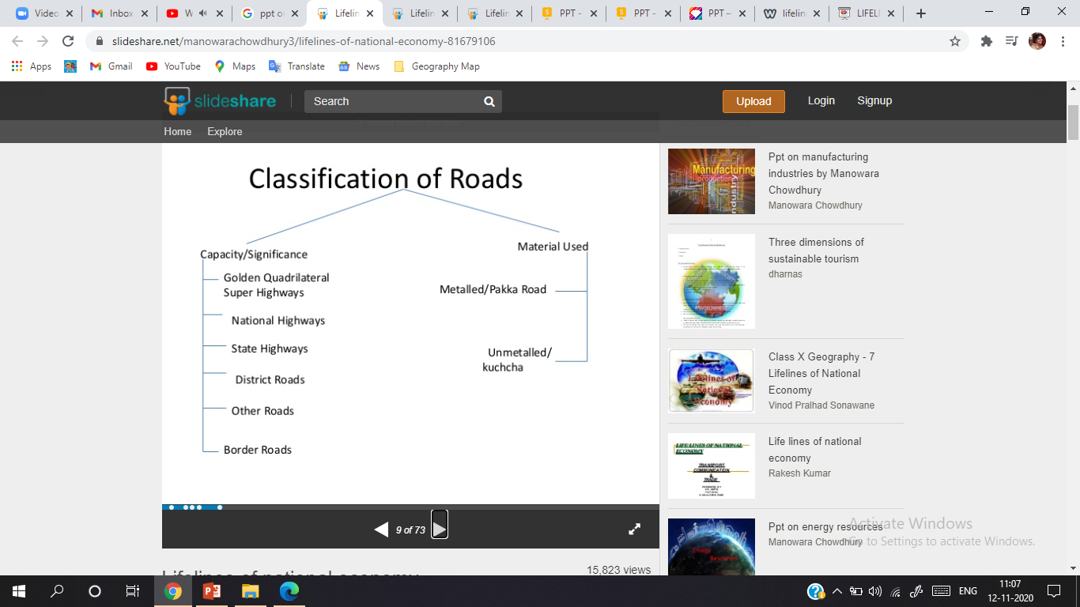
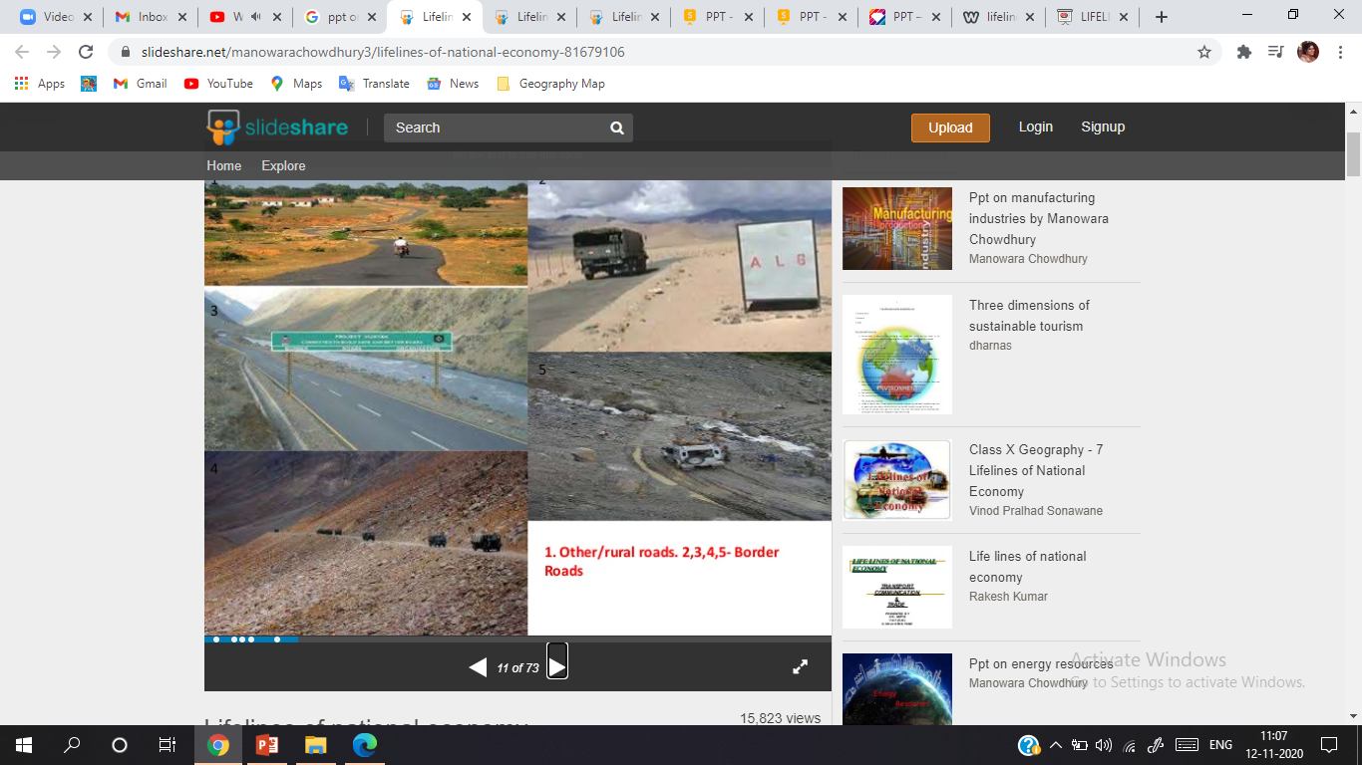

Slide 12
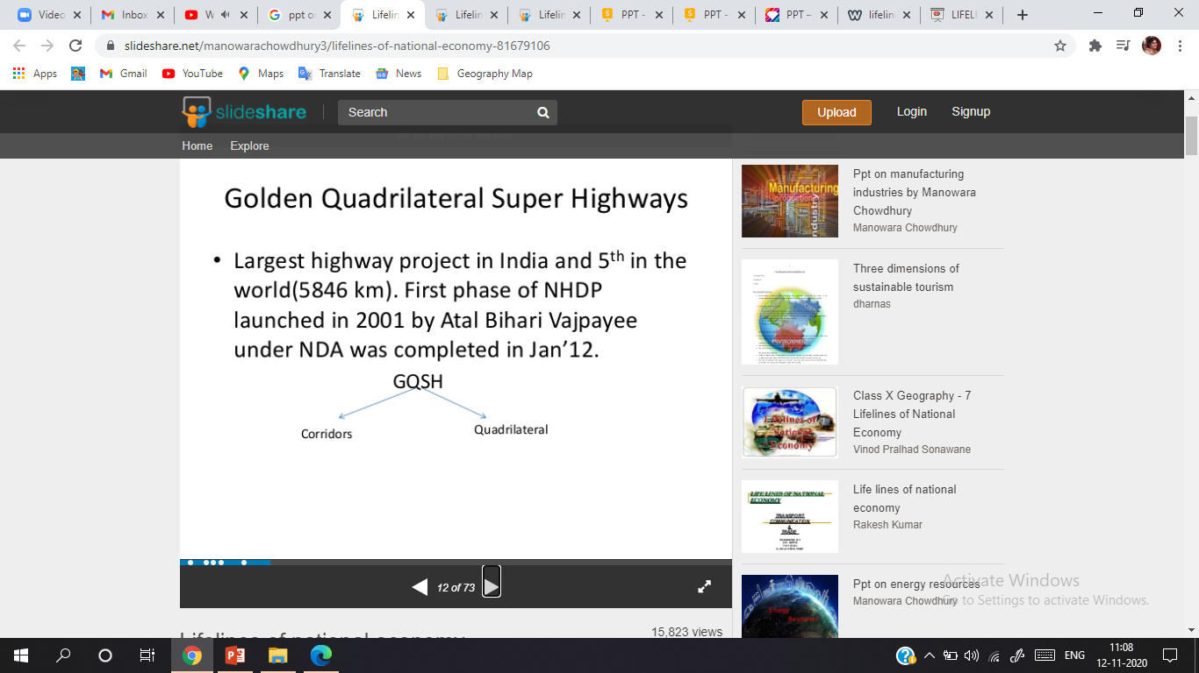
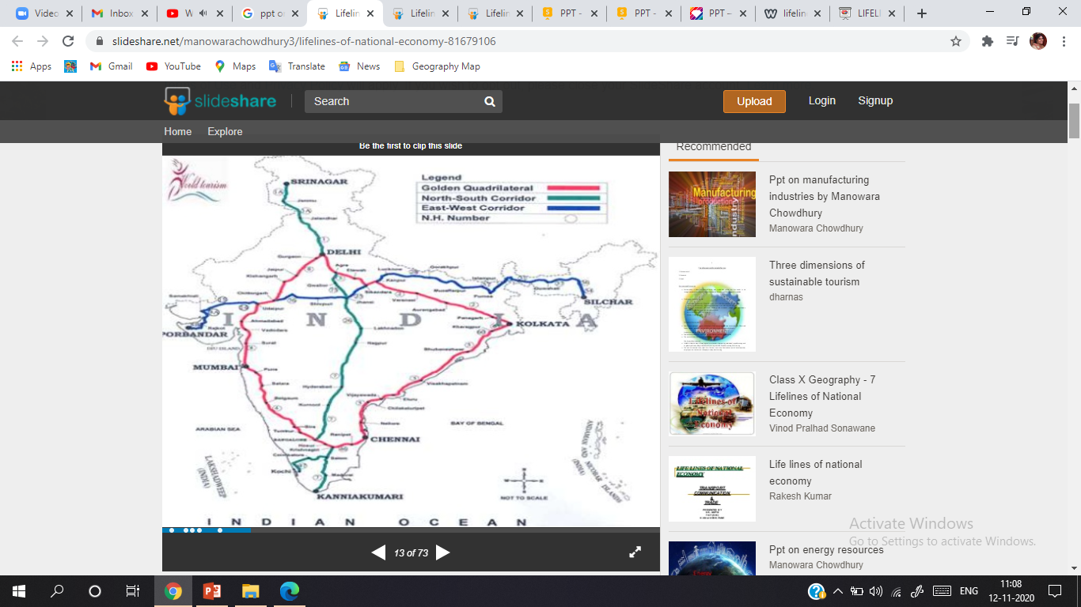

Slide 13
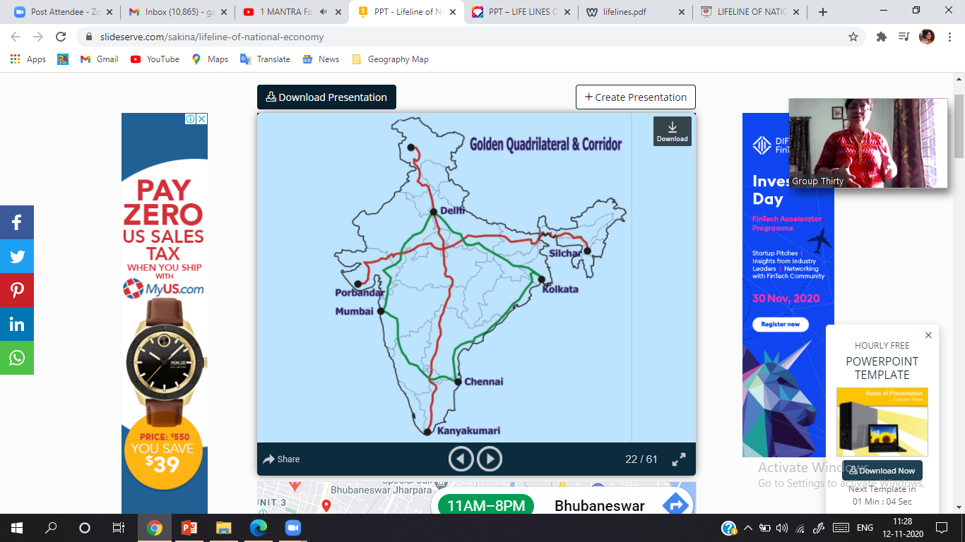
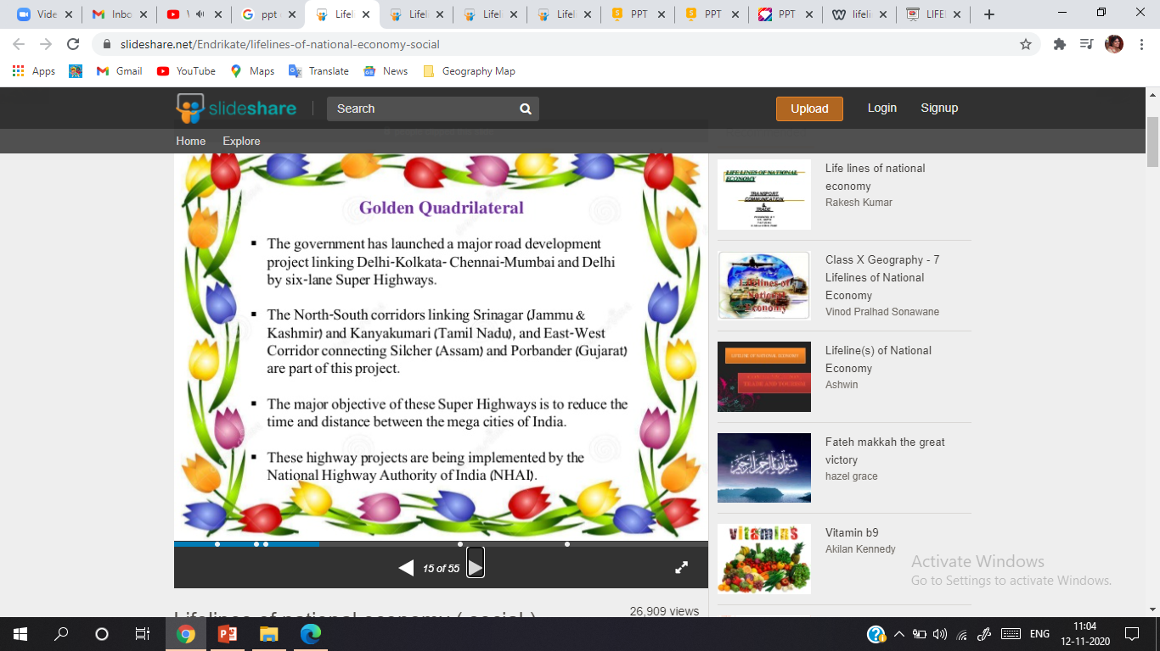

Slide 14
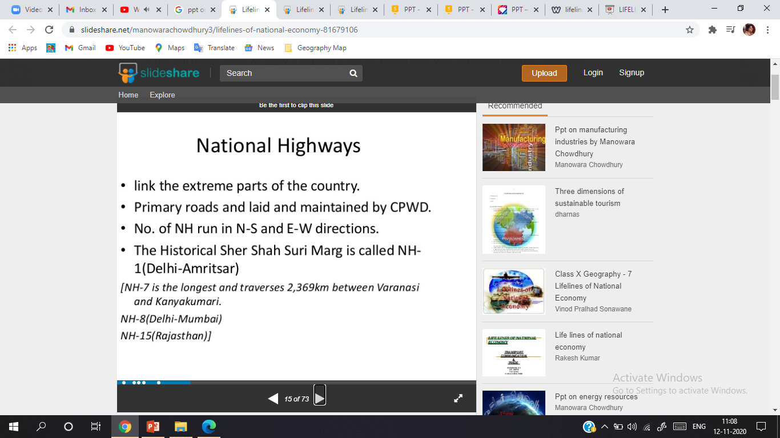
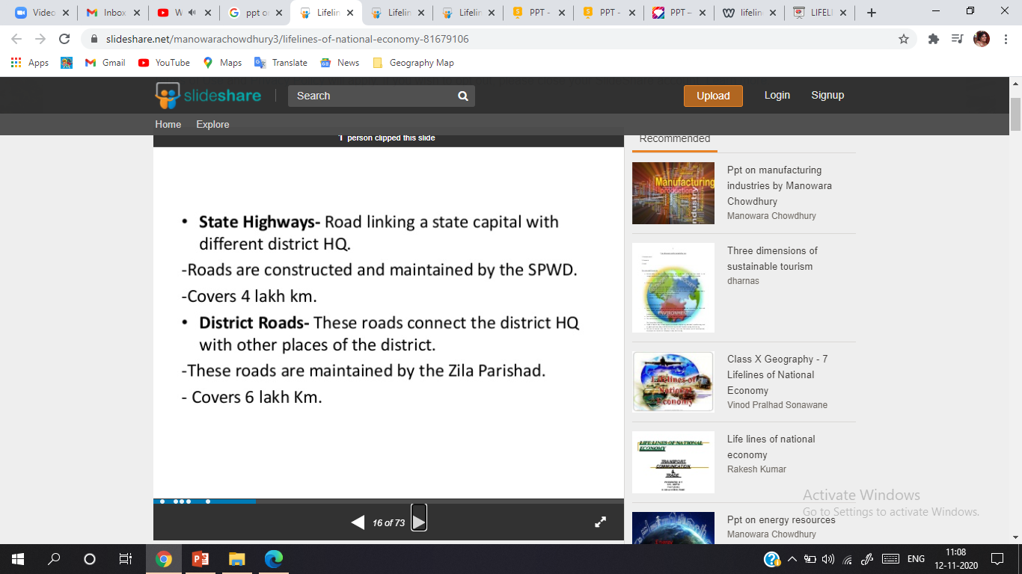

Slide 15
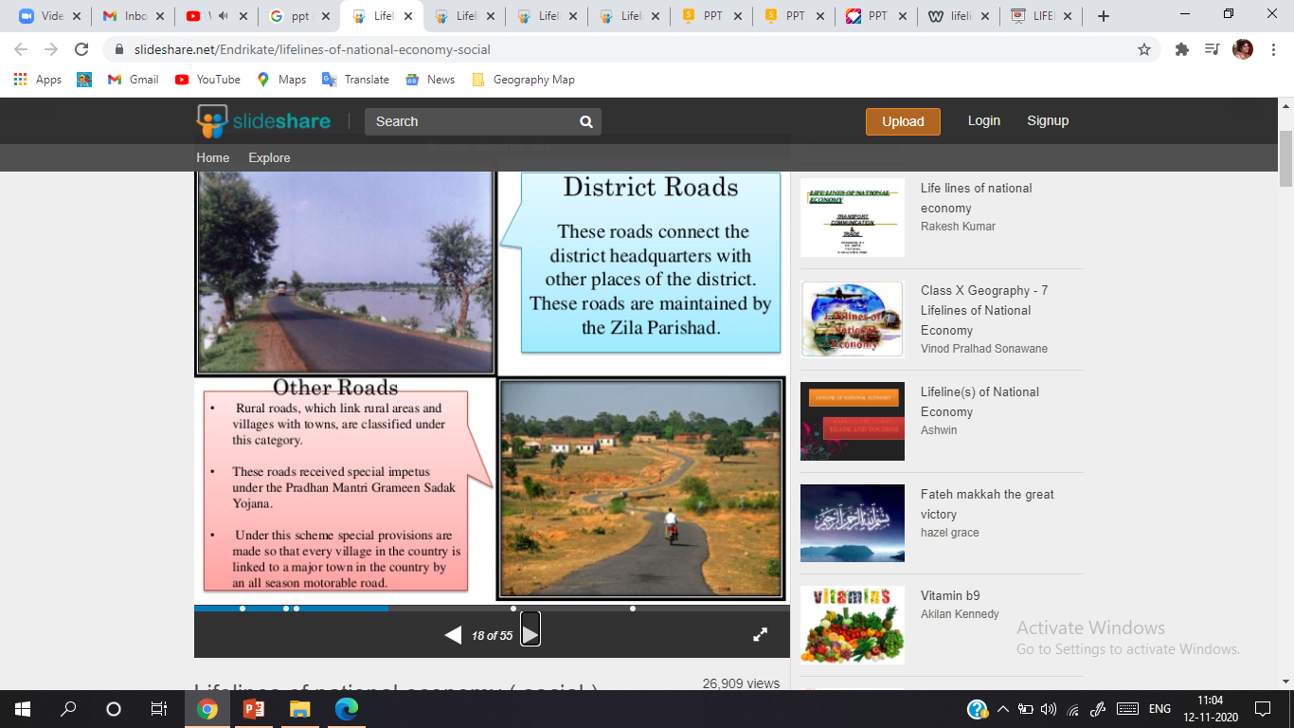

Slide 16
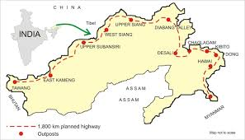
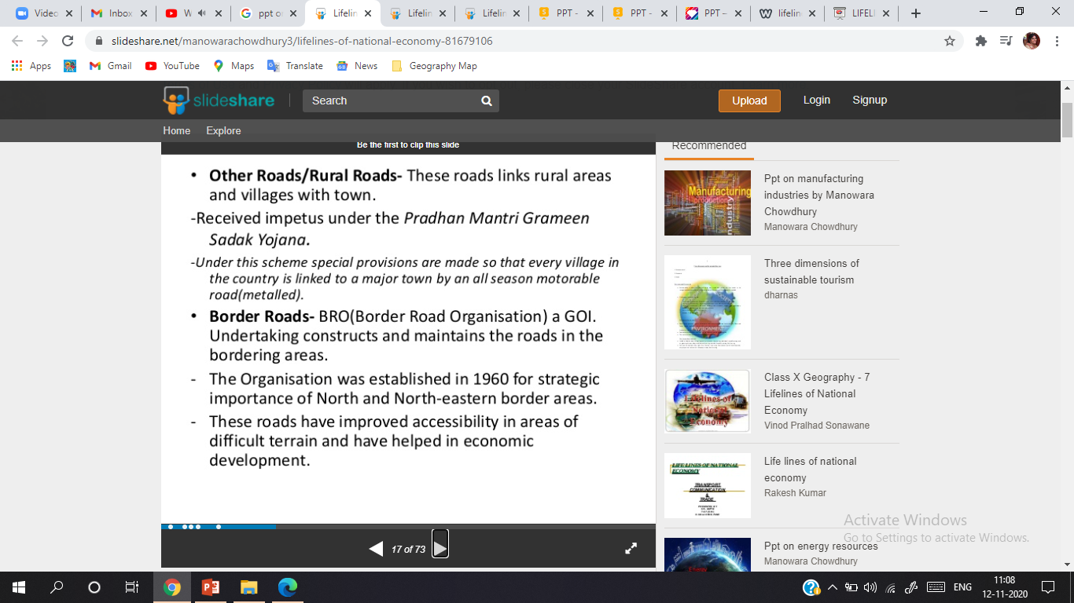

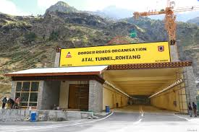

Slide 17

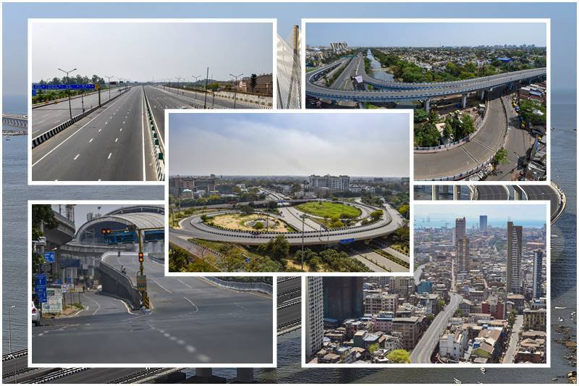
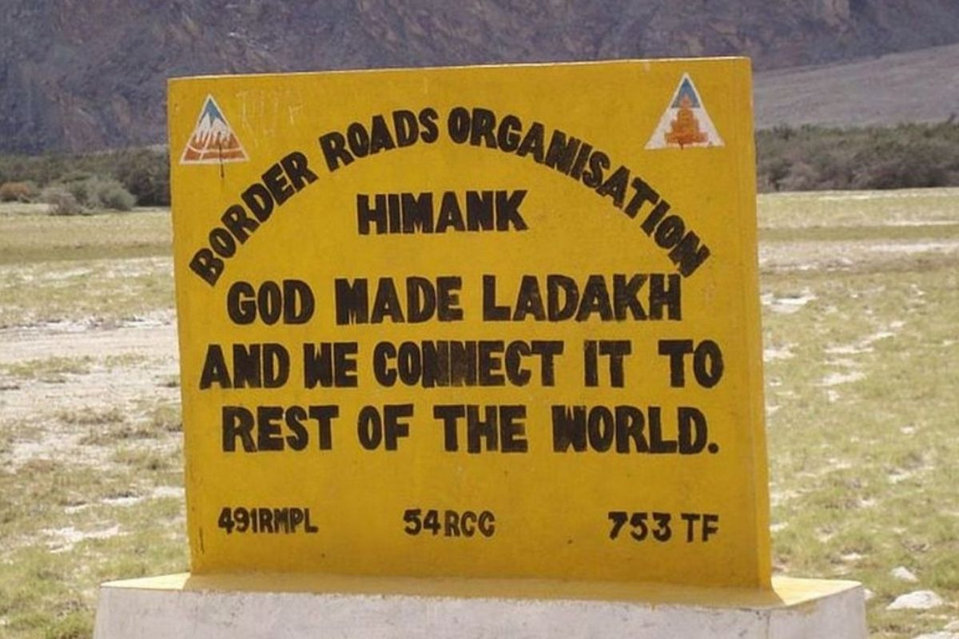
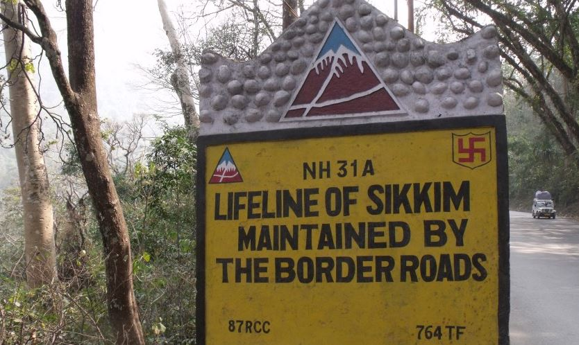

Slide 18
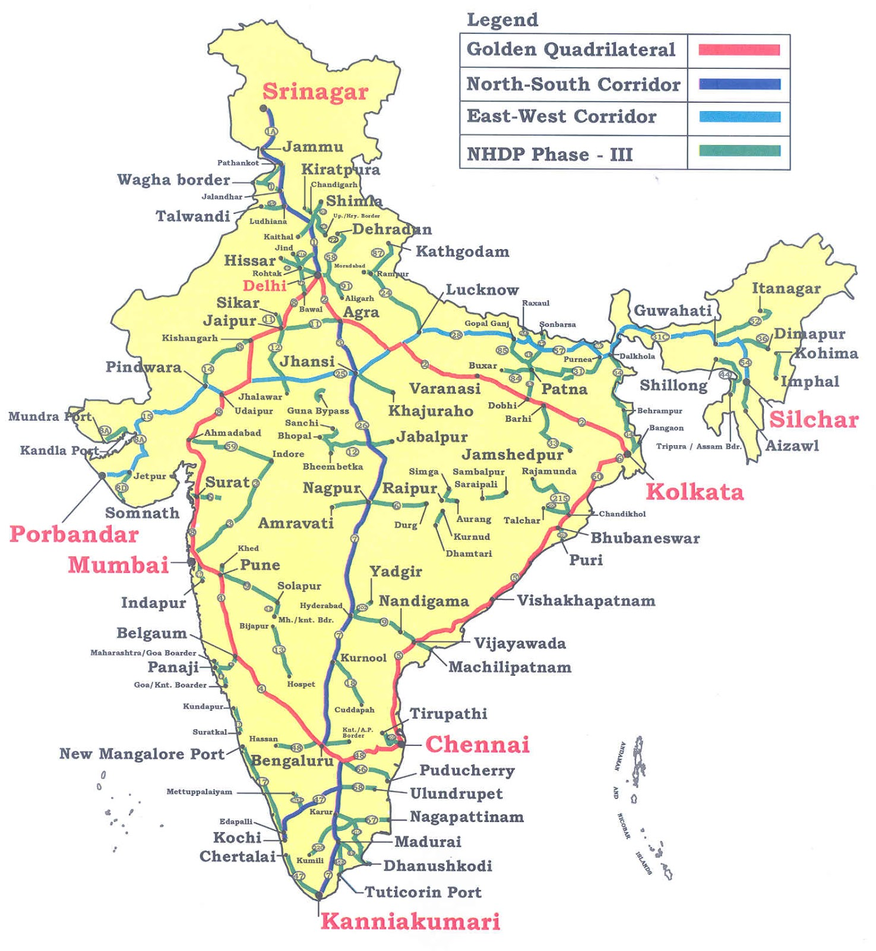
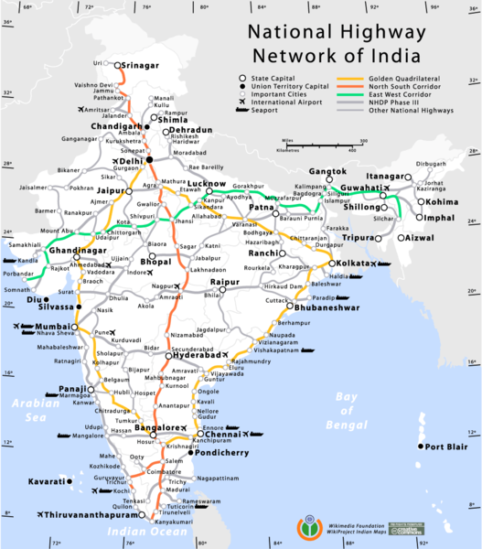

Slide 19
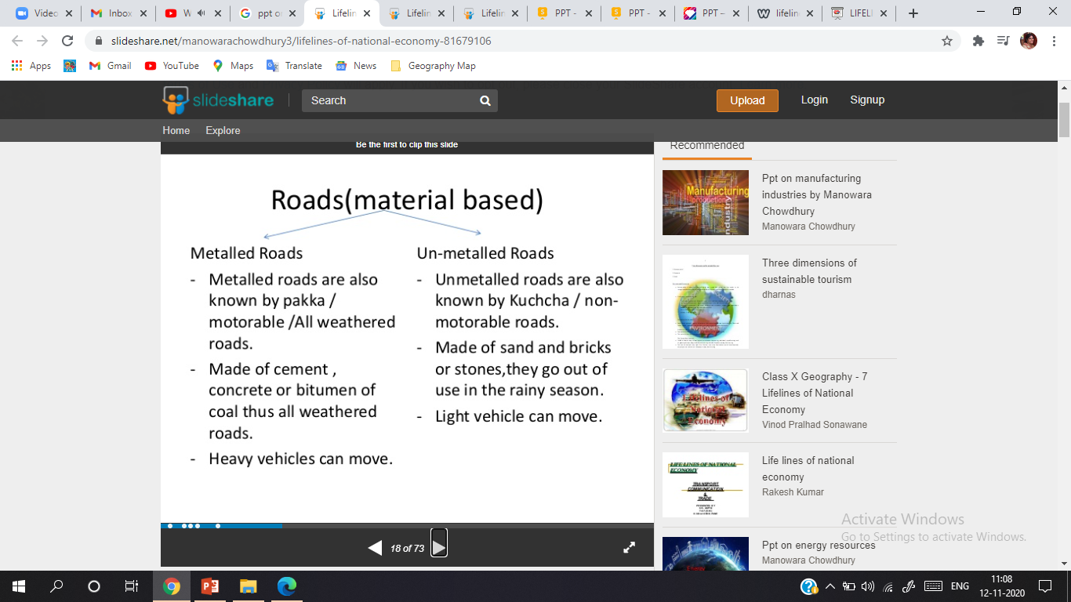
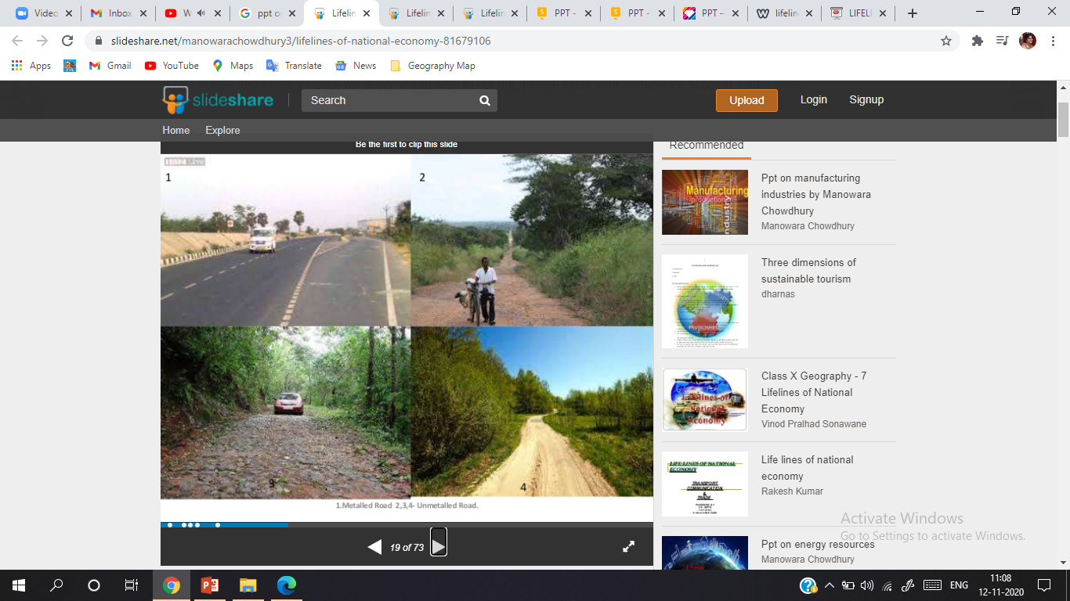
https://www.youtube.com/watch?v=KZUrc4xAXyY

Slide 20
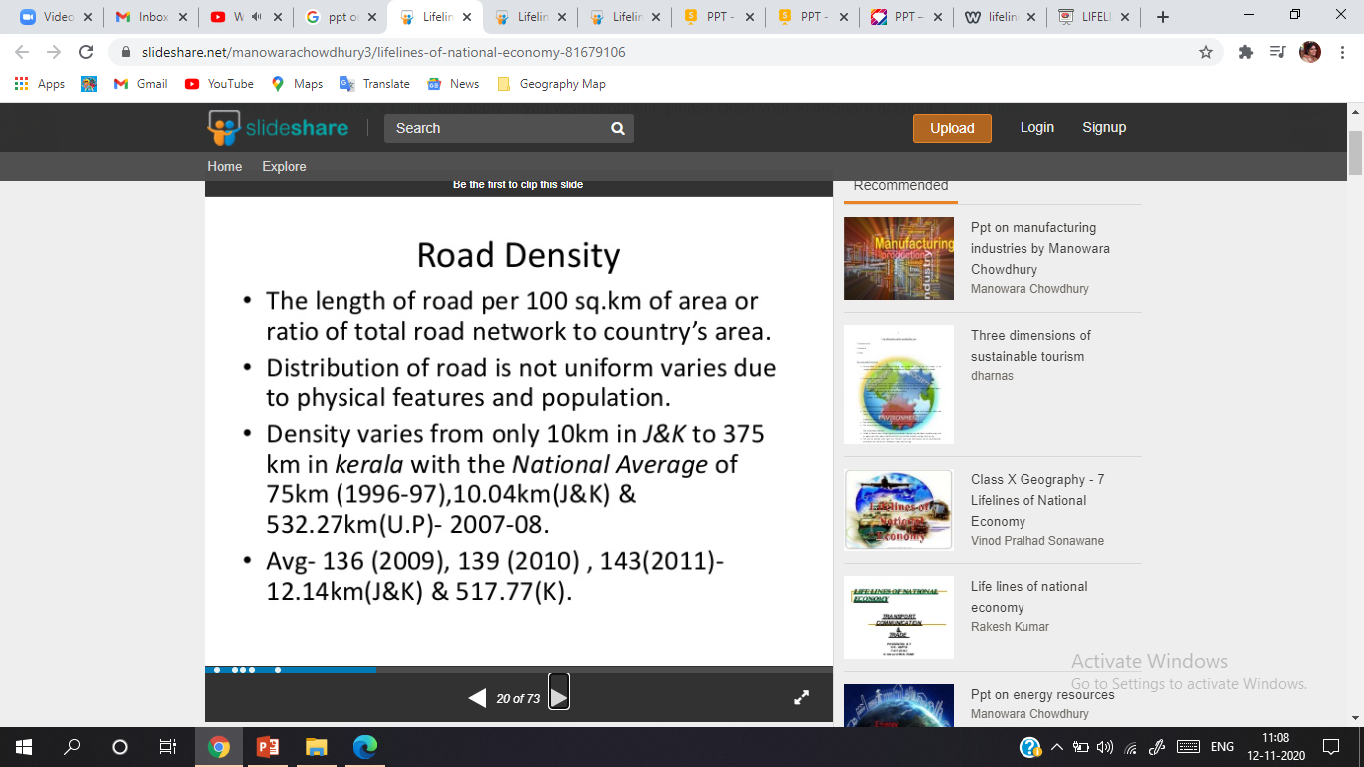
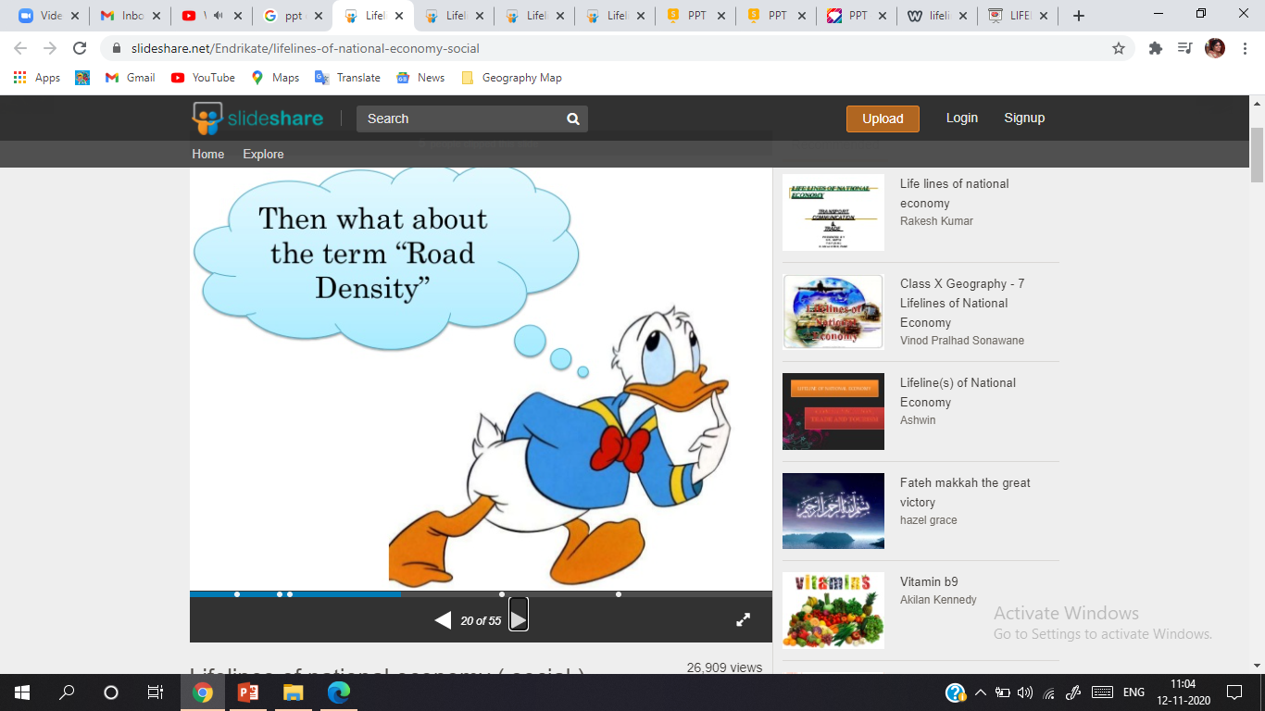

Slide 21
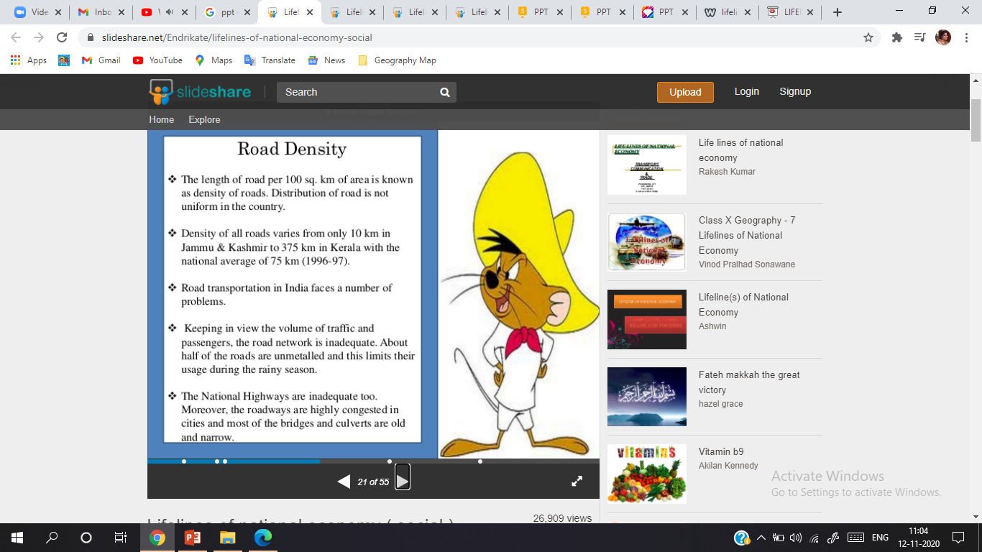

Slide 22
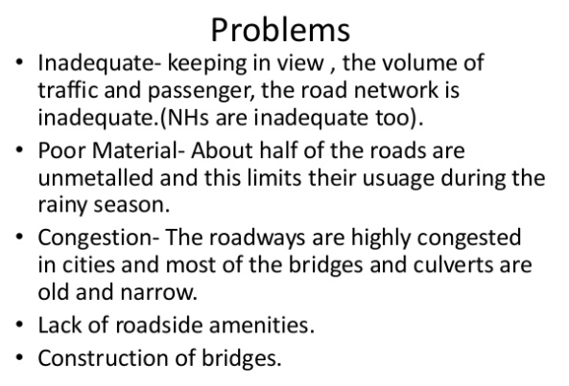
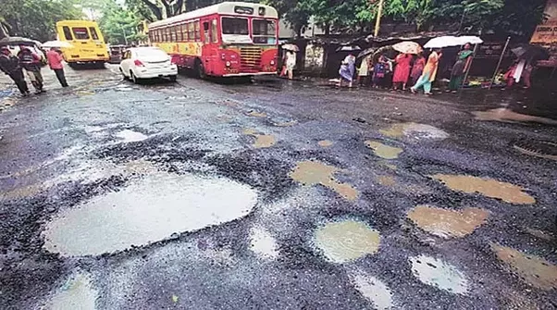
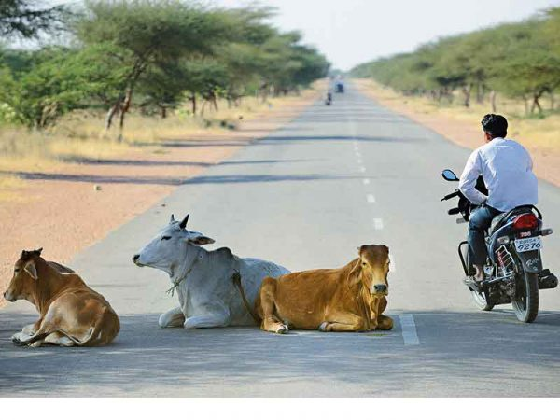
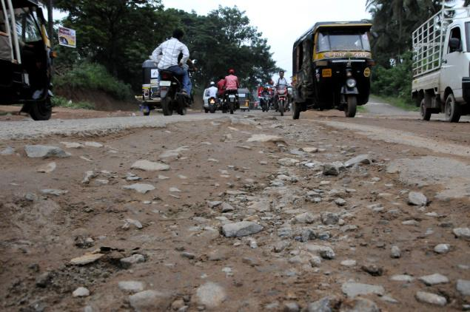
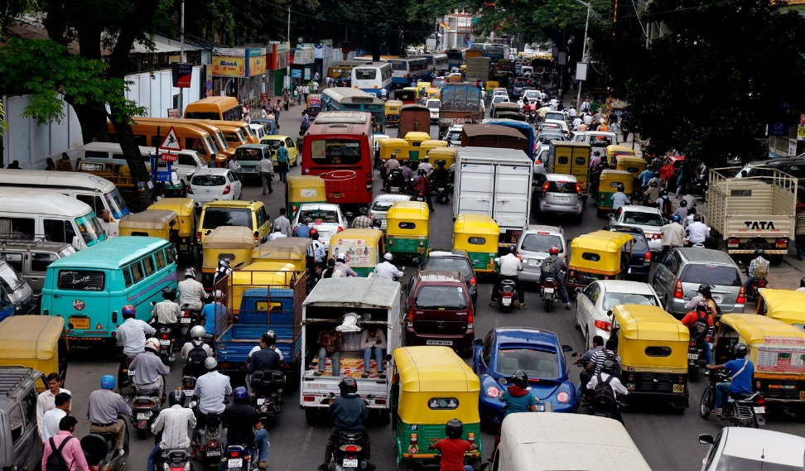

Slide 23
https://www.youtube.com/watch?v=5lX8vXJ_qf8 e-expressways

Slide 24
THANKING YOU
ODM EDUCATIONAL GROUP

Slide 25
LIFELINES OF NATIONAL ECONOMY
INTRODUCTION
SUBJECT : GEOGRAPHY
CHAPTER NUMBER: 07
CHAPTER NAME : LIFELINES OF NATIONAL ECONOMY

Slide 26
CONTENT

Slide 27
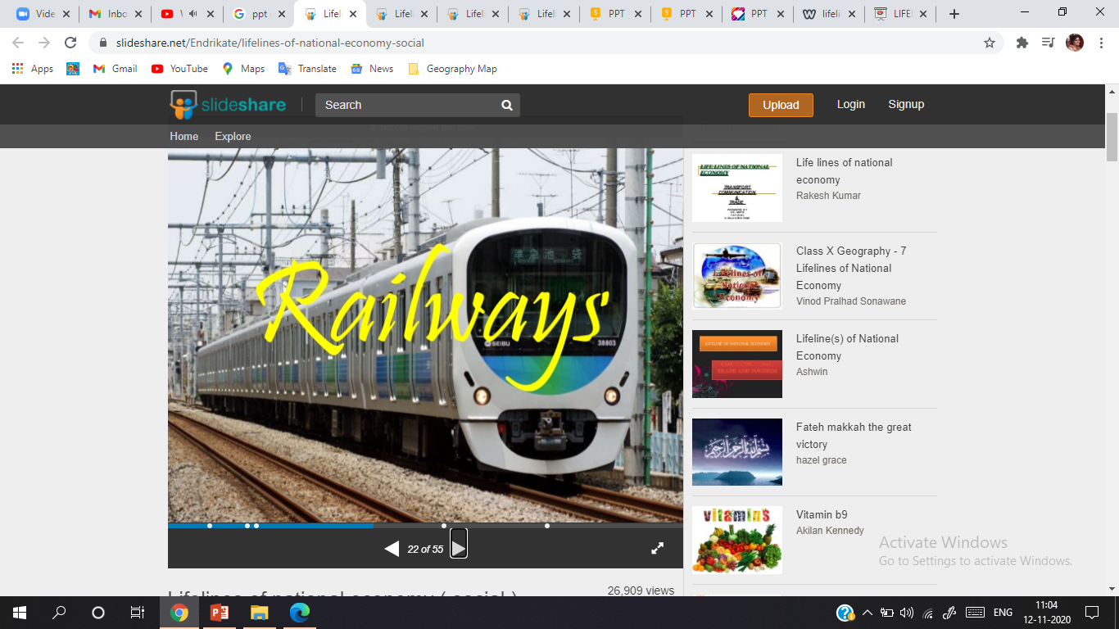

Slide 28
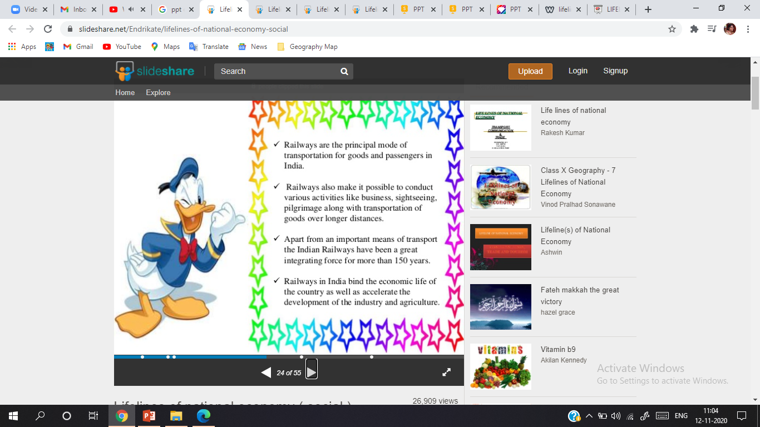

Slide 29
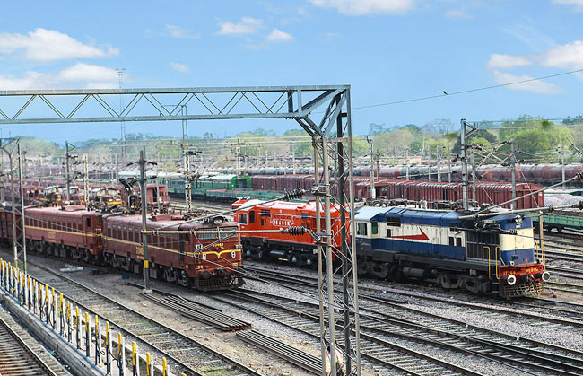
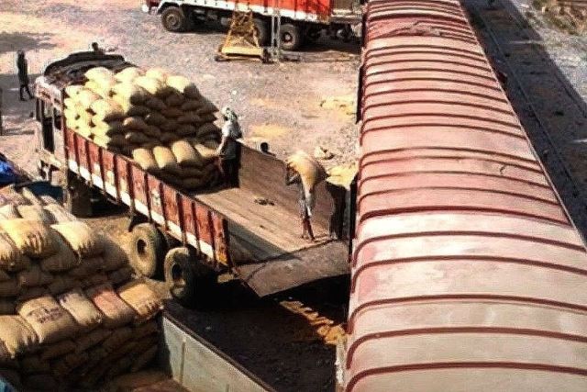
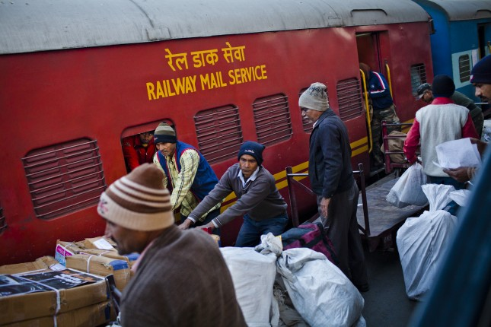
ADVANTAGES :-
Principal mode of transportation for freight and passengers in India.
Multifarious activities- Business, Sightseeing, Pilgrimage (Supports Tourism)
Mobile services- connecting far-off places.
Distance and heavy loads (Comfortable carrier)
Inexpensive services.
Saves Time
Enhances domestic trade.
Connects Industrial Production Centres and Market
Generates employment (6%)
Revenue- 1%

Slide 30
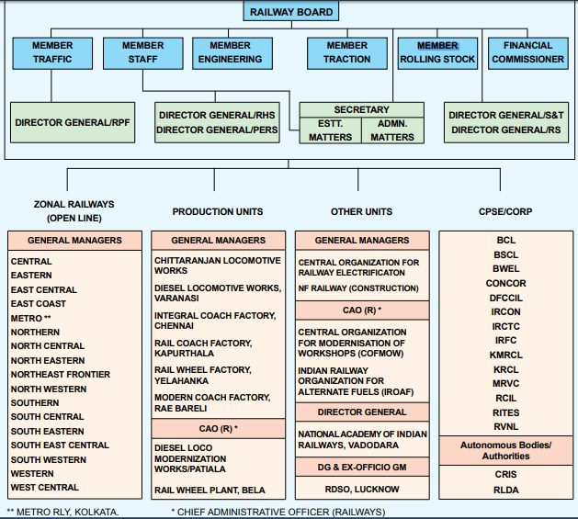

Slide 31
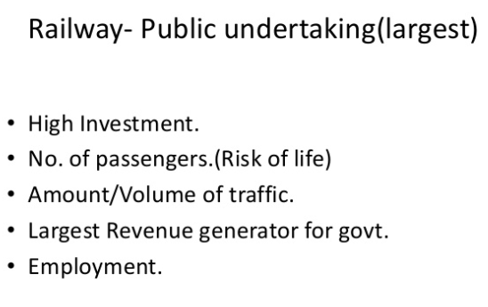
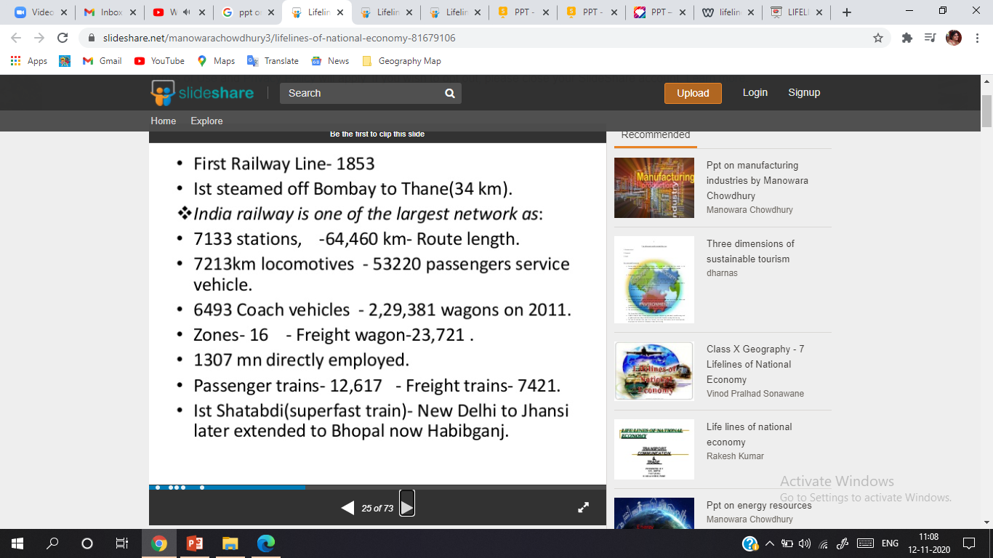
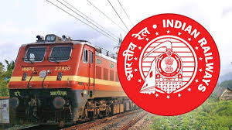

Slide 32
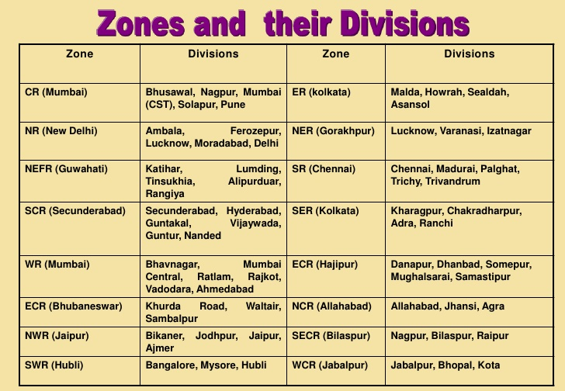

Slide 33
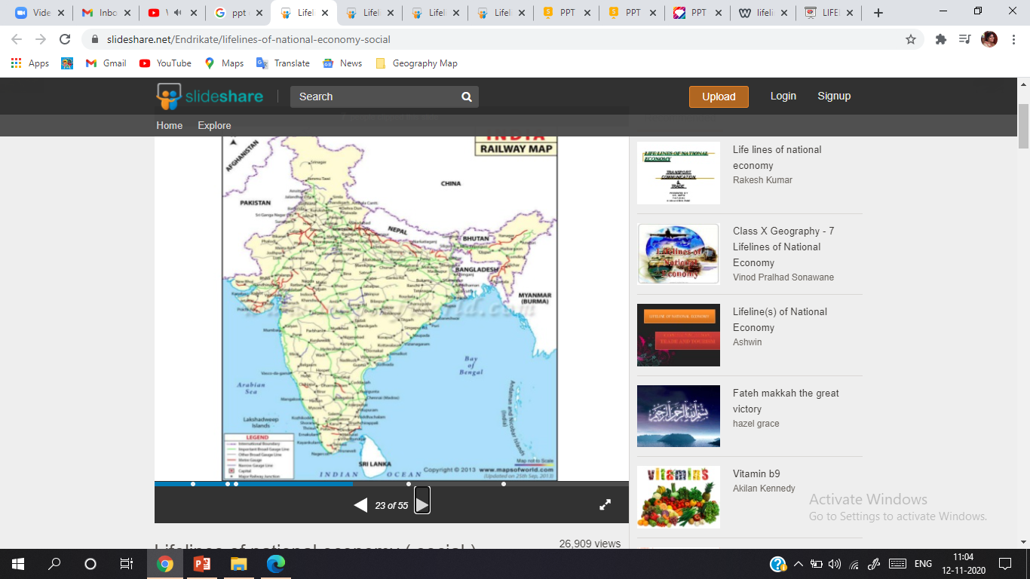
The Indian Railways is the largest public sector undertaking in the country. The first train steamed off from Mumbai to Thane in 1853, covering a distance of 34 km.
The Indian Railway is now reorganized into 16 zones.

Slide 34
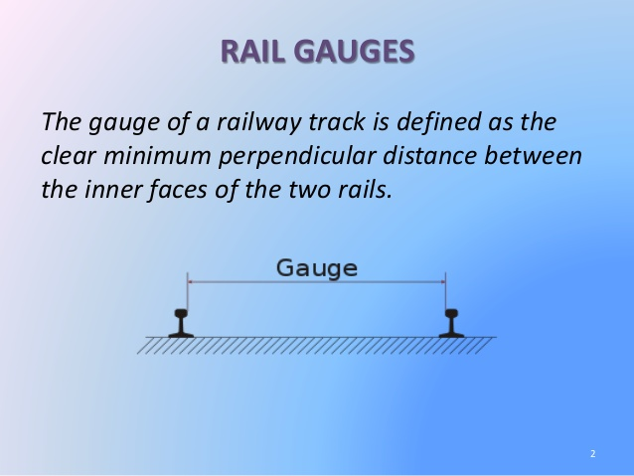
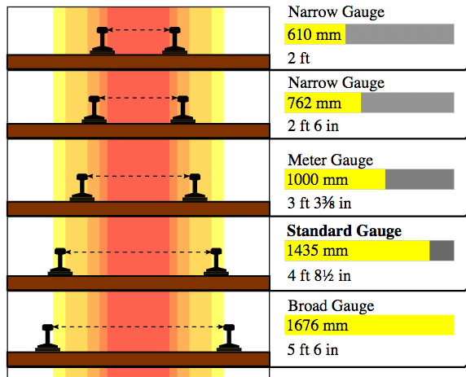
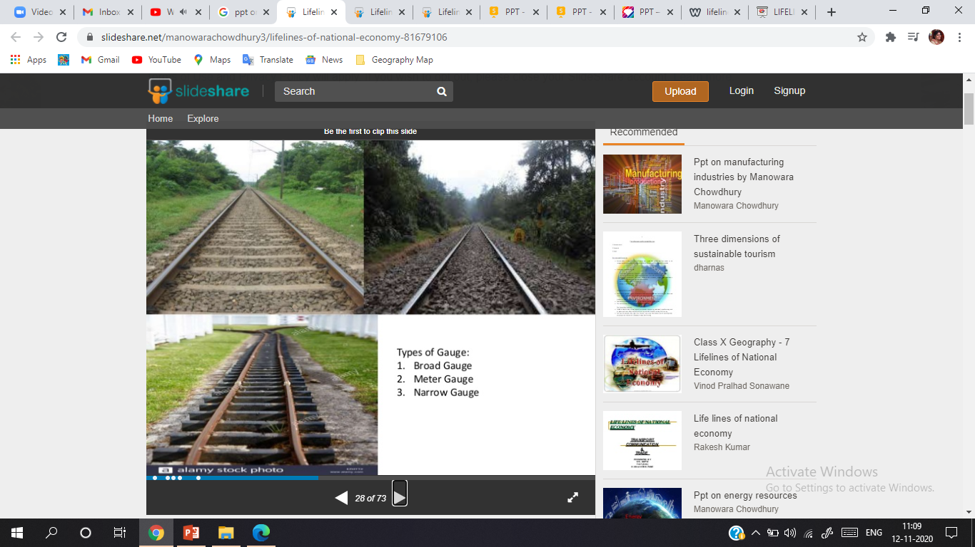

Slide 35



Slide 36



Slide 37






Slide 38





Slide 39



Slide 40
THANKING YOU
ODM EDUCATIONAL GROUP

Slide 41
LIFELINES OF NATIONAL ECONOMY
INTRODUCTION
SUBJECT : GEOGRAPHY
CHAPTER NUMBER: 07
CHAPTER NAME : LIFELINES OF NATIONAL ECONOMY

Slide 42

TRANSPORT
PIPELINES
Pipeline transport network is a new arrival on the transportation map of India.
The far inland locations of refineries like Barauni, Mathura, Panipat and gas based fertilizer plants could be thought of only because of pipelines.
Initial cost of laying pipelines is high but subsequent running costs are minimal.
It rules out trans-shipment losses or delays.

Slide 43

There are three important networks of pipeline transportation in the country:-
From oil field in upper Assam to Kanpur (Uttar Pradesh), via Guwahati, Barauni and Allahabad. It has branches from Barauni to Haldia, via Rajbandh, Rajbandh to Maurigram and Guwahati to Siliguri.
From Salaya in Gujarat to Jalandhar in Punjab, via Viramgam, Mathura, Delhi and Sonipat. It has branches to connect Koyali (near Vadodara, Gujarat) Chakshu and other places.
Gas pipeline from Hazira in Gujarat connects Jagdishpur in Uttar Pradesh, via Vijaipur in Madhya Pradesh. It has branches to Kota in Rajasthan, Shahajahanpur, Babrala and other places in Uttar Pradesh.

Slide 44



Slide 45



Slide 46



Slide 47



Slide 48

WATERWAYS
The Ganga river between Allahabad and Haldia (1620 km)-N.W. No.1
The Brahmaputra river between Sadiya and Dhubri (891 km)-N.W. No.2
The West-Coast Canal in Kerala (Kottapurma-Komman, Udyogamandal and Champakkara canals-205 km) – N.W. No.3
Other inland waterways include Godawari, Krishna, Barak, Sunderbans, Buckingham Canal, Brahmani, East-West Canal and Damodar Valley Corporation Canal.

Slide 49


Slide 50


https://www.youtube.com/watch?v=d4nqJAkpmL4

Slide 51

National Waterway 2 (NW-2) is a section of the Brahmaputra River having a length of 891 km between the Bangladesh border near Dhubri and Sadiya in Assam.
It was declared as National Waterway No. 2 on 1 September 1988.

Slide 52

The West Coast Canal or National Waterway No 3 is a 168-km stretch of this inland navigational route located in Kerala and runs from Kollam to Kottapuram and was declared a National Waterway in 1993.
In addition to the main stretch, Champakara and Udyogmandal canals are navigable and connect the industrial centers of Kochi to Kochi port Inland Waterways Authority of India (IWAI) under the Ministry of Shipping is coordinating the task for developing, monitoring and administering national waterways.
It is the first National Waterway in the country with 24-hour navigation facilities along the entire stretch.

Slide 53

National Waterway 4 (NW-4) is a 1,095 kilometers (680 mi) long.
It connects the Indian states of Telangana, Andhra Pradesh, Tamil Nadu, and the union territory of Puducherry.
The NW-4 runs along the Coromandal Coast through Kakinada, Eluru, Commanur, Buckingham Canals and also through part of Krishna and Godavari rivers in South India.
The National Waterways Act, 2016 has extended the length of NW-4 from 1,078 km (670 mi) to 2,890 km (1,800 mi) by connecting the Krishna and Godavari Rivers.

Slide 54


Slide 55

National Waterway 5 (NW-5) is one of six National Waterways in India and it covers the state of Odisha and a part of West Bengal.
It runs a total length of 623 km of which 91 km is within West Bengal and the remaining 532 km is in Odisha.
It was declared a National Waterway in November 2008.
The NW-5 consists of the stretches from Talcher to Dhamra on the Brahmani River a distance of 265 km including the Kharsua and Dhamra river systems, the Geonkhali–Charbatia stretch of the East Coast Canal of 217 km, the Charbatia–Dhamra stretch of Matai River of 40 km and the Mangalgadi–Paradip stretch of the Mahanadi River Delta running for 101 km.
The waterway also includes a 91 km stretch in Bengal between Geonkhali and Nasirabad, West Bengal.

Slide 56

National Waterways 6 is a waterway between Lakhipur and Bhanga of the Barak River.
This was announced in the Budget 2013–14.
The Inland Waterways Authority of India will be integrating the waterways in the northeast and helping cargo transport through Assam, Nagaland, Mizoram, Manipur, Tripura and Arunachal Pradesh.

Slide 57


Slide 58



Slide 59



Slide 60



Slide 61



Slide 62

The other viable inland waterways include the Godavari, Krishna, Barak, Sunderbans, Buckingham Canal, Brahmani, East-west Canal and Damodar Valley Corporation Canal.
India’s trade with foreign countries is carried from the ports located along the coast.
95 per cent of the country’s trade volume (68 per cent in terms of value) is moved by sea.

Slide 63




Kandla in Kuchchh was the first port developed soon after Independence to ease the volume of trade on the Mumbai port, in the wake of loss of Karachi port to Pakistan after the Partition. Kandla is a tidal port. It caters to the convenient handling of exports and imports of highly productive granary and industrial belt stretching across the states of Jammu and Kashmir, Himachal Pradesh, Punjab, Haryana, Rajasthan and Gujarat.

Slide 64




Mumbai is the biggest port with a spacious natural and well-sheltered harbour.
The Jawaharlal Nehru port was planned with a view to decongest the Mumbai port and serve as a hub port for this region.

Slide 65


Marmagao port (Goa) is the premier iron ore exporting port of the country. This port accounts for about fifty per cent of India’s iron ore export.

Slide 66


New Mangalore port, located in Karnataka caters to the export of iron ore concentrates from Kudremukh mines.

Slide 67


Kochi is the extreme south-western port, located at the entrance of a lagoon with a natural harbour.

Slide 68


Slide 69
The extreme south-eastern port of India, Tuticorin(Tamil Nadu). This port has a natural harbour and rich hinterland. Thus, it has a flourishing trade handling of a large variety of cargoes to even our neighboring countries like Sri Lanka, Maldives, etc. and the coastal regions of India.
Chennai is one of the oldest artificial ports of the country. It is ranked next to Mumbai in terms of the volume of trade and cargo.
Vishakhapatnam is the deepest landlocked and well-protected port. This port was, originally, conceived as an outlet for iron ore exports.
Paradip port located in Orissa, specializes in the export of iron ore.
Kolkata is an inland riverine port. This port serves a very large and rich hinterland of Ganga- Brahmaputra basin. Being a tidal port, it requires constant dredging of Hoogly.
Haldia port was developed as a subsidiary port, in order to relieve growing pressure on the Kolkata port.

Slide 70



Slide 71


Slide 72




Slide 73




Slide 74




Slide 75


Slide 76
THANKING YOU
ODM EDUCATIONAL GROUP

Slide 77


LIFELINES OF NATIONAL ECONOMY
INTRODUCTION
SUBJECT : GEOGRAPHY
CHAPTER NUMBER: 07
CHAPTER NAME : LIFELINES OF NATIONAL ECONOMY

Slide 78


Slide 79


Slide 80



Slide 81



Slide 82



Slide 83



Slide 84





Slide 85


Find out the names of the countries connected by Indian Airlines.

Slide 86


Slide 87



Slide 88



Slide 89







Slide 90

The posts put in the YELLOW postal boxes are meant for the Capital of India to metropolitan cities and vice versa. (CAPITAL CITIES)
There are GREEN colored postal boxes installed at the post offices in big towns and metropolitan cities. The letters posted in them are meant for local delivery in the same city or nearby area. They are delivered the next day. (LOCAL MAILS)
The posts put in the BLUE boxes are meant for metro to metro communication of posts by people. (METRO CITIES)
Red boxes are meant for collection of mails, which are not local. (OUT OF STATION)

Slide 91

Bulk mail broadly refers to mail that is mailed and processed in bulk at reduced rates. The term is sometimes used as a synonym for advertising mail. ... The presorting and the use of containers allow highly automated mail processing, both in bulk and piecewise, in processing facilities called bulk mail centers (BMCs).
The Periodicals class of mail is designed for newspapers, magazines, and other periodical publications whose primary purpose is transmitting information to an established list of subscribers or requesters.

Slide 92




Slide 93



Slide 94




Slide 95





Slide 96


Slide 97


Slide 98





Slide 99



Slide 100




Slide 101



Slide 102



Slide 103


Slide 104





Slide 105



Slide 106




Slide 107


Slide 108
THANKING YOU
ODM EDUCATIONAL GROUP

